Slide 1
AP Environmental Science
Ozone Depletion(Chapter 15)

Slide 2
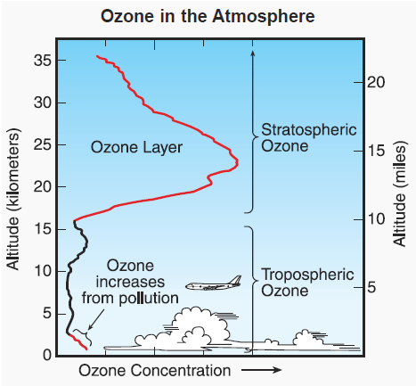
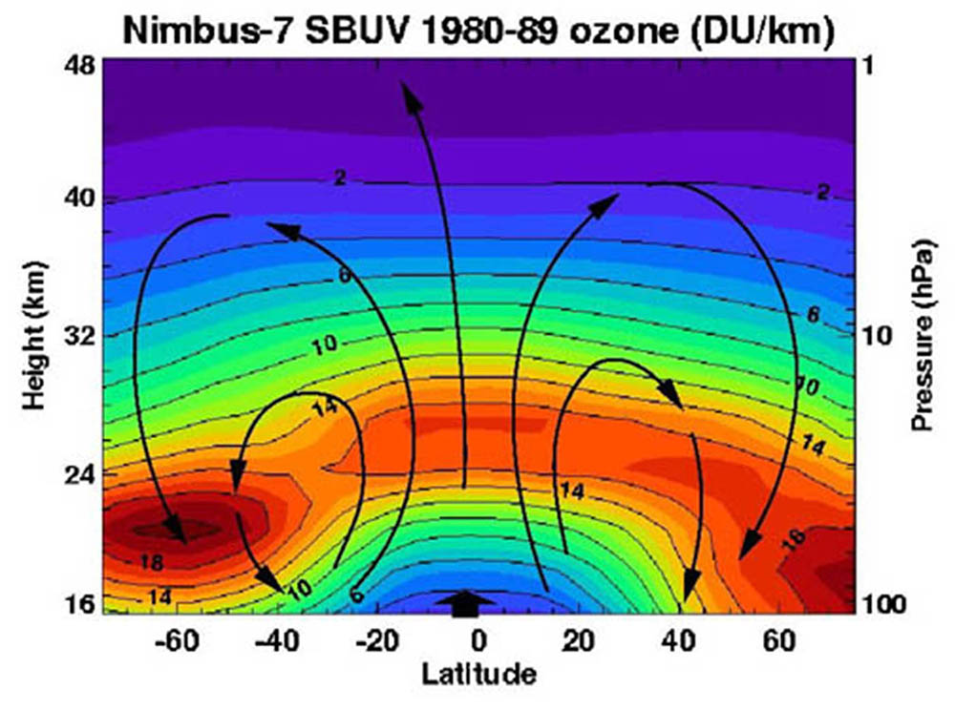
Ozone Properties
Ozone (O₃) is a triatomic form of oxygen found mostly in the lower half of the atmosphere
Highly reactive strong oxidant
Tropospheric pollutant produced by photochemical reactions
Found largely in the stratosphere (90%) at peak concentrations of 400ppb

Slide 3
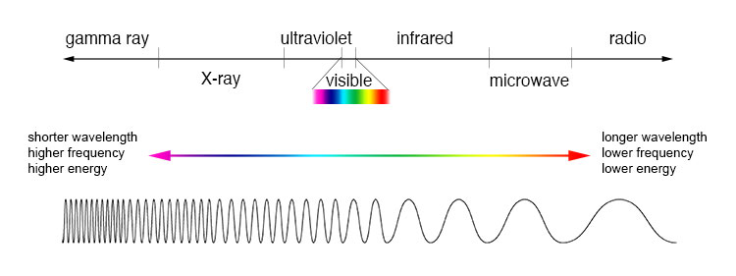
Ozone Properties
Stratospheric ozone acts as a shield against ultraviolet radiation entering the atmosphere
Ultraviolet radiation emitted by the sun has a higher frequency and shorter wavelengths than visible light
The shorter the wavelength, the more energetic the radiation making it more hazardous to life

Slide 4
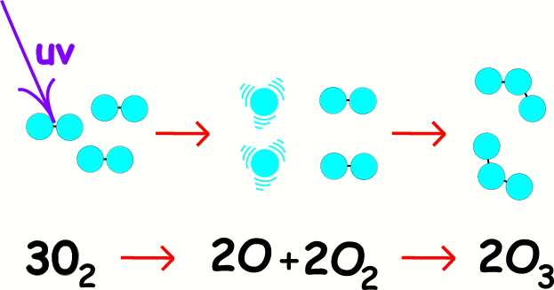
Ozone Properties
Ultraviolet C (UVC)
Shortest wavelength
Energetic enough to break down O₂ through photodissociation then recombine to form ozone again
Chemical reactions that break down and form ozone release heat
Completely absorbed by the ozone layer

Slide 5
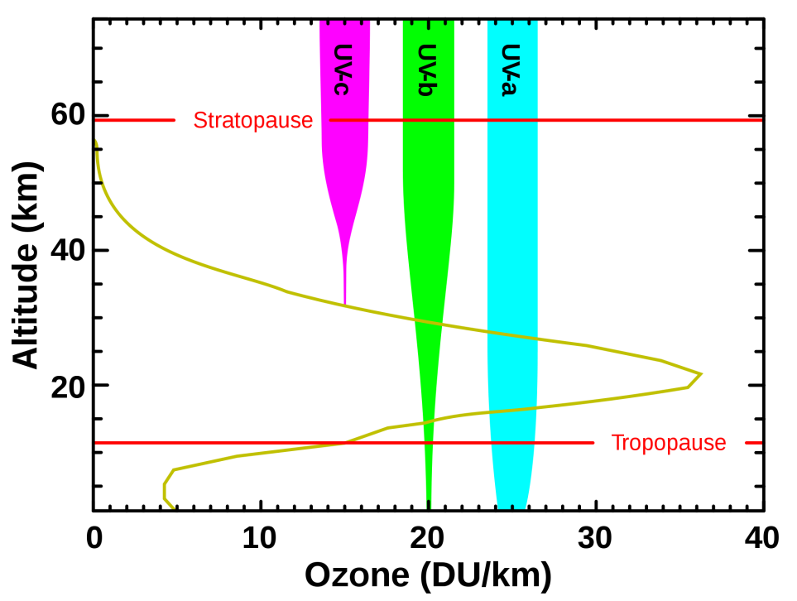
Ozone Properties
Ultraviolet B (UVB)
Similar in properties to UVC
Mostly absorbed by the ozone layer
Only absorbed by ozone
Biggest concern from ozone depletion
Ultraviolet A (UVA)
Longest wavelength
Not affected by stratospheric ozone

Slide 6
Measurement of Ozone
First measured in the 1920’s using the Dobson ultraviolet spectrometer
British Antarctic Survey began measuring ozone in Antarctica in 1957
Satellite measurements began in the 1970’s
30 locations have made ozone measurements for over 30 years (mostly mid-latitudes)
Measurements are made in Dobson units (DU) which are equivalent to 1ppb of ozone

Slide 7
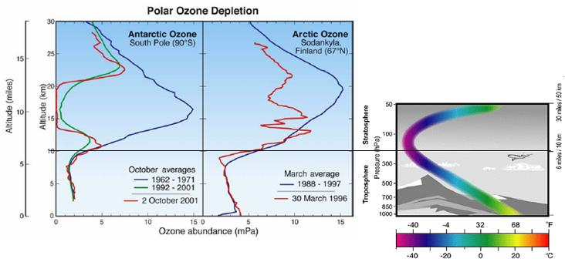
Ozone Depletion

Slide 8
Ozone Depletion
Ozone depletion by chlorofluorocarbons (CFCs) was first suggested by Mario Molina and F. Sherwood Rowland in 1974
Molina and Rowland Hypothesis:
CFCs in the lower atmosphere are stable and have a high residence time (~100 years)
CFCs that reach the stratosphere react with ultraviolet radiation and release highly reactive chlorine atoms
Chlorine causes ozone to break apart
Ozone depletion causes increases in UVB rays in the troposphere

Slide 9
Ozone Depletion
Emissions of chemicals destroy stratospheric ozone by approximately 1.5 million metric tons per year (CFC’s = 60% of emissions)
CFCs as aerosol propellants were banned by the Montreal protocol in 1970 but are still in use as refrigerants
Any chemicals that include chlorine or bromine like elements can be involved in ozone depletion

Slide 10
Ozone Depletion
Peak production of CFCs occurred in 1989
CFC compounds can stay in the troposphere for 75-111 years
It takes CFCs approximately 11-20 years to reach the stratosphere through atmospheric circulation
One chlorine molecule can convert 100,000 molecules of ozone into O or O₂

Slide 11
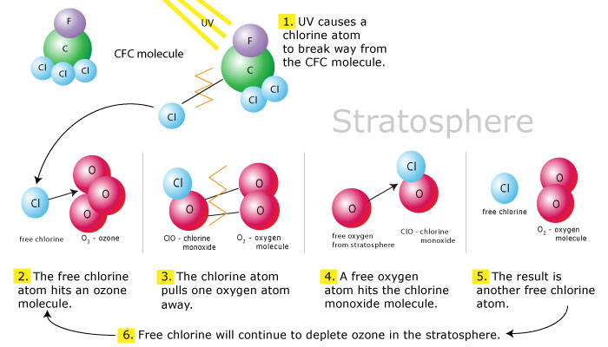
Ozone Depletion
Chlorine released from CFCs by ultraviolet radiation reacts with ozone to create forms of chlorine and O2
Since chlorine is produced by the reactions it can react again in a catalytic chain reaction to continue to deplete ozone until it is removed by the atmosphere

Slide 12
Ozone Depletion
Chemical emissions released into the stratosphere can undergo many different reactions with a wide range of molecules found in the atmosphere beyond ozone
Two reactions that help to remove chlorine:
Chlorine monoxide (ClO) can react with nitrogen dioxide to form chlorine nitrate (ClONO2) that can safely store chlorine in the atmosphere
Chlorine can react with methane (CH4) to form hydrochloric acid (HCl) that sinks into the troposphere and rains out

Slide 13
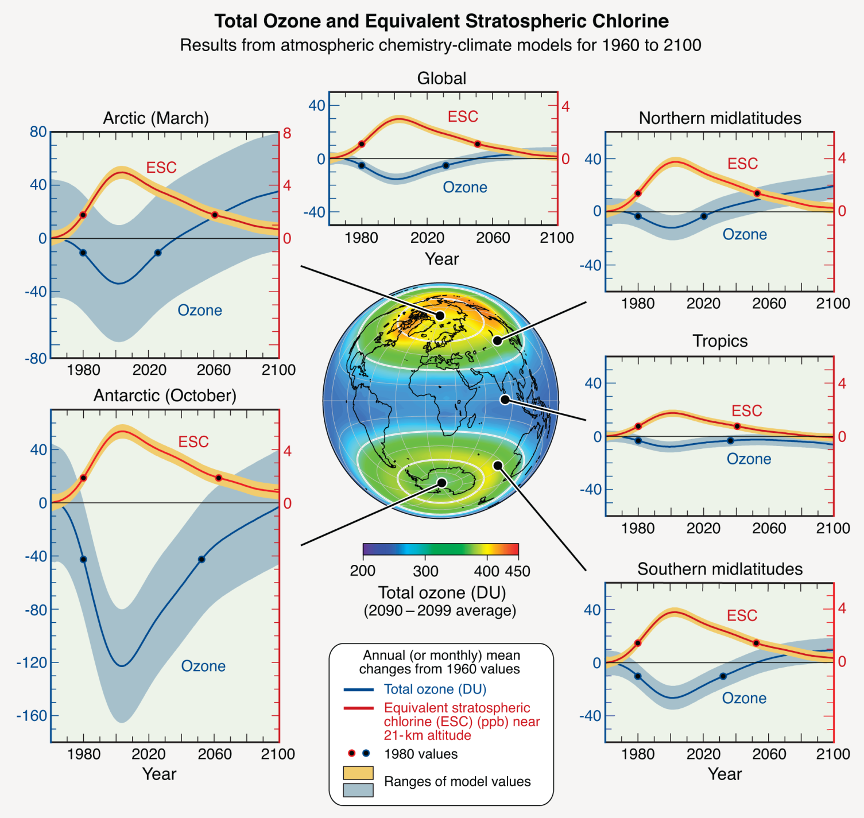
Ozone Depletion

Slide 14
Antarctic Ozone Depletion
The Antarctic ozone hole was first reported in 1985 by the British Antarctic Survey
The thickness of the ozone layer has continued to decrease in the Antarctic since 1985 creating the ozone hole during the Southern Hemisphere spring season in October each year
The size of the ozone hole continued to increase until the beginning of the 21st century and has fluctuated in size since then
Due to programs to remove CFC emissions recovery of the ozone layer should begin now but will not see significant progress until 2050

Slide 15
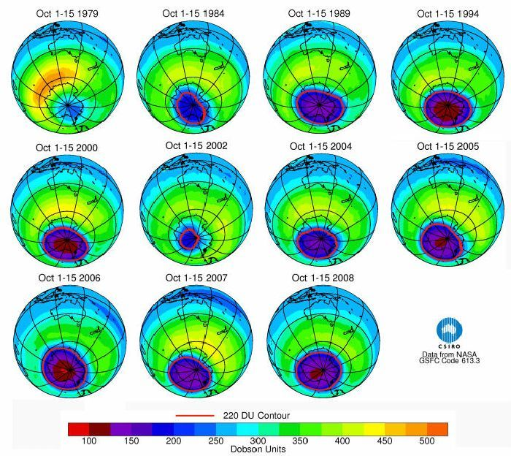
Antarctic Ozone Depletion

Slide 16
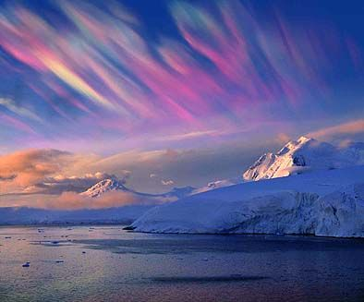
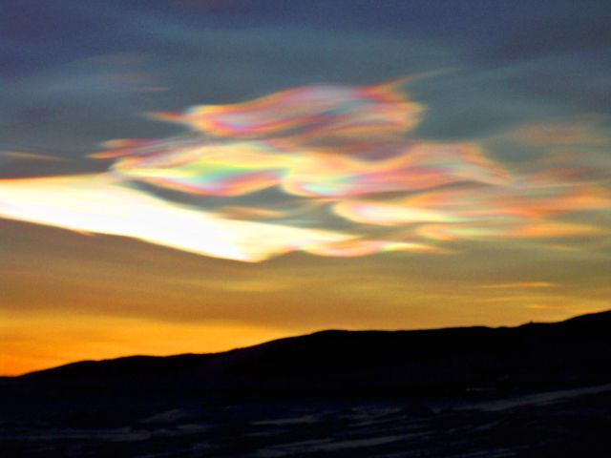
Polar stratospheric clouds are thick clouds that form during the polar winter in the lower stratosphere (12 miles above the surface)
Formed by a lack of sunlight and isolation of the Antarctic air mass (polar vortex) from other global atmospheric circulation
Require cold temperatures (-108ºF) that can freeze sulfuric acid particles to act as condensation nuclei for nitric acid (HNO₃)

Slide 17
Antarctic Ozone Depletion
With the formation of polar stratospheric clouds nitrogen oxides are trapped in the lower stratosphere as nitric acid reducing sinks for chlorine molecules
Nitric acid can form from the reaction
HCl + ClONO₂ → Cl₂ + HNO₃
Cl₂ present as the sun returns in the spring reacts to deplete ozone in higher levels than normal
Higher levels of polar stratospheric clouds mean lower amounts of stratospheric ozone

Slide 18
Antarctic Ozone Depletion
Similar issues arise in the Arctic but at lower levels due to warmer temperatures from Northern Hemisphere landmasses
Strong polar vortex events around the North Pole can cause ozone losses of 30-40%
As the northern polar vortex weakens it can shift ozone deficient air south toward populated regions

Slide 19
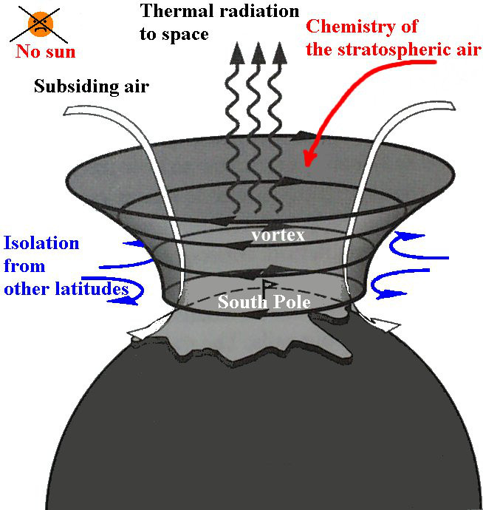
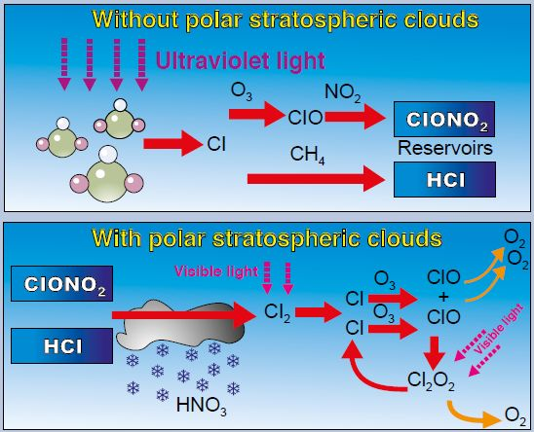

Slide 20
Tropical and Mid-latitude Ozone Depletion
Although the highest rates of ozone depletion occur in polar regions there have been decreases in stratospheric ozone across the globe
The same ice particles that form polar stratospheric clouds can occur in rare events in the tropics and mid-latitudes due to sulfuric aerosols produced from volcanic eruptions

Slide 21
Environmental Effects of Ozone
Based on emissions like CFCs that have high residence times in the lower atmosphere, ozone depletion is expected to continue for years in the future
35% of CFC-12 molecules are expected to still be in the atmosphere in 2100, 15% in 2200
Due to their use in foam insulation and refrigerants some CFCs have not yet been released into the atmosphere
Overall, CFC molecules in the atmosphere are declining

Slide 22
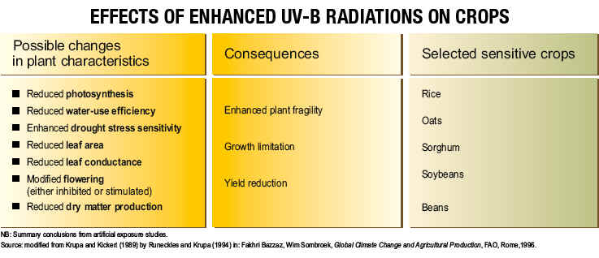
Environmental Effects of Ozone
Environmental Effects of Ozone:
Disruption of food chains
Increases in skin cancers, cataracts and suppressed immunity diseases
Reduction of primary productivity in the oceans
Increased CO₂ remaining in the atmosphere
Decreased agriculture production

Slide 23
Environmental Effects of Ozone
With the threat of UVB radiation in the troposphere forecasts are required to warn the public about the dangers of skin exposure
A 1% decrease in ozone can lead to a 1-2% increase in UVB radiation and 2% increase in skin cancers
The UV Index was created by the National Weather Service and EPA to rate the hazard of skin exposure to UV radiation on a scale from 1-11+

Slide 24
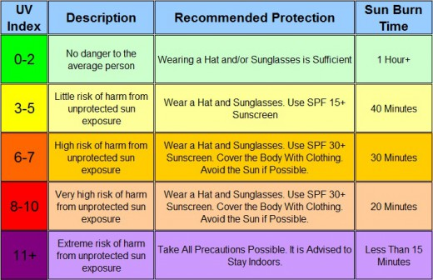
Environmental Effects of Ozone
Preventative Measures:
Limit exposure to sunlight
Wear sunscreen with SPF 30 or above
Wear UV protective sunglasses
Avoid tanning salons and sunlamps

Slide 25
Management Issues
Until the 1980’s there was a lot of debate about whether ozone depletion was a natural process or human-induced problem
The discovery of CFCs as an ozone depleting substance provided proof that the ozone issue was human induced and possibly reversable
After the 1985 British Antarctic Survey report by Molina and Rowland world governments began to take a stand against CFC and other chemical emissions

Slide 26
Management Issues
The Montreal Protocol
International agreement signed in 1987 to reduce CFC emissions that cause ozone depletion
Originally signed by 27 countries then ratified by 119 additional countries
Called for a 50% reduction of 1986 emissions
Required an eventual ban by 1995 of all CFC emissions (2005 for developing nations)
Amendments in London (1990) and Copenhagen (1992) have continued to restrict chemical production and emissions

Slide 27
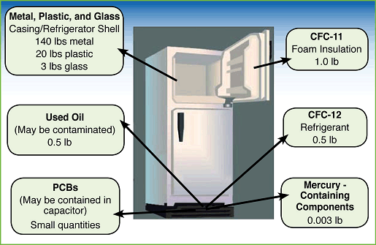
Management Issues
Collection and Reuse of CFCs
Collection of foam insulation and refrigerants containing CFCs to remove CFCs and reapply them

Slide 28
Management Issues
Substitutes for CFCs
Hydrofluorocarbons (HFCs)
Do not contain chlorine
Do contain fluorine which is less effective at depleting ozone
Hydrochlorofluorocarbons (HCFCs)
Contain a hydrogen in place of chlorine
Broken down in the lower atmosphere
To be phased out by 2030
Helium
Limited in supply
Too expensive for home refrigeration

Slide 29
Management Issues
Substitutes for CFCs
Hydrocarbon propane
Inexpensive
Easily liquefied for storage in containers
Potential explosive
Not owned by the manufacturers of CFCs and therefore not promoted as a substitute in the industry
Still being researched for viability

Slide 30
Management Issues
Concentrations of CFCs in the stratosphere are currently declining
We are in a gradual recovery process that should improve as CFCs are removed in the atmosphere
Until ozone levels increase we will have to adapt to higher levels of UVB radiation
Continued monitoring and reduction of ozone depleting chemicals will be required

