Slide 1
AP Environmental Science
Atmosphere, Climate and Global Warming (Chapter 15)

Slide 2
Atmosphere Structure and Composition
The atmosphere is made up of layers of gases that surround the Earth
The main components of the atmosphere are:
Gas Name | Chemical Formula | Percent Volume
Nitrogen | N2 | 78.08%
Oxygen | O2 | 20.95%
*Water | H2O | 0 to 4%
Argon | Ar | 0.93%
*Carbon Dioxide | CO2 | 0.0360%
Neon | Ne | 0.0018%
Helium | He | 0.0005%
*Methane | CH4 | 0.00017%
Hydrogen | H2 | 0.00005%
*Nitrous Oxide | N2O | 0.00003%
*Ozone | O3 | 0.000004%
* = variable gases

Slide 3
Atmosphere Structure and Composition
The atmosphere is divided up into layers based on changes in temperature and the abundance of gas molecules
75% of the mass of the atmosphere is located within 11km (7 miles) of the Earth’s surface
The force of gravity draws atmospheric gases toward the center of the Earth creating air that is under pressure
As atmospheric gases thin, air pressure decreases

Slide 4
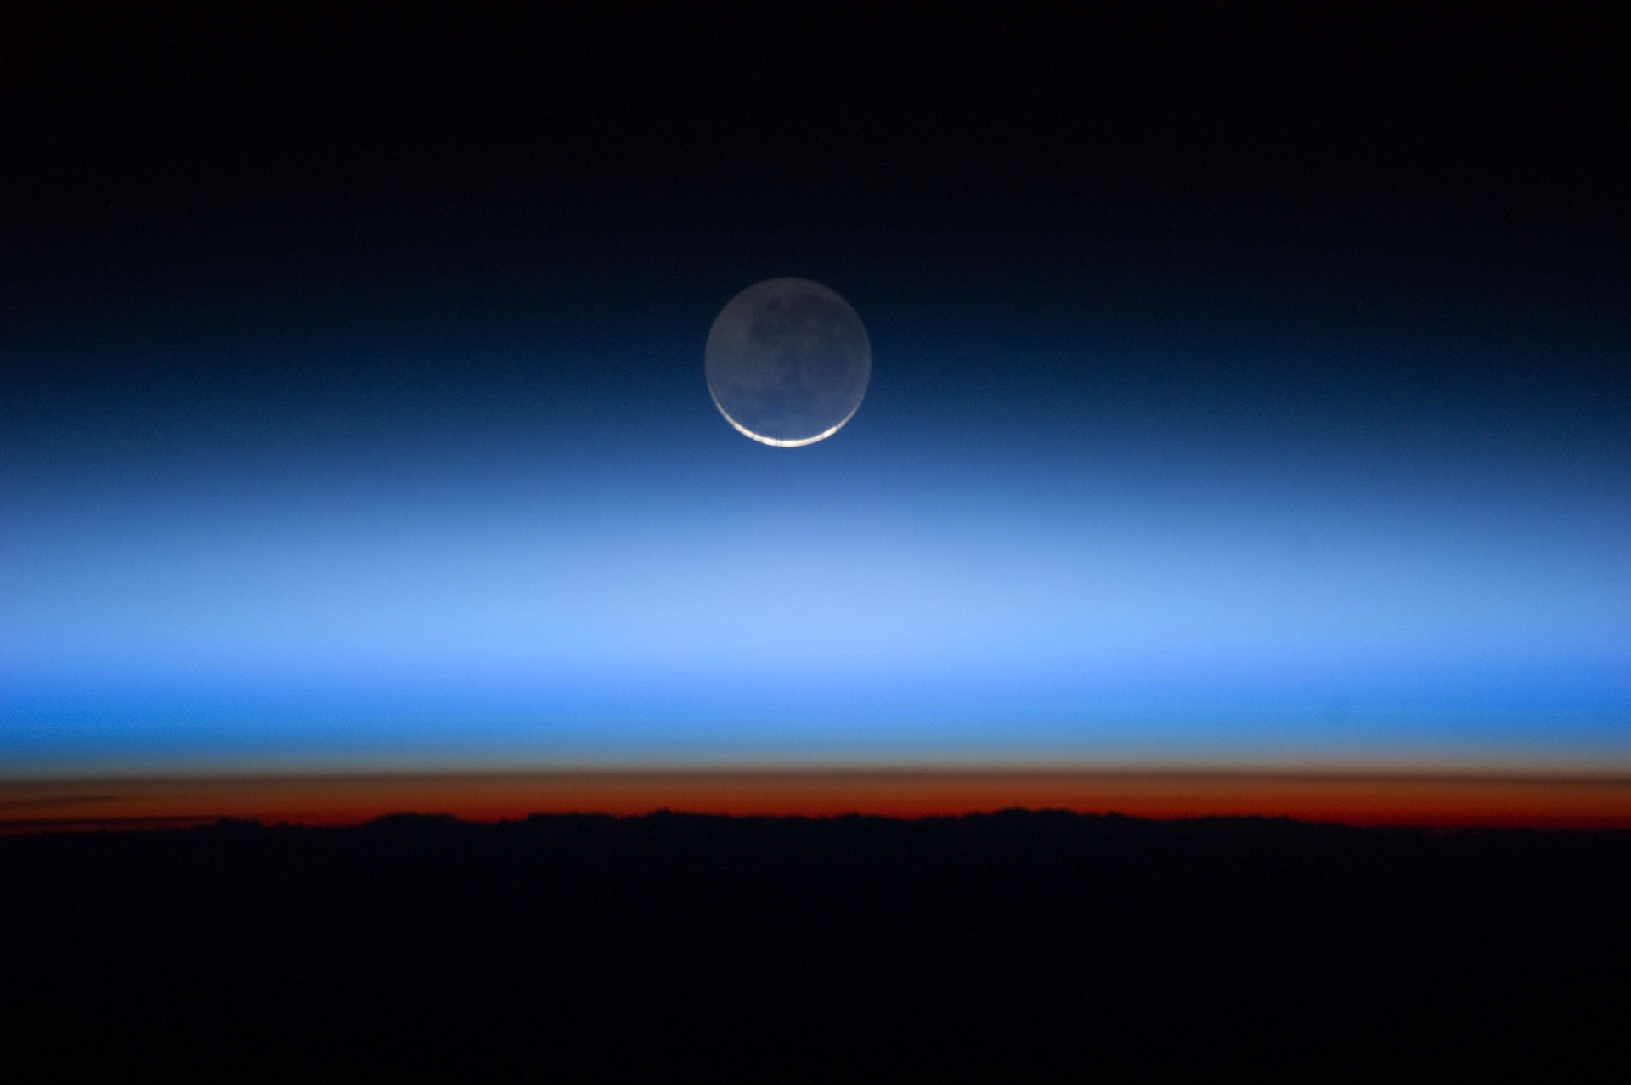
The atmosphere becomes thinner with increasing altitude and changes temperatures
There is no definite boundary between the atmosphere and outer space
Kármán line – 100km above the Earth’s Surface
Exosphere – layer above the thermosphere
Atmosphere Structure and Composition

Slide 5
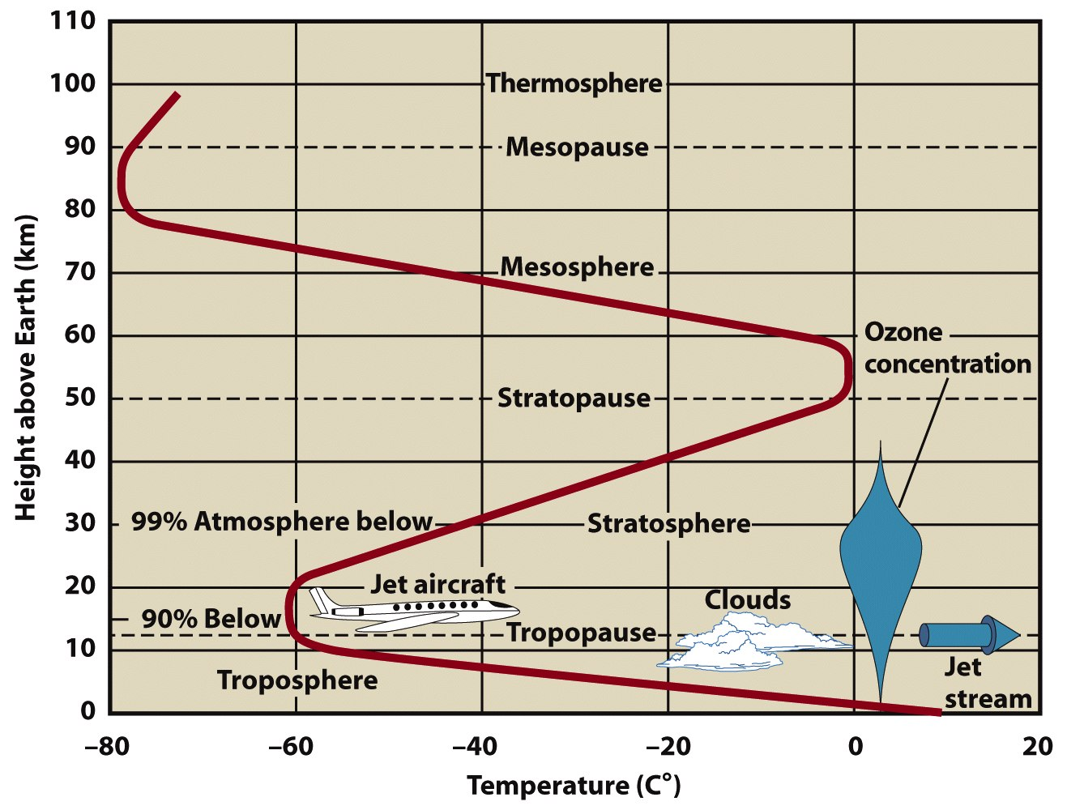
Atmosphere Structure and Composition

Slide 6
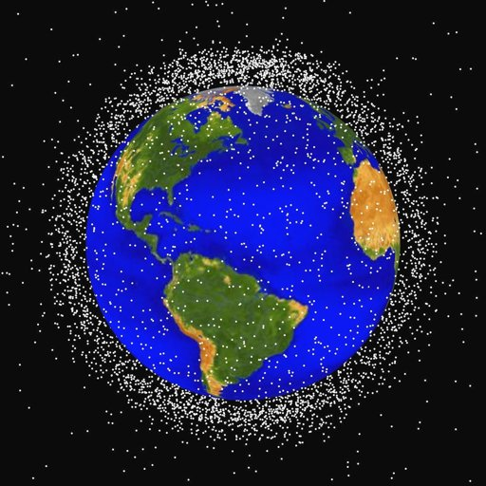
Exosphere
Outermost layer of the atmosphere extending from the Exobase just above the Thermosphere to approximately 10,000km above the Earth’s surface
Composition: mostly hydrogen and helium with small amounts of nitrogen, oxygen and carbon dioxide
Gases are so spread out here that molecules rarely interact with one another
Changes occur because of interactions with solar radiation and the magnetosphere
Atmosphere Structure and Composition

Slide 7
Thermosphere
Extends from the mesopause at 80Km to the thermopause (also known as the exobase) at 500-1000 km above the surface
Height of the thermosphere varies with solar activity
Temperature due to solar radiation increases with altitude
Temperature is not significant because of the low density of air molecules to trap and transfer heat ( it would not feel hot although solar radiation is high)
Atmosphere Structure and Composition

Slide 8
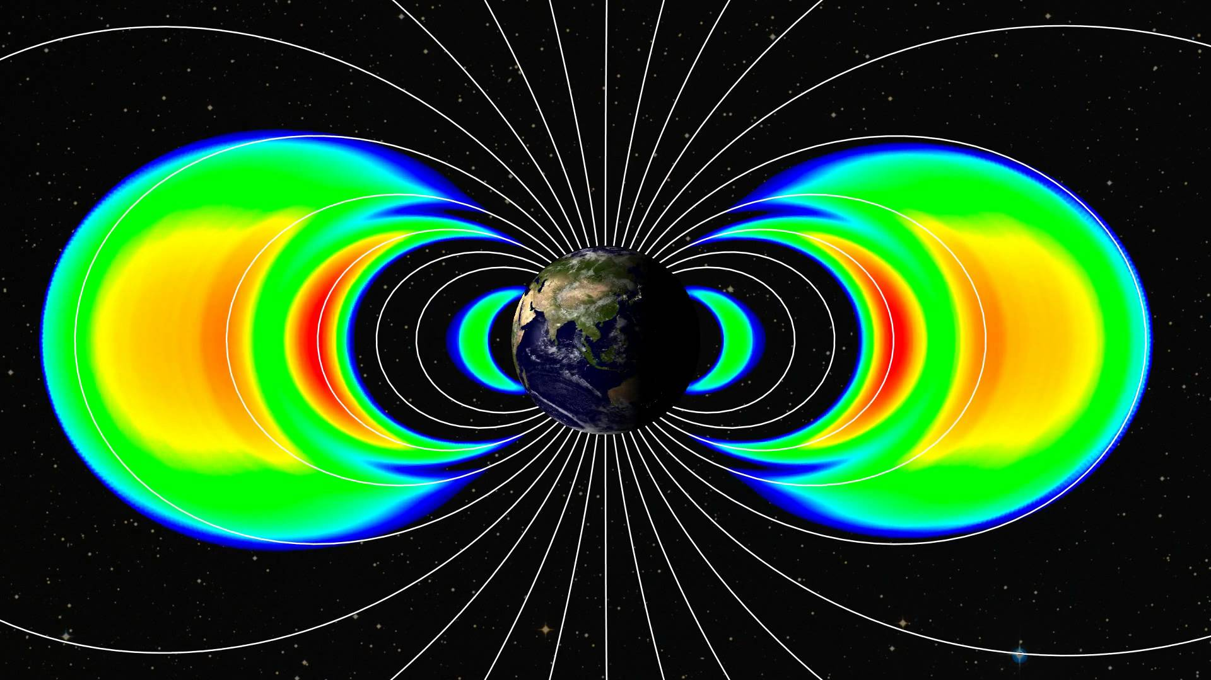
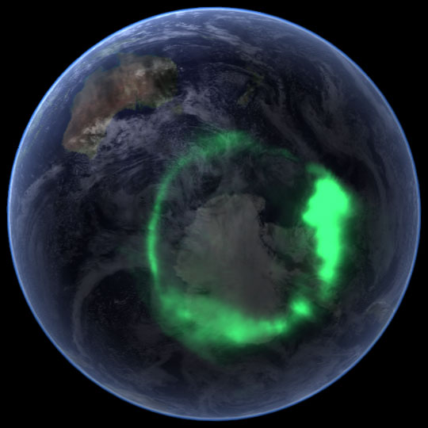
Thermosphere sub-layers:
Magnetosphere – area of charged subatomic particles generated by the magnetic field of the Earth
Extends above the atmosphere starting at 1000km above the surface
Traps solar radiation in Van Allen belts
Collisions of charged particles create auroras
Atmosphere Structure and Composition

Slide 9
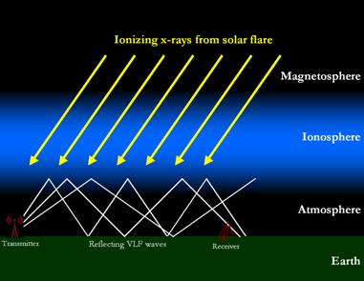
Thermosphere sub-layers:
Ionosphere- lower layer of the thermosphere that absorbs ultraviolet and X-ray radiation from the Sun
Creates charged ions
Radio waves bounce off of this layer and reflect back to Earth
Atmosphere Structure and Composition

Slide 10
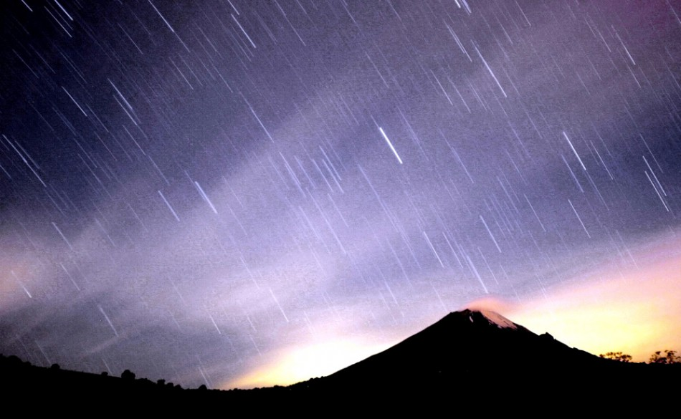
Mesosphere
Extends from the stratopause at 50km to the mesopause at 80km
Temperatures drop with altitude
Coldest region of the atmosphere (-85ºC)
Meteors burn up due to friction from higher densities of gases
Noctilucent clouds can
form from trace amounts
of water vapor that
condenses with the cold
temperatures
Atmosphere Structure and Composition

Slide 11
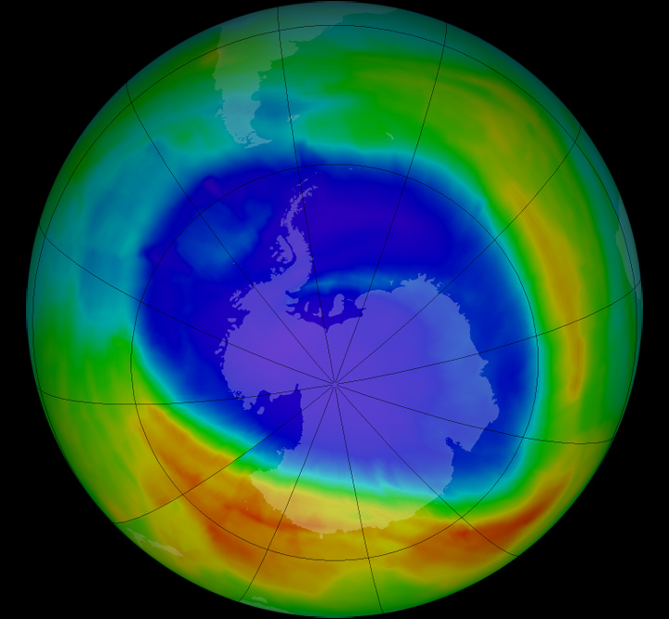
Stratosphere
Extends from the tropopause at 12km to the stratopause at 50km
Contains the ozone layer (15-35 km above the surface) that varies with seasons and geography
Temperatures rise with altitude due to the absorption of solar radiation by the ozone layer
Temperatures stabilize this layer so that there is very little air turbulence to generate weather
Atmosphere Structure and Composition

Slide 12
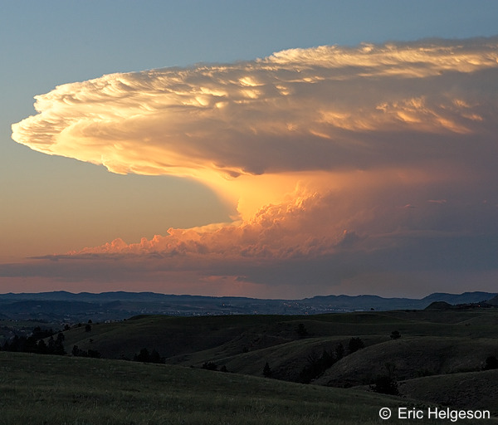
Troposphere
Extends from the surface to the tropopause at 12km above the surface
Temperature inversion in the tropopause creates a ceiling for water vapor and weather
Most heat comes from the surface so temperature decreases with altitude
Contains most of the atmospheric mass and pressure
Atmosphere Structure and Composition

Slide 13
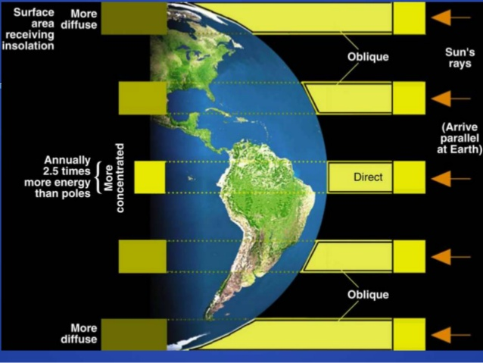
Solar radiation is the driving force that generates weather changes in the troposphere
Unequal solar radiation on the Earth creates places with higher temperatures and lower temperatures which forces the movement of wind and changes in water vapor
Atmosphere Structure and Composition

Slide 14
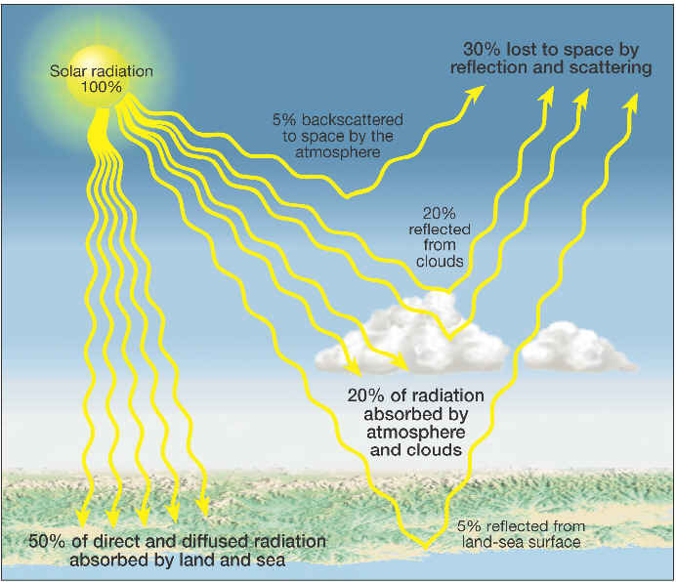
Atmosphere Structure and Composition

Slide 15
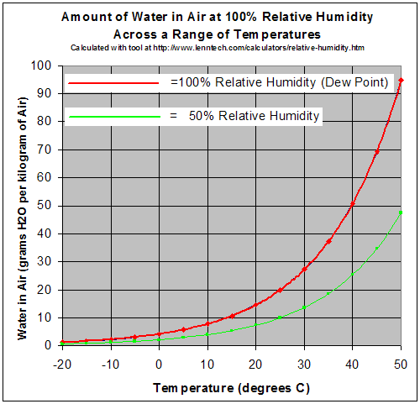
As temperature increases, the amount of water vapor that the air can hold increases
Amounts of water vapor in the atmosphere is called Humidity
The maximum amount of water vapor that can be contained at a specific temperature is maximum saturation
Most forecasting compares the specific humidity of the air to the maximum saturation values to give a reading of relative humidity
Atmosphere Structure and Composition

Slide 16
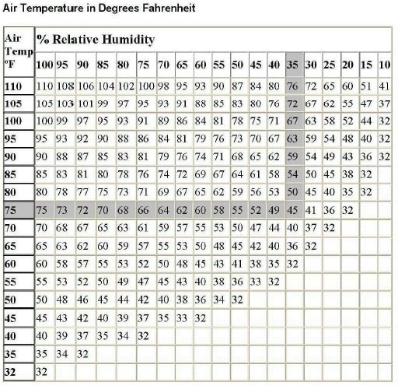
Dew Point: the temperature at which the air becomes cool enough for water vapor to condense into liquid water.
→ high relative humidity indicates that the dew point is closer to the current air temperature. Relative humidity of 100% indicates the dew point is equal to the current temperature.
Atmosphere Structure and Composition

Slide 17
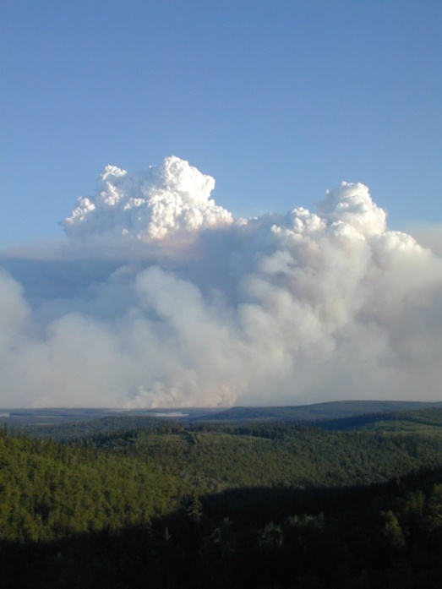
The condensation of water vapor in the atmosphere due to temperature and pressure changes forces the creation of clouds
Cloud: visible masses of tiny water and ice particles suspended in the atmosphere
For a cloud to form you must have:
Water or moisture in the air
Dust particles
A change in temperature and/or pressure
Atmosphere Structure and Composition

Slide 18
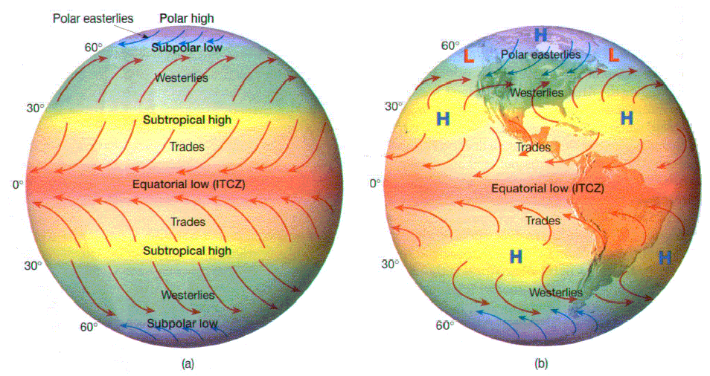
Circulation and patterns of cloud movement are based on the movement of wind due to unequal solar radiation, pressure differences, and the rotation of the Earth
These processes result in global patterns of prevailing winds and latitudinal belts of low and high pressure
Atmosphere Structure and Composition
“Horse latitudes” are two belts of high pressure at 30º N and S that create the world’s deserts

Slide 19
Removal of materials from the atmosphere helps to cycle nutrients through the different global sinks and reduce pollution
Sedimentation- settling of larger materials due to gravity (dry deposition)
Rain out- raindrops form on atmospheric particulates that then fall with the raindrops to the surface
Oxidation- Oxygen chemically combines with other substances
Photodissociation- light breaks down chemical bonds in atmospheric compounds
Atmosphere Structure and Composition

Slide 20
Climate
Climate:
The characteristic atmospheric conditions for a region on Earth over a period of time
Based on average temperature and rainfall
Categorized by latitudes and/or humidity trends
Microclimate
The climate of a very small local area
Can change from one side of a rock to another
Can result in changes from cities to rural areas

Slide 21
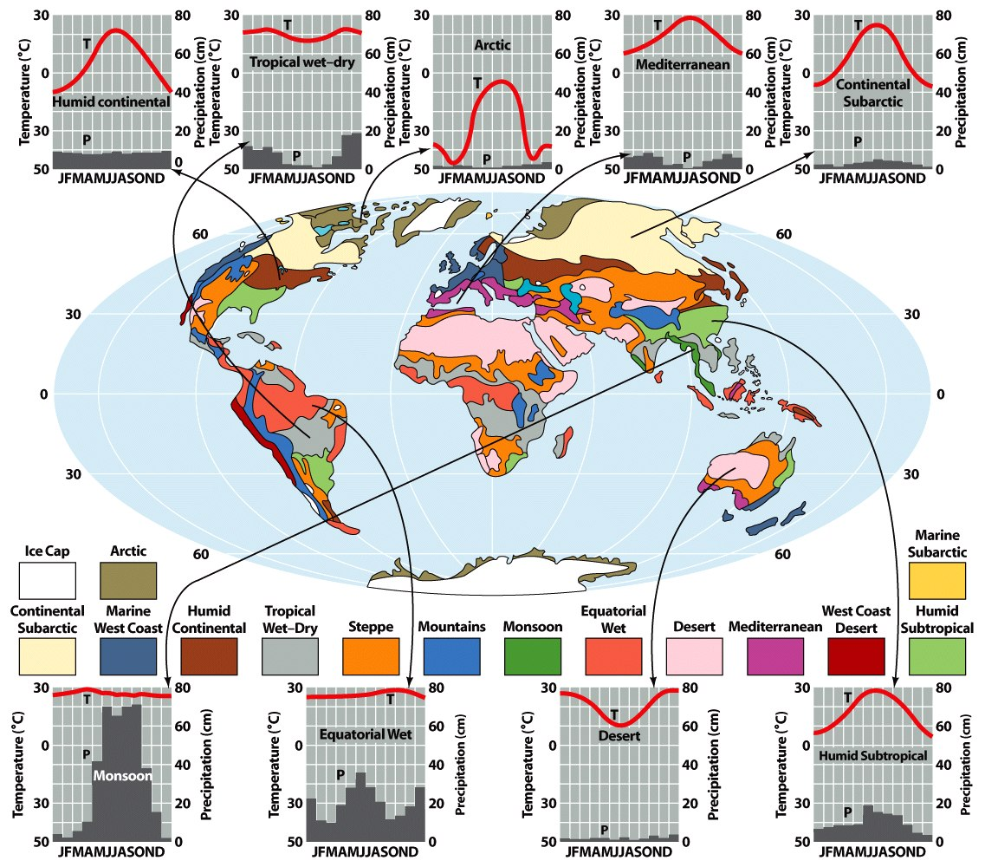
Climate

Slide 22
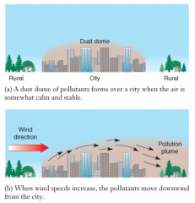
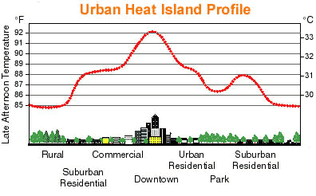
Climate
Urban Climate Trends
Generally warmer than surrounding rural areas (heat island)
Less humidity
Increased particulate matter (urban dust dome)
Increased rain and cloud formation

Slide 23
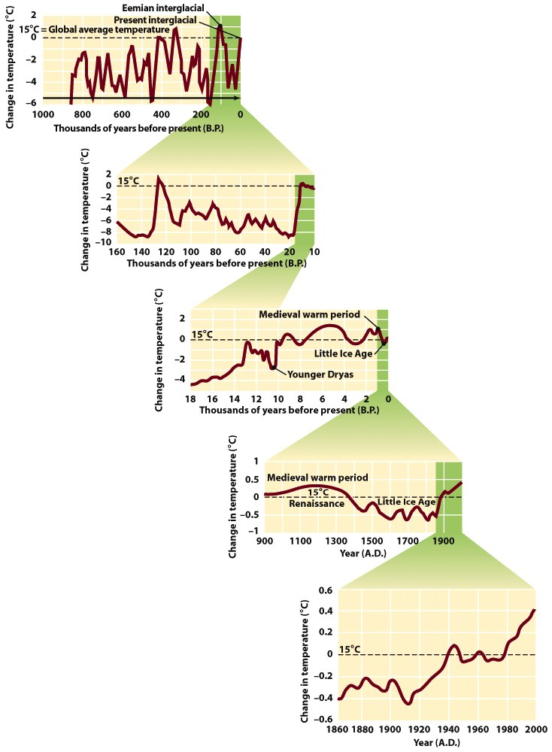
Climate Change
Major climatic changes have occurred during the past 2 million years
Appearances and retreats of glaciers have occurred several time
Natural cycles appear to cause variations in temperature and ice at the poles
During the past 100 years, the mean global annual temperature has increased by .6 degrees Celsius

Slide 24
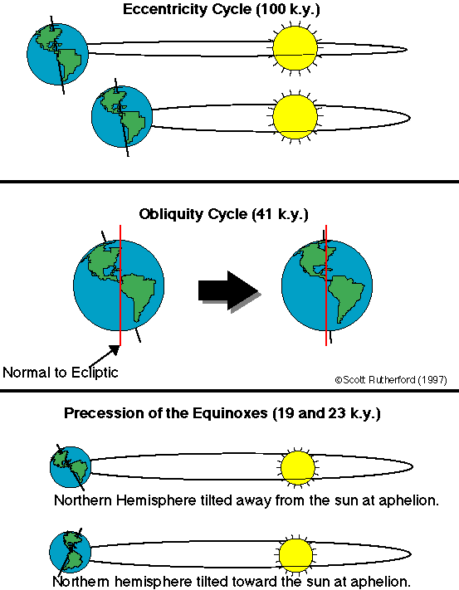
Climate Change
Milankovitch Cycles
Describe the changes in the Earth’s climate based on the movements of the Earth
State that variations in eccentricity, axial tilt, and precession of the Earth's orbit occur in regular cycles and can affect climate

Slide 25
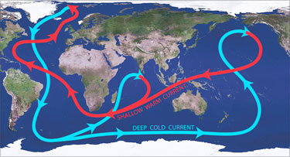
Climate Change
Short term climate change can be a direct result of changes in ocean currents especially along strong density currents regulated by temperature and salinity
Ocean Conveyor belts move cold, dense water down from the poles cooling water near the equator. Warm, light water from the equator travels up toward arctic regions where it cools and continues the cycle.
Without this regulation there could
be extreme temperature changes
especially in local areas that rely on
the warming from ocean currents

Slide 26
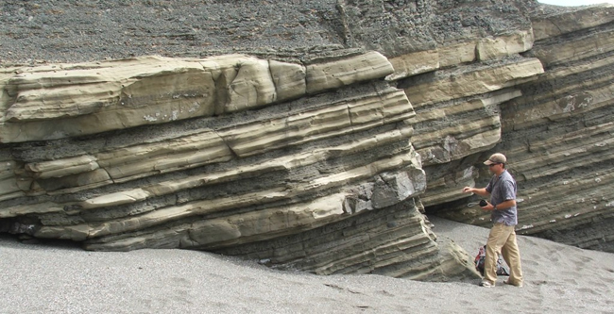
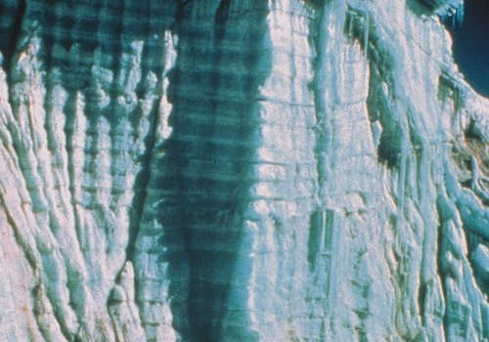
Studying Global Climate Change
Geologic Record
Analysis of sediments and organic material gives information about the types of environments that have existed in the past
Glacial ice bubbles give a record of atmospheric gases
Carbon dioxide levels
Solar radiation through isotopes

Slide 27
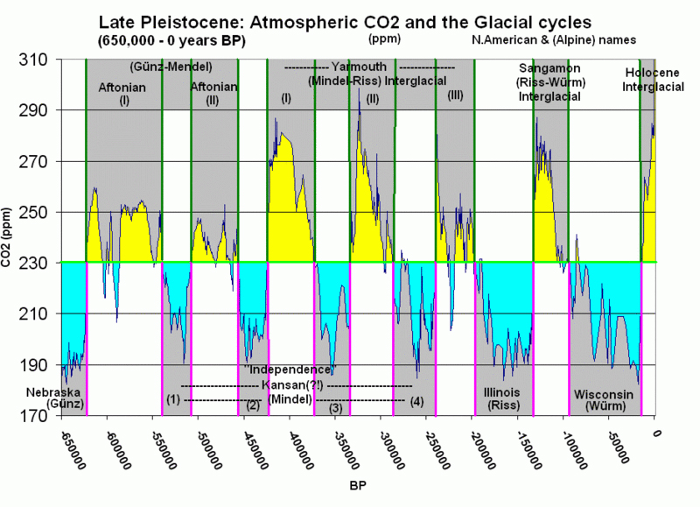
Studying Global Climate Change

Slide 28
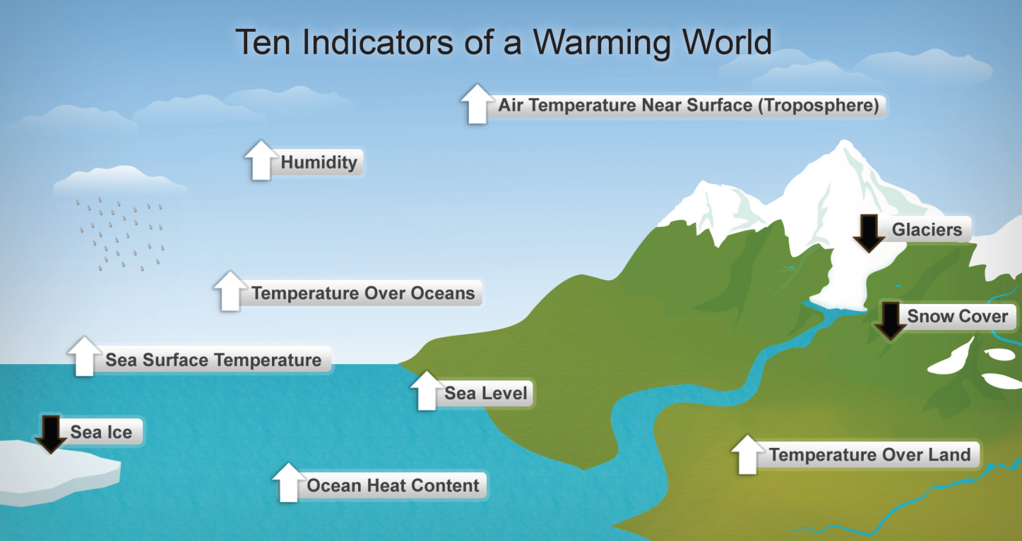
Global Warming
Whether natural or human-induced, increases the average global temperature of the lower atmosphere
Temperature is generally determined by:
Solar radiation levels
Evaporation and condensation changes

Slide 29
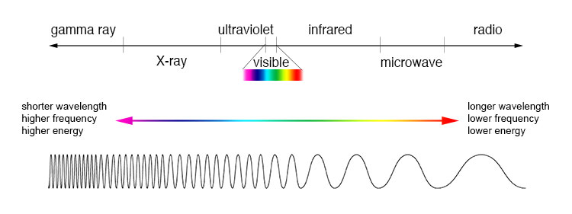
Electromagnetic Radiation and Earth’s Energy Balance
Most of the Earth’s energy comes from the Sun
Earth’s energy balance is determined by input from the sun and output by the Earth
Solar energy is emitted in the form of electromagnetic radiation
The electromagnetic spectrum describes the wavelengths of energy that determine various types of radiation emitted

Slide 30
Electromagnetic Radiation and Earth’s Energy Balance
Energy emitted by a object varies with the fourth power of the absolute temperature
Higher absolute temperature = higher radiation
The hotter an object the faster it radiates energy
Faster radiation = shorter wavelengths
Energy from the Sun is mostly in the visible light spectrum
Energy radiated by the Earth is mostly infrared

Slide 31
Greenhouse Effect
The process of trapping heat in the atmosphere
Greenhouse effect video clip
Water vapor and several other gases warm the Earth’s atmosphere because they absorb and emit radiation
Water accounts for 85% of natural warming
Anthropogenic influences
Burning fossil fuels
Deforestation
Greenhouse gas emissions

Slide 32
Greenhouse Effect
Greenhouse Gases
Water
Most abundant (non-anthropogenic)
CO₂
both anthropogenic and non-anthropogenic
Methane (CH₄ ) - both
10 times stronger than CO₂
CFCs (strictly man made)
Banned in most countries by the Montreal Protocol
Ozone-both
Nitrous oxides-both

Slide 33
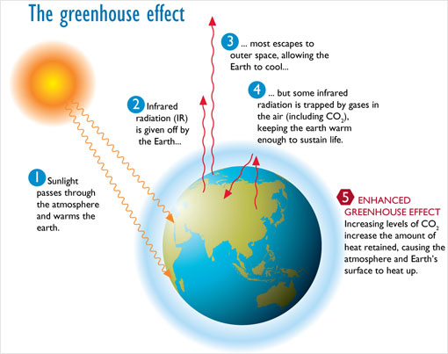
Greenhouse Effect

Slide 34
Influences on Global Warming
Positive feedback
Ice caps melt and the earth gets darker therefore hotter
Deforestation decreases CO₂ absorption
More water vapor due to evaporation leads to more abundant greenhouse gases
Thawing of permafrost releases CH₄ trapped in decomposing organic material

Slide 35
Influences on Global Warming
Negative Feedback
More clouds block more radiation from reaching earth
More land from retreating glaciers means more plants
Warmer oceans means more cyanobacteria completing more photosynthesis
More CO₂ means less competition for plants to absorb CO₂

Slide 36
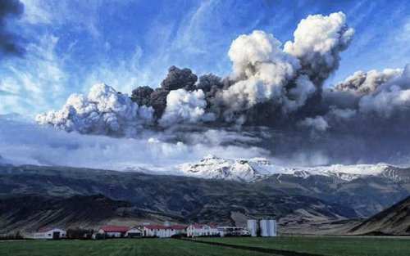
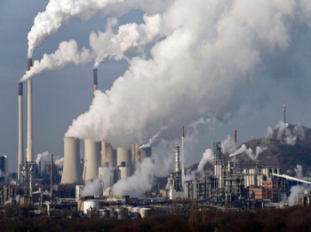
Influences on Global Warming
Evidence in glacial ice bubbles shows that levels of solar energy correspond with patterns of warmer and colder historical periods
Increased particulate matter can cause an increase in cloud formation that leads to global dimming
Volcanic eruptions
Industrial emissions

Slide 37
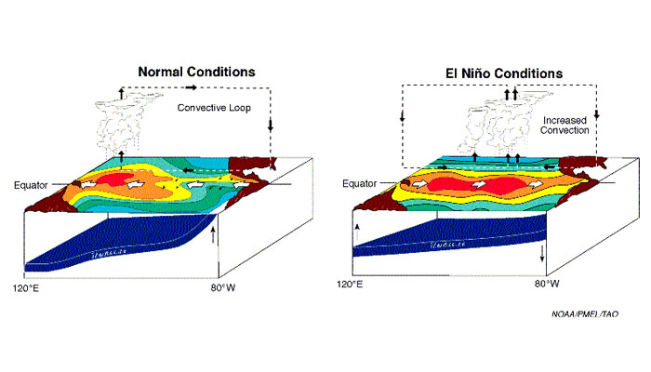
Influences on Global Warming
El Nino
Reduced upwelling in the Eastern Pacific
Reduced CO₂ outgassing from the oceans
Changes to weather patterns in the upper atmosphere (jet stream)
Increased occurrences of El Nino are predicted as the Earth warms

Slide 38
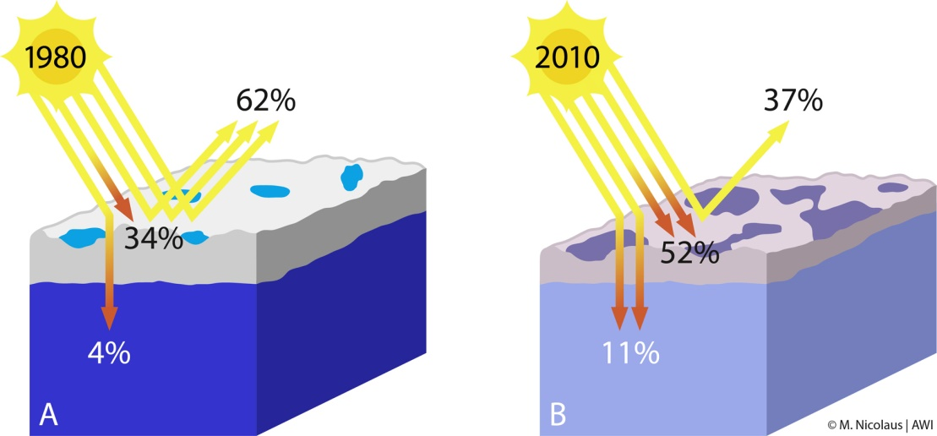
Effects of Global Warming
Polar amplification explains increased solar absorption by ocean water as polar ice melts and reduces reflective surfaces
Increased absorption of solar energy means warmer ocean temperatures, rising sea levels due to melting ice, and changes to the hydrologic cycle

Slide 39
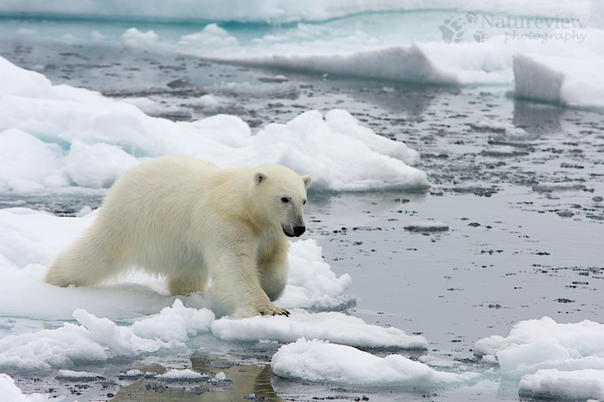
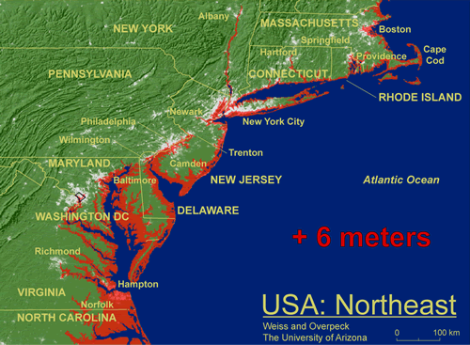
Effects of Global Warming
Due to changes in the hydrologic cycle, weather patterns change and climate shifts
Redistribution of water
Biome changes
Stress to agricultural production
Human population displacement

Slide 40
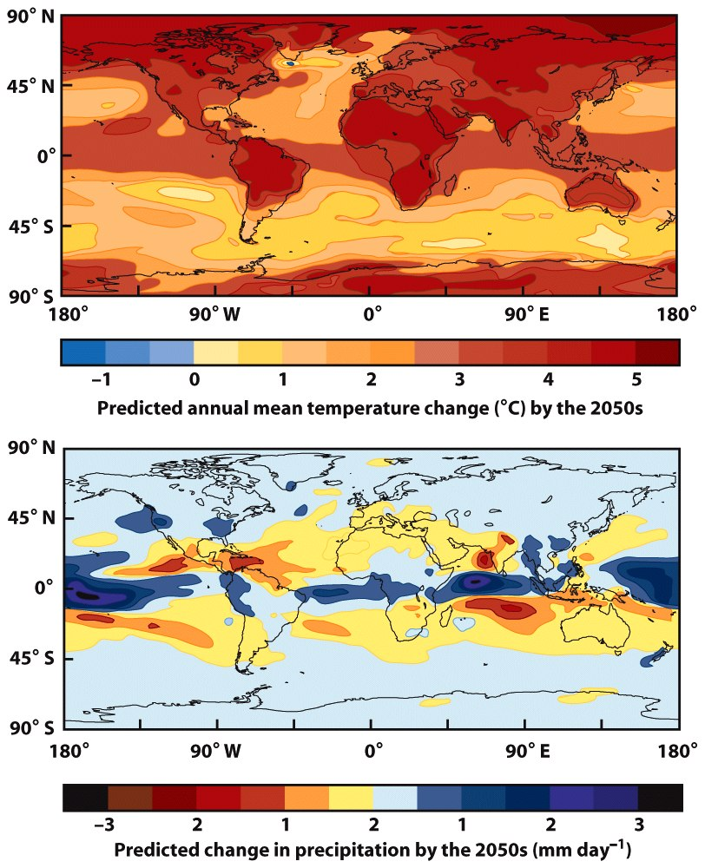
Effects of Global Warming

Slide 41
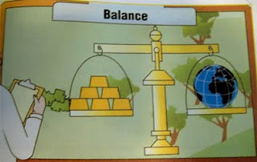
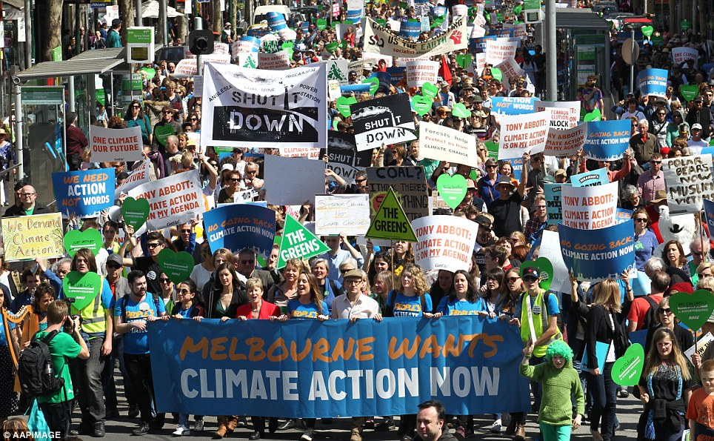
Adjustments to Global Warming
Adaptation by humans and agriculture production to gradual increases in temperature
Worldwide policies to reduce greenhouse emissions
Increased alternative energy use
Energy conservation
Better management of carbon sinks (carbon sequestration)

