Slide 1
AP Environmental Science
Air Pollution (Chapter 16)

Slide 2
History of Air Pollution
1550 – first observation of photochemical smog
17th century- first observation of acid rain
18th century- recognition of smog and acid rain as damaging to plants
1905- introduction of “smog” as a technical term
1948- Donora Zinc Works air pollution event
1952- London smog crisis
1997 & 2015- Indonesian wildfires

Slide 3
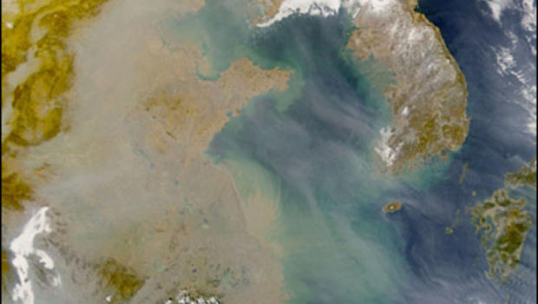
History of Air Pollution
South Asian Brown Cloud
Brown smog cloud 2 miles thick
Directly linked to 380,000 deaths per year
Contributes to 40% crop losses
Circulation of pollution by prevailing winds travels around the globe in 2 weeks
Effects in the U.S. = 25% increase in particulate matter, 77% increase in carbon soot, 33% increase in mercury pollution

Slide 4
History of Air Pollution
The atmosphere has a short residence time making it a convenient place for waste disposal that results in pollution (movement of air pollution video)
Following the Donora and London events air control became a major issue
Clean Air Act of 1955
Legislation to reduce air pollution emissions has been successful but chronic exposures to air pollutants continues to contribute to illness and death worldwide
Current health care systems struggle to keep up with the demands caused by environmental related health issues

Slide 5
History of Air Pollution
Currently the EPA maintains a list of 188 hazardous air pollutants (HAPs) that it is required to control (complete list)
Each year industries that produce more than 25,000 pounds or handles more than 10,000 pounds of a toxic chemical must provide a report to the Toxic Release Inventory
667 chemicals must be reported
An Air Quality Index is generated to inform the public of daily threats to their air quality based on measurable pollutants and local reports (AirNow website)

Slide 6
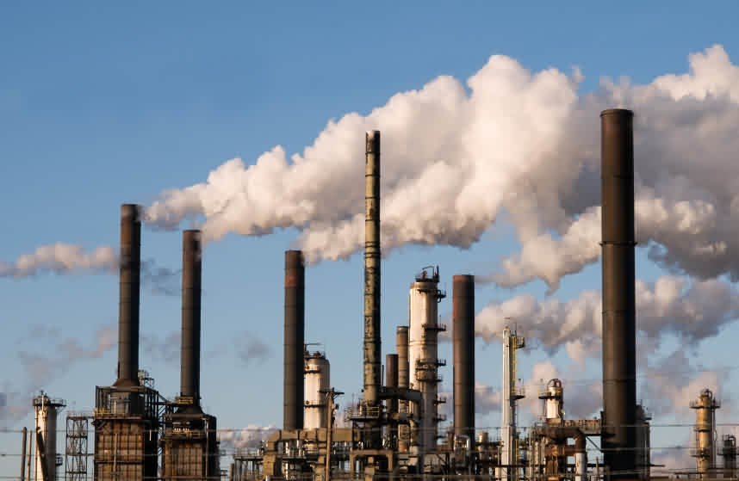
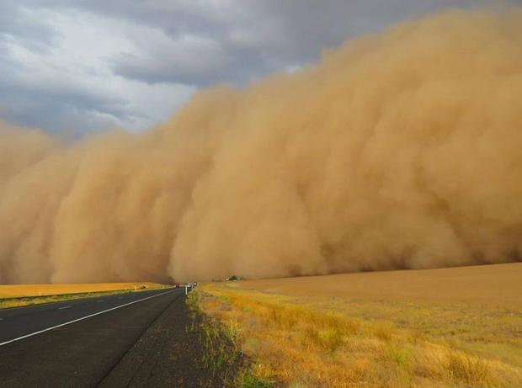
Sources of Air Pollution
Stationary sources
Point sources emit pollutants from one or more controllable sites.
Fugitive sources generate air pollutants from open areas exposed to wind processes.
Area sources are well defined areas within which are several sources of air pollutants

Slide 7
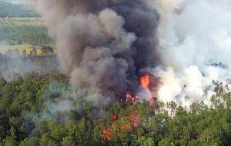
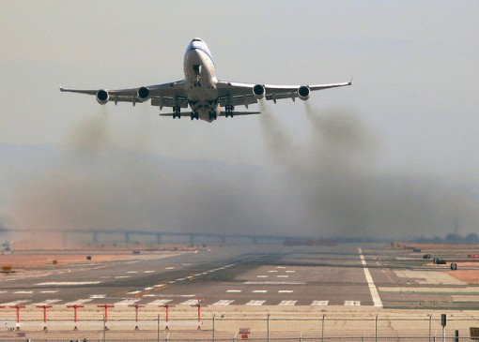
Sources of Air Pollution
Mobile sources
Move from place to place while emitting pollutants (vehicles)
Natural sources
Particulate emissions from natural processes (volcanic eruptions, wildfires, lightning)

Slide 8
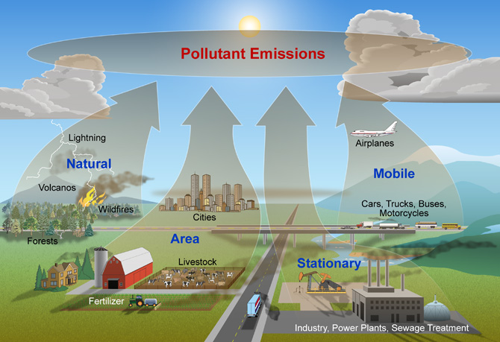
Sources of Air Pollution

Slide 9
Effects of Air Pollution
Discoloration of the atmosphere resulting in reduced visual range and clarity
Damage to plants
Tissue damage, suppression of growth, susceptibility to environmental conditions, disruption of reproductive processes
Damage to animals
Toxicity, cancer, birth defects, eye and respiratory irritation, susceptibility to infection and heart disease, chronic diseases

Slide 10
Effects of Air Pollution
Healthy people may be able to acclimate to pollutants so that they feel like they have no symptoms even though the pollutants may continue to affect them
Many air pollutants have a synergistic effect where they combine to have greater effects than the individual pollutant would on its own
The respiratory system in vertebrate animals is affected more than any other body system
(TED talk on the global pandemic from air pollution)

Slide 11
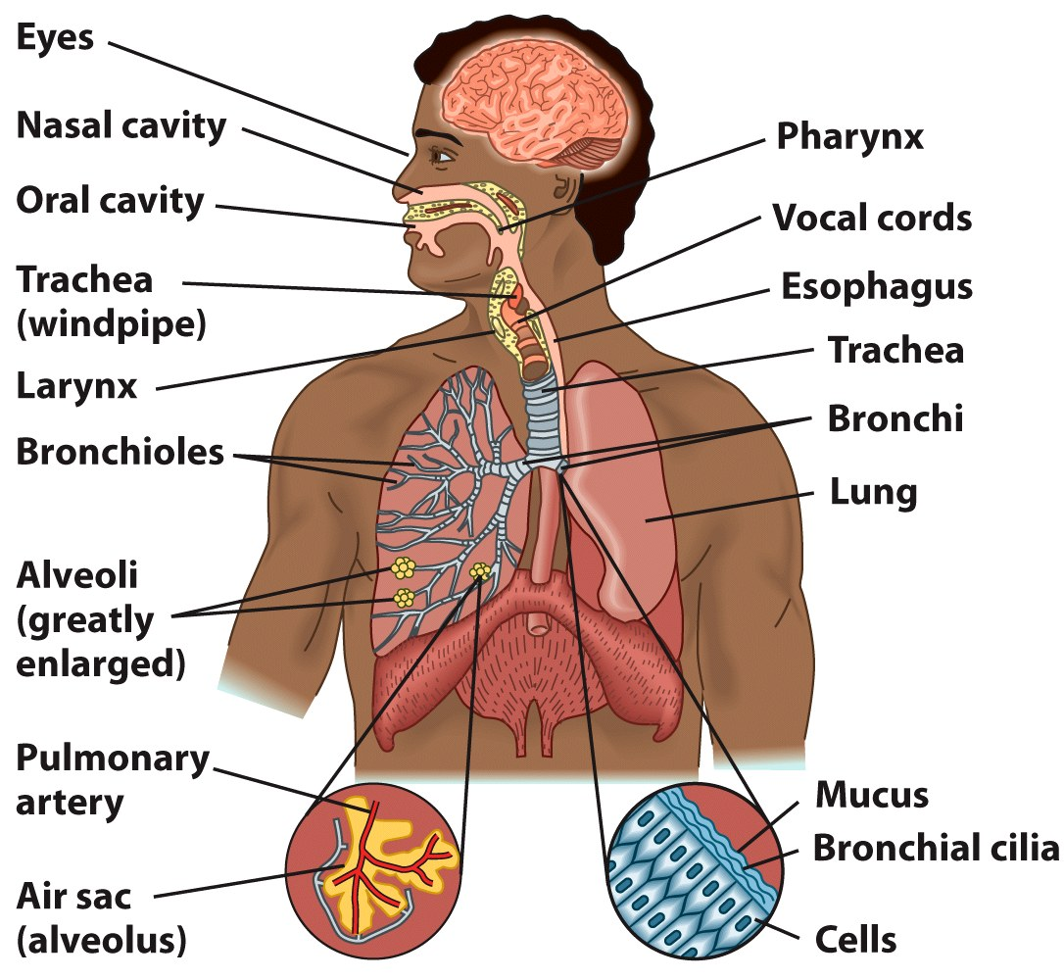
Effects of Air Pollution

Slide 12
Types of Pollutants
Air pollutants occur either
in gaseous form or as small
liquid or solid materials called
particulate matter
Two Types:
Primary pollutants emitted directly into the air
Secondary pollutants created through reactions between primary pollutants and other compounds in the air

Slide 13
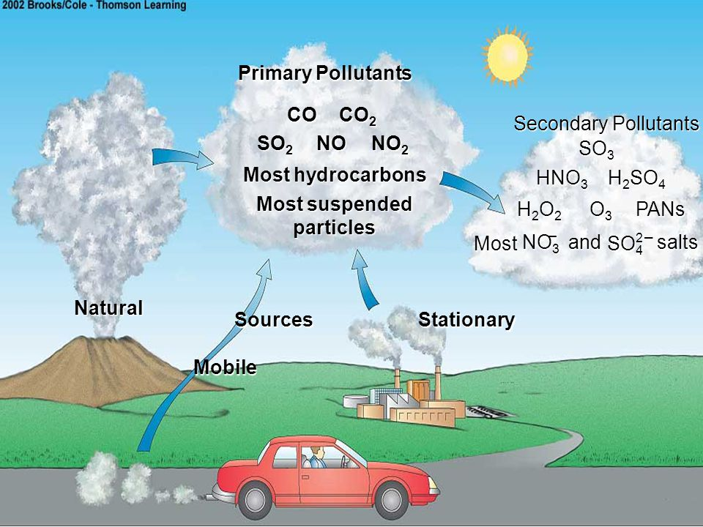
Types of Pollutants

Slide 14
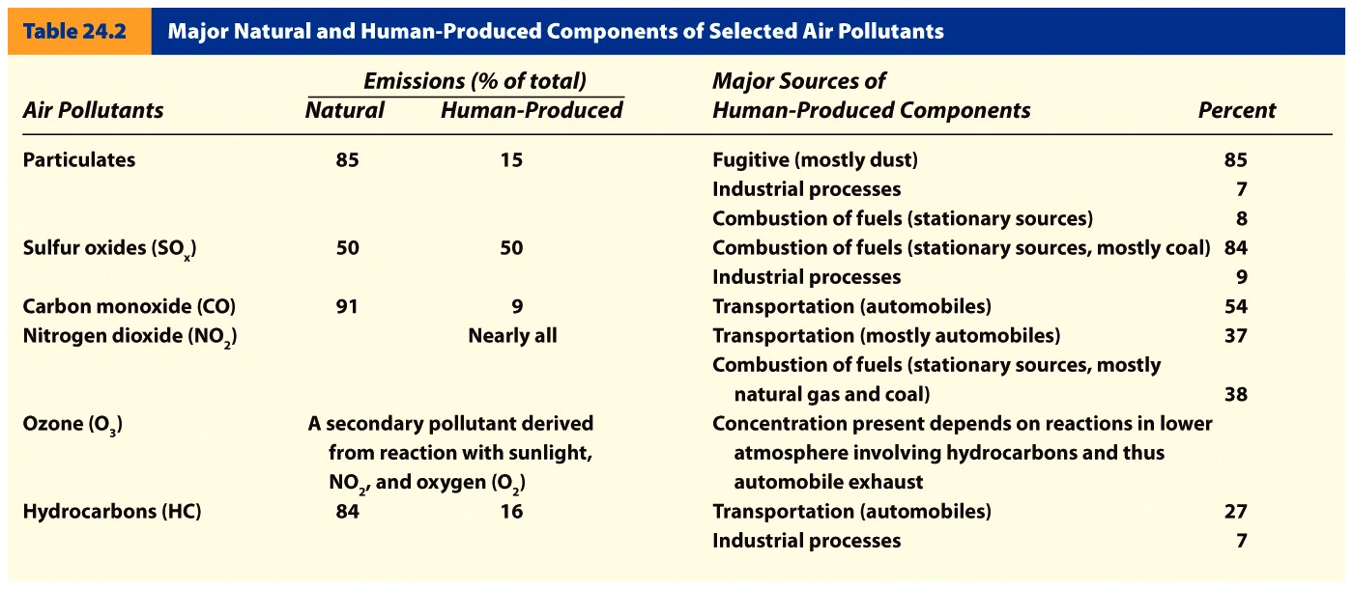

Slide 15
Types of Pollutants
Secondary pollutant reactions require a collision between molecules which occurs rarely because of the relatively low density of the atmosphere.
Most atmospheric reactions that occur require a free radical.
Free radicals are produced from stable molecules being broken apart (typically through photolysis) to form atoms that have unpaired electrons. These atoms are much more reactive than the original molecule.

Slide 16
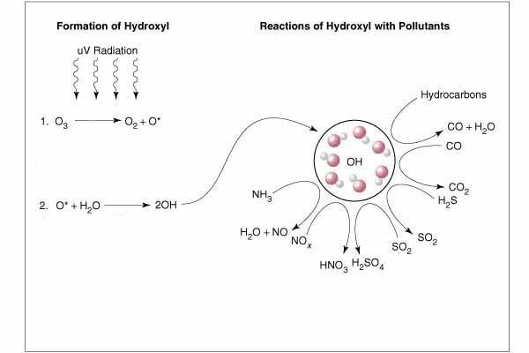
Types of Pollutants
Hydroxyl (OH) is one of the most important atmospheric radicals formed from the photolysis of tropospheric ozone
OH is short lived and almost immediately reacts with compounds like carbon monoxide, methane and VOCs

Slide 17
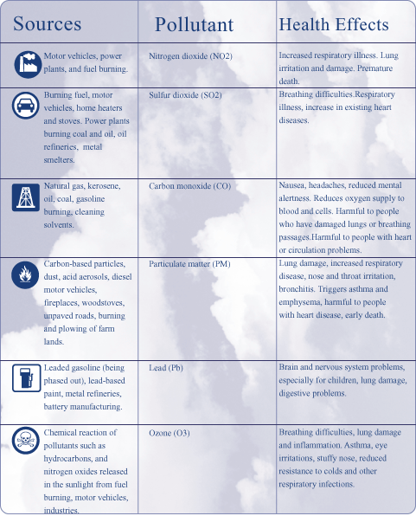
Types of Pollutants

Slide 18
Types of Pollutants
Sulfur Dioxide (SO₂)
Colorless odorless gas
Once emitted can be converted to sulfateSO₄
Removed from atmosphere by wet or dry deposition
Major human sources; coal power plants, industrial processes
Adverse effects depend on dose and concentration present
Injury or death to animals and plants
Corrosion of paint and metals
Important precursor to acid rain

Slide 19
Types of Pollutants
Nitrogen Oxides
Occur in many forms in the atmosphere but largely emitted in two forms:
Nitrogen monoxide - NO
Nitrogen dioxide - NO₂
A yellow-brown to reddish-brown gas
May be converted to NO₃¹⁻
Both subject to emissions regulation and contribute to smog
NO₂ major contributor to acid rain

Slide 20
Types of Pollutants
Nitrogen Oxides
Nearly all NO₂ emitted is from human sources
Automobiles and power plants that burn fossil fuels
Environmental effects:
Irritate eyes and mucous membranes
Suppress plant growth
However when convert to nitrate may promote plant growth

Slide 21
Types of Pollutants
Carbon Monoxide
CO is a colorless, odorless gas
Even at low concentrations is extremely toxic to humans
Binds to hemoglobin in blood.
90% of CO in atmosphere comes from natural sources
10% comes from fires, cars, and incomplete burning of organic compounds

Slide 22
Types of Pollutants
Ozone and other Photochemical Oxidants
Photochemical oxidants result from atmospheric interactions of nitrogen dioxide and sunlight.
Most common is ozone (O₃)
Colorless gas with slightly sweet odor
Very active chemically, oxidizes or burns
Beneficial in the upper atmosphere
Hard to regulate
Effects include
Kills leaf tissue at high concentration
Damage eyes and respiratory system
Even young, healthy people may have breathing difficulty on polluted days

Slide 23
Types of Pollutants
Particulate Matter
PM10 is made up of particles less than 10μm in diameter
Present everywhere but high concentrations and/or specific types dangerous
Much particulate matter easily visible as smoke, soot, or dust
Includes airborne asbestos and heavy metals
Of particular concern are very fine pollutants
PM2.5- less than 2.5 μm in diameter
Easily inhaled into the lungs, then absorbed into the bloodstream
Ultrafine particles- <0.18 μm released by automobiles.
Related to heart disease

Slide 24
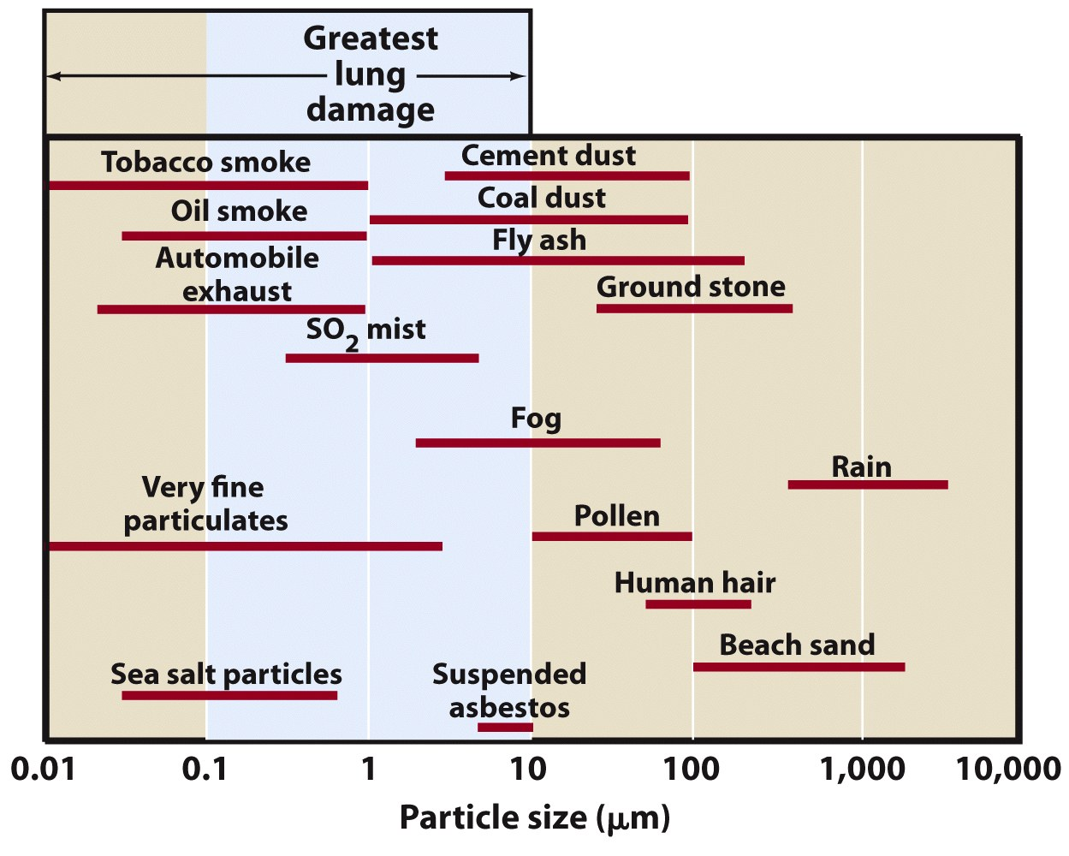
Types of Pollutants

Slide 25
Types of Pollutants
Particulate Matter
When measured often referred to as total suspended particles (TSPs)
Tend to be highest in large cities in developing countries
Recent studies estimate that 2 to 9% of human mortality in cites is associated with PM
Linked to both lung cancer and bronchitis
Especially hazardous to elderly and those with asthma
Dust can be deposited on plants
Interferes w/ absorption of CO₂ and O₂ and transpiration
Block sunlight and may cause climate change

Slide 26
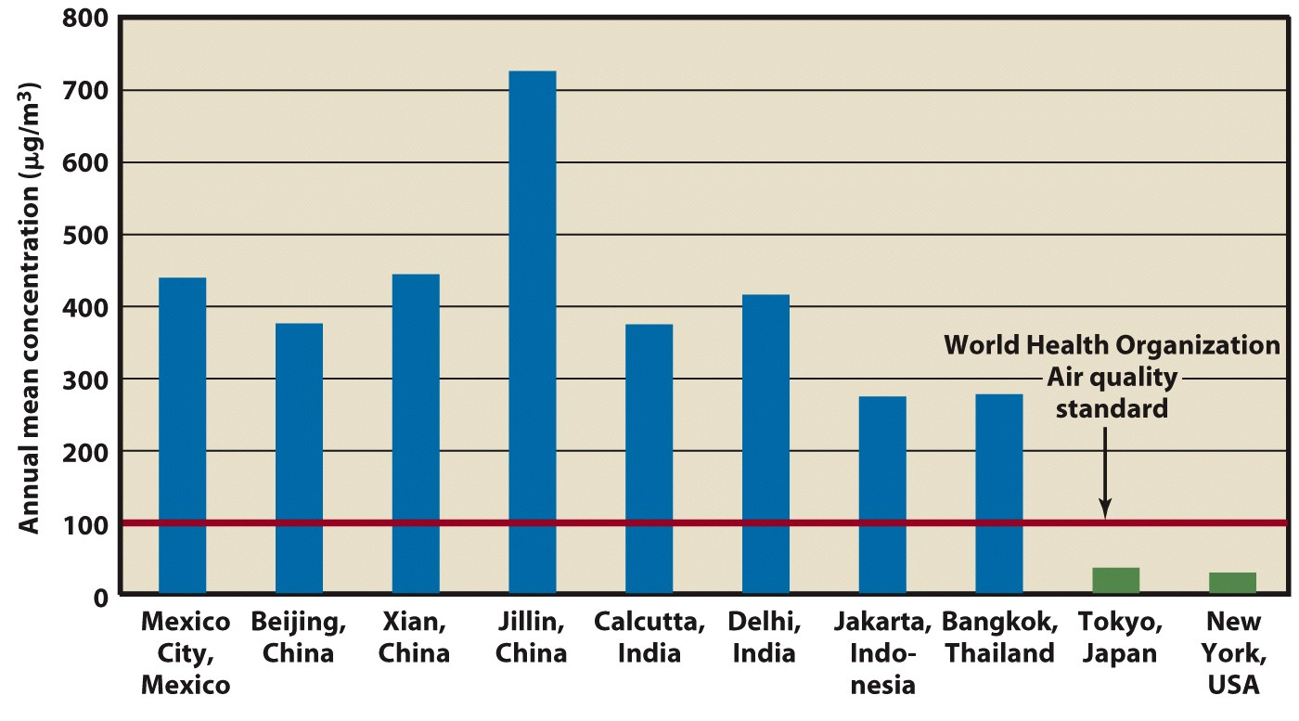

Slide 27
Types of Pollutants
Lead
A constituent of auto batteries and used to be added to gasoline.
Lead in gas emitted into air with exhaust
Spread widely around world in soils and water along roadways
Once in soil can enter the food chain
Lead now removed from gas in US, CAN, EU
98% reduction in emissions since 1970s

Slide 28
Additional Pollutants
Hydrogen Sulfide
Highly toxic corrosive gas easily identified by its rotten egg odor.
Produced from
Natural sources such as geysers, swamps, and bogs
Human sources such as industrial plants that produce petroleum or that smelt metals.
Effects of hydrogen sulfide include
Functional damage to plants
Health problems ranging from toxicity to death for humans and other animals.

Slide 29
Additional Pollutants
Hydrogen Fluoride
Extremely toxic gaseous pollutant
Released by some industrial activities
Such as production of aluminum, coal gasification, and burning of coal in power plants.
Even a small concentration (as low as 1 ppb) of HF may cause problems for plants and animals.
Potentially dangerous to grazing animals because forage plants can become toxic when exposed to this gas.

Slide 30
Additional Pollutants
Methyl Isocyanate (CH₃NCO)
An ingredient of a common pesticide
known in the United States as Sevin.
Colorless gas
Causes severe irritation (burns on contact) to eyes, nose, throat, and lungs.
Breathing the gas in concentrations of only a few ppm causes violent coughing, swelling of the lungs, bleeding, and death.
Less exposure can cause a variety of problems, including loss of sight.

Slide 31
Additional Pollutants
Methyl Bromide (CH₃Br)
Colorless, odorless, nonflammable gas
Ozone depleting chemical
Used as a pesticide (strawberries, tomatoes)
Produced naturally and artificially
Naturally by marine organisms and some plants
Undergoes photolysis to create bromide that destroys stratospheric ozone

Slide 32
Additional Pollutants
Volatile Organic Compounds
Variety of organic compounds used as solvents in industrial processes
Dry cleaning, degreasing, and graphic arts.
Hydrocarbons
Comprise one group of VOCs.
Thousands of hydrocarbon compounds exist, including natural gas, or methane (CH₄); butane (C₄H₁₀); and propane (C₃H₈).
Some VOCs react w/ sunlight to produce photochemical smog
Globally 15% of hydrocarbons emissions are anthropogenic
In the US 50%
Primary human source automobiles

Slide 33
Additional Pollutants
Benzene
Additive in gasoline and an important industrial solvent.
Produced when gasoline and coal undergo incomplete combustion.
Also component of cigarette smoke
Major environmental source on and off road vehicles

Slide 34
Additional Pollutants
Acrolein
A volatile hydrocarbon that is extremely irritating to nose, eyes, and respiratory system.
Produced from
Manufacturing processes that involve combustion of petroleum fuels
Component of cigarette smoke

Slide 35
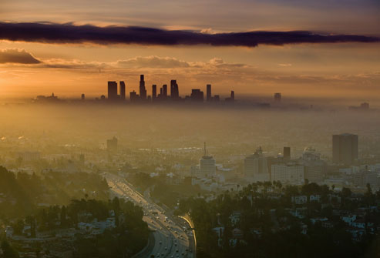
Variability of Air Pollution
Problems vary in different regions of the country and the world.
LA pollution mainly from mobile sources
Ohio and Great Lakes point sources
Also varies with time of year
Smog a problem in summer when there is lots of sunshine
Particulates a problem in dry months

Slide 36
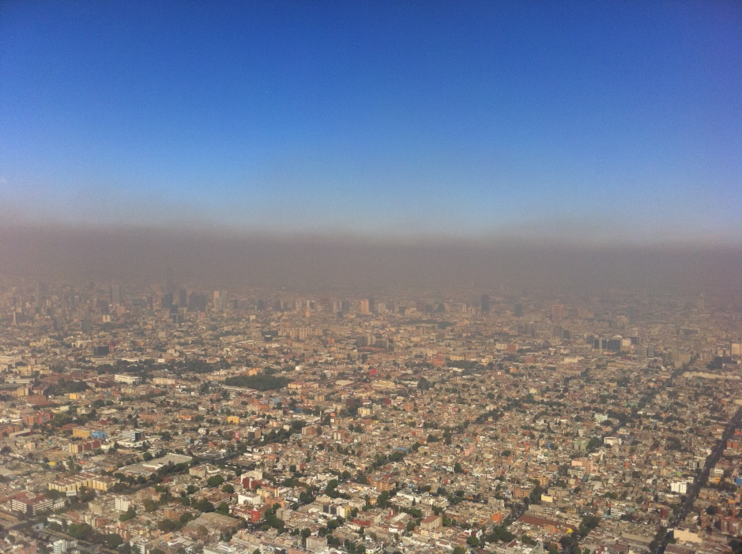
Urban Air Pollution
Whether air pollution develops depends on topography and meteorological conditions
Determine the rate at which pollutants are transported away and converted to harmless compounds.
In the lower atmosphere, restricted circulation is associated with inversion layers may lead to pollution events.
Atmospheric inversion
occurs when warmer
air is found above cooler
air

Slide 37
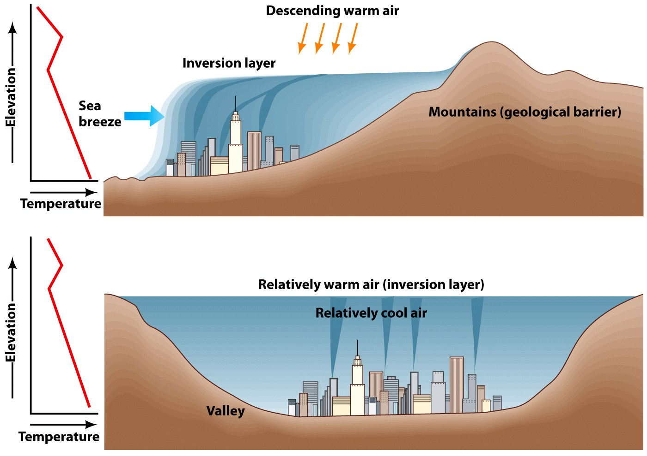
Primarily summer and fall conditions
Increased cloud cover creates stagnant air

Slide 38
Urban Air Pollution
Potential for urban pollution is determined by the following factors:
Rate of emission of pollutants per unit area.
Downwind distance that a mass of air moves through an urban area.
Average speed of the wind.
Elevation to which potential pollutants can be thoroughly mixed by naturally moving air in the lower atmosphere.

Slide 39
Urban Air Pollution
Concentration of pollutants in the air is directly proportional to the first two factors.
As either emission rate or down wind travel distance increase, so will the concentration of pollutants
City air pollution decreases w/ increases in third and forth factors.
The stronger the wind and the higher the mixing layer, the lower the pollution.

Slide 40
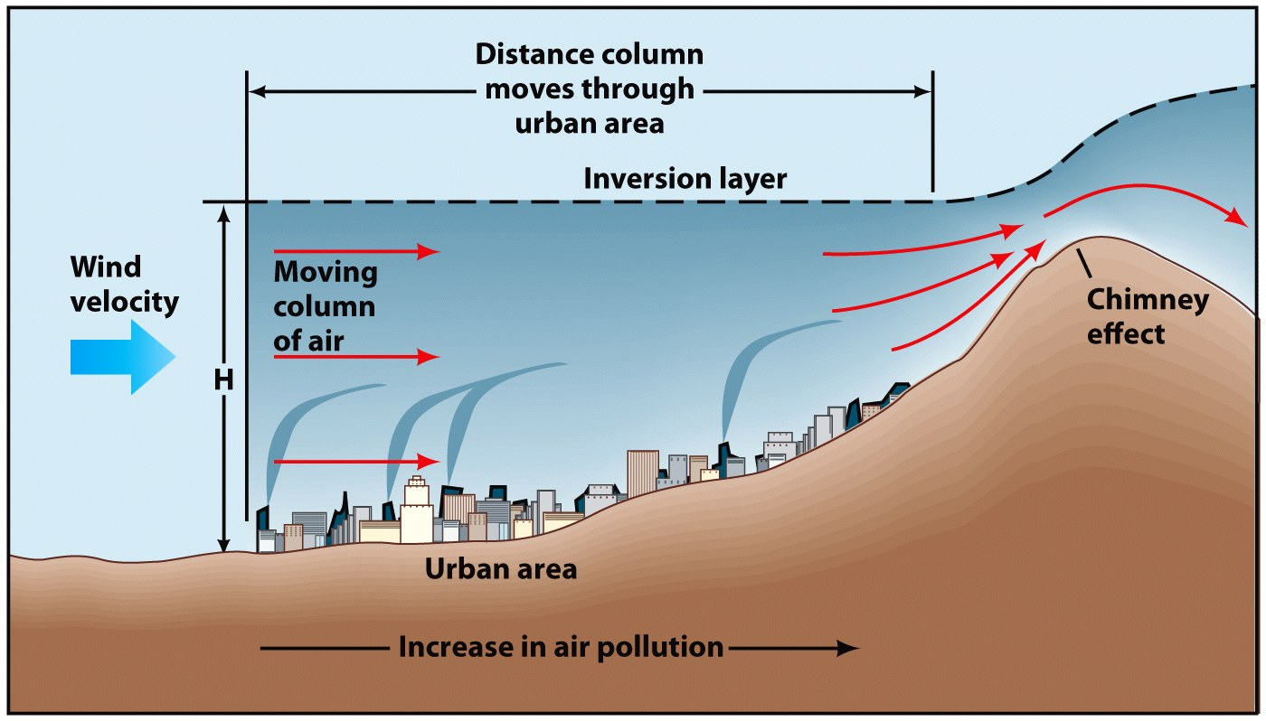

Slide 41
Urban Air Pollution
Smog
Two major types
Photochemical smog (LA type smog or brown air)
Sulfurous smog (London type smog, gray air, or industrial smog)
Photochemical smog reaction involves sunlight, nitric oxides and VOCs
Directly related to automobile use
Sulfurous smog is produced by the burning of coal or oil at large power plants.

Slide 42
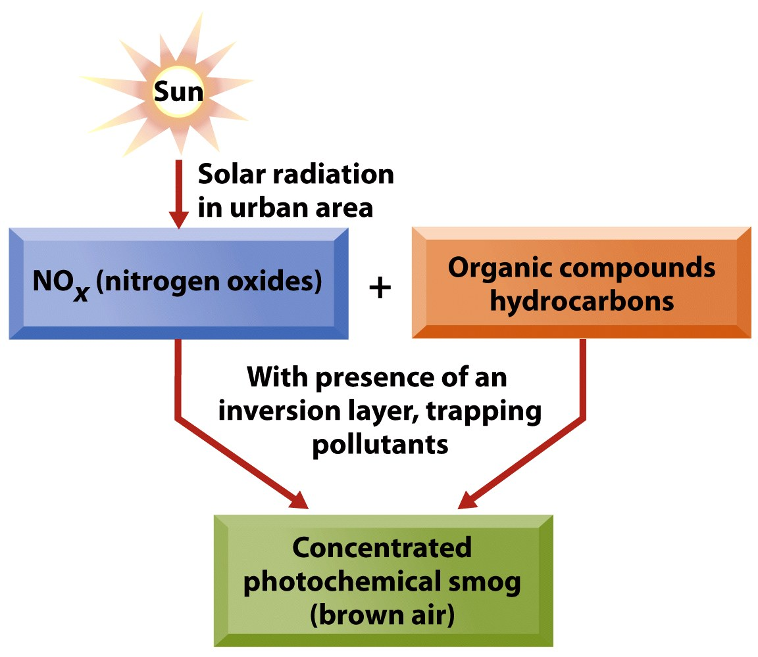
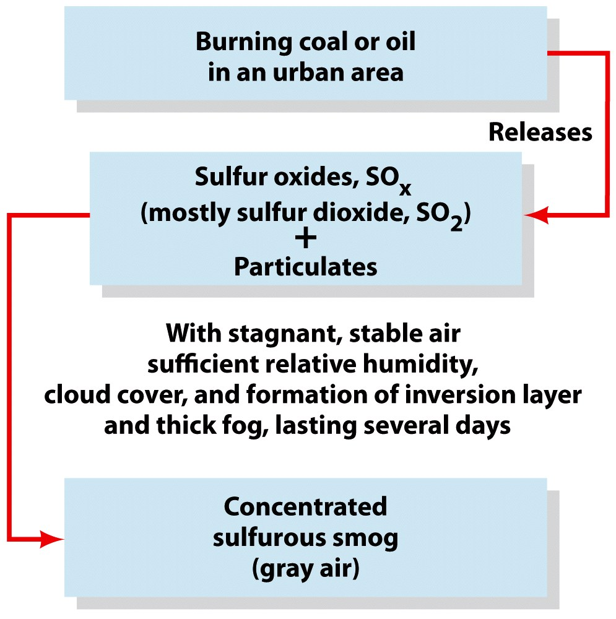

Slide 43
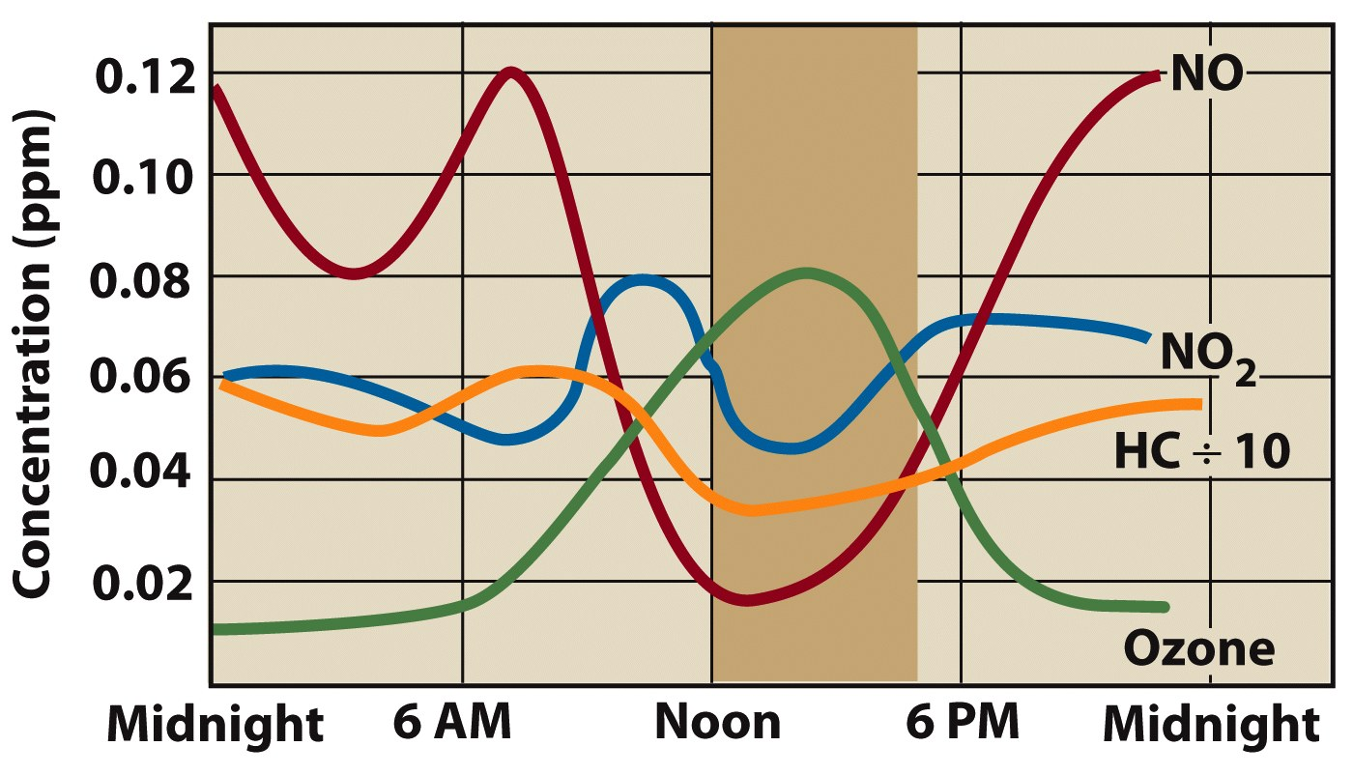

Slide 44
Future Trends
As we understand more about where air pollution is coming from we should be able to improve air quality
Steps to improve air quality include:
Reduce emissions
Improve transportation
Stricter regulations on pollutant sources
Developing countries face more difficulty controlling air pollution because of a lack of infrastructure around industry and urban environments

Slide 45
Pollution Control
The most reasonable strategies for control have been to reduce, collect, capture, or retain the pollutants before they enter the atmosphere.
Reduction of emissions through energy efficiency and conservation measures is preferred.
Implementing pollution control must be a social, political, economical and global priority to be truly effective

Slide 46
Pollution Control
Sulfur Dioxide Control Techniques
Washing- allowing iron sulfide to settle out of a solution (does not get sulfur combined with carbonaceous compounds)
Coal gasification- converts coal to gas to remove sulfur (expensive)
Scrubbing- Sulfur dioxide released during coal burning is sent through a slurry of lime (CaO) and water which causes the sulfur to react with calcium and precipitate out
Liquid ammonia- reacts with sulfur to create ammonium sulfate which can be cooled and collected in condensing towers

Slide 47
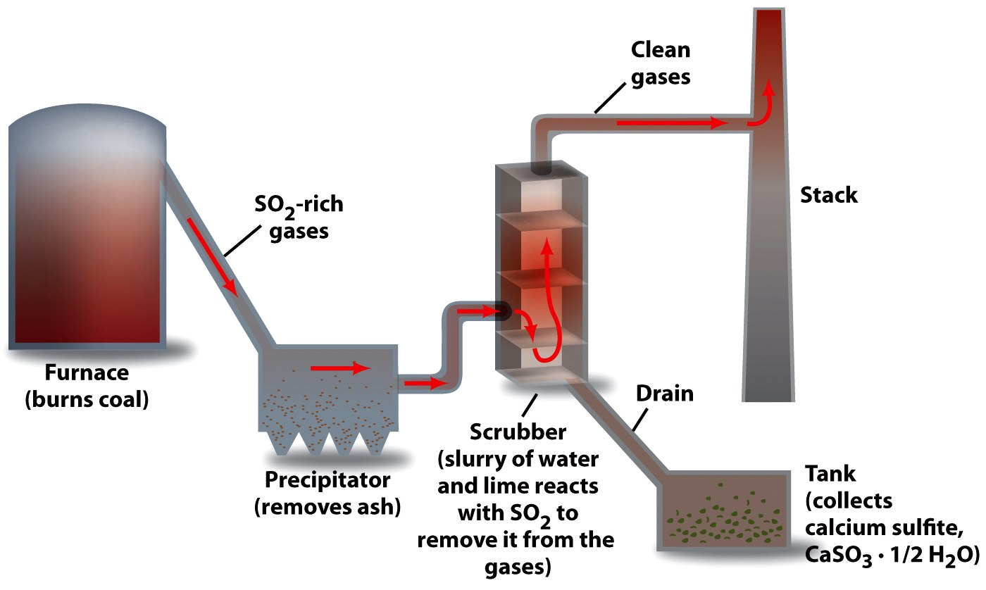
Pollution Control

Slide 48
Air Pollution Legislation and Standards
Clean Air Act Amendments of 1990
Goal to reduce coal burning emissions by 50% by 2000 (achieved)
Incentives to reduce emissions including permits that allow companies to buy and sell the right to pollute
Reduce nitrogen dioxides (auto emissions)
Reduce toxic air emissions by 90%
End productions of all CFCs by 2030

Slide 49
Kyoto Protocol (1997)
Main goals were to control emissions that contribute to increases in greenhouse gases and human induced climate change
Established emissions trading policies (cap and trade) that would help to regulate emissions from countries and individual industries within countries
Places more responsibility on developed countries due to their historical influence on greenhouse gases

Slide 50
Air Pollution Legislation and Standards
Clean Power Plan of 2015
Plan to reduce carbon emissions from power plants (70% reduction by2030)
Focuses on states regulating and reducing carbon emissions
Promotes accountability from industries by requiring plans to reduce emissions by 2016
Invests in clean energy options and job creation
Hopes to reduce energy costs for the average household

Slide 51
Air Pollution Legislation and Standards
Air quality standards study the levels of certain pollutants that could be hazardous to health
Requires tougher standards for PM2.5 and ozone
Increases monitoring of emissions by the EPA
Sets the Air Quality Index for common pollutants

Slide 52
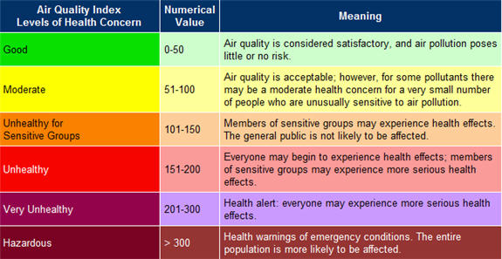
Air Pollution Legislation and Standards

Slide 53
Costs of Air Pollution Control
Costs for pollution control vary with the types of industry
Goals are to balance the cost of clean up with the benefits
Could require taxing citizens for pollution emissions
Should focus on the cost of health care in the future because of environmental toxins

Slide 54
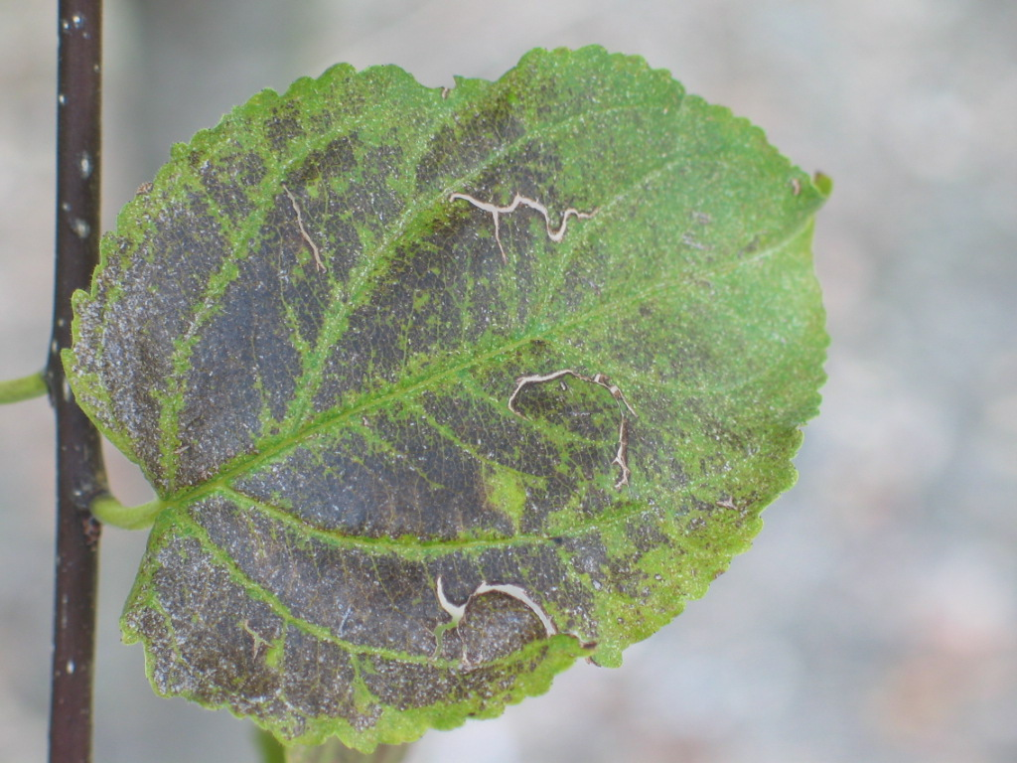
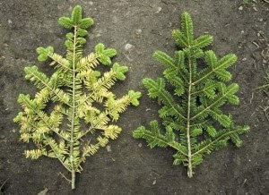
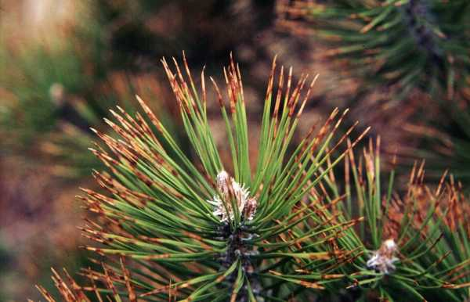
Sulfur Dioxide Effects

Slide 55
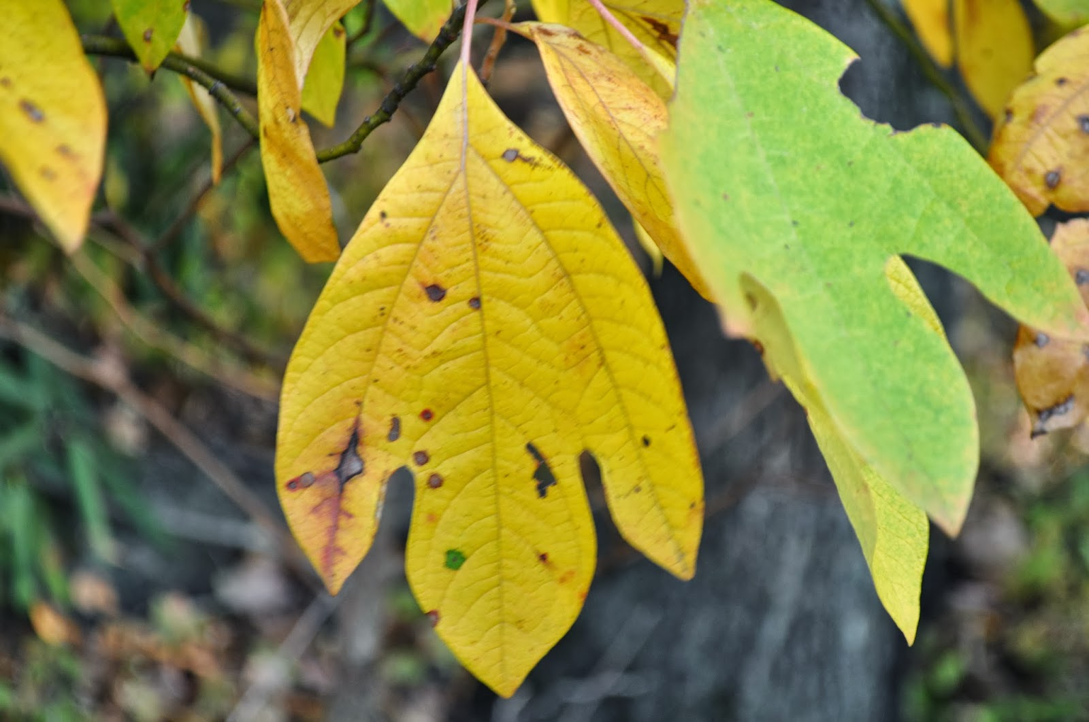
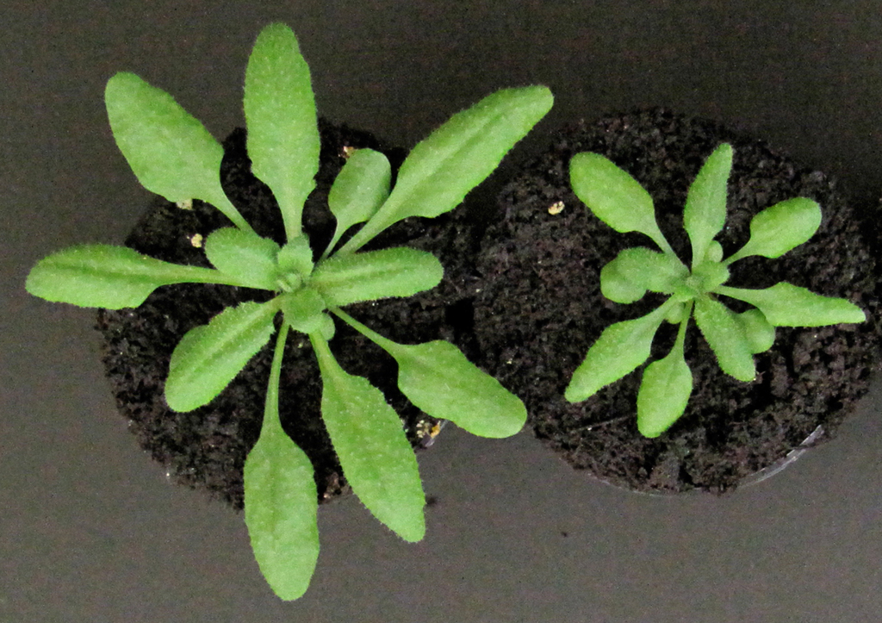
Nitrogen Dioxide or Carbon Monoxide Effects

Slide 56
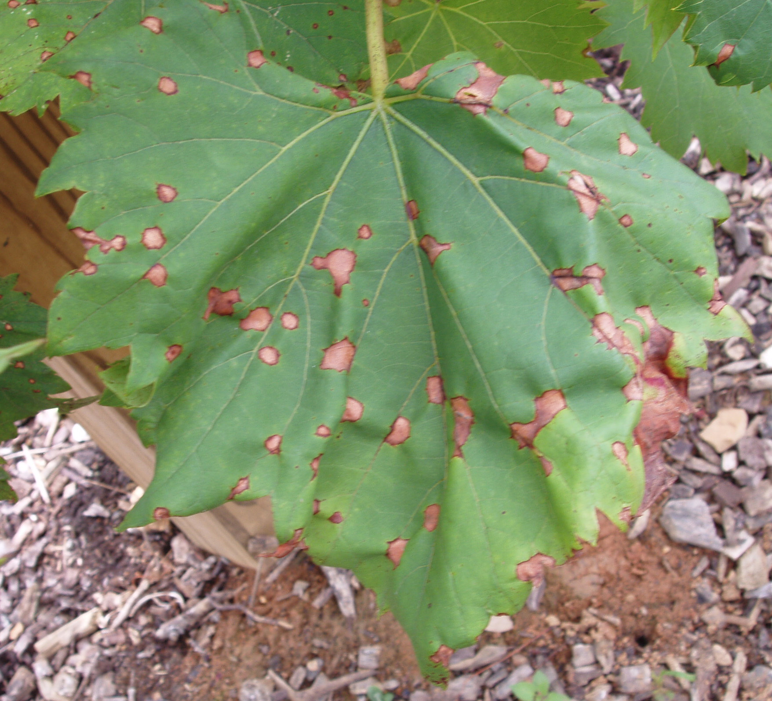
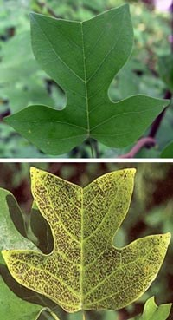
Ozone Effects

