Slide 1
AP Environmental Science
Indoor Air Pollution (Chapter 16)

Slide 2
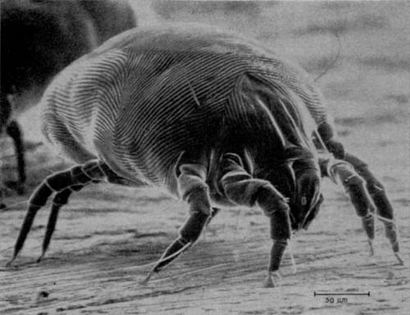
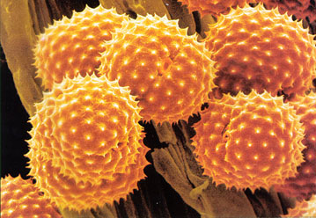
Sources of Indoor Air Pollution
Sources of indoor air pollution can come from both human activities and natural processes
Two of the most common household pollutants are dust mites and pollen

Slide 3
Sources of Indoor Air Pollution
Environmental Tobacco Smoke (secondhand smoke)
Emitted by smoke exhalation and burning tobacco products
Contains thousands of toxic chemicals (Nitrogen oxides, Carbon monoxide, Hydrogen Cyanide)
Causes health issues mainly in the respiratory system
Exposure varies with amount of tobacco smoke present, size of the space, and ventilation

Slide 4
Sources of Indoor Air Pollution
Carbon Monoxide
Colorless, odorless gas
Common sources include gas stoves, space heaters, leaky chimneys, exhaust from attached garage spaces, environmental tobacco smoke
Health effects range with concentration. Low concentrations can lead to fatigue, dizziness, and nausea. High concentrations can be fatal.
Proper ventilation and maintenance of appliances are the best ways to reduce exposure to high concentrations of CO

Slide 5
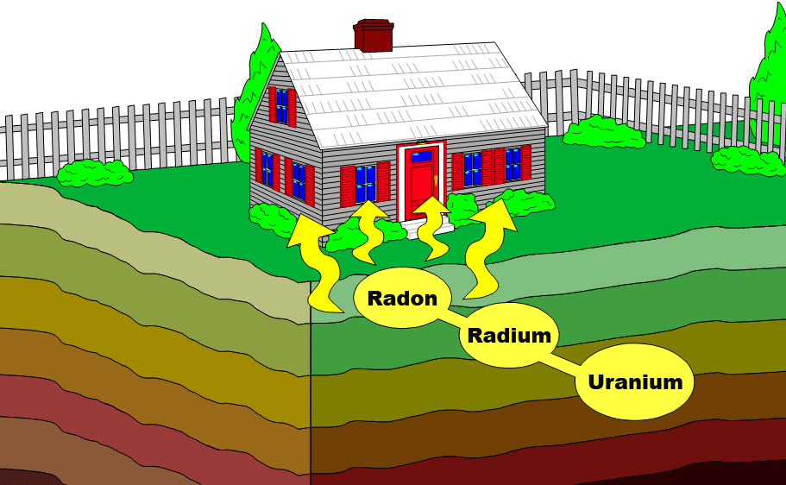
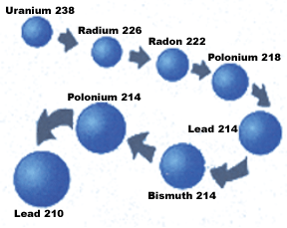
Sources of Indoor Air Pollution
Radon Gas
Naturally occurring radioactive gas that is colorless, odorless, and tasteless
Comes from the radioactive decay of radiogenic uranium to stable lead
Enters homes through rock or soil that contains concentrations of uranium

Slide 6
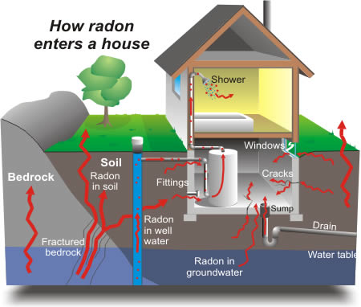
Sources of Indoor Air Pollution
Radon gas enters homes and buildings in 3 main ways:
Migration through soil and rock into basements and lower floors
Dissolution in groundwater pumped into wells
Radon-contaminated materials used in construction
Home radon testing and mitigation video

Slide 7
Sources of Indoor Air Pollution
Asbestos
Fibrous mineral fragments used in building materials
Common sources include roof shingles, ceiling and floor tiles, insulation, and fire retardant fabrics
Health risks come from inhalation of fibers when building materials are broken up. Asbestos fibers attach to respiratory tissue and may develop tumors in the lungs
National policies have restricted the use of asbestos in building materials since 1969

Slide 8
Sources of Indoor Air Pollution
Formaldehyde
Volatile organic compound often used as a preservative or coating material in building supplies
Common sources include dry wall coating, wood flooring, new furniture
Health risks from low exposure include skin, eye, nose, and throat irritation. At greater exposure formaldehyde may cause cancer.

Slide 9
Sources of Indoor Air Pollution
Additional pollution sources include:
Legionella pneumophila- bacterium that grows in stagnant water and can be transported through the air
Mold
Pesticides (ex: methyl bromide)
Chloroform (chlorine treated water heated above 105ºF)
Para-dichlorobenzene (moth balls)
Flame retardants

Slide 10
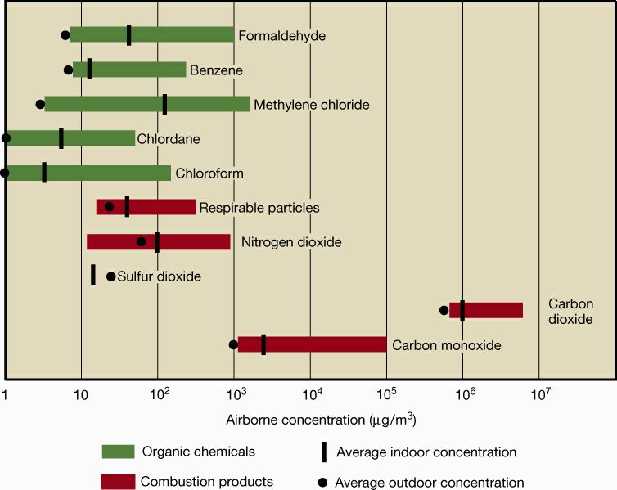

Slide 11
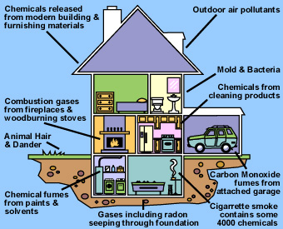
Sources of Indoor Air Pollution
Indoor air pollution is often highly concentrated compared to outdoor pollution because of the numerous sources of pollution, proximity to the sources, and lack of ventilation

Slide 12
Sources of Indoor Air Pollution
Newer homes are often more susceptible to indoor air pollution issues than older homes for various reasons:
Energy efficient windows and doorways seal in air and prevent circulation
New construction materials are more likely to contain chemicals that could be emitted into indoor air spaces
New homes are more likely to be built on slabs that increases chances of air pollution from the ground

Slide 13
Sources of Indoor Air Pollution
Heating and air systems in a home are designed to regulate indoor temperatures and ventilate using outdoor air
Along with temperature, humidity must be controlled to prevent mold and mildew growth
Ventilation systems are not designed to reduce indoor air pollution, if not maintained properly these systems can be sources of pollution themselves

Slide 14
Sources of Indoor Air Pollution
Movement of air within a building depends on pressure and temperature differentials
Windward sides of buildings build up higher pressure s and leeward sides tend to have lower pressure
Home with different temperature controls in different areas can create movement due to temperature differentials
Leaky buildings have greater air movement

Slide 15
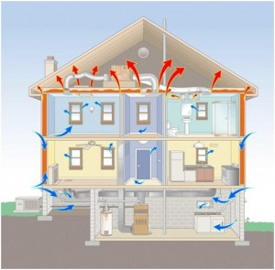
Sources of Indoor Air Pollution
A chimney effect (stack effect) occurs when there is a temperature differential from indoor to outdoor environments
As warm air rises to upper levels cooler air can be drawn in from outside to replace it

Slide 16
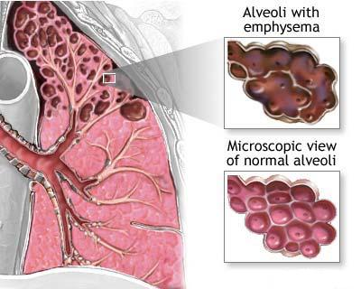
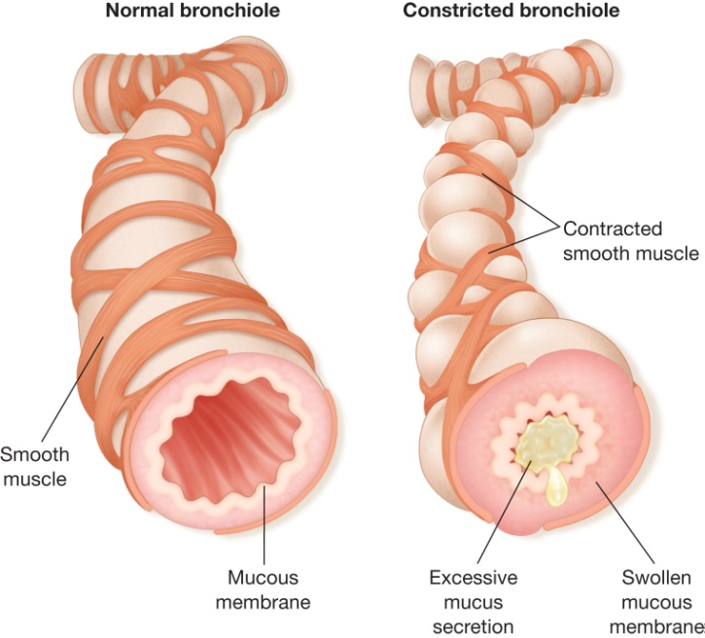
Susceptibility and Health Effects
Susceptibility to health effects from indoor air pollution can vary according to genetic factors, lifestyle and age
Older people, children, and individuals with impaired health are generally more sensitive to air pollution

Slide 17
Susceptibility and Health Effects
Diseases related to air pollution include:
Asthma-bronchial tubes tighten & narrow.
Bronchitis-tubes swell & fill with mucus. They get narrow, so it is hard to inhale & exhale.
Emphysema-air sacs lose elasticity so it is hard to inhale & exhale.
Lung cancer-cancer cells grow rapidly, poisoning body.

Slide 18
Susceptibility and Health Effects
Sick buildings
Building related illnesses (BRI) are illnesses produced by a building with identifiable pollutant sources
Sick building syndrome (SBS) results when several cases of illness from a building have been reported with no identified source
Numerous factors can be attributed to sick buildings including stress and working conditions
Video Resource

Slide 19
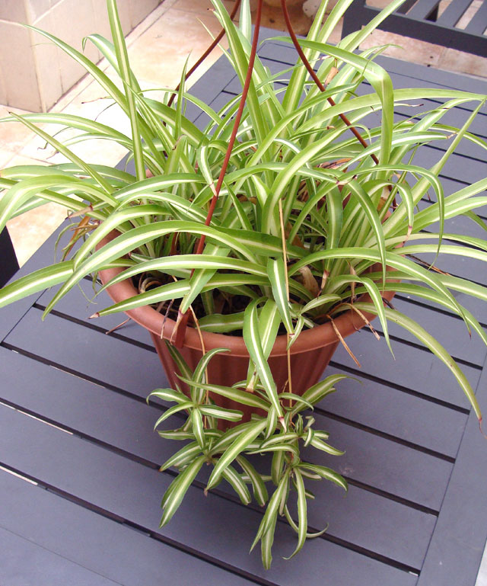
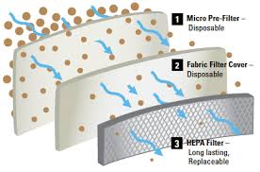
Air Pollution Control
To improve household air:
Open windows when possible
Use an air cleaner with a HEPA (high-efficiency particle air) filter.
Grow spider plants- they absorb many pollutants.

Slide 20
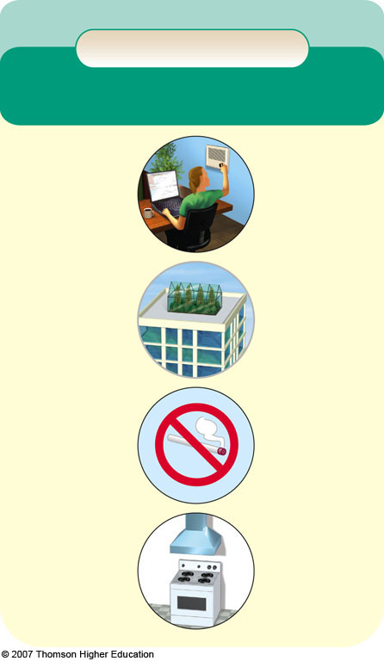
Solutions
Indoor Air Pollution
Prevention
Cleanup or Dilution
Cover ceiling tiles & lining of AC ducts to prevent release of mineral fibers
Use adjustable fresh air vents for work spaces
Increase intake of outside air
Ban smoking or limit it to well ventilated areas
Change air more frequently
Set stricter formaldehyde emissions standards for carpet, furniture, and building materials
Circulate a building’s air through rooftop green houses
Prevent radon infiltration
Use exhaust hoods for stoves and appliances burning natural gas
Use office machines in well ventilated areas
Use less polluting substitutes for harmful cleaning agents, paints, and other products
Install efficient chimneys for wood-burning stoves

Slide 21
What Can You Do?
Indoor Air Pollution
• Test for radon and formaldehyde inside your home and take corrective measures as needed.
• Do not buy furniture and other products containing formaldehyde.
• Remove your shoes before entering your house to reduce inputs of dust, lead, and pesticides.
• Test your house or workplace for asbestos fiber levels and for any crumbling asbestos materials if it was built before 1980.
• Don't live in a pre-1980 house without having its indoor air tested for asbestos and lead.
• Do not store gasoline, solvents, or other volatile hazardous chemicals inside a home or attached garage.
• If you smoke, do it outside or in a closed room vented to the outside.
• Make sure that wood-burning stoves, fireplaces, and kerosene- and gas-burning heaters are properly installed, vented, and maintained.
• Install carbon monoxide detectors in all sleeping areas.

