Slide 1
AP Environmental Science
Energy basics (Chapter 16)

Slide 2
History of energy
For as long as civilization has been around there has been a need and an economic focus on energy sources
Early civilizations utilized wood and solar energy for heat and light
Greeks and Romans developed simple machines and made modifications to buildings to harness heat
First steam powered machines and windmills built in Alexandria, Greece
Romans developed glass windows to trap heat and built greenhouses to grow crops in cold temperatures

Slide 3
History of energy
Modern Energy Advances
1712-1775 Thomas Newcomen and James Watt made improvements to primitive steam engines to give the basis for modern steam technology
1880 the first coal powered steam engine was attached to an electric generator made by Thomas Edison
1881 the first hydroelectric power plant produced energy for Appleton, Wisconsin
Late 1800’s petroleum began to be used as an alternate to coal
Early 1900’s gasoline production fuels combustion engines

Slide 4
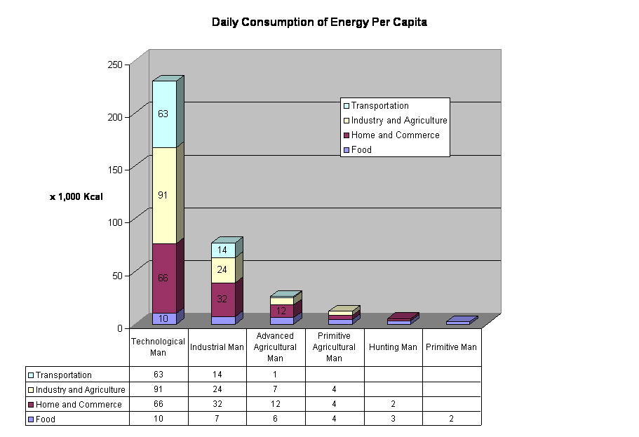
History of energy
Both the energy source and the use of energy has changed since early civilizations
Technology and improvements to the standard of living have steadily increased the daily consumption of energy

Slide 5
History of Energy
U.S. Energy Consumption By Energy Resource 1635-2000 (in Quadrillion Btu) Source: http://www.eia.doe.gov/emeu/aer/eh/intro.html

Slide 6
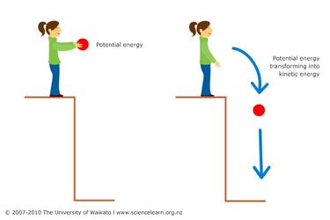
Energy basics
Energy is the ability to do work
Work is the product of force times distance
Force is an interaction between two objects (push/pull)
Two main types of energy:
Potential energy: stored energy
Kinetic energy: energy of motion
Other types:
Chemical energy: stored in molecules
Heat energy: energy from the random motion of atoms

Slide 7
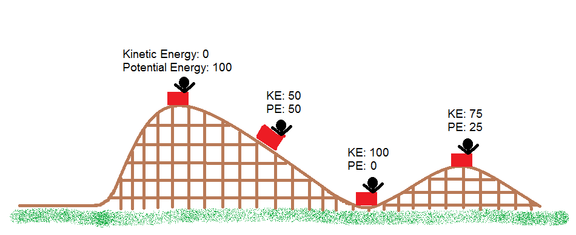
Energy basics
Energy can be transformed from one type to another but the total energy is always conserved
1st law of thermodynamics: energy cannot be created or destroyed
Energy in a system is never lost but it can be transformed and it can become lower quality and unable to perform work

Slide 8
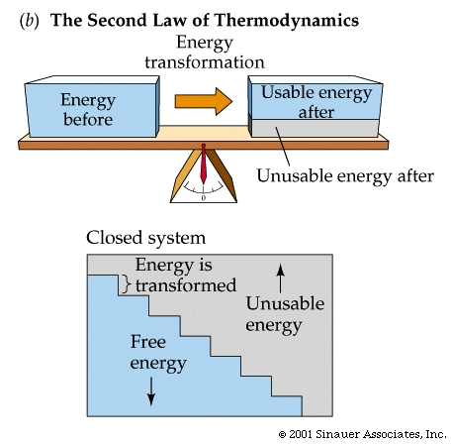
Energy basics
2nd law of thermodynamics: as energy is transferred or transformed entropy either increases or remains the same
Entropy is the amount of energy unavailable for work
Energy always goes from a usable high quality form (low entropy) to a less usable lower quality form (high entropy)

Slide 9
Energy efficiency
First law efficiency: amount of energy without any consideration of the quality or availability of energy
Ratio of the amount of energy delivered where it is needed to the amount of energy actually supplied to meet that need
Second law efficiency: how well matched the energy use is with the quality of the energy source
Important to the study of energy use because it shows where improvements can be made to increase the efficiency of an energy system
Example: Not using a blowtorch to light a match

Slide 10
Energy Efficiency
Low second-law efficiency numbers indicate places where improvements can be made to increase the high quality energy available for work

Slide 11
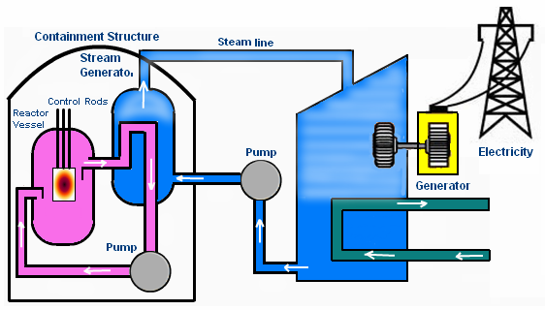
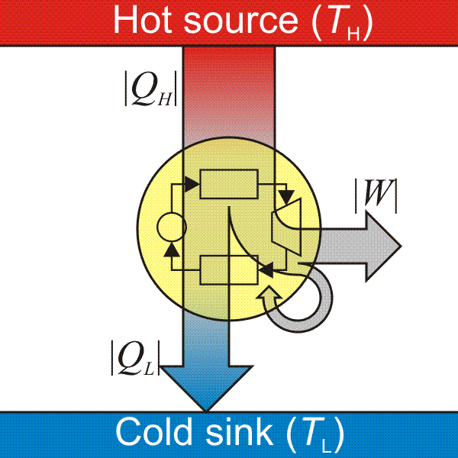
Energy Efficiency
Examples of systems that have nearly equal first and second law efficiency values are heat engines
Heat engines are systems that convert thermal energy into mechanical energy which is then used to do work

Slide 12
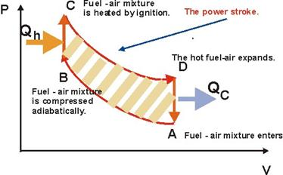
Energy efficiency
Maximum possible efficiency of a heat engine is described as thermal efficiency
Discovered by French engineer Carnot in 1824
Modern heat engines have thermal
efficiencies between 60-80%
Modern electrical generating
plants have efficiencies
between 30-40%
Energy lost in a system is
rejected as waste heat

Slide 13
Energy efficiency
Electricity is often the product of heat engine systems using things like coal, oil, natural gas, or nuclear reactions to generate heat
Electricity produced is fed into a network of electrical power lines and then into homes and businesses
As electricity travels through the grid it loses energy through electrical resistance and heat

Slide 14
Energy sources and consumption
There is a direct relationship between a country’s standard of living and the energy consumption per capita
The U.S. contains a small percentage of the world’s population but uses a much larger proportion of the world’s energy
90% of the energy consumed in the United States is generated using fossil fuels that are non-renewable

Slide 15
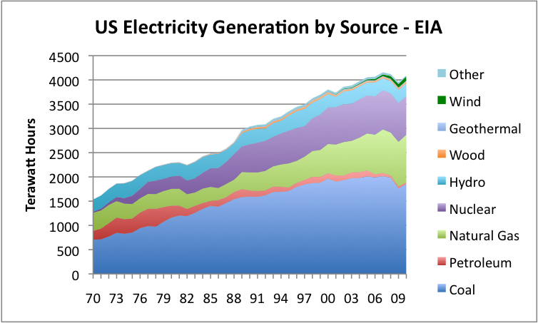
Energy Sources and Consumption

Slide 16
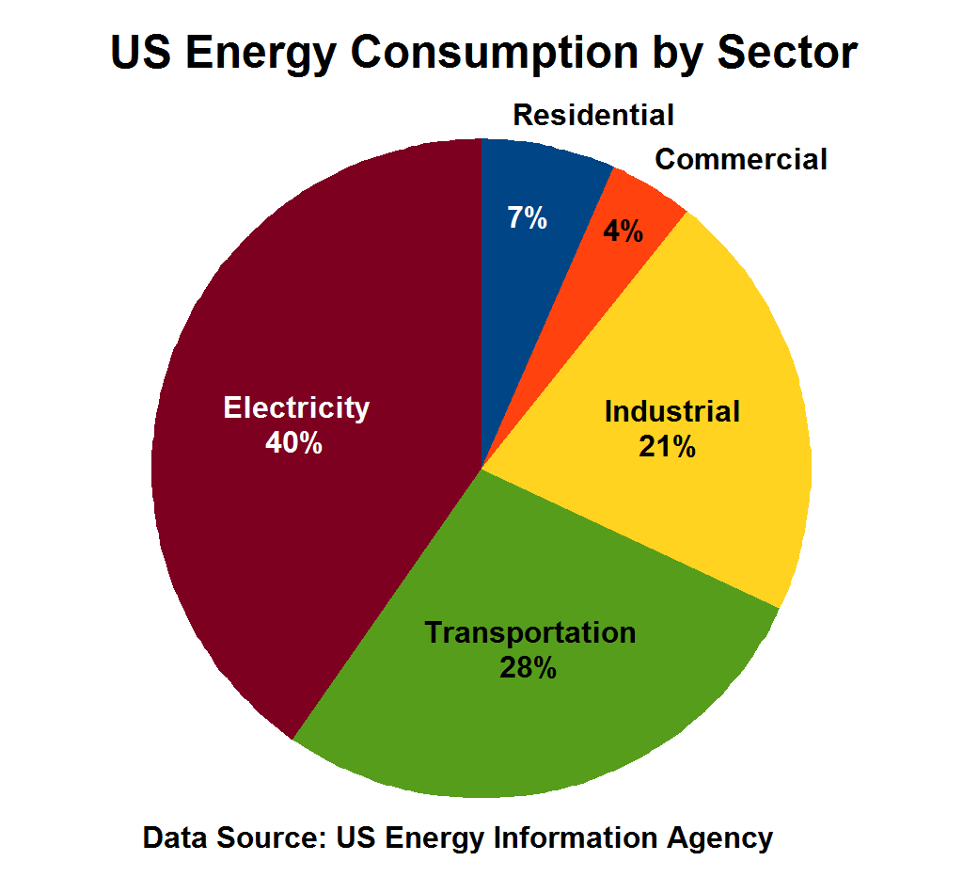
Energy sources and consumption
Since 1950 energy consumption has increased at varying rates
As consumption increases so does energy loss
Most energy is lost in the processes that produce electricity and transportation

Slide 17
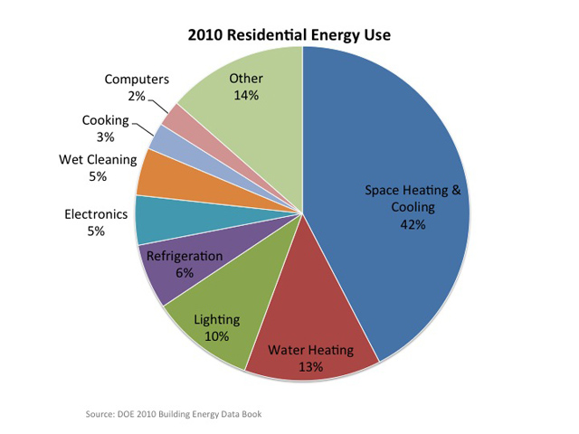
Energy conservation
Conservation of energy means reducing energy demands
Minimize high quality energy used to complete a task (increase energy efficiency)
Cogeneration makes use of capturing waste heat instead of letting it escape into the atmosphere
Methods to reduce energy
losses should focus on places
where energy is used the most

Slide 18
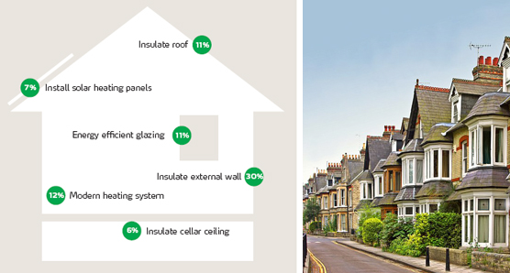
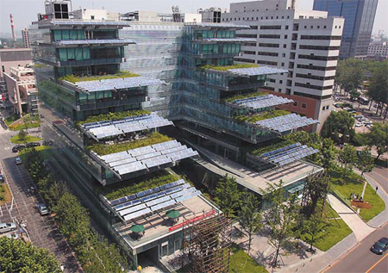
Conservation in building design
Construction of buildings to take advantage of natural energy sources (solar, geothermal) and daily or seasonal changes
Buildings constructed to reduce heat loss often have greater air pollution issues due to poor ventilation

Slide 19
Lifestyle choices to promote conservation
Improving energy conservation per person means making choices that promote high energy efficiency
Carpooling
Buying cars with higher mileage ratings
Turning off lights not in use
Taking shorter showers
Adjusting clothing to match external temperatures
Options to improve personal energy efficiency are available but sometimes at a higher cost. Is the cost worth the environmental benefit?

Slide 20
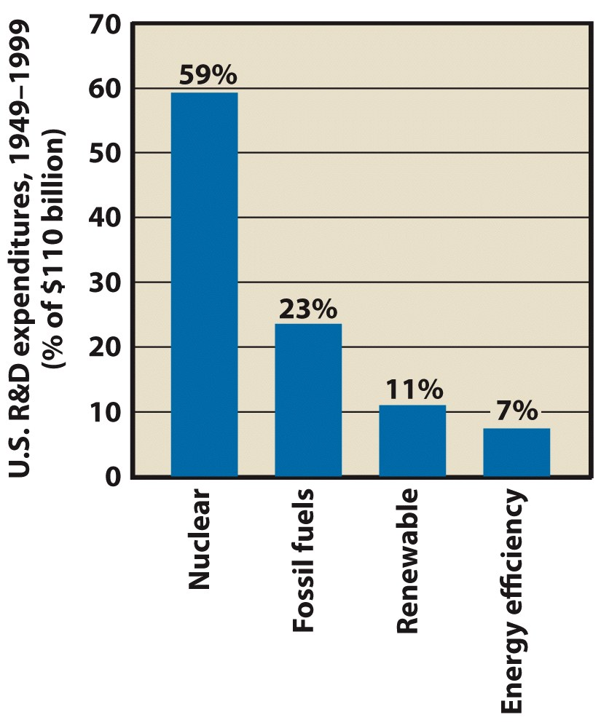
Energy Policy
U.S. energy policy during the past half-century has not moved us closer to energy self-sufficiency.
We still import fossil fuels from other countries
In the late 1990s, the US spent $2 billion per year on R and D for energy.
By comparison, $45 billion per year went to R and D for the military.
Energy efficient appliances have reduced household energy uses

Slide 21
Energy Policy
Hard Path Energy Policy involves finding greater amounts of fossil fuels and building larger power plants.
Continues the past emphasis on quantity of energy used.
Requires no new thinking; no realignment of political, economic, or social conditions; and little anticipation of coming reductions in fossil fuels.
According to hard-path proponents, we should
1. Let the energy industry develop the available energy resources
2. Let industry, free from government regulations, provide a steady supply of energy with less total environmental damage.

Slide 22
Energy policy
Soft Path Energy Policy involves energy alternatives that emphasize energy quality, are renewable, are flexible, and are environmentally more benign than those of the hard path
They rely heavily on renewable energy resources, such as sunlight, wind, and biomass.
They are diverse and are tailored for maximum effectiveness under specific circumstances.
They are flexible, accessible, and understandable to many people.
They are matched in energy quality, geographic distribution, and scale to end-use needs.

Slide 23
Energy Policy

Slide 24
Energy Policy
Year | Legislation | Goals
1920 | Federal Water Act | Encouraged hydroelectric power and established the Federal Power Commission
1936 | Rural Electrification Act | Promoted distribution and installation of household electric power
1946 | Atomic Energy Act | Made nuclear power and weapon development civilian controlled
1974 |  | Atomic weapons and power put under control of federal agencies
1978 | National Energy Act | Established tax incentives, alternative energy and efficiency programs
1992 |  | Created framework for electrical generation, clean fuel auto incentives, expanded natural gas
2009 | American Recovery and Reinvestment Act | $800 billion stimulus package that included tax credits and research money for energy efficient programs

Slide 25
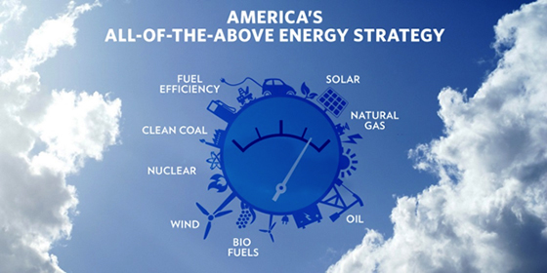
Energy Policy
The current U.S. energy policy is called the “All of the Above Energy Strategy”
Goals are to reduce dependence on foreign oil, promote safe oil and gas domestic production, increase carbon sequestration, and to advance clean energy and efficiency
Is this a hard or soft energy policy?

Slide 26
Energy for tomorrow
Future changes in population densities as well as intensive conservation measures will probably change existing patterns of energy use.
To stabilize the climate in terms of global warming, use of energy from fossil fuels would need to be cut by about 50%.
Reductions in energy use need not be associated with lower quality of life.

Slide 27
Energy for tomorrow
What is needed is increased conservation and more efficient use of energy:
More energy-efficient land-use planning that maximizes the accessibility of services and minimizes the need for transportation.
Agricultural practices and personal choices that emphasize
1. Eating more locally grown foods
2. Eating more vegetables, beans, and grains.
Industrial guidelines for factories that promote energy conservation and minimize production of waste.

Slide 28
Integrated, Sustainable energy management
Recognizes that no single energy source can provide all the energy required.
Range of options that vary from region to region will have to be employed.
The mix of technologies and sources of energy will involve both fossil fuels and alternative, renewable sources.

Slide 29
Integrated, Sustainable energy management
A basic goal is to move toward sustainable energy development, implemented at the local level.
Would have the following characteristics:
It would provide reliable sources of energy.
It would not cause destruction or serious harm to our global, regional, or local environments.
It would help ensure that future generations inherit a quality environment with a fair share of the Earth’s resources.

Slide 30
Integrated, Sustainable energy management
A good energy plan is part of an aggressive environmental policy with the goal of producing a quality environment for future generations.
A good plan should do the following:
Provide for sustainable energy development.
Provide for aggressive energy efficiency and conservation.
Provide for the diversity and integration of energy sources.
Provide for a balance between economic health and environmental quality.
Use second-law efficiencies as an energy policy tool.

Slide 31
Integrated, Sustainable energy management
WE NEED A CHANGE
Current policy and management plans cannot sustain the ever increasing demands for energy
An effective energy plan must generate buy in from all stakeholders involved meaning everyone on Earth must make choices to be more energy efficient

