Slide 1
Water Supply, Use and Management
Unit 7: AP Environmental Science (Chapter 17)

Slide 2
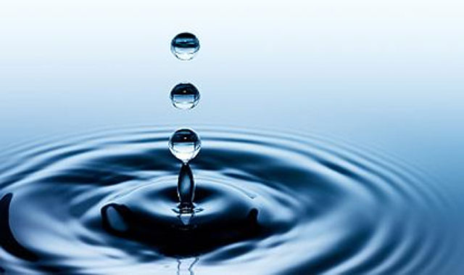
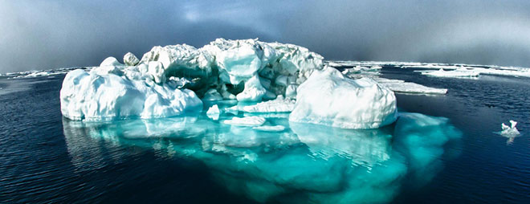
Water
Water is a necessity, a resource, and a factor in pollution because of it’s unique properties:
High capacity to absorb and store heat
Universal solvent
High surface tension
Less dense as a solid
Penetrated by sunlight

Slide 3
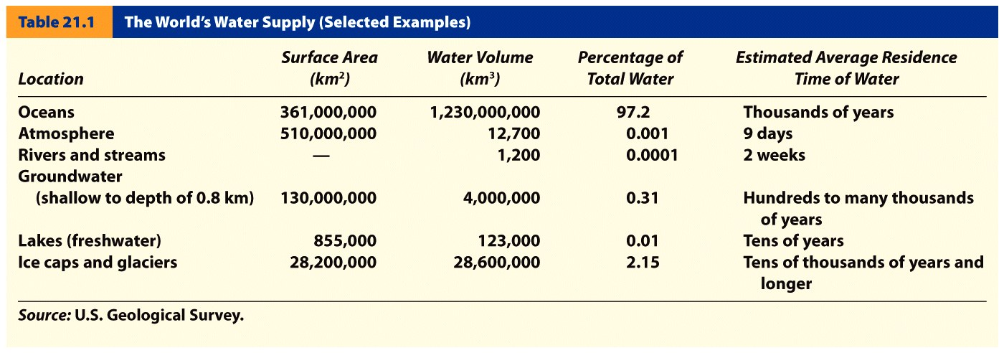
Global Perspective
Problem: Growing global water shortage linked to our food supply
97% of the hydrosphere is in the oceans and 2% trapped in glaciers or ice sheets
0.001% of the hydrosphere is in the atmosphere at any given time and that small amount drives weather systems that deliver freshwater through precipitation

Slide 4
Global Perspective
We currently use more than half of the world’s reliable runoff of surface water and could be using 70-90% by 2025.
About 70% of the water we withdraw from rivers, lakes, and aquifers is not returned to these sources.
Irrigation is the biggest user of water (70%), followed by industries (20%) and cities and residences (10%).

Slide 5
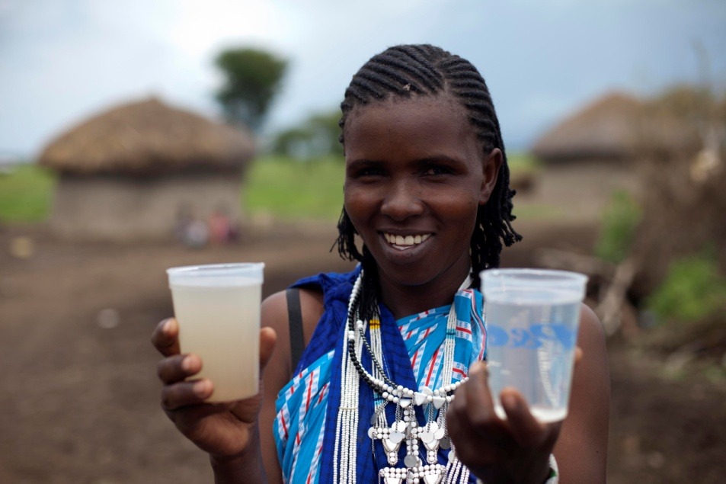
Is it safe to drink?
Safe in the U.S. and developed countries
Some discomfort may result if not used to local water bacteria
Fresh potable water is a major
issue in developing countries
- even in cities
India
Nigeria
Sudan, etc.

Slide 6
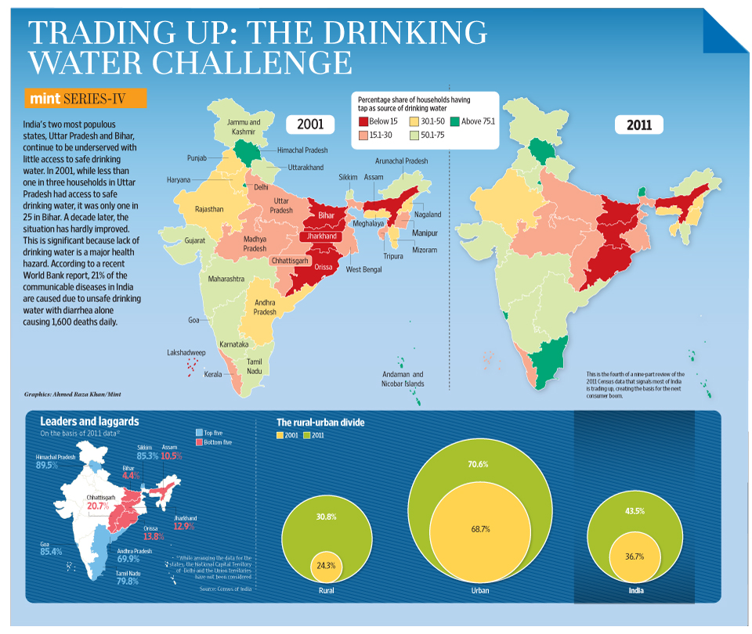

Slide 7
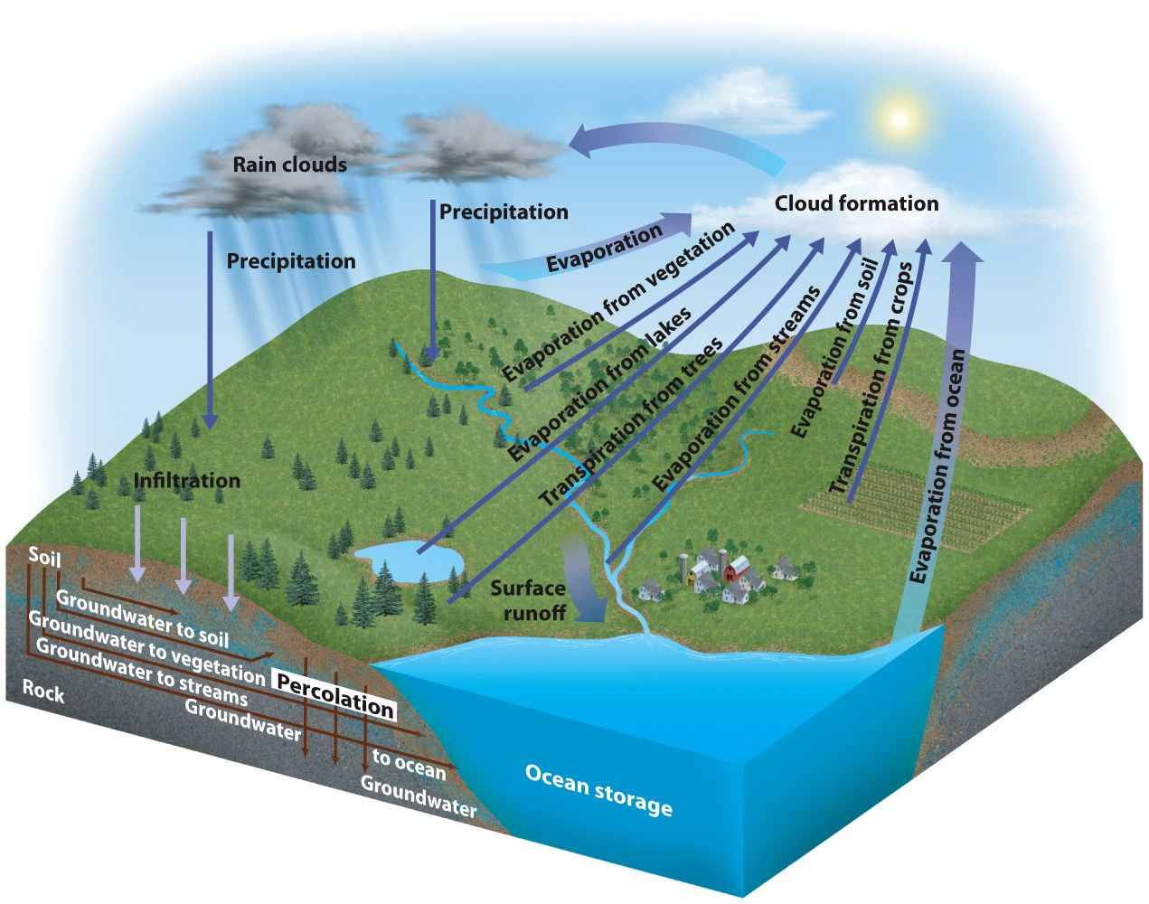
Hydrologic Cycle

Slide 8
Hydrologic Cycle
The hydrologic cycle is a continuous cycle that balances evaporation and precipitation
Some precipitation infiltrates the ground and is stored in soil and rock (groundwater).
The land from which the surface water drains into a body of water is called its watershed or drainage basin
Water that does not sink into the ground or evaporate into the air runs off (surface runoff) into bodies of water.

Slide 9
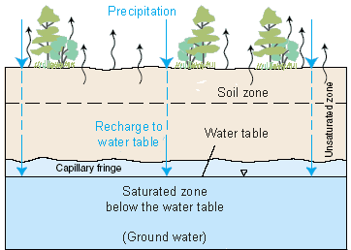
Groundwater and Streams
Groundwater refers to the water below the water table
Where soil or rock is saturated is called the zone of Saturation
The area of permeable soil or rock above the water table is called the zone of aeration
Locations where surface waters infiltrate into the ground are recharge zones

Slide 10
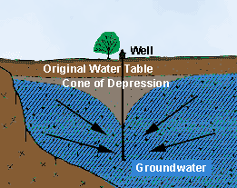
Groundwater and Streams
An aquifer is an underground zone from which groundwater can be obtained
When water is pumped
from an aquifer it forms a cone
of depression
Any places where groundwater
flows or seeps out are discharge
zones
Natural springs or wells

Slide 11
Groundwater and Streams
Freshwater on the surface often occurs in the form of streams that carry water from a source to a larger body of water
Effluent Stream
A type of stream where flow is maintained during the dry season by groundwater seepage into the channel
Influent Stream
A type of stream that is everywhere above the groundwater table and flows in direct response to precipitation

Slide 12
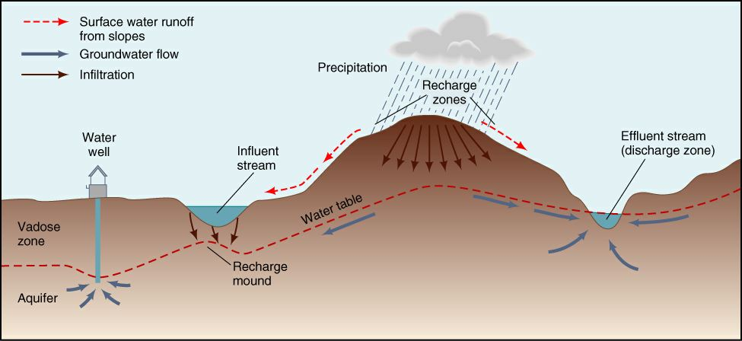
Groundwater and Streams

Slide 13
Groundwater and Streams
Both locations of freshwater should be considered part of the same resource.
Nearly all surface water environments have connections to ground water
Example: withdrawal of groundwater can lower stream flow or lake levels
Pollution can spread from one source to the other

Slide 14
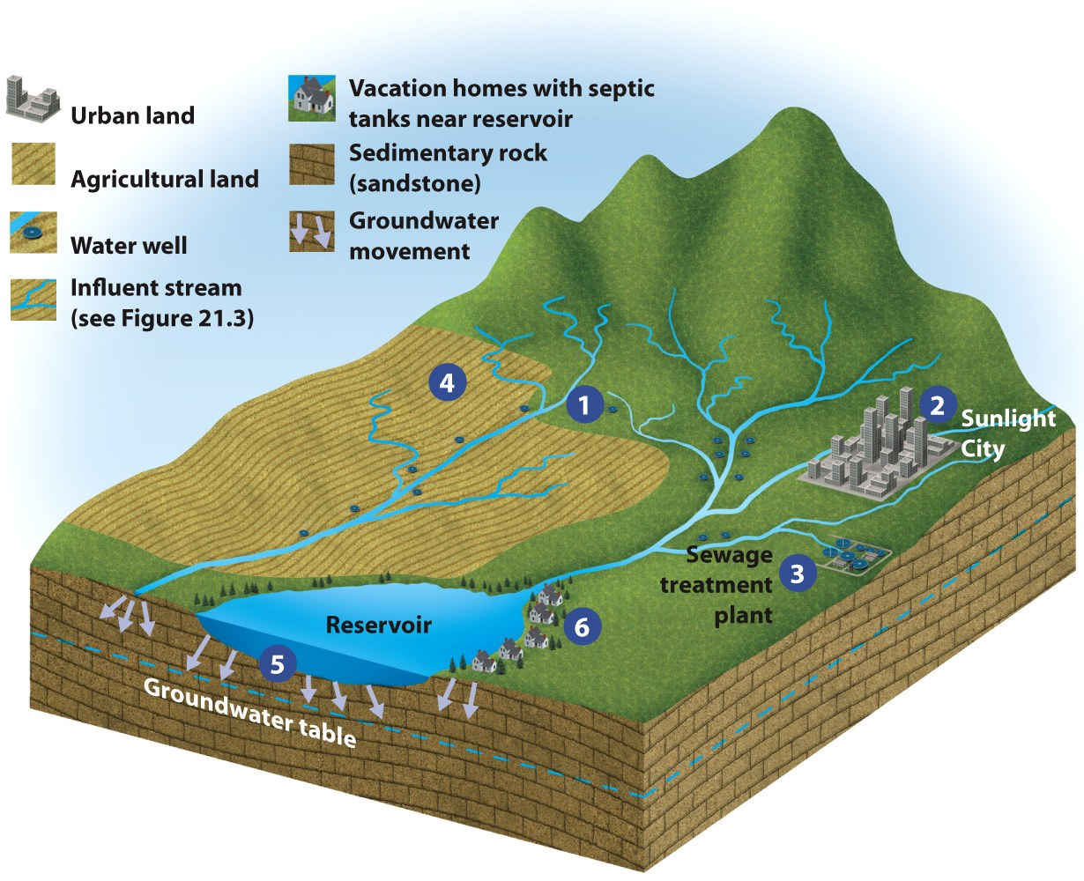
Groundwater and Stream Interactions

Slide 15
Water Supply and Use
Water supply at any point on the land surface depends on several factors in the hydrologic cycle
rates of precipitation, evaporation, transpiration
stream flow
subsurface flow
Water budget
A model that balances the inputs, outputs, and storage of water in a system.
Precipitation - evaporation = runoff

Slide 16
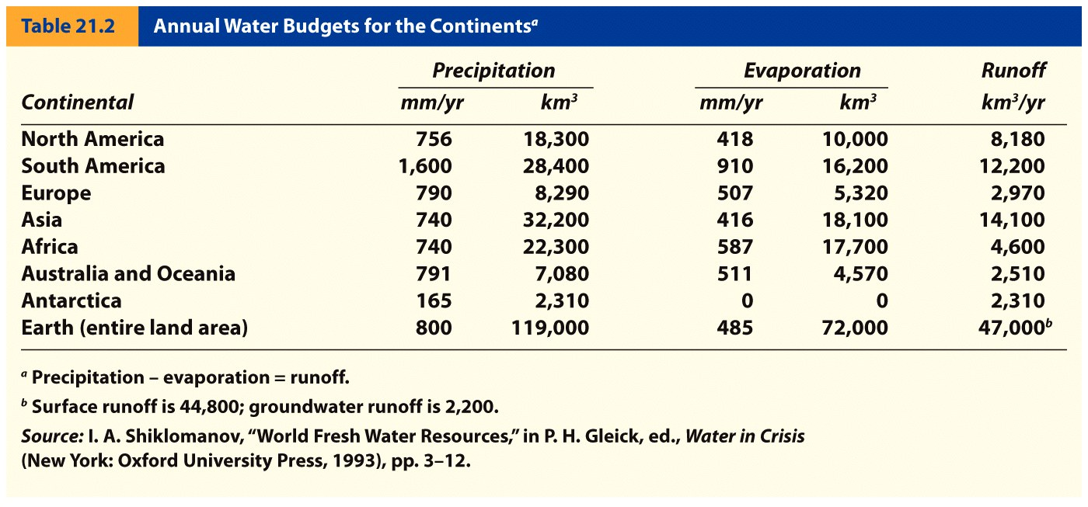
Water Supply and Use

Slide 17
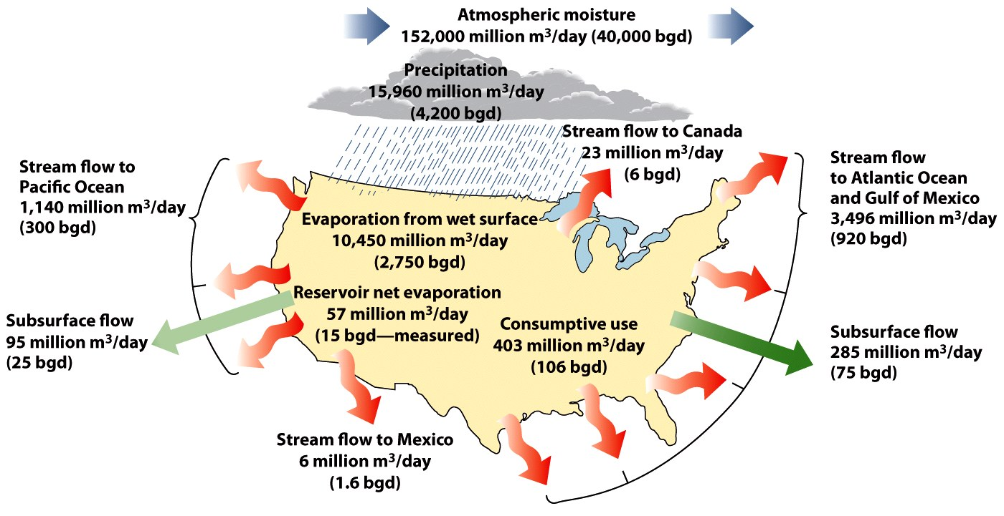
Water Supply and Use
Amount of water vapor passing over the US every day equals ~ 152,000 million m³
10% falls as precipitation (66% of which is evaporated or transpired)
Only 34% enters surface or groundwater

Slide 18
Water Supply and Use
In developing water budgets for water resources management it is useful to consider annual precipitation and runoff patterns.
Potential problems can be predicted in areas where average runoff and precipitation low
Total storage of runoff not possible because of evaporative losses
Because there are large annual and regional variations in stream flow, even areas with high precipitation and runoff may suffer from droughts.

Slide 19
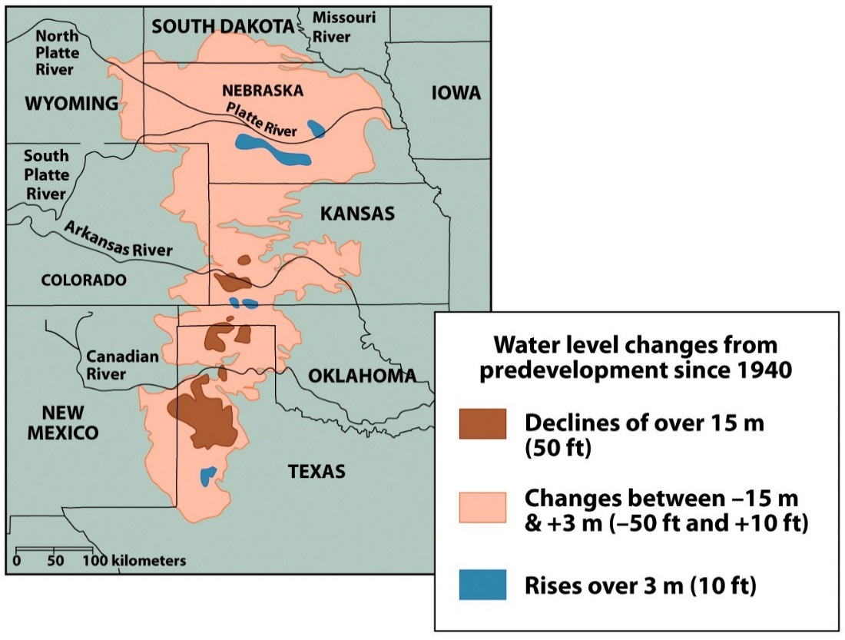
Water Supply and Use
½ the people in the US use groundwater as a primary source of drinking water
In many parts of the
country withdrawal from
wells exceeds natural inflow
Overdraft
Changes to river basins
Land subsidence

Slide 20
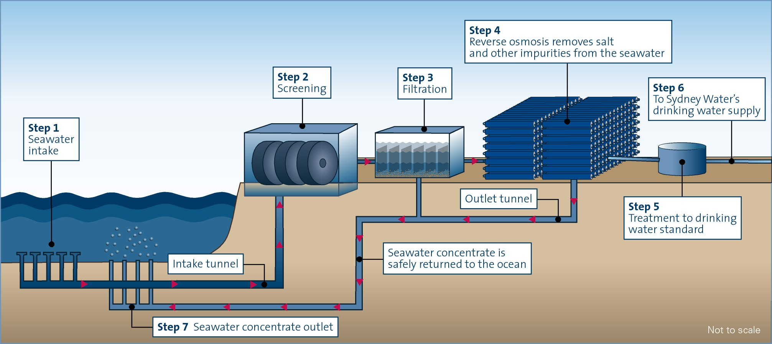
Alternative Water Sources
Seawater is 3.5% salt
Desalination is a technology to remove salt from water
Must be reduced to 0.05% salt to be fresh water
Requires large amounts of energy, tied to fuel prices and fossil fuel use
Has place value- price increases quickly with transport distance
Discharge may affect local salinity

Slide 21
Water Use
Off-stream use:
water removed from it’s source for use e.g. irrigation, drinking, washing
In-stream use:
The use of water without removing it from its source
Example: the use of rivers for navigation, hydroelectric power generation, fish and wildlife habitats and recreation

Slide 22
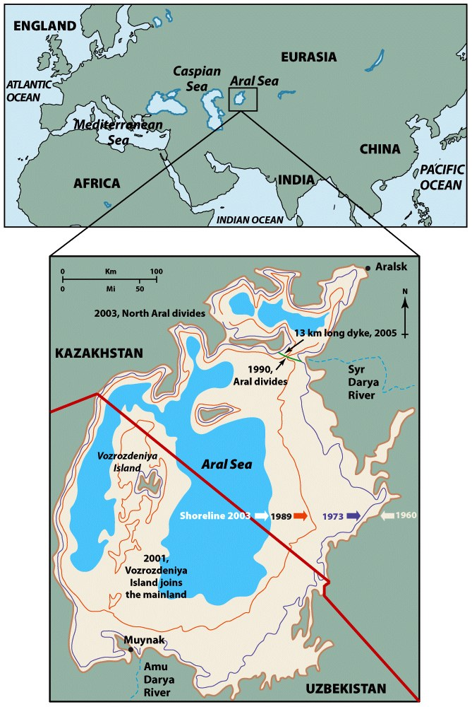
Water Use
Problems with off-stream use include determining how much water can be removed without damaging a stream ecosystem.
Example: On the Aral sea locals diverting water for agriculture have caused the sea to dry up
Surface area of sea reduced 90% in 50 years

Slide 23
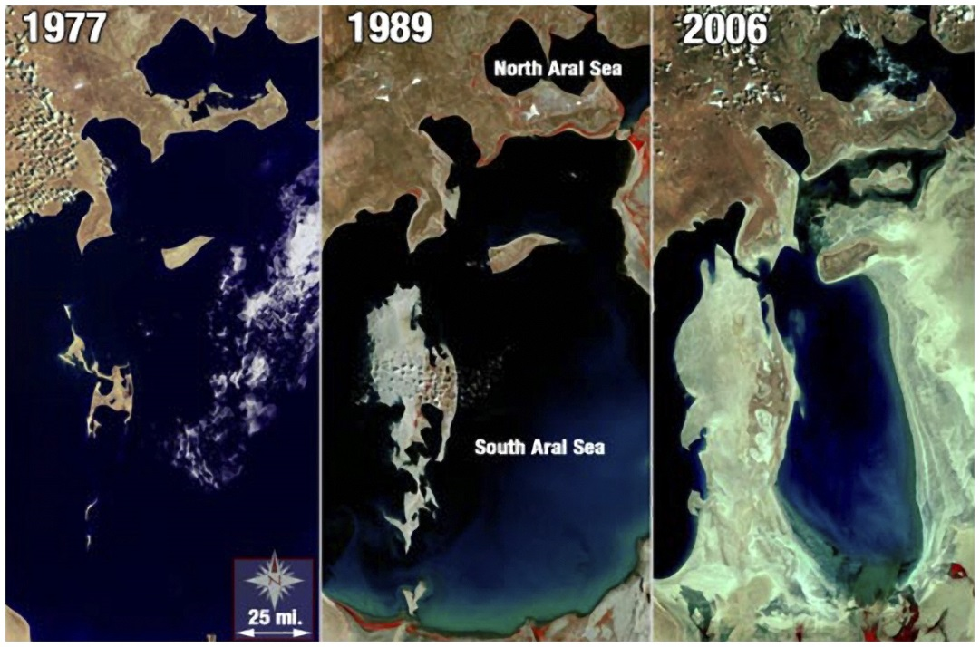
Aral Sea Water Issues
Salt content of the water has increased
Dust storms have increased in strength and occurrence because of the dry salt flats
Climate change
Colder winters
Warmer summers
Loss of fishing and tourism

Slide 24
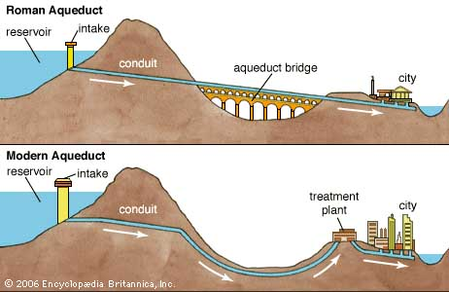
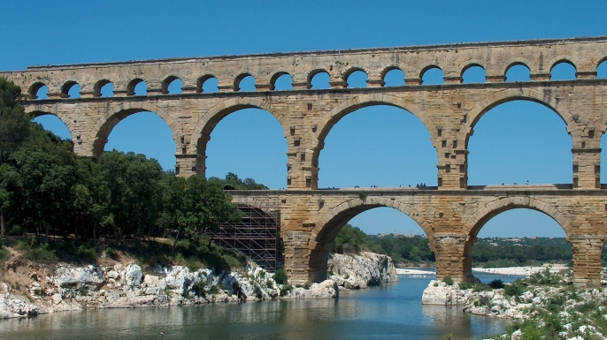
Transport of Water
Ancient civilizations constructed canals and aqueducts to transport water
From distant rivers to where it was needed
In modern civilization water moved from areas of abundant rain and snow fall to areas of high usage
California moves water from north to south
New York City has had to obtain water from farther and farther away

Slide 25
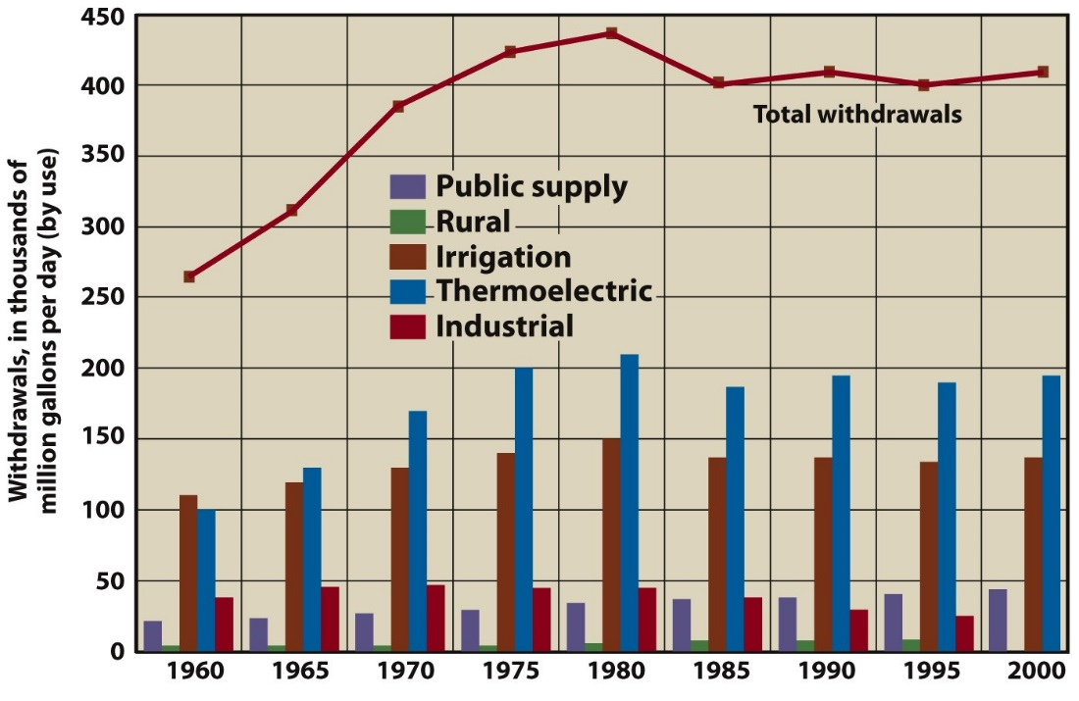
Water Use Trends
Withdrawal of surface water far exceeds withdrawal of groundwater
Since 1980 use has decreased and leveled off
Suggests improvement in water management and conservation

Slide 26
Water Conservation
The careful use and protection of water resources
Involves the quantity of water used and quality
Important component of sustainable water use
Domestic use accounts for about 10% of total national water withdrawals
Concentrated in urban areas
May pose major local problems
Improved irrigation could reduce agricultural withdrawals to 30%

Slide 27
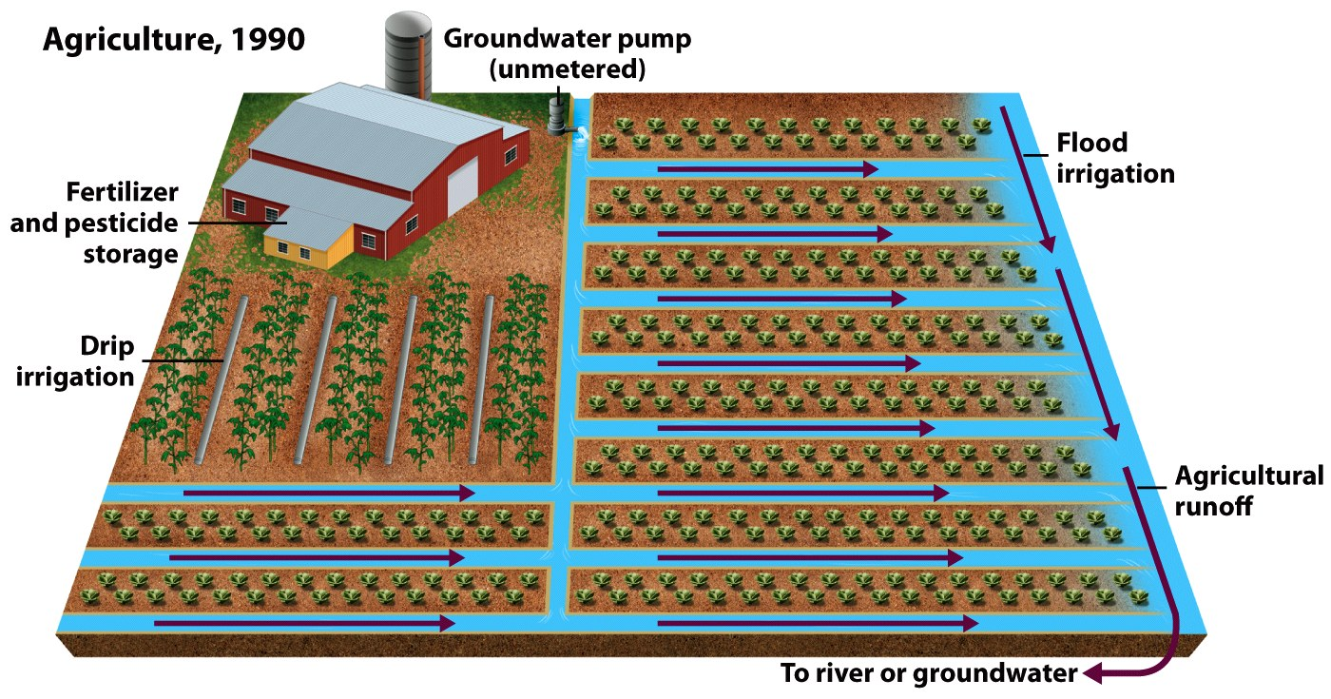
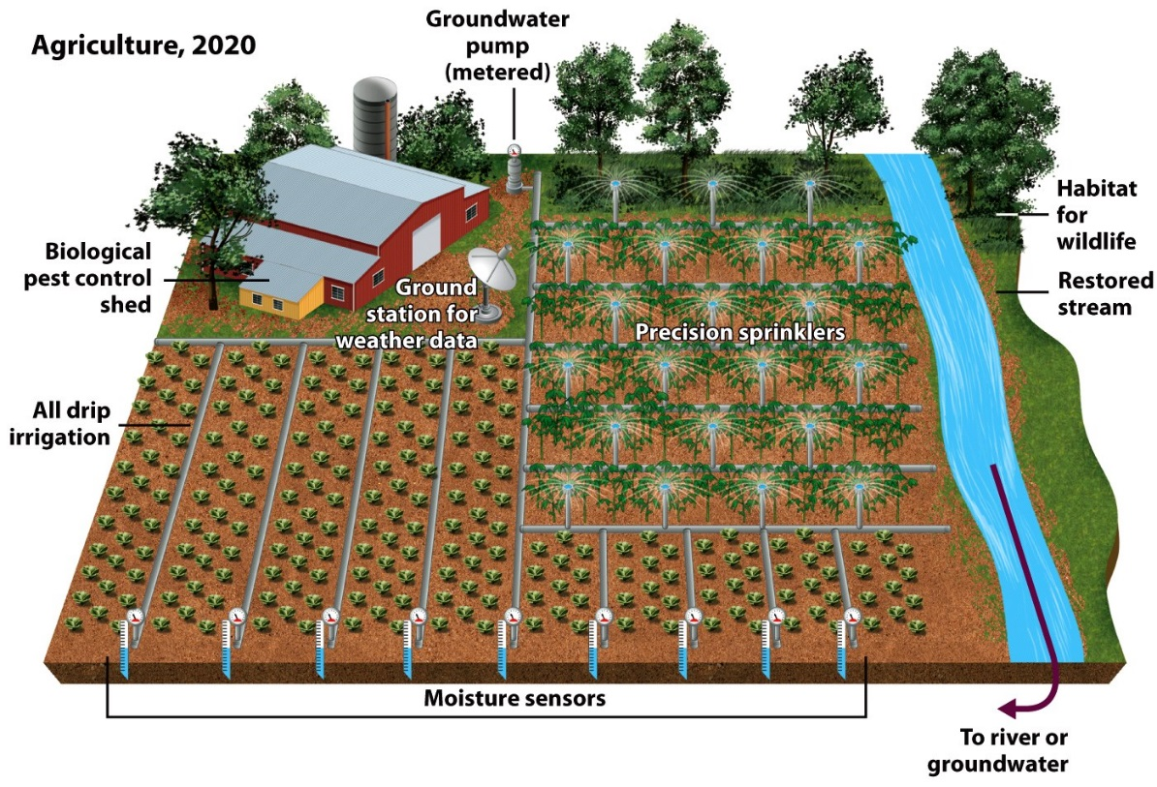
Water Conservation

Slide 28
Perception and Water Use
Perception of water is based partly on its price and availability.
If water is abundant and inexpensive, we don’t think much about it.
If water is scarce or expensive, it is another matter.
People in Tucson pay about 100% more for water than people in Phoenix.
Tucson residents use less water per person per day

Slide 29
Sustainability and Water Management
From a water supply use and management perspective, sustainable water use defined as:
Use of water resources by people in a way that allows society to develop and flourish into an indefinite future
Without degrading the various components of the hydrologic cycle or the ecological systems that depend on it.

Slide 30
Water Management
Management plans focus on ensuring a clean water supply as population and water demands increase
Potential options for minimizing water supply problems include:
Alternative water supplies
Better management of existing supplies
Towing icebergs
Variable water source approaches use several options for providing water to a population along with a permanent conservation plan

Slide 31
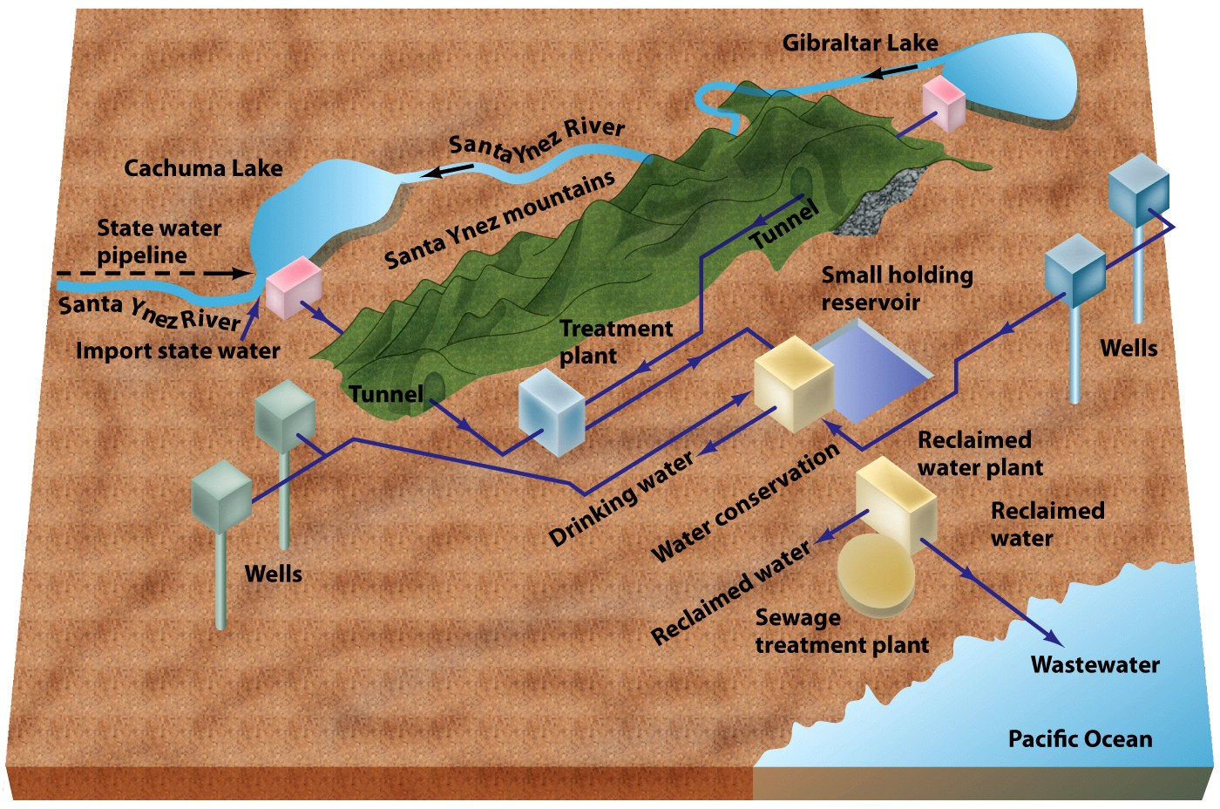
Water Management

Slide 32
Master Plan for Water Management
New philosophies of water management suggest that plans must be based on geologic, geographic, and climate factors that are considered with the economic, social and political status of the population being served
Assumes natural changes in freshwater supplies
Creates emergency plans for water shortages
Identifies alternative sources that may need extra planning to gain access
Considers environmental impacts

Slide 33
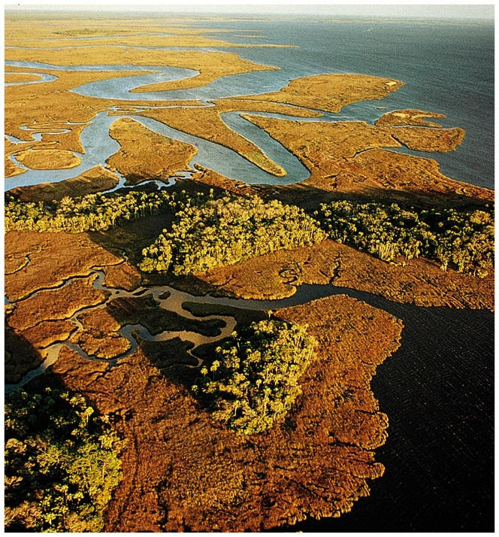
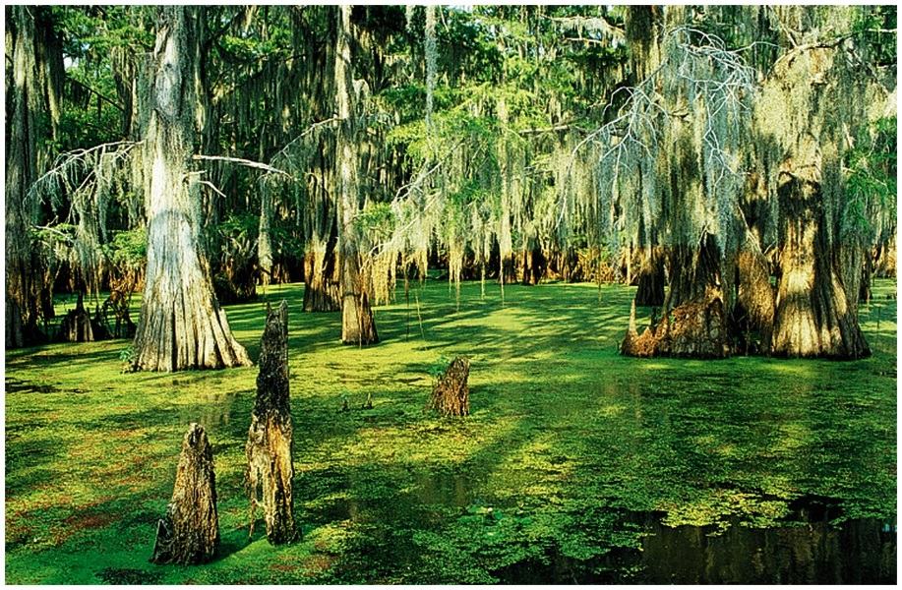
Wetlands
Comprehensive term for landforms such as salt marshes, swamps, bogs, prairie potholes, and vernal pools.
Common feature is that they are wet at least part of the year
Soils lack oxygen and have poor drainage
Vegetation is well adapted to anaerobic, wet soil conditions

Slide 34
Natural Service Functions of Wetlands
Natural sponge for water. (reducing flooding)
Areas of groundwater recharge or discharge.
Primary nursery grounds for fish, shellfish, aquatic birds, and other animals.
Natural filters that help purify water.
Hotspot for nutrient cycling
Buffer zone for coastal communities affected by storms

Slide 35
Wetland Concerns
Freshwater wetlands are currently threatened in many environments
In the past 200 years 50% of the wetlands in the United States have disappeared, as much as 90% of the freshwater wetlands
Human modification has caused the largest damage to domestic wetlands
Dikes
Levees
Draining for agriculture
Filling for industrial development

Slide 36
Wetland Restoration
Preservation efforts have protected almost all coastal marshes in the United States
Restoration efforts include flooding to allow natural water flow, sediment accretion, and restoring vegetation
New wetlands have been constructed around agricultural areas to filter run-off
Current legislation requires that wetlands destroyed by development must be replaced elsewhere

Slide 37
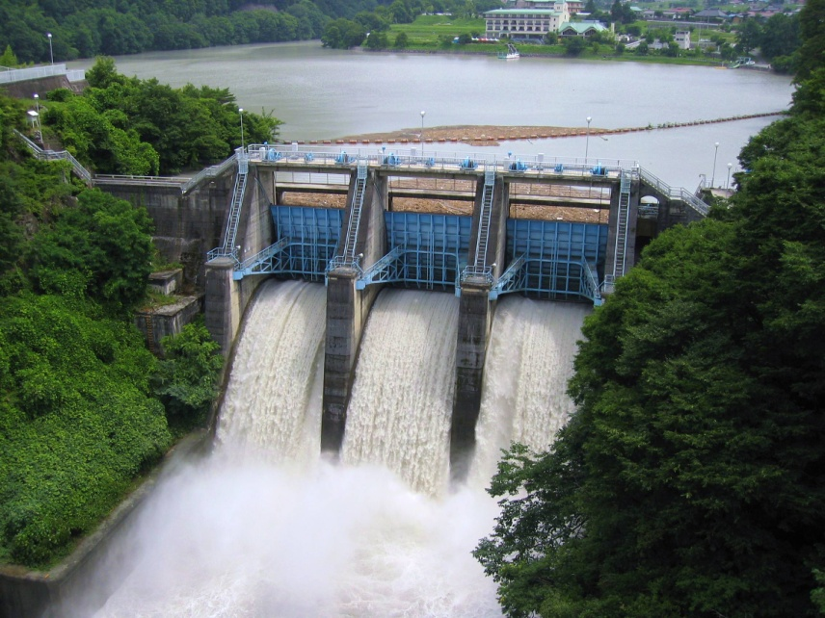
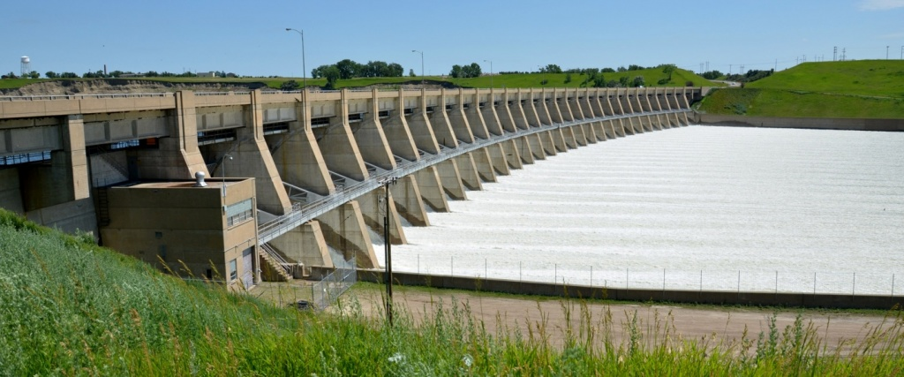
Dams and their Environment
Dams and their reservoirs generally are designed to be multifunctional.
Used for recreational activities
Generating electricity
Providing flood control
Ensuring a more stable water
supply

Slide 38
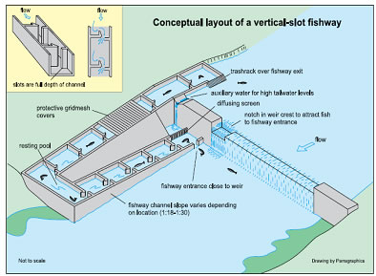
Dams and their Environment
The environmental effects of dams include:
Loss of land, cultural resources, and biological resources in the reservoir area.
Flood hazards should they fail
Lack of natural sediment flow.
Changes in water flow
Fragmentation of ecosystems
Restricted movement of nutrients and organisms

Slide 39
Dams and their Environment
Despite the environmental concerns, dams are necessary to support the water demands of some populations
Canals have been utilized to direct some water from reservoirs in an attempt to create water flow to surrounding areas but they do no recreate the natural interaction of streams on the surface
Dam removal provides an option for restoring streams

Slide 40
Dam Removal
Dam removal can sometimes be more expensive than the construction
Trapped sediment in the reservoir must be carefully handled so it is not released all at once and stops water flow downstream
Gradual release of reservoir water is the most effective way to restore water in the downstream environments safely and without too much erosion or disruption of wildlife

Slide 41
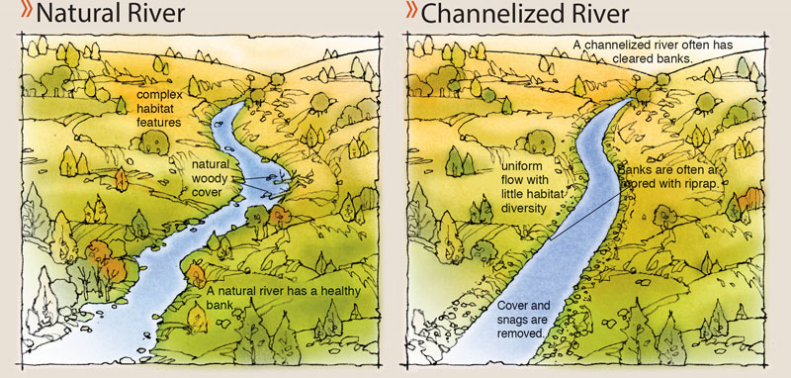
Channelization
Channelization of streams consists of straightening, deepening, widening, clearing, or lining existing stream channels.
Engineering technique that has been used to control floods, improve drainage, control erosion, and improve navigation

Slide 42
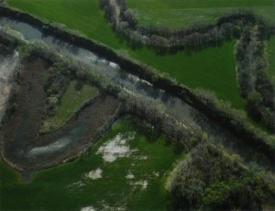
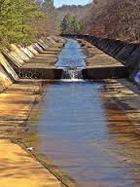
Channelization and the Environment
Negative Impacts
Degradation of the stream’s hydrologic qualities;
nearly all riffle flow, resulting in loss of important fish habitats.
Removal of vegetation along the watercourse, which removes wildlife habitats and shading of the water.
Downstream flooding where the channelized flow ends.
Damage or loss of wetlands.
Aesthetic degradation.

Slide 43
Flooding
Flooding along streams and rivers can be as natural and as beneficial as wildfires in a forest
Areas covered by water during a flood (floodplain) receive beneficial nutrients from river sediments
Flooding is only an issue when human lives and man-made structures are damage
Urbanization has increased run-off and chances of flooding in urban areas

