Slide 1
Water Pollution and Treatment
Unit 5: AP Environmental Science (Chapter 21)

Slide 2
Water Pollution
Pollution refers to a degradation from a normal state
Analysis of pollution includes:
Intended use
Departure from the norm
Effects on the public health
Ecological impacts
Some materials can be considered pollutants in one situation but be considered beneficial in another

Slide 3
Water Pollution
Primary water pollution problem worldwide is the lack of clean, disease free drinking water
Outbreaks of waterborne disease affects several billion people worldwide (Examples: cholera, crytosporidium)
Increasing population often results in the introduction of more pollutants.
Increased demands on finite water resources
~36 million people in US supplied with water from systems that violated federal standards
EPA sets thresholds and limits on some but not all pollutants
700 identified drinking water contaminants

Slide 4
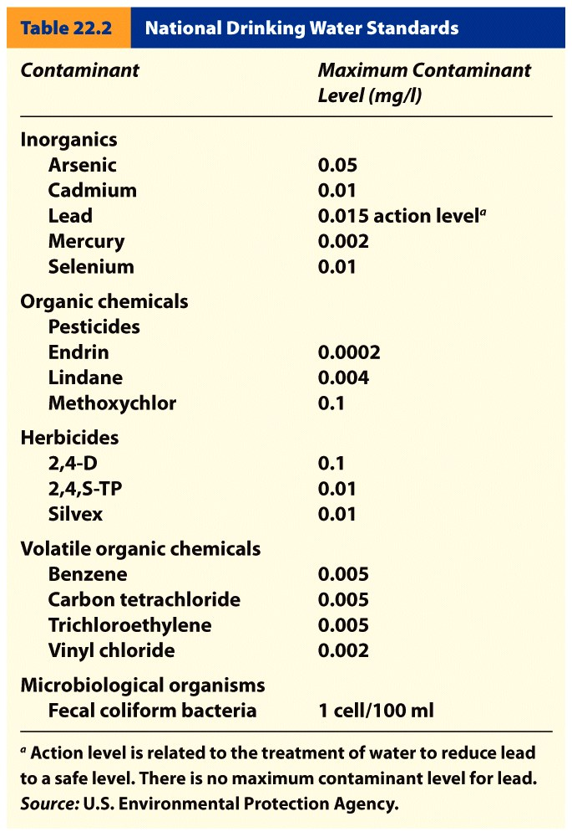
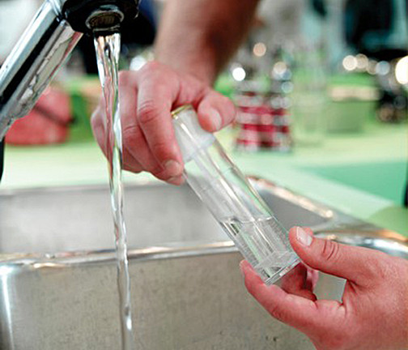
Water Pollution

Slide 5
Dissolved Oxygen
Bacteria in streams decompose dead organic matter and this uses oxygen.
Larger amount of bacterial activity = little oxygen in the water available to fish and other organisms
Can be reduced to levels so low that all other organisms die
High Bacteria cause a high Biochemical Oxygen Demand (BOD – common water quality metric).
Dissolved oxygen content of less than 5 mg/l of water is considered “polluted”

Slide 6
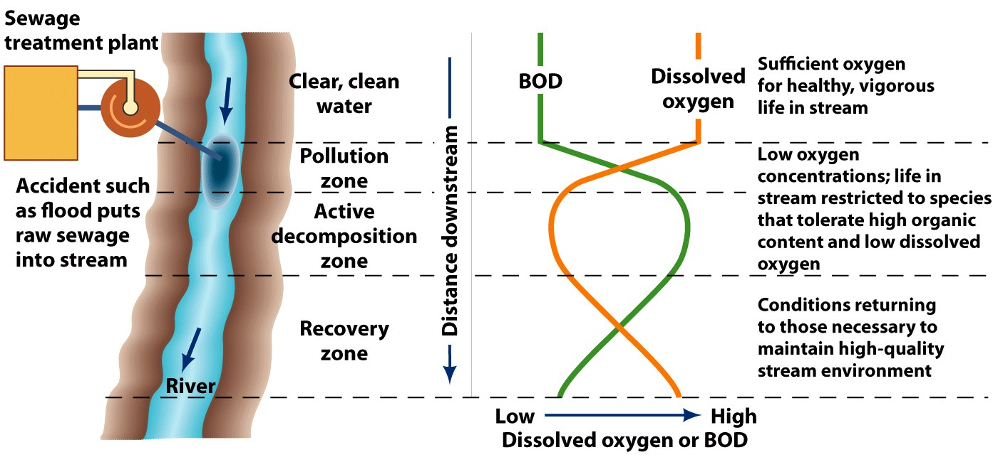
Biochemical Oxygen Demand
When a spill takes place three zones are identified:
1. A pollution zone, where a high BOD exists.
2. An active decomposition zone, where the dissolved oxygen content reaches a minimum.
3. A recovery zone, where the dissolved oxygen increases and the BOD is reduced.

Slide 7
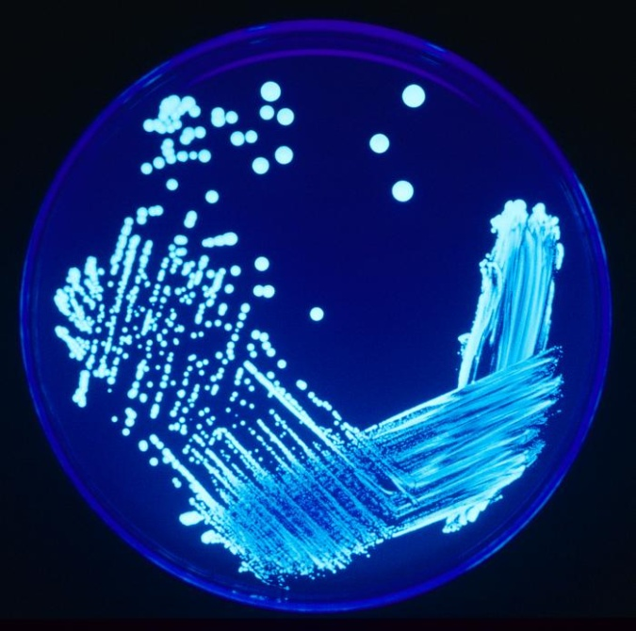
Waterborne Disease
Occurrences of waterborne diseases range with the level of development and water treatment in areas affected
Effects of waterborne diseases range from an upset stomach to death
Common waterborne diseases:
Cholera
Cryptosporidium
Legionella
Dysentery
E.coli
SARS

Slide 8
Waterborne Disease
Fecal Coliform – Intestinal bacteria
we use fecal coliform bacteria as a standard measure and indicator of disease potential
Indicates that fecal matter is present
Normal constituent of human and animal intestines
Escherichia coli (E. coli)
Responsible for human illness and death
Eating contaminated food or drink
Presence of fecal coliforms may also indicate presence of
Virus like hepatitis

Slide 9
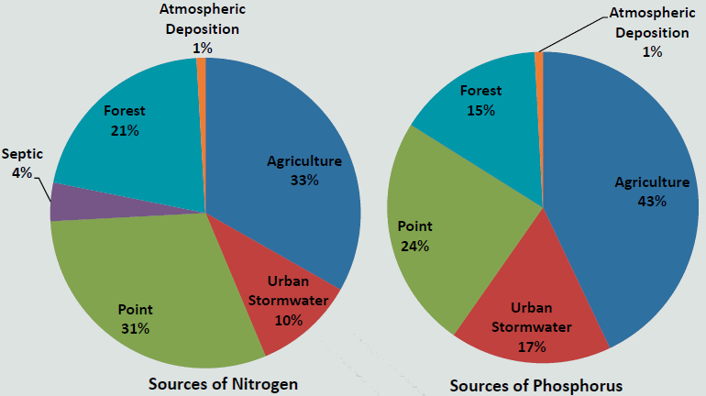
Nutrient Pollution
Two important nutrients that cause water pollution are phosphorous and nitrogen
Highest levels found in agricultural areas in response to fertilizer use and presence of agricultural animal waste
Nutrient pollution sources in the Chesapeake Bay region

Slide 10
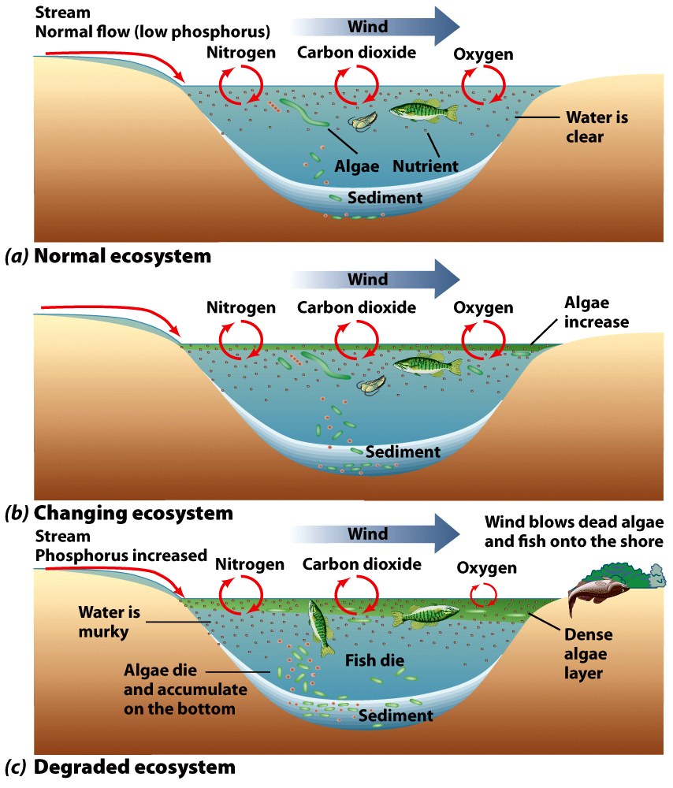
Eutrophication
The process by which a body of water develops a high concentration of nutrients.
Causes a large growth in aquatic plants and photosynthetic bacteria and algae.
The bacteria and algae then die
As they decompose BOD increases
Oxygen content becomes low and all other organisms die

Slide 11
Eutrophication
Cultural eutrophication
Human processes that add nutrients to water
Solution is to ensure that high concentrations of nutrients do not enter water
Accomplished by
use of phosphate-free detergents
controlling nitrogen runoff
disposing or reusing treated wastewater
advanced water treatment methods

Slide 12
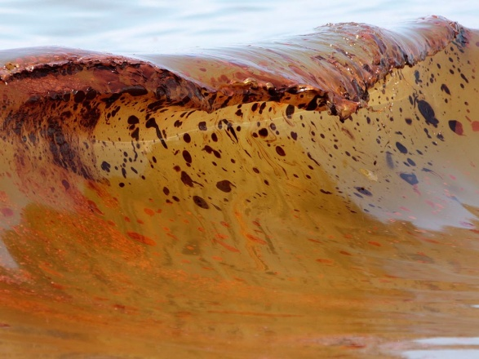
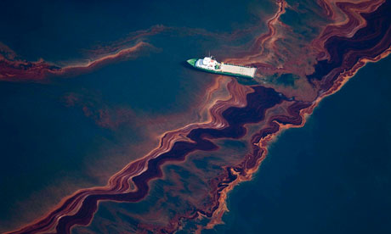
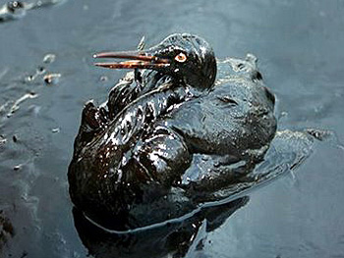
Oil Pollution
Oil discharged into surface water has caused major pollution problems.
Large spills make headlines, but normal shipping activities probably release more oil over a period of years than is released by a single spill.

Slide 13
Sediment Pollution
By volume and weight is the greatest water pollutant
Two fold problem
Results from erosion, which depletes a land resource (soil) at its site of origin
Reduces the quality of water resource it enters
Land use changes result in erosion and sedimentation
Forested areas more stable
Agricultural practices can lead to large soil erosion loss
Large quantities of sedimentation during construction phase of urbanization – notice straw booms at sites

Slide 14
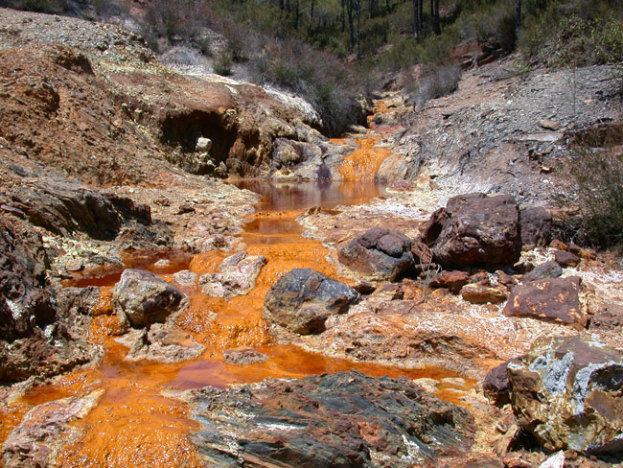
Acid Mine Drainage
Refers to water with a high concentration of sulfuric acid that drains from mines.
Coal mines often associated with pyrite (iron sulfide)
When it come into contact with oxygen and water it weathers through oxidation
A product of weathering is sulfuric acid
Water runs through the mine tailings

Slide 15
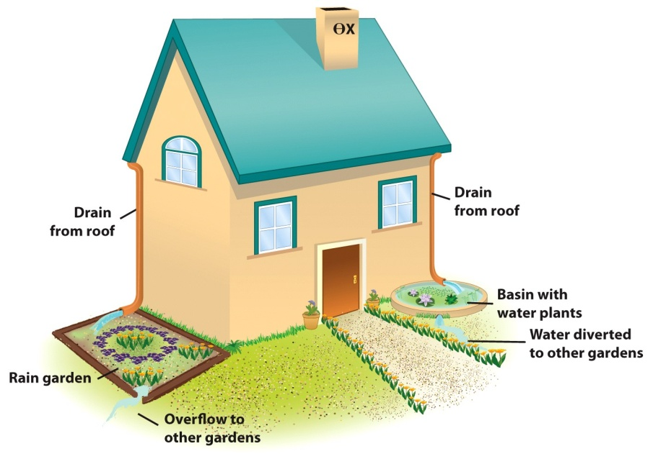
Surface Water Pollution
Two approaches to dealing with surface water pollution are
1. To reduce the sources
2. To treat the water to remove pollutants or convert them to forms that can be disposed of safely.

Slide 16
Groundwater Pollution
Pollution leaking from buried gasoline tanks from service stations
Wide spread problem
Many thousands of old tanks removed and surrounding groundwater and soil treated
Disposal of soil, vapor extraction of water and use of microorganisms (bioremediation)
Some pollutants, such as gasoline, are lighter than water and thus float on the groundwater.
Some pollutants are heavier than water and sink or move downward through groundwater.

Slide 17
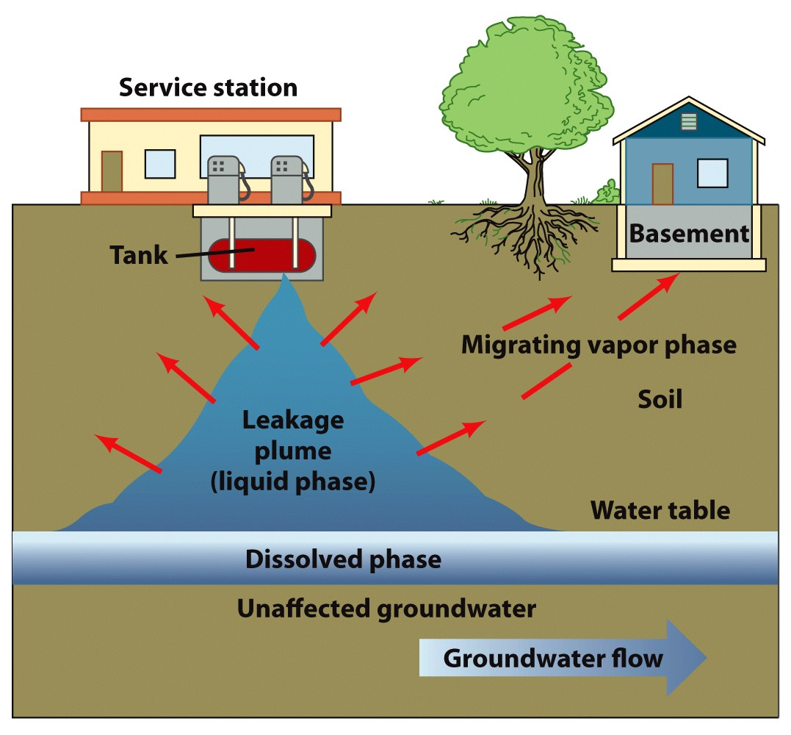
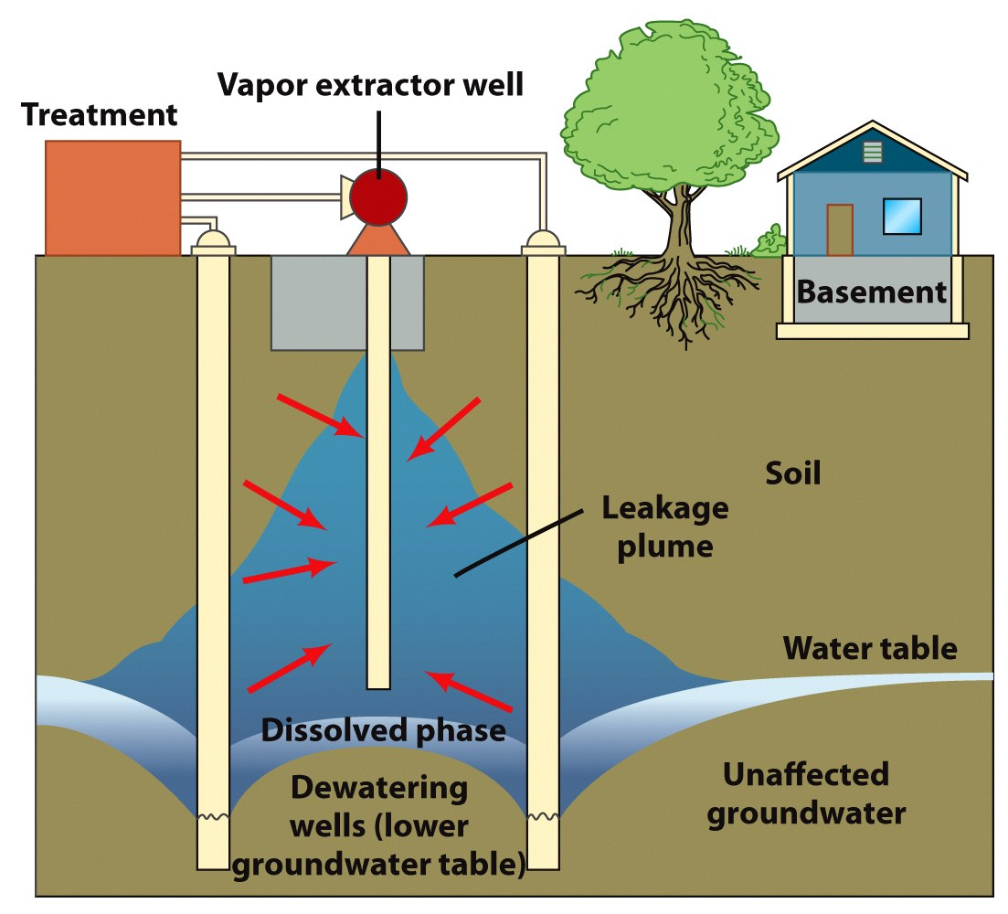
Groundwater Pollution

Slide 18
Groundwater vs. Surface water Pollution
Pollution in groundwater differs from surface water pollution in several ways
Groundwater lacks oxygen but may provide environment for anaerobic bacteria
Channels through which groundwater moves often small and variable
Rate of movement is low and opportunity for dispersion and dilution limited

Slide 19
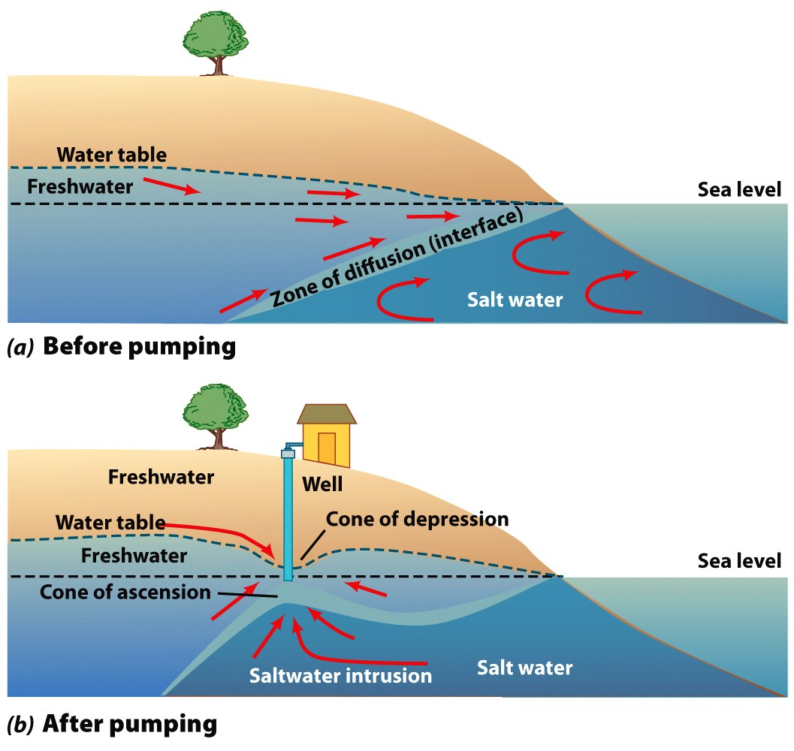
Groundwater vs. Surface water Pollution
Saltwater intrusion has become a problem for some coastal communities
Must pump water from a deeper aquifer
Below and isolated from saltwater
Most serious problem is shallow aquifer pollution associated with urbanization
Pollutants enter surface waters then migrate downward

Slide 20
Wastewater Treatment
Water used for industrial and municipal purposes is often degraded during use
Addition of suspended solids, salts, nutrients, bacteria, and oxygen demanding material.
Water must be treated before released
Wastewater treatment
$20 billion a year industry
Conventional methods; septic tanks and centralized treatment

Slide 21
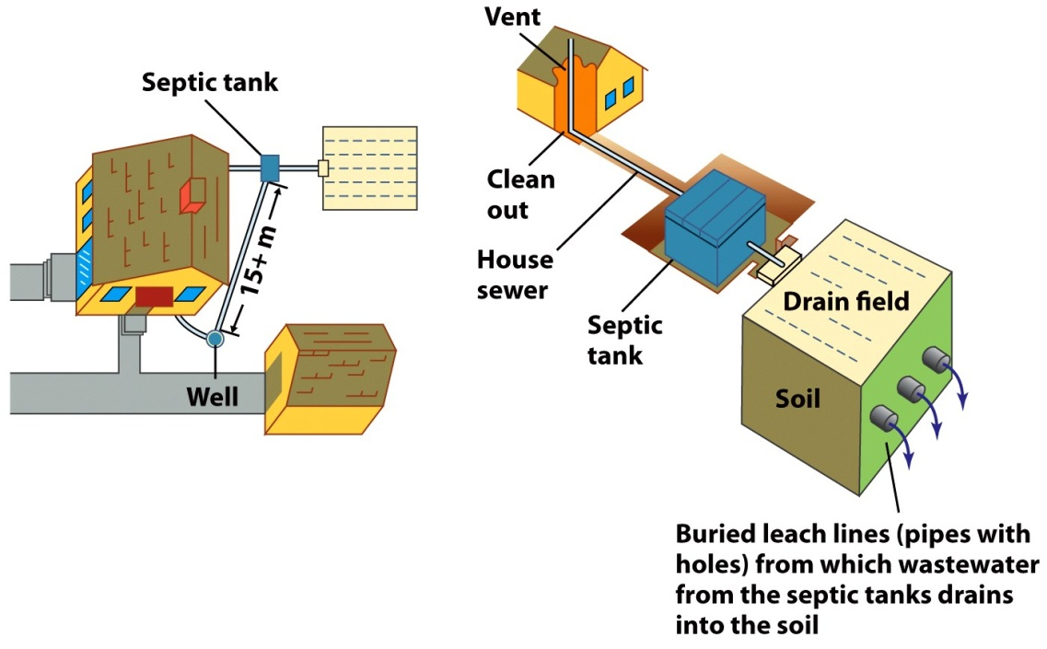
Septic Tank Disposal
Basic parts of a septic-tank disposal system:
Sewer line from house to underground tank
Tank separates solids from liquids
Digest and store solids
Liquid sent to absorption field
By the time water reaches any fresh water it “should” be safe.

Slide 22
Wastewater Treatment Plants
Specially designed plants that accept municipal sewage from homes, businesses and industrial sites.
Delivered to plant by network of pipes
Following treatment, they discharged into surface water
Main purpose is to breakdown and reduce BOD and kill bacteria with chlorine
Methods usually divided into three categories:
Primary treatment
Secondary treatment
Advanced wastewater treatment
Primary and secondary required by law

Slide 23
Primary Treatment
Incoming raw sewage enters plant
Passes through series of screens
Remove large floating organic material
Next enters a grit chamber
Sand, small stones and grit removed
Then enters sedimentation tank
Particulate matter settles out to form a sludge
Sludge is removed and transported to a digester
Primary treatment removes ~35% of BOD

Slide 24
Secondary Treatment
Most common treatment, activated sludge.
Wastewater from primary sedimentation tank enters the tank
Then enters the final sedimentation tank
Sludge settles out
Some activated sludge used again in aeration
Most of the sludge transported to digester
Wastewater from final tank is disinfected with chlorine and discharged
Secondary treatment removes ~90% of BOD
Sludge from the digester is dried and disposed of in a landfill or applied to improve soil.

Slide 25
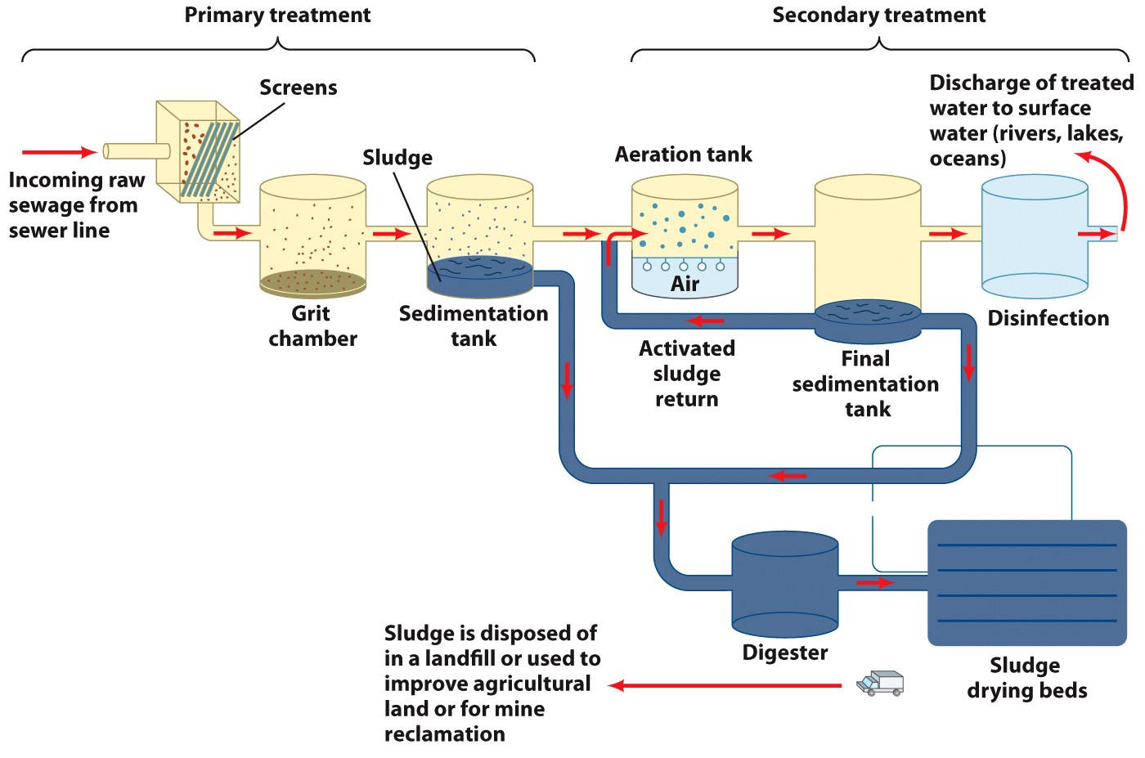

Slide 26
Advanced Treatment Plants
Additional pollutants can be removed by adding more treatment steps.
Sand filters, carbon filters and chemicals applied to assist removal process.
Treated water can then be used for agricultural or municipal irrigation (referred to as “Grey Water” – most of this is currently discharged to sea)
Chlorine Concerns
Chlorine is very effective in killing the pathogens that historically caused outbreaks
Chlorine treatment byproducts may pose hazard to fish and cancer risk to humans.
(This is a HUGE risk and benefit issue)

Slide 27
Waste Renovation and Conservation Cycle
Major steps in the cycle:
1. Return of treated wastewater to crops via a sprinkler or other irrigation system.
2. Renovation, or natural purification by slow percolation of the wastewater into the soil, to eventually recharge the groundwater resource with clean water.
3. Reuse of the treated water, which is pumped out of the ground for municipal, industrial, institutional, or agricultural purposes.

Slide 28
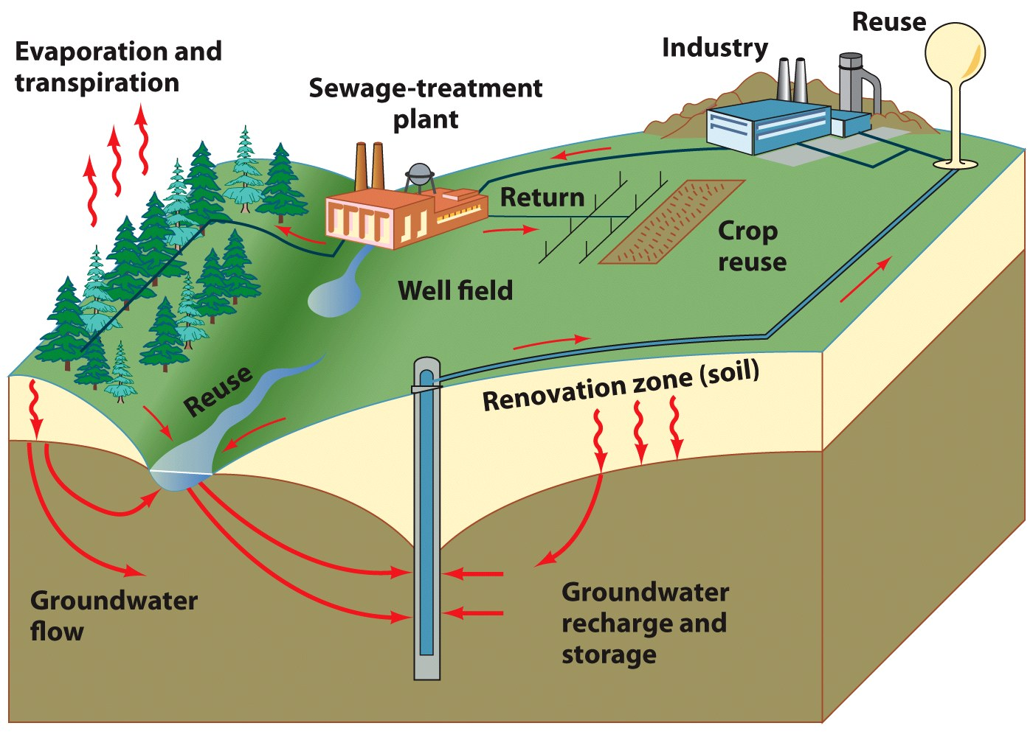

Slide 29
Waste Renovation and Conservation Cycle
Technology for wastewater treatment is rapidly evolving.
Resource recovery wastewater treatment plant
Refers to the production of resources such as methane and ornamental plants.
The process
1. The wastewater is run through filters to remove large objects.
2. The water undergoes anaerobic processing.
Produces methane
3. The nutrient rich water flows over an incline surface containing plants

Slide 30
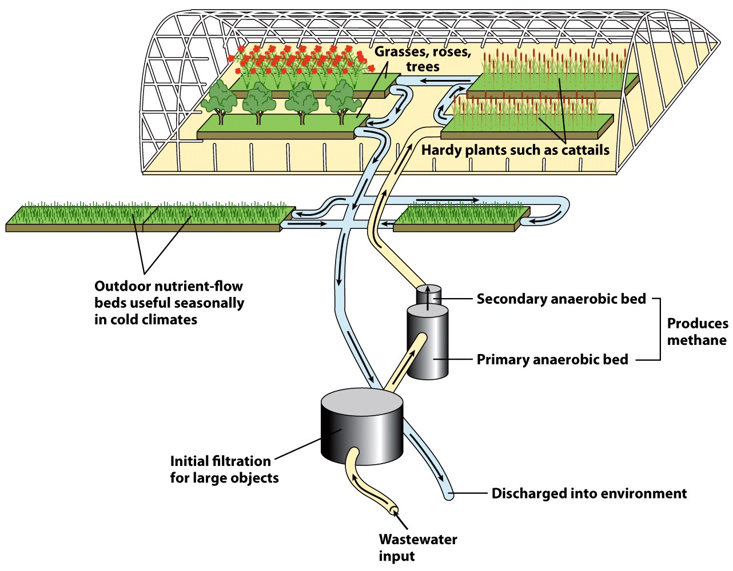

Slide 31
Wastewater and Wetlands
Wastewater applied to wetlands can be an effective management tool for naturally filtering:
Stormwater runoff (metals, nitrate, BOD, pesticides, oils).
Industrial wastewater (metals, acids, oils, solvents).
Agricultural wastewater and runoff (BOD, nitrate, pesticides, suspended solids).
Mining waters (metals, acidic water, sulfates).
Groundwater seeping from landfills (BOD, metals, oils, pesticides).

Slide 32
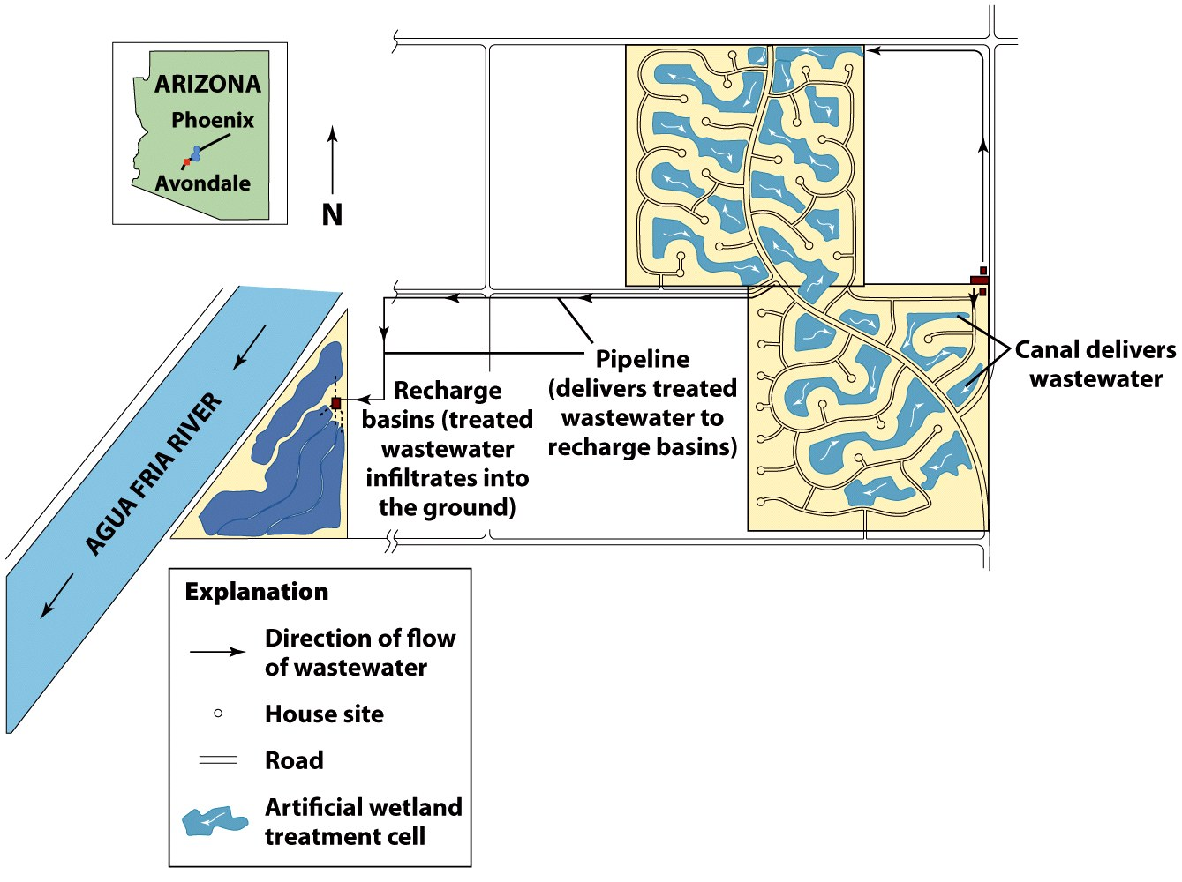

Slide 33
Water Reuse
Water reuse can be inadvertent, indirect or direct.
Inadvertent
Results when water is withdrawn, treated, used, treated, and returned to the environment.
Followed by further withdrawal and use.
Common for people who live along large rivers.
Indirect water reuse
A planned endeavor.
Several thousand cubic meters of treated water per day applied to surface recharge areas.
Eventually enters the groundwater.

Slide 34
Water Reuse
Direct water reuse
Refers to use of treated wastewater that is piped directly from a treatment plant to the next user.
Normal for industrial processes. Also used for fountain and other water displays in Las Vegas.
Little direct use for human consumption.
Orange County, CA developing program to process 70 million gal/day

Slide 35
Water Reuse
Risks associated with inadvertent reuse:
1. Inadequate treatment facilities may deliver contaminated or poor-quality water to downstream users.
2. Environmental health hazards of treated water remain uncertain.
3. Every year, new potentially hazardous chemicals are introduced into the environment. Ingested in low concentrations over many years, effects on humans difficult to evaluate.

Slide 36
