Slide 1
Ap environmental
Fossil fuels and the environment (ch.19)

Slide 2
Fossil fuels
Fossil fuels still supply approximately 80% of the World’s commercial energy
Fossil fuel use is declining due to climate change concerns and the rapidly growing renewable energy sector but the United States and many other countries still have a heavy dependence on fossil fuels that will likely continue for many decades

Slide 3
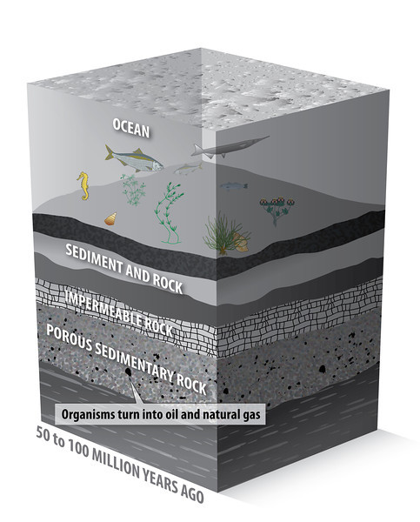
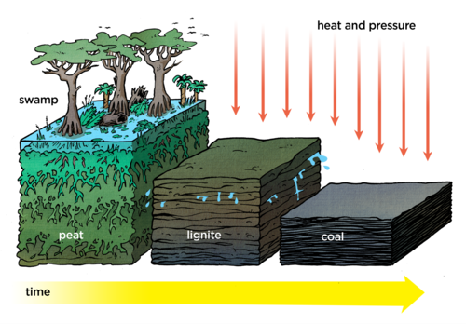
Fossil fuels
Forms of stored solar energy (converted into chemical energy by photosynthesis)
Result of incomplete biological decomposition
Stored in sedimentary rocks

Slide 4
Coal
Solid, brittle, carbonaceous rock
Most abundant fossil fuel
Found mostly in North America, Europe and Asia with proven reserves mostly in China, Russia, and the United States
Classified according to its energy and sulfur content
Anthracite
Bituminous
Subbituminous
Lignite
Energy content greatest in anthracite and lowest in lignite
Lower sulfur coal emits less sulfur dioxide

Slide 5
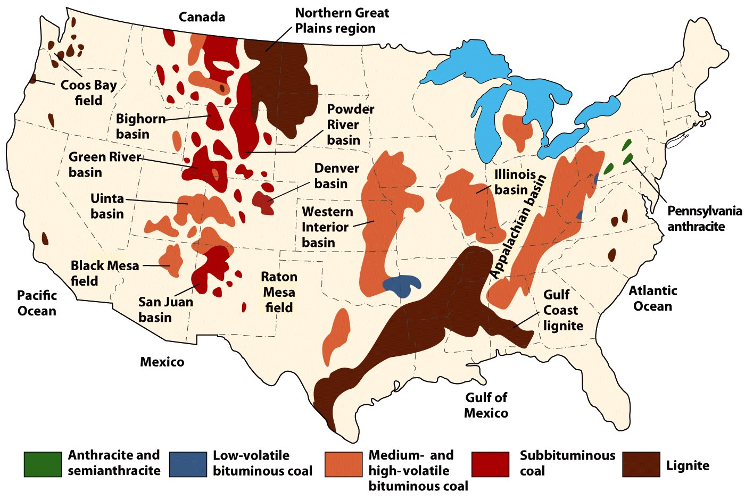
Coal

Slide 6
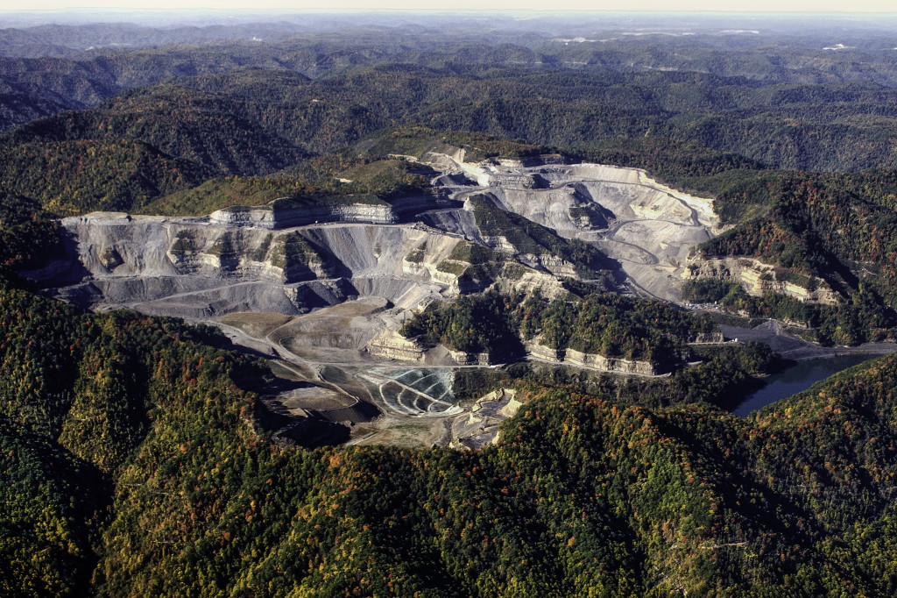
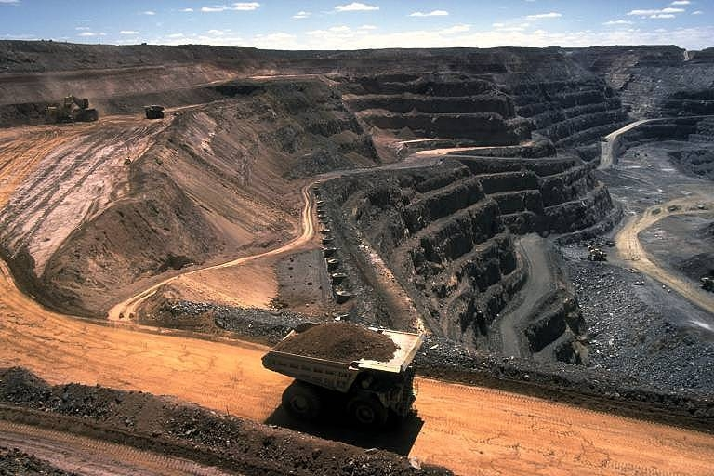
Coal concerns
Coal can be mined from the surface through strip mining or mountain top removal or from underground shafts
Mining for coal is dangerous for workers and leads to environmental concerns
Mountain top removal
Strip Mining

Slide 7
Coal concerns
Burning coal emits harmful pollutants
Sulfur dioxide, nitrogen oxides and carbon dioxide are released in the process of burning coal
Additional toxins such as mercury, arsenic, chromium, lead, and uranium could be released into the air from coal impurities
Coal power plants emit more radioactivity into the surrounding environment than nuclear power plants
Coal combustion produces toxic ash that must be stored on sites around power plants and can be vulnerable to spills into surrounding ecosystems

Slide 8
Coal
Coal combustion is the greatest environmental concern.
Legislation worldwide has restricted the amount of pollutants produced by coal burning plants but not enough to prevent damage to the environment and cause climate shifts
As oil and gas reserves dry up more pressure is put on coal.
Increased use of coal will have significant environmental impact due to the increase in pollutants.

Slide 9
Coal
Options for cleaner coal include:
Physical cleaning before combustion
Injection of material rich in calcium carbonate into the gases following burning (scrubbers)
Conversion of coal at power plants into gas before burning.
Convert coal to oil.
Carbon capture and storage in rock beds
Goal: Development of zero emissions coal-burning electric power plants

Slide 10
Crude oil and natural gas
Generally believed to have formed from organic materials buried with aquatic sediment beds in depositional basins
Most are found along geologically young plate boundaries or faults but can be formed away from plate boundaries as well
Source material is fine grained organic sediment buried at least 500 meters below the surface under increased heat and pressure

Slide 11
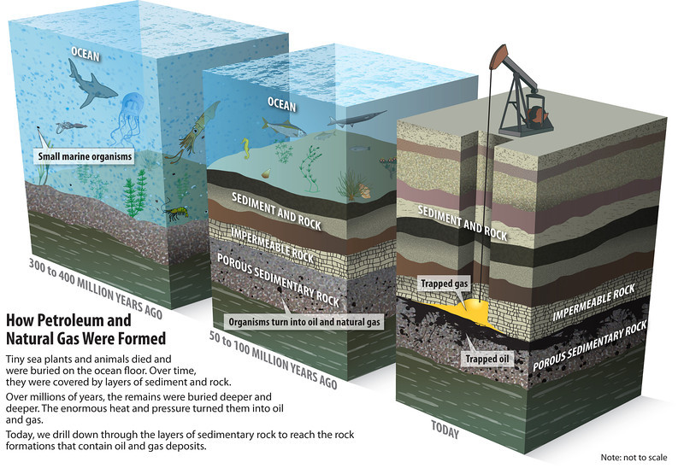
Crude oil and natural gas

Slide 12
Crude oil and natural gas
Elevated pressure causes sediment to be compressed which initiates upward migration to lower-pressure reservoir rock
Reservoir rock is coarser grained and relatively porous
E.g. sandstone and porous limestone
Natural upward migration of the oil and gas is interrupted or blocked in a trap
Rock that helps form a trap is known as cap rock, often shale

Slide 13
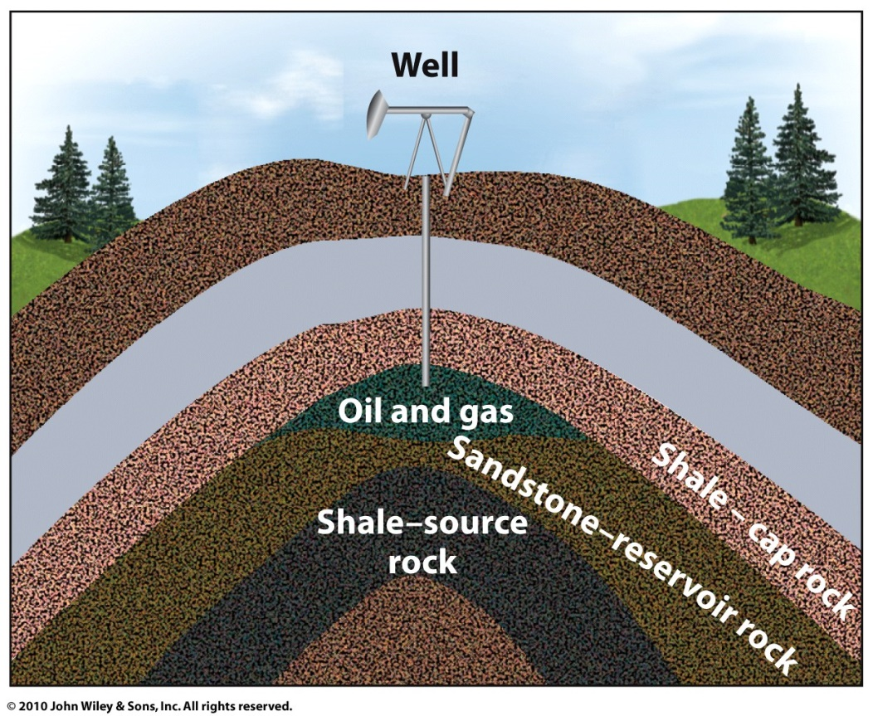
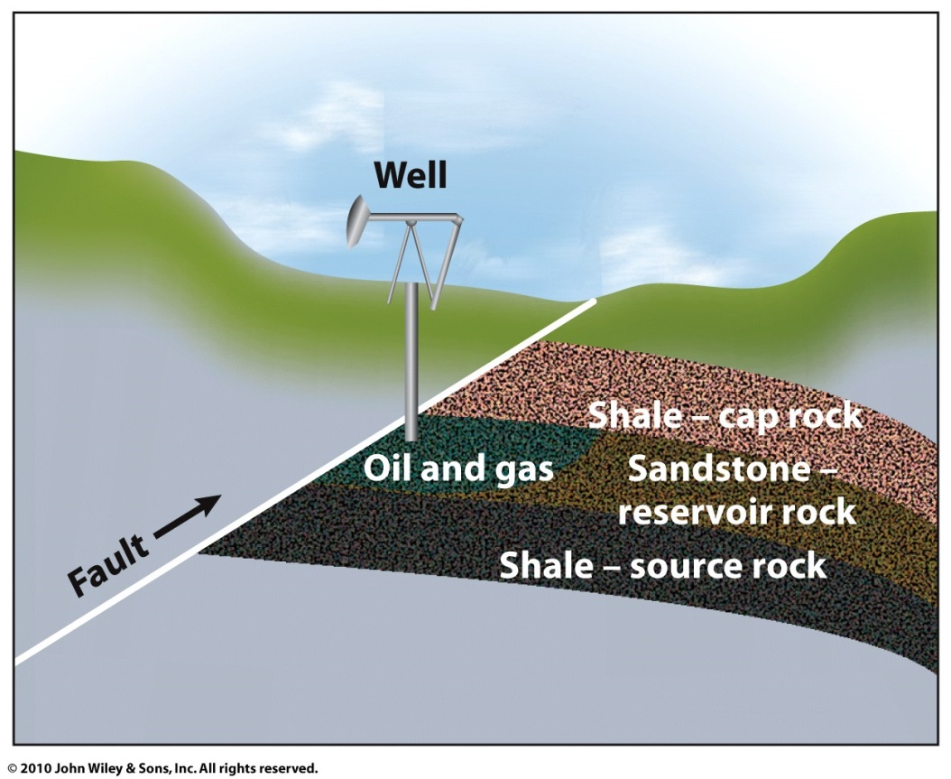
Crude oil and natural gas
Anticline Trap
Fault Trap

Slide 14
Petroleum production
Primary production
Involves simply pumping the oil from wells
Recovers only 25% of petroleum in reservoir
Enhanced recovery
Increase the amount recovered to about 60%
Steam, water, or chemicals injected into the reservoir to push oil towards wells

Slide 15
Petroleum Production
Next to water, oil is the most abundant fluid in the upper crust
Concentrated in a few fields
Proven reserves of oil are a part of the total resource that can be extracted for profit
65% of oil reserves are found in 1% of fields, mostly in the Middle East
Total resource numbers have been increasing with better technology to identify depositional basins
Increases in proven oil reserves have only come from discoveries in some of the largest oil fields (Middle East, Venezuela, Kazakhstan)

Slide 16
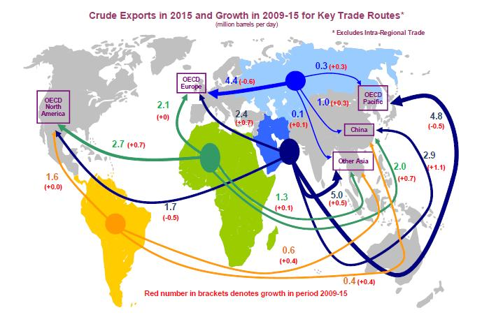
Petroleum production

Slide 17
Oil in the 21st century
Recent estimates of proven oil reserves suggest that oil and natural gas will last only a few decades.
When will we reach peak production?
Likely to have already passed meaning people alive today will have to adjust to potential changes in lifestyle and economies in a post-petroleum era
We are approaching the time when approximately 50% of the total crude oil available from transitional oil fields will have been consumed.
Proven reserves are about 1.2 trillion barrels. World consumption is quickly using what is left.

Slide 18
Oil in the 21st century
Measurement of future resource availability is the reserves-to-production ratio calculated by dividing the volume of total proved reserves by the volume of current annual consumption
Over time global oil reserves will may increase as new technologies will be able to increase production and access oil not currently profitable for extraction
Currently, for every three barrels of oil we consume, we are finding only one barrel
In the US production of oil as we know it now may end by 2090. World production by 2100.

Slide 19
Oil Concerns
Drilling technology and the exploration of oil deposits in the arctic and deep ocean have increased the threat of environmental damage from spills
Recent discovery of oil in Canada’s tar sands has led to clearing of vast amounts of boreal forest and the construction of additional pipelines through North America
Geopolitical volatility and economics have also led to an unstable market for oil

Slide 20
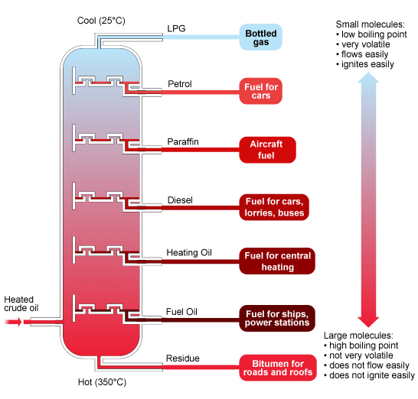
Oil concerns
Oil refineries take crude oil and through a process of distillation turn the oil into various products
Refineries release volatile organic compound pollutants into the air that are dangerous for ecosystems and humans

Slide 21
Oil Shale
Fine grained sedimentary rock containing organic matter mixtures (kerogen).
Not the same as crude oil or tight oil but can be used as a substitute called synfuel
More expensive to extract and process
When heated to a high temperature pyrolysis occurs that turns oil shale into a vapor that can be turned into a usable form of oil
Examples of oil-bearing shales are the Marcellus Shale, Bakken Formation, Pierre Shale, Niobrara Formation, and Eagle Ford Formation.

Slide 22
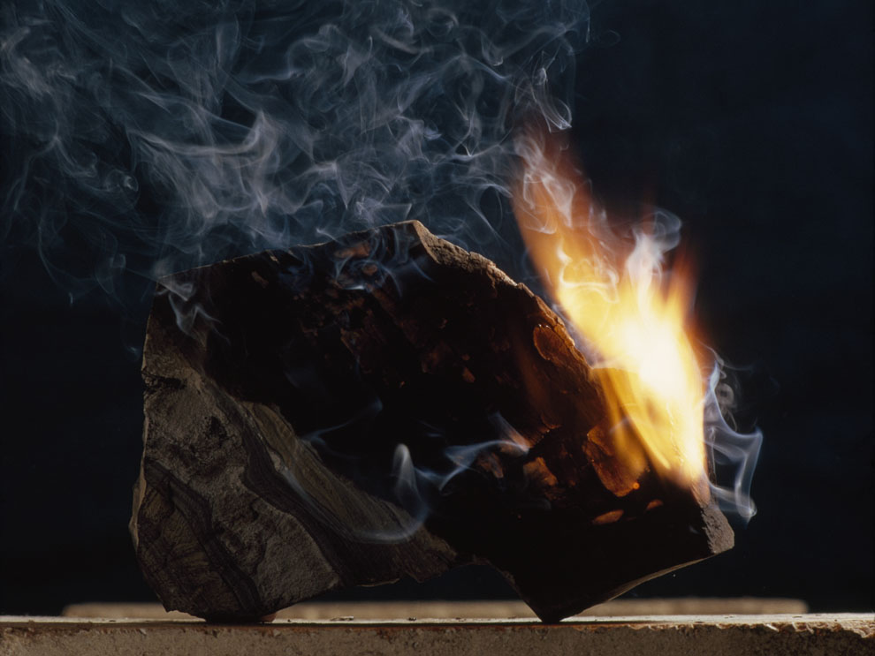
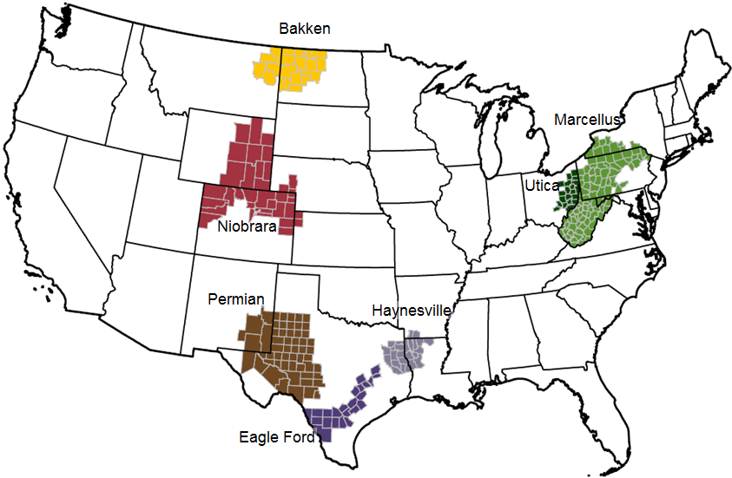
Oil Shale

Slide 23
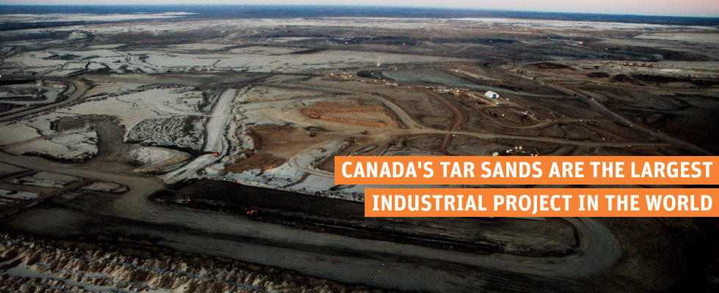
Tar Sands
Sedimentary rocks or sands impregnated with tar oil, asphalt, or bitumen.
Recovered by mining the sands and then washing the oil out with hot water.
Most abundant reserves located in Alberta, Canada
Strip mined in large swampy areas that are deforested, drained, and then removed layer by layer

Slide 24
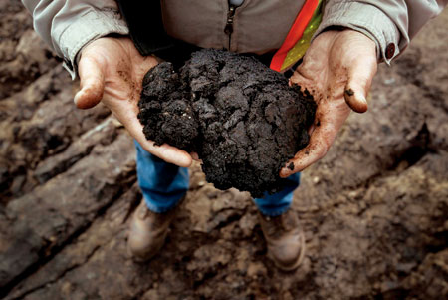
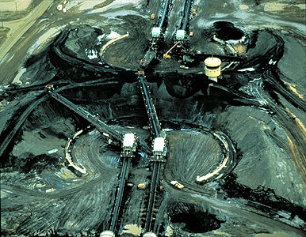
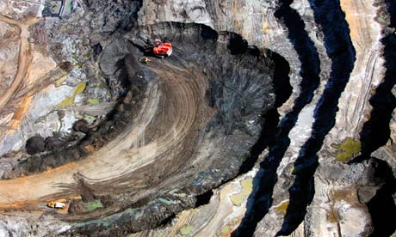
Tar Sands

Slide 25
Natural Gas
Only begun to utilize this resource
Transported by pipelines, not able to be safely shipped long distances
Currently makes up ¼ of the global energy consumption
Considered a clean fuel
Produces fewer pollutants (specifically sulfur oxides) than burning oil or coal
Could be a transition fuel to alternative energy

Slide 26
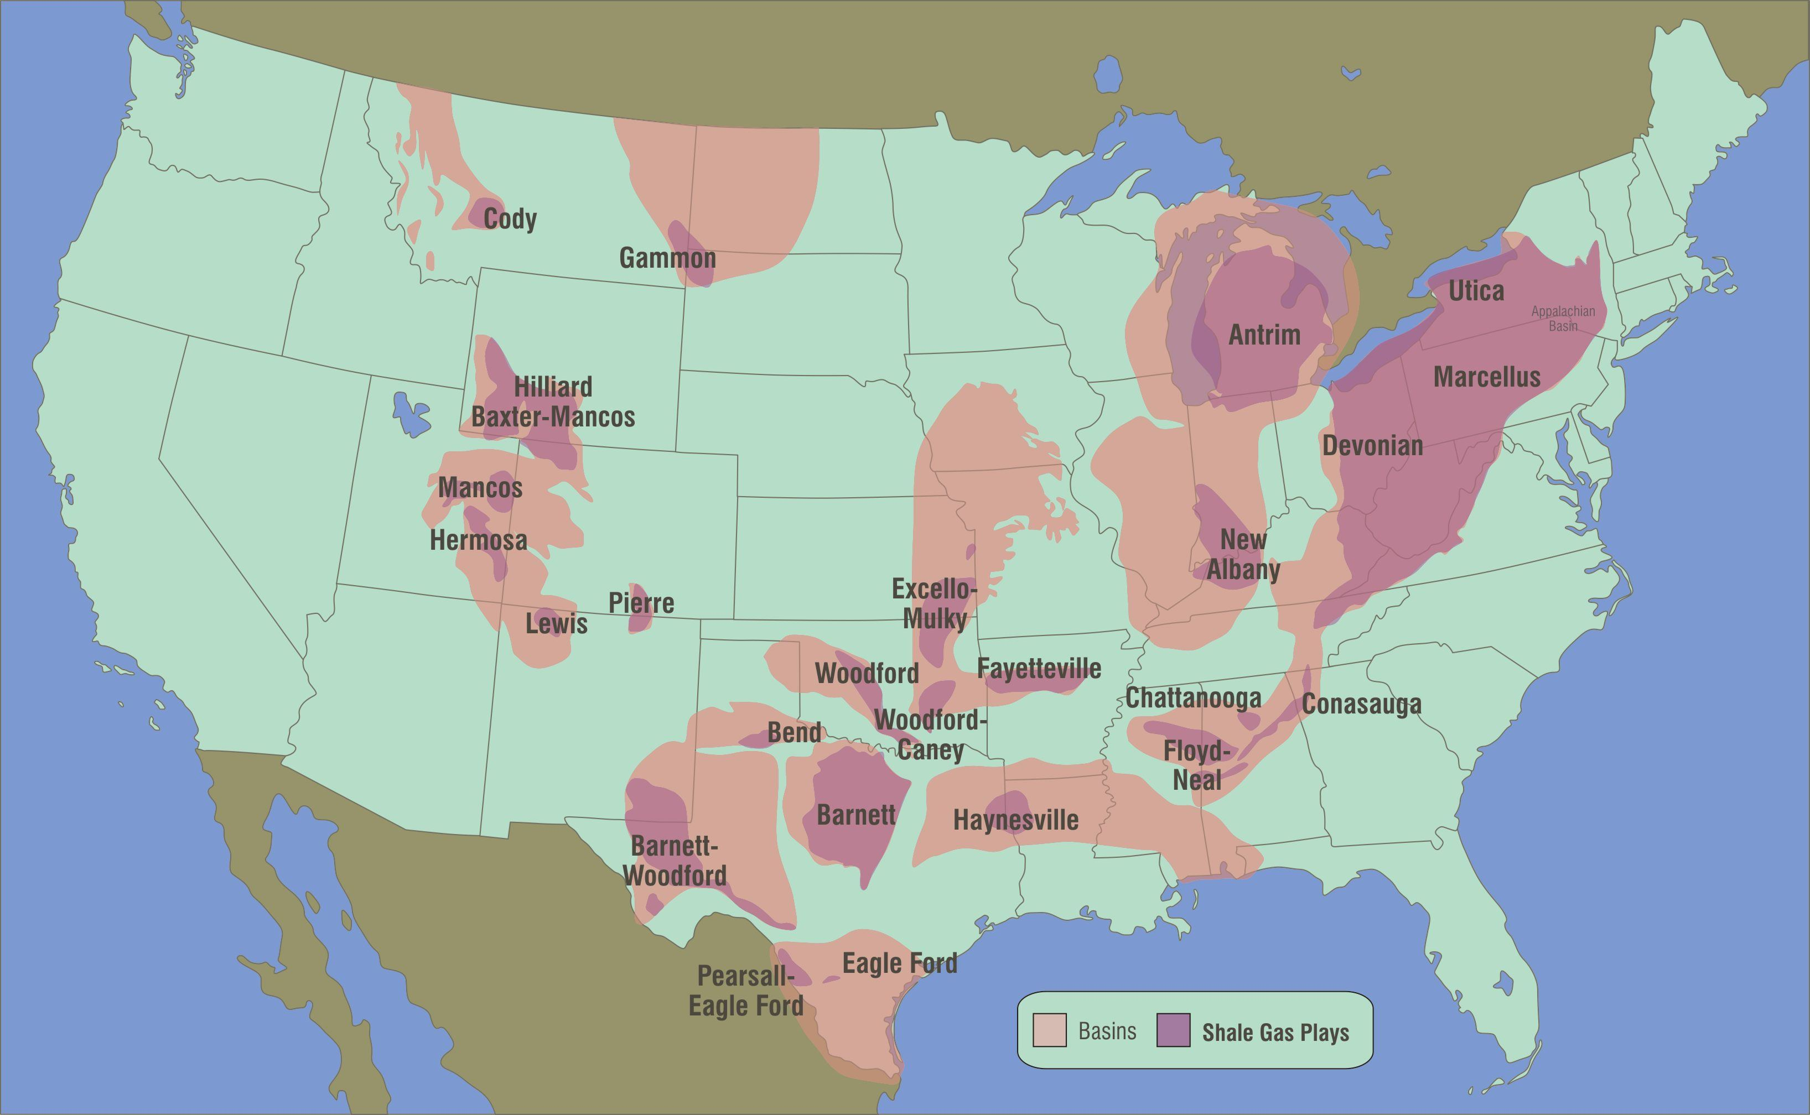
Natural Gas
The main compound in natural gas is methane that naturally accumulates as coal and oil is broken down
Most natural gas reserves are found in the Middle East and Russia but gas trapped in tight sand and shale deposits have been identified in the United States

Slide 27
Natural Gas
Natural gas sources
Crude oil wells with a gas cap above the crude oil trap or gas dissolved in the oil produce associated gas
Gas wells and condensate wells are gas sources that contain little to no crude oil and are called non-associated gas
Condensate wells that contain heavier forms of natural gas (pentane) can also produce low weight hydrocarbons in the gas product

Slide 28
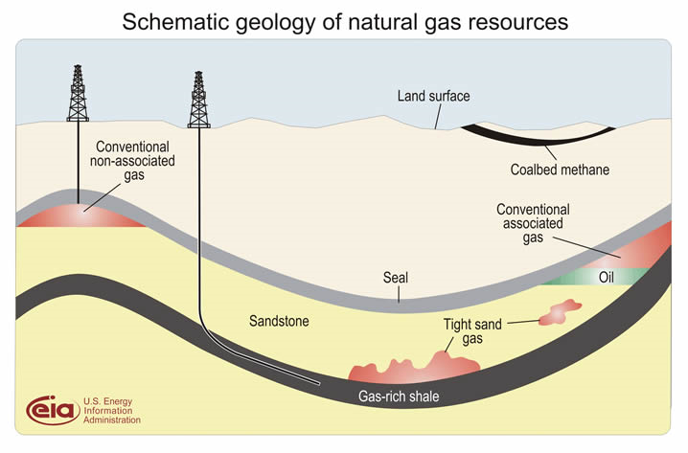
Natural gas

Slide 29
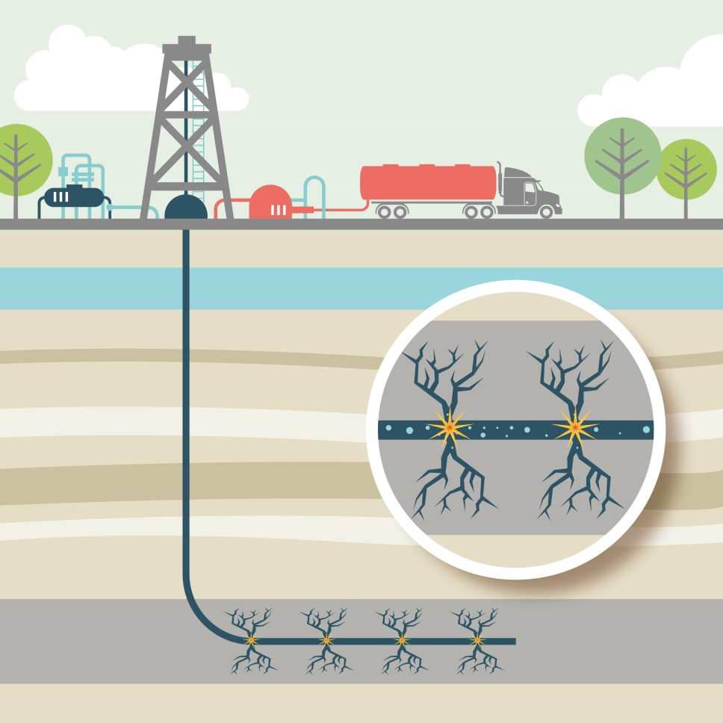
Natural Gas
Fracking is the process of drilling down into the earth before a high-pressure water mixture is directed at the rock to release the gas inside.
Water, sand and chemicals are injected into the rock at high pressure which allows the gas to flow out to the head of the well.

Slide 30
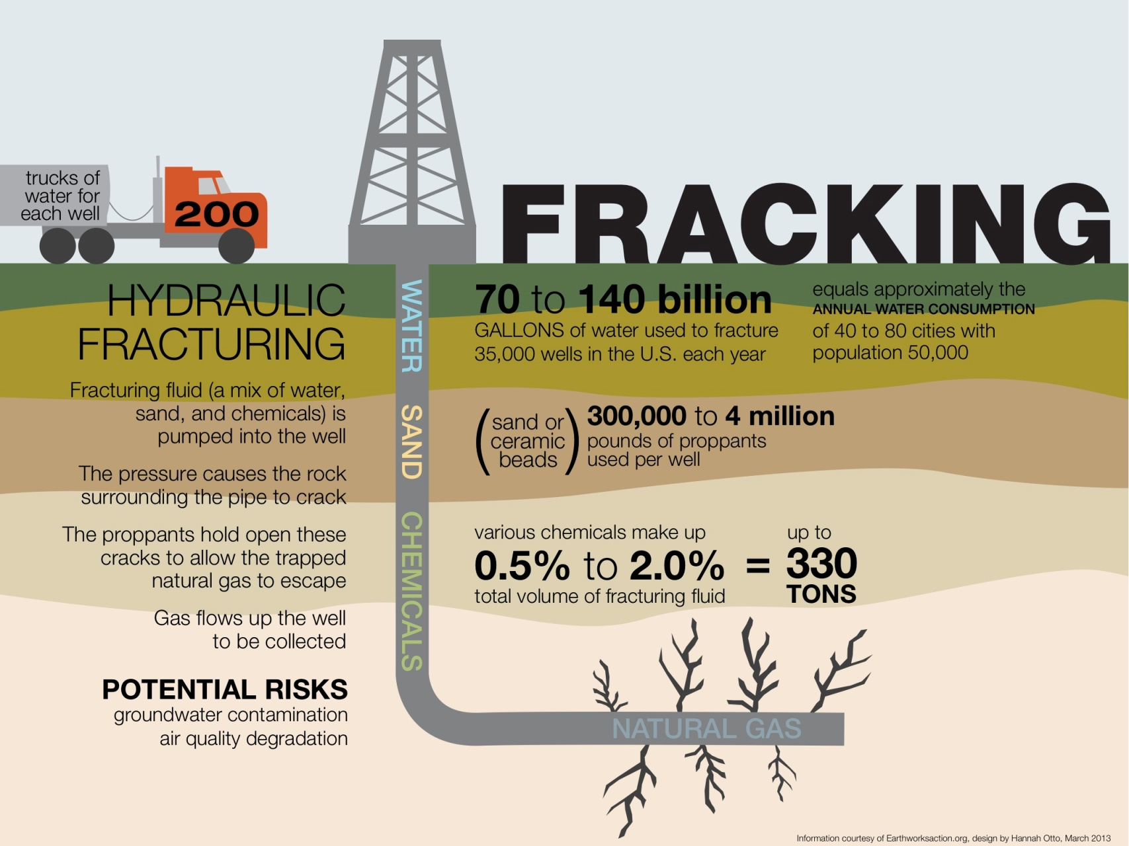
Natural Gas

Slide 31
Natural Gas Concerns
Water consumption and contamination from fracking
Cheap prices inhibits the market exploration of energy from renewable energy sources
Intercontinental shipping of natural gas is dangerous due to the volatility of the gas and the possibility of ignition

Slide 32
Methane Hydrates
Beneath the seafloor there exist deposits known as methane hydrates
White, ice like compound made up of molecules of methane gas molecular “cages” of frozen water
Forms as a result of microbial decomposition on the sea floor and then trapped in ice
Also found on land in permafrost
Found in ocean where deep, cold seawater provides high pressure and low temperatures.
Not stable at lower pressure and warmer temps.
Potential energy source but currently no way to mine or transport the gas

Slide 33
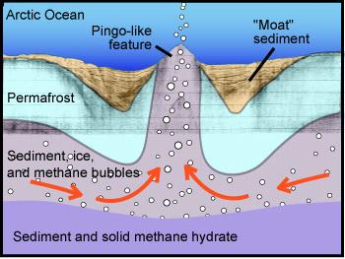
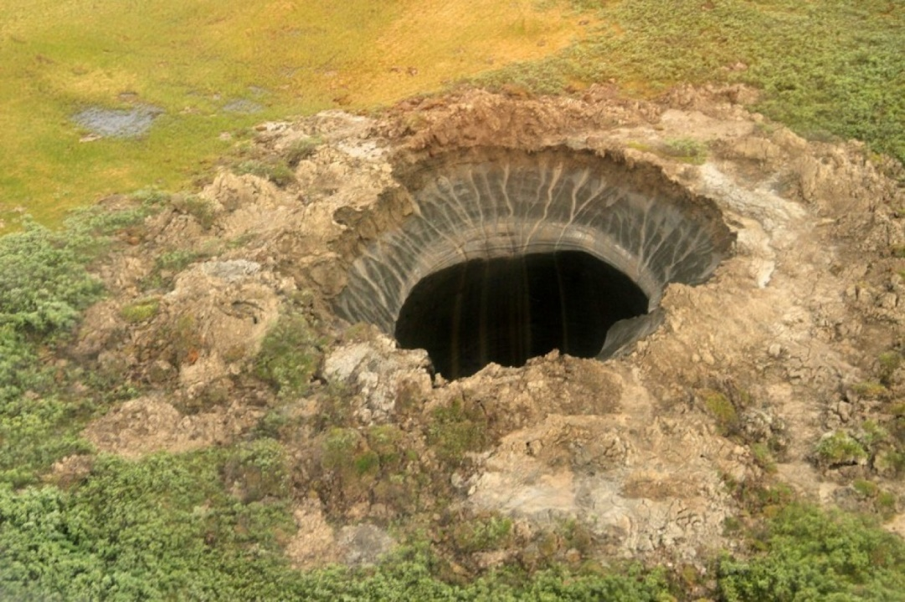
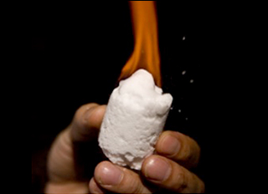
Methane Hydrates
Recent releases of methane hydrates have been documented in the Arctic ocean and in the permafrost of Russia

