Slide 1
AP environmental
Nuclear Energy (Ch. 19)

Slide 2
Nuclear Energy Use
All nuclear energy requires changing of atomic nuclei to produce energy
Nuclear fission is the most common type of nuclear energy reaction on Earth using Uranium as the fuel source to heat water and turn a turbine
Splits a larger atom into smaller atoms
Nuclear fusion is the energy source for all stars and has not yet be developed for use on Earth
Creates a larger atom from two smaller atoms

Slide 3
History of Nuclear Energy
Uranium was first discovered in 1789 by a German chemist named Martin Klaproth
Progressive discoveries about the characteristics of uranium and its radioactive decay process occurred from 1895-1945
From 1932-1934 experiments were done to test the transformation of uranium when struck by smaller particles
In 1938 Otto Hahn and Fritz Strassmann (also German chemists) proved that these transformations created elements of lighter weight than Uranium confirming that nuclear fission had occurred.

Slide 4
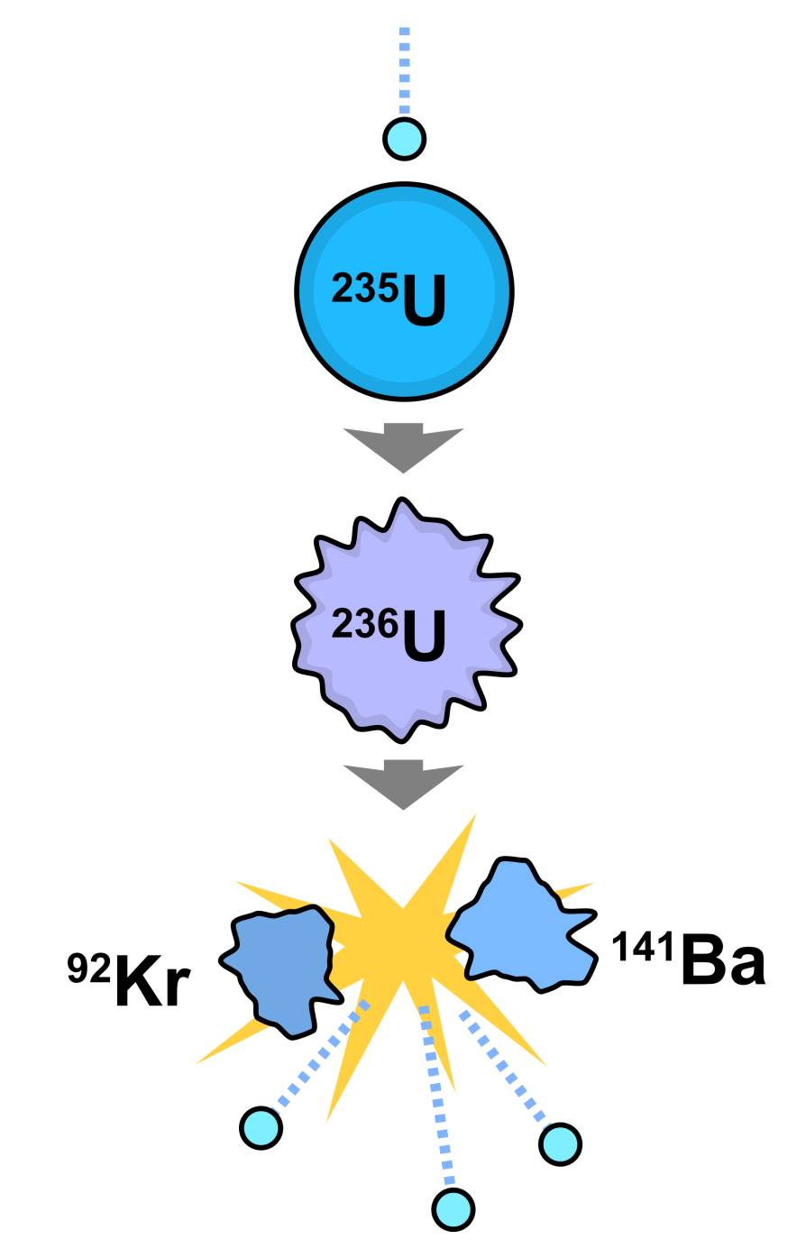
History of Nuclear Energy
Lise Meitner and Otto Frisch (working with Neils Bohr) explained that in a nuclear fission reaction a neutron must be captured by the larger uranium nucleus causing severe vibrations that break the nucleus apart
The product of the nuclear division resulted in 200 million electron volts of energy

Slide 5
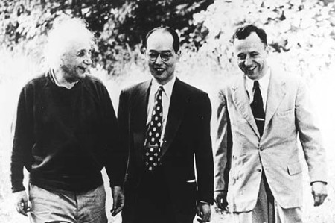
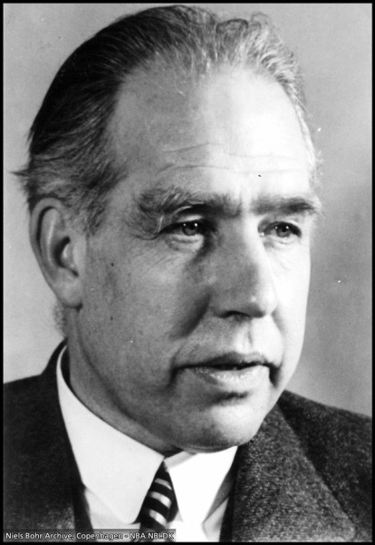
History of Nuclear Energy
Continued research by Niels Bohr and American theoretical physicist John Wheeler found that U-235 would react better than the more common U-238 and that slowing down neutrons increased the likelihood of nuclear fission
They published their paper on the foundations of nuclear fission two days before the beginning of World War II

Slide 6
History of Nuclear Energy
With the timing of World War II most nuclear energy research went into efforts to aid the war
In 1940 Russia had created a “Committee for the problem of uranium” then turned all research into war applications after the German invasion in 1941
German physicist refugees Rudolf Peierls and Otto Frisch implored the British government to look into atomic weaponry in a report they wrote stating that an atomic bomb could be built that would equal to several thousand tons of dynamite
After the Peierls-Frisch report the British government formed the MAUD committee to research and develop atomic weapons

Slide 7
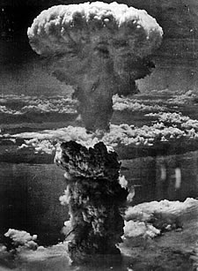
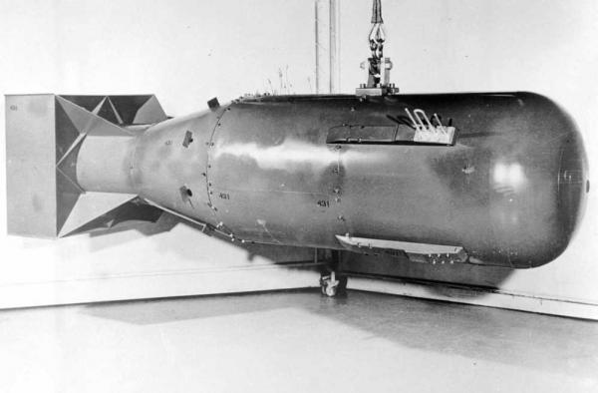
History of Nuclear Energy
In 1941 the MAUD committee published reports on their atomic research that detailed the use of nuclear fission reactions for weapons and for energy
After the bombing of Pearl Harbor in 1941 the United States entered the search for atomic weaponry and developed the Manhattan Project that eventually developed the atomic bombs (one uranium and one plutonium) dropped in Japan in 1945

Slide 8
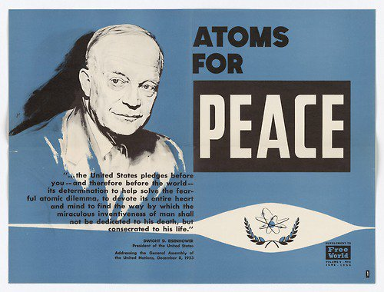
History of Nuclear Energy
Following WWII the research into nuclear energy could be focused on more peaceful applications like the production of energy
The first small scale nuclear reactor to produce electricity was developed in the United States in 1951
In 1953 President Eisenhower
proposed an “Atoms for Peace”
initiative which increased civil
efforts to generate electricity
using nuclear power

Slide 9
History of Nuclear energy
Between 1970 and 1974 American utilities ordered 140 new nuclear reactors for power plants
In 1970 the International Atomic Energy Agency projected that worldwide nuclear power generation would reach 4.5 million megawatts by 2000 which is 18 times the current nuclear power capacity
After 1975 only 13 new nuclear reactors were ordered and then subsequently canceled along with 100 of the 140 orders placed in the early 1970’s
No new reactors have been built in the United States since

Slide 10
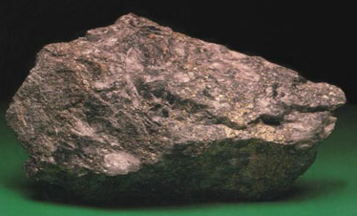
Nuclear Power Generation
Nuclear energy in power plants is generated in nuclear reactors that produce and control nuclear fission
The most common fuel in nuclear reactors is Uranium 235
Uranium 235 is found in 0.7% of Uranium ores and is dangerous to mine because of radioactive dust and tailings as well as the threat of radon gas emissions

Slide 11
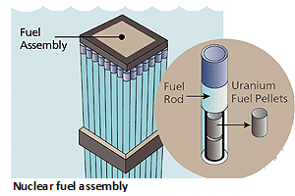
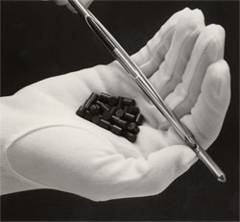
Nuclear Power generation
When processed the uranium ore is turned in to cylindrical pellets the thickness of a pencil and measuring 1.5cm long
Each pellet weighs approximately 8.5 grams and is equal to a ton of coal or 4 barrels of crude oil
Pellets are stacked in metal rods 4 meters long and then 100 rods create a fuel assembly

Slide 12
Nuclear Power generation
Thousands of fuel assemblies containing 100 tons of uranium are bundled together in a heavy steel vessel called a reactor core
Free neutrons are released in the reactor core to begin a chain reaction of nuclear fission reactions
To control the nuclear fission reactions a neutron absorbing solution is circulated between fuel rods and control rods of neutron absorbing materials can be inserted into spaces between fuel assemblies

Slide 13
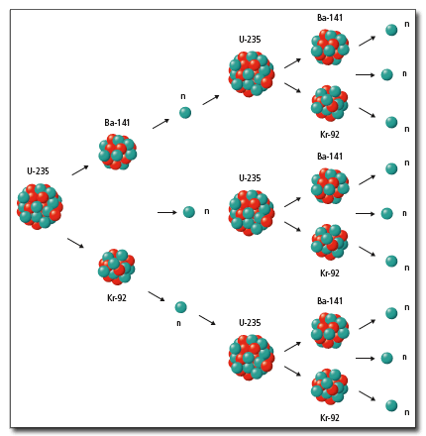
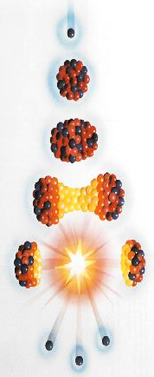
Nuclear Power Generation

Slide 14
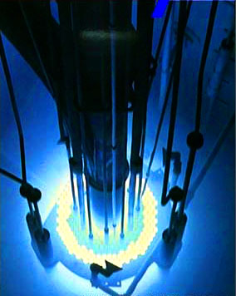
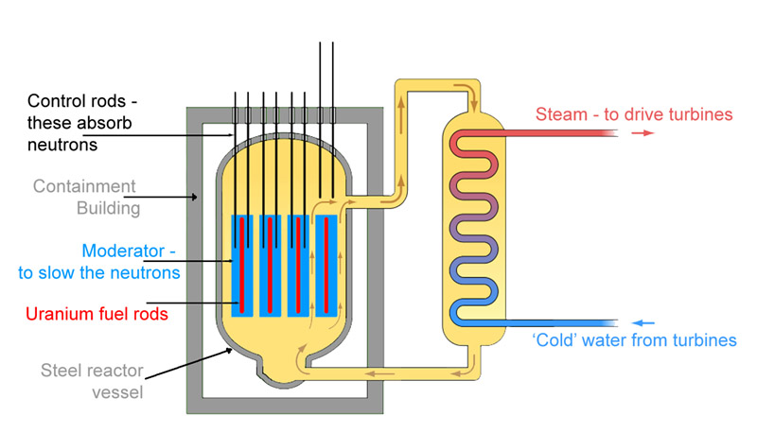
Nuclear Power Generation

Slide 15
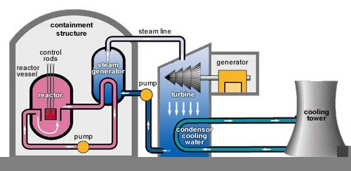
Nuclear Power Generation
There are currently 104 nuclear power plants in the United States
Most nuclear power plants use a reactor core to heat water that then is turned to steam and directed through pipes to turn a turbine that drives a generator to produce electricity

Slide 16
Nuclear Power advantages and disadvantages
Nuclear power is considered “clean” energy because the operation of creating electricity from nuclear fission does not produce air pollution
Nuclear power is also a way to reduce the use of fossil fuels
Concerns about nuclear power surround the possibility of nuclear accidents and the disposal of radioactive waste

Slide 17
Nuclear accidents
Three nuclear power accidents have generated public fear of nuclear power across the world
March 28, 1979- Three Mile Island nuclear plant in Pennsylvania, partial meltdown due to a mechanical oversight
April 26, 1986- Chernobyl nuclear plant in Ukraine, complete meltdown due to deliberate removal of cooling systems
March 11, 2011- Fukushima nuclear plant, structural damage to nuclear reactor systems due to an earthquake

Slide 18
Radioactive waste
Nuclear materials no longer useful in the generation of power continue to emit radioactivity long after they are removed from operation
Types of waste: fuel rods, clothing and tools used in maintenance, uranium mine tailings
Waste materials emit radioactivity as their half life dictates.
A half-life is the amount of time it takes for half of the radioactive atoms to decay to a stable form

Slide 19
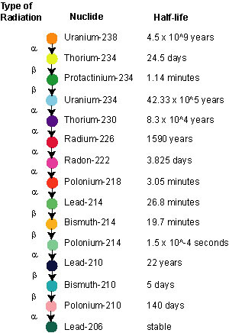
Radioactive waste
Radioactive isotopes change form as they decay and spend various amounts of time as their transition isotopes
Each type of isotope has a different half life measurement
Uranium 238 has a half life of 4.5 billion years while Uranium 235 has a half life of 704 million years

Slide 20
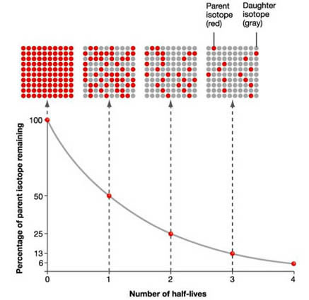
Radioactive waste

Slide 21
Radioactive waste
Current estimates put the amount of radioactive waste in the United States at:
200,000 million tons of material from mining
100,000 tons of low level material (clothing, tools)
77,000 tons of high level material (fuel rods, weapons)
There is no clear plan on how to best contain and store radioactive waste
The most common method of storage is in ponds but space in these ponds is quickly running out so land containers are the next best option

Slide 22
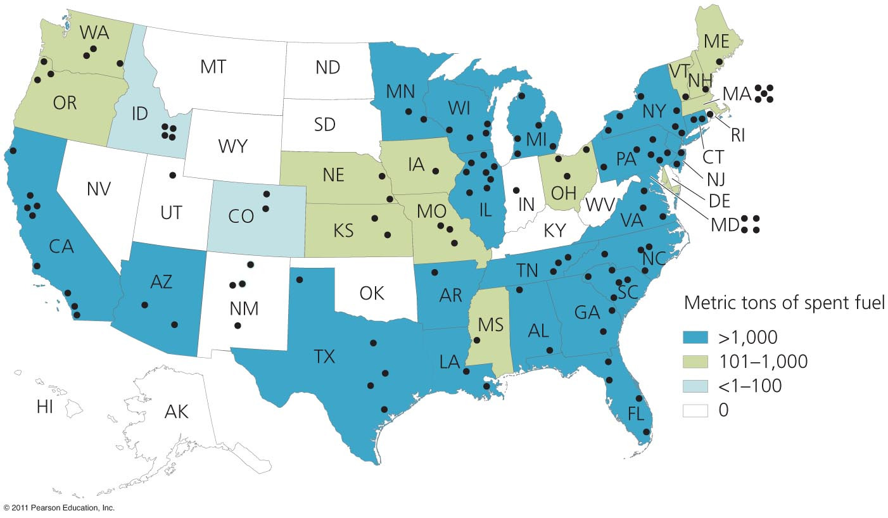
Radioactive waste
Waste is held at 125 sites in 39 states
161 million citizens live within 75 miles of nuclear waste

Slide 23
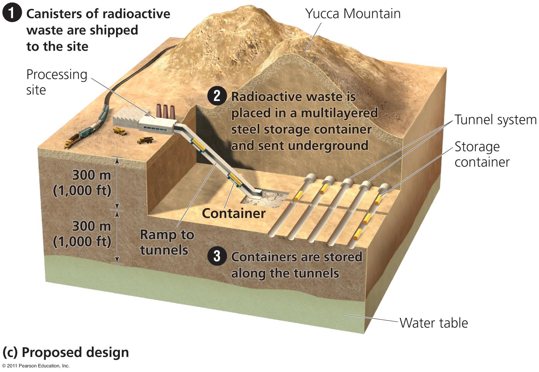
Radioactive waste

Slide 24
Radioactive exposure
Human exposure to radioactive isotopes has led to skin burns in acute cases and various types of cancer in both acute and chronic cases
Exposure is measured in a variety of units:
Rads (rd) stand for radiation absorbed dose and measure the amount of radiation absorbed by living tissue
Sieverts (sv) are a measurement of the effective equivalent dose and take into account the penetration levels of different types of tissue (LD-50 of radiation is equal to approximately 5 sieverts)

Slide 25
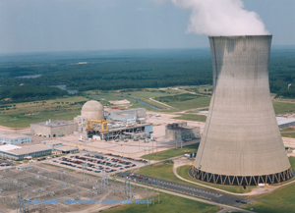
Nuclear alternatives
Many improvements can be made to increase efficiency, decrease waste, and improve safety at nuclear power plants
Increased safety regulations, protocols and checks and balances
Improved fuel resources through breeder reactors that turn low grade fuel into usable fuel
Nuclear fusion reactors

Slide 26
Nuclear alternatives
Nuclear fusion reactors would provide a solution to the mining and radioactive waste issues that plague nuclear fission reactors
Nuclear fusion requires lighter, more abundant materials like hydrogen and helium that can be fused together to release energy
Fusion power is difficult to produce because of extremely high temperatures needed to fuse small atoms together

Slide 27
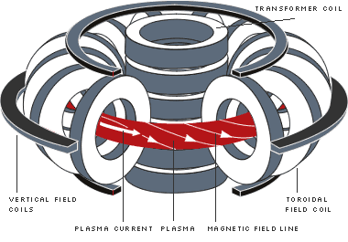
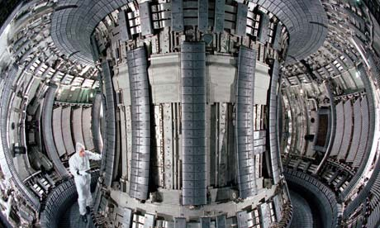
Nuclear alternatives
Current tests on nuclear fusion involve suspending superheated material in a magnetic field but sustaining high temperatures requires more energy input than the output produced
Video

Slide 28
Future of nuclear power
With the dwindling of fossil fuel supplies and focus on cleaner energy the world is starting to focus more on nuclear power
Since 2012, 2 permits to build new nuclear facilities in the United States have been approved for the first time since the 1980’s
Nuclear fusion research and testing has picked up speed and is expected to meet major milestones toward progress in the next few years

