Slide 1
Ap environmental
Sustainable energy (ch.20)

Slide 2
Energy efficiency
The energy future of the world will not only require new options for energy sources but also better choices on how we use energy even from its current sources
Energy efficient homes, appliances, lightbulbs, etc. maximize the energy input and reduce the amount of energy lost as heat during use
Energy can also be conserved by just unplugging devices in the home that act as energy vampires and consume energy even when not turned on
In transportation, higher efficiency vehicles that run off of diesel could also reduce our fossil fuel consumption

Slide 3
Energy efficiency
High efficiency construction of buildings is not becoming more popular especially in Europe.
Homeowners can make their homes more energy efficient my taking advantage of passive heating and cooling techniques and increased efficiency of heating and cooling systems within the home
Larger buildings and industries have tapped into cogeneration of energy which uses energy lost as heat to fuel steam power processes that generate more electricity

Slide 4
Alternative energy
Alternative energy sources are sources of energy that do not rely on fossil fuels or organic material stored within layers of rock
Non-renewable alternatives cannot be replenished faster than they are consumed (Ex: nuclear, geothermal, hydrogen)
Renewable alternatives can keep up with consumption demands and all derive their energy from the Sun
(Ex: solar, wind, hydroelectric, biomass)

Slide 5
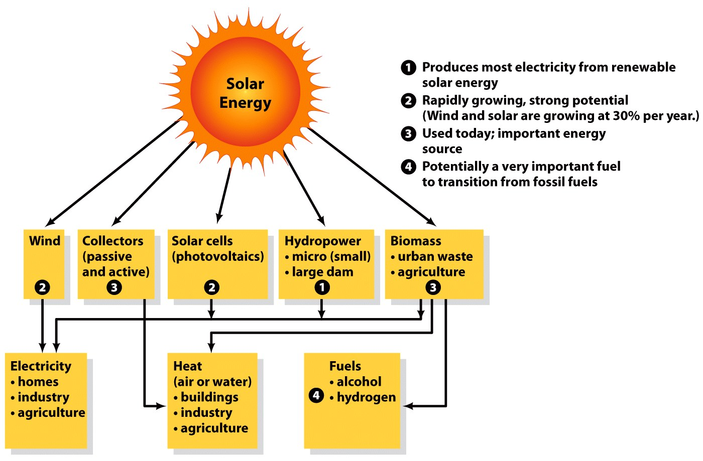
Alternative Energy

Slide 6
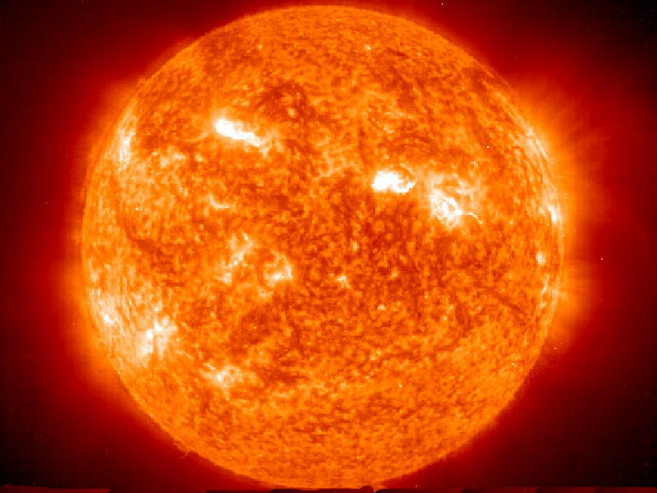
Solar energy
The Sun either directly or indirectly provides the original source of energy for all other energy sources
The Sun generates energy through nuclear fusion of atoms under extreme gravitational pressure
During nuclear fusion solar energy is emitted as electromagnetic radiation and travels to the Earth as photons

Slide 7
Solar Energy
It takes over 100,000 years for a photon created in the Sun’s core to make its way to the surface and just 8.5 minutes for it to travel from the Sun to the Earth
Due to the distance that the photons must travel from the Sun only ½ of a billionth of the solar energy emitted makes it to the Earth
The average amount of energy that falls on one square meter every second outside of the Earth’s atmosphere is known as the solar constant and is equal to 1,368 watts per square meter

Slide 8
Solar Energy
As solar energy enters the atmosphere it is filtered out at different levels according to wavelength.
368 watts/m² is either reflected or absorbed by the atmosphere leaving 1000 watts/m² that makes it to the Earth’s surface
Solar panels are rated on the standard assumption that maximum power would equal 1 kilowatt/m² during peak conditions so the standard is called 1 kWp

Slide 9
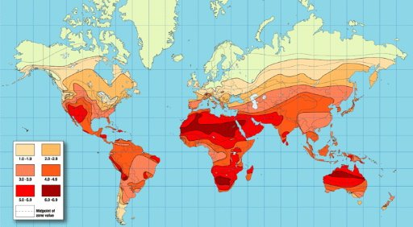
Solar Energy
The average amount of energy reaching the Earth’s surface (also called insolation) is generally understood to be 1 kW/m² but this varies by location depending on geography, cloud cover, time of day, and season

Slide 10
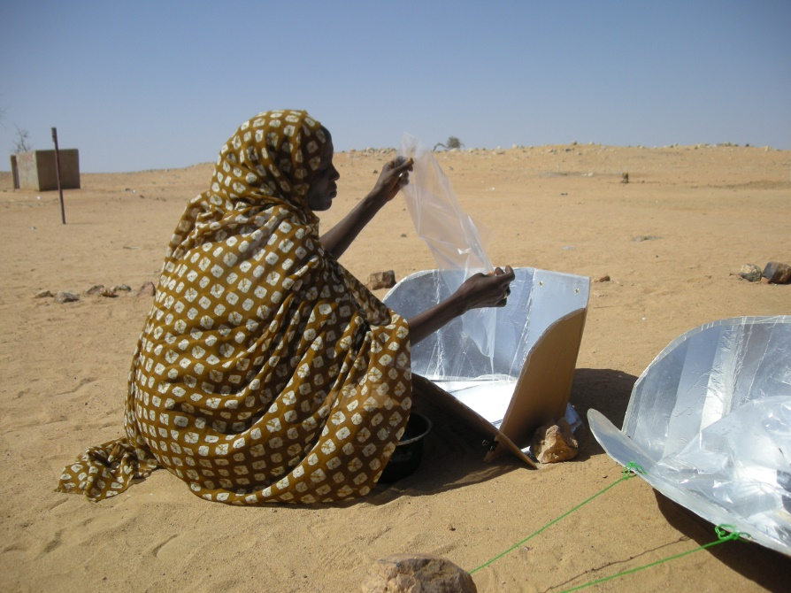
Solar Energy
Solar radiation captured as an energy source can happen two ways
Passive solar heating
allowing normal solar radiation
to heat buildings through window
placement, and/or dark building
materials (roofs or siding)
Using reflective material to focus
solar radiation in a solar oven

Slide 11
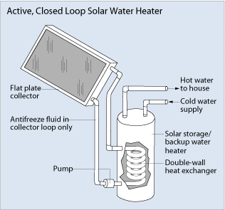
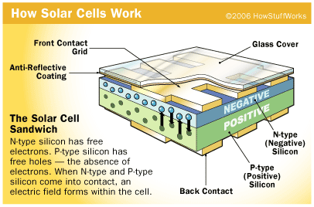
Solar Energy
Active Solar Energy- using technology to capture sunlight and use it to perform a function
Water heating systems
Photovoltaic cells
Thin sheets of semiconducting material that generate low voltage direct current when exposed to sunlight
Direct current is then converted to high voltage alternating current that can power batteries or provide electricity

Slide 12
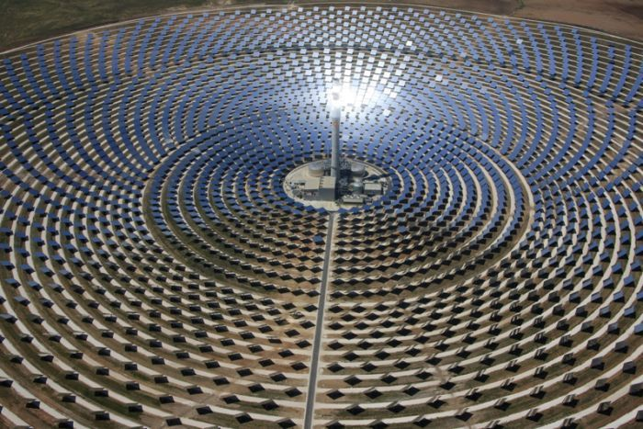
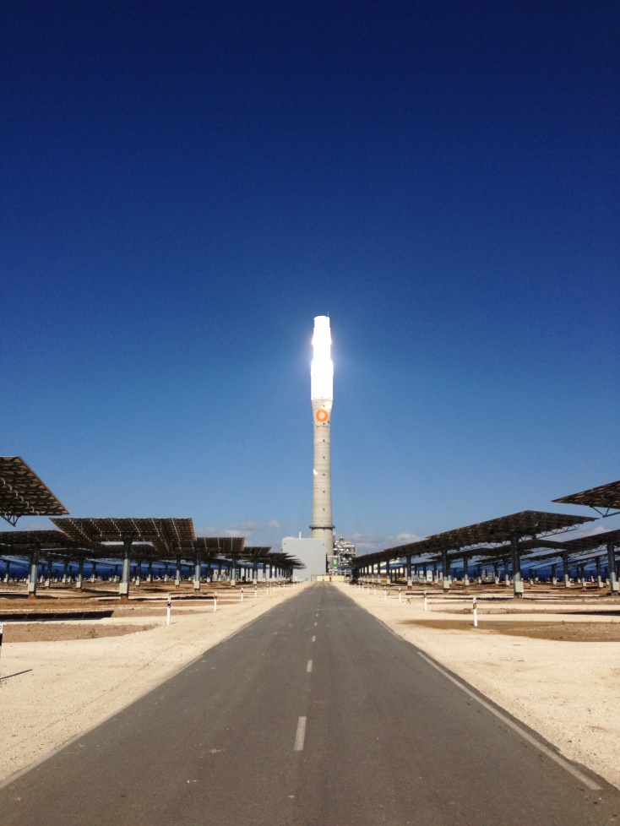
Solar Energy
Concentrating Solar Thermal (CST) systems
Large scale solar collectors
Use lenses and mirrors to track and focus sunlight over a large area into a small beam
Heat from the beam is used to turn water into steam which turns a turbine to generate electricity
Require a large space with consistent solar insolation

Slide 13
Wind Energy
Energy created from the kinetic energy in wind generated by unequal solar radiation
Air circulation follows the basic principles:
Warm air rises, cool air sinks
Heat moves from warm to cold
Largest growing renewable energy source in the world growing from 10 gigawatts in 1996 to more than 300 gigawatts today
6% of U.S. electricity comes from wind power, compared to 26% in countries like Denmark

Slide 14
Wind Energy
Wind turbines convert kinetic energy into electricity using the same basic turbine mechanisms that use spinning blades to spin a generator that creates electrical current
Turbines can be up to 100 meters (330 feet) tall and have blades 40-75 meters (130-250 feet) long
Turbines require moving air so they may only generate electricity 25% of the time depending on environmental conditions for wind (land turbines are less efficient than offshore turbines)

Slide 15
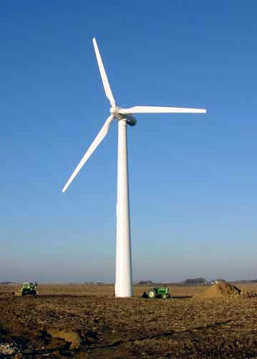
Wind Energy
When spinning, wind turbines can generate between 2000 and 3000 kW of energy
Wind farms are generally in rural areas where land is used for cattle grazing or agriculture but they must be easily linked to power grids
Resistance to increasing wind farms include aesthetic concerns and danger to wildlife like birds that may have collisions with spinning blades

Slide 16
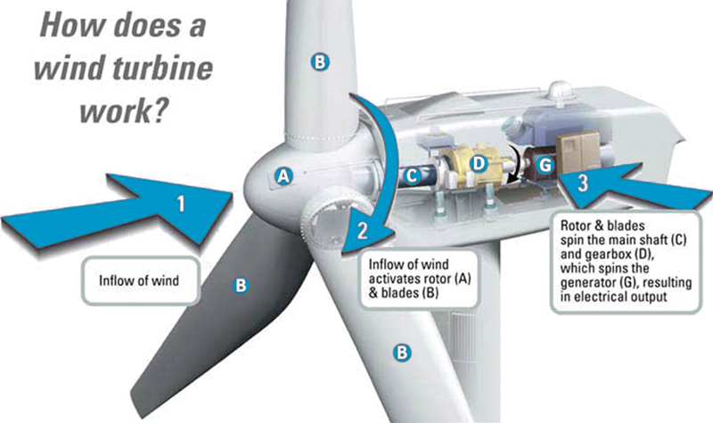
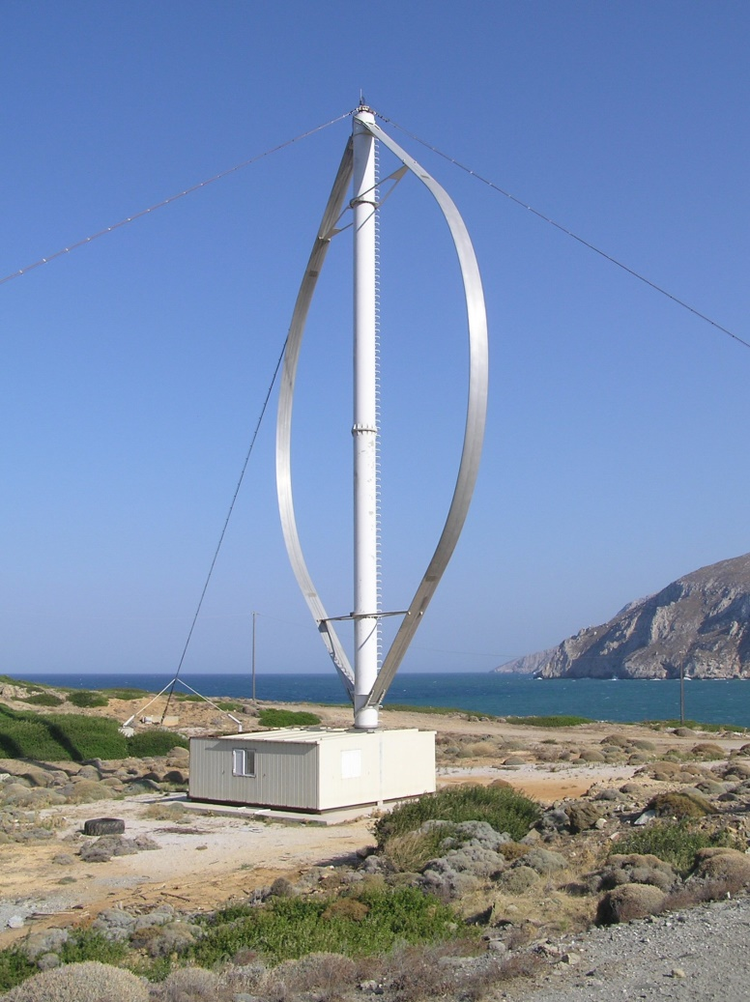
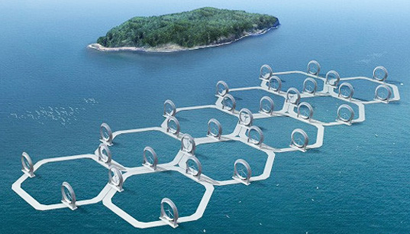
Wind Energy

Slide 17
Hydroelectric power
Electricity generated by moving water
Second most common renewable energy source in the world
Generates 7% of electricity in the U.S. and approximately 20% worldwide (led by China)

Slide 18
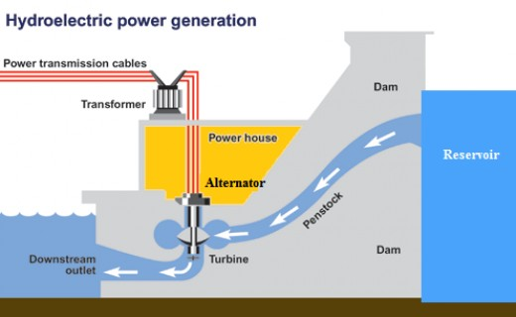
Hydroelectric Power
Energy from moving water can be captured as water falls over a vertical distance, from tidal movement or currents in streams and rivers
Kinetic energy is converted into electrical energy as moving water spins a turbine that turns a generator that creates electrical current
Electricity generated
depends on flow rate

Slide 19
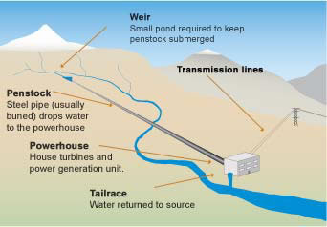
Hydroelectric Power
Hydroelectric Systems
Run-of-the-river generation uses natural currents and/or low dams to promote water movement
Small scale
Not consistent
No reservoir
Natural flooding
Very little disruption
to natural ecosystems

Slide 20
Hydroelectric power
Water impoundment Systems store water behind a dam (water impoundment) and control the flow of water downstream
Most common method
Largest dam in the United States is the Grand Coulee Dam in Washington state (6,800 MW at peak capacity)
Largest dam in the world is the Three Gorges Dam in China that generates 11% of the countries electricity (18,000 MW output and 85 billion kWh per year)
Environmental concerns include sediment build up in reservoirs and damage to natural ecosystems downstream

Slide 21
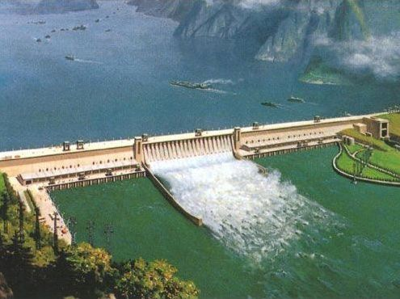
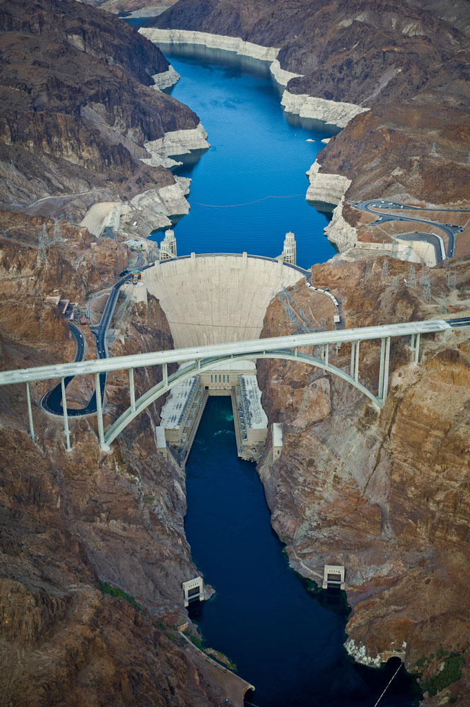
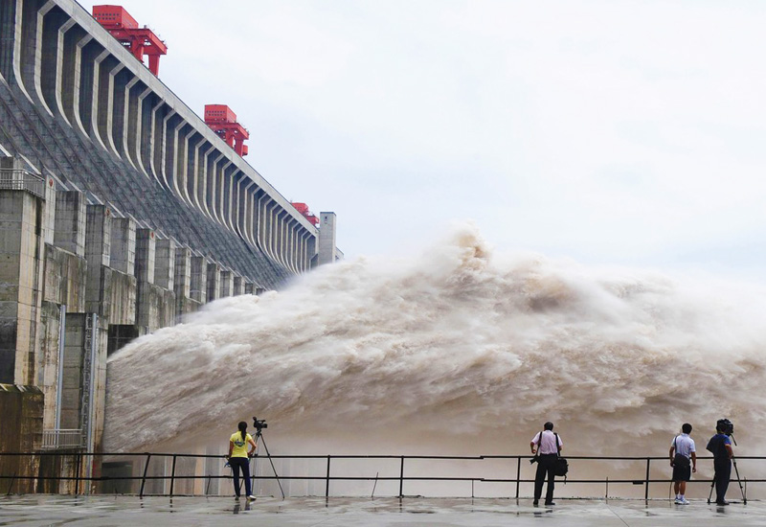
Hydroelectric Power

Slide 22
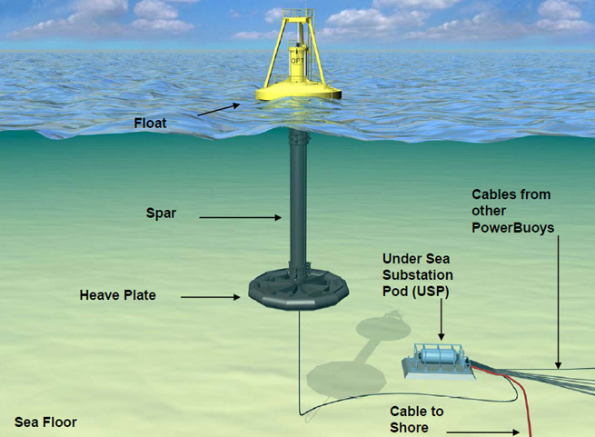
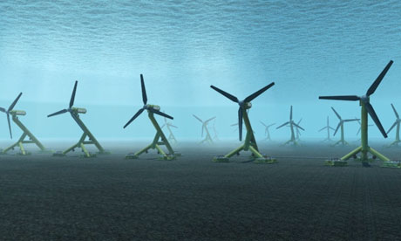
Hydroelectric Power
Tidal energy takes advantage of moving water caused by the gravitational pull of the Moon
Uses a system of gates and turbines to capture kinetic energy and convert it to electricity

Slide 23
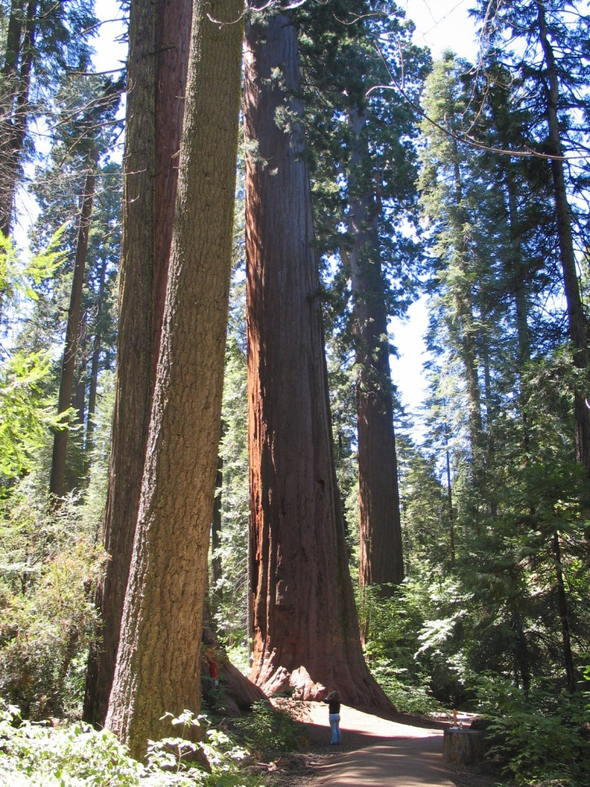
Biomass
Biomass energy comes from carbon recently processed or stored in organisms
This carbon is called modern carbon because it is found in organisms still alive today in contrast to fossil fuels that come from organisms that died long ago
Represents ½ of all renewable energy produced and 3.5% of renewable energy consumed in the United States

Slide 24
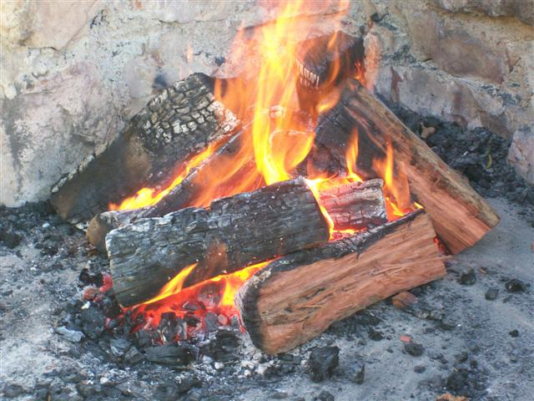
Biomass
In the United States sources of biomass include:
Wood
Municipal solid waste
Biofuels (usually from agriculture)
In developing countries sources of biomass include:
Wood
Animal manure

Slide 25
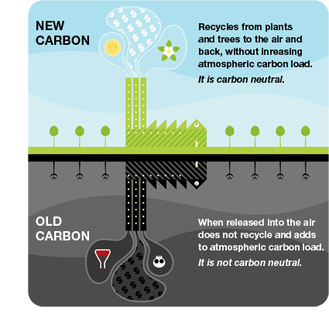
Biomass
Biomass shares several properties with fossil fuels. Both forms of energy contain carbon and produce carbon dioxide when burned.
Biomass is considered cleaner because it releases carbon recently in the atmosphere and does not add carbon that was removed millions of years ago
The balance of releasing modern carbon into the atmosphere that can be filtered by growing more plants is a condition called carbon neutrality

Slide 26
Biomass
Wood is the largest industry for solid biomass material worldwide
Wood is used for heating homes, cooking, and in industrial paper and packaging processes
Wood should be renewable as long as regrowth of trees keeps up with demand
Removing more timber than can be replaced by growth is called net removal and can result in an increase of CO₂ in the atmosphere

Slide 27
Biomass
Wood can also be used to produce charcoal, a lighter form of wood that contains twice the energy output per unit weight
Charcoal is abundant as an energy source in developing nations or urban cities that can afford the processing of wood into charcoal
Poorer nations or areas that lack trees primarily use dried animal manure for heating and cooking
Environmental concerns from solid biomass include particulate matter and other pollutants released during burning

Slide 28
Biomass
Biofuels (ethanol and biodiesel) are biomass options that can be substitutes for gasoline and diesel from fossil fuels
Ethanol is created by converting plant sugars and starches into alcohol and carbon dioxide
World leader in production is the United States using corn followed by Brazil that uses sugarcane
Currently added to gasoline in a ratio of 9 parts gasoline to 1 part ethanol
Flex-fuels can have up to 85% ethanol and 15% gasoline
Concerns about use involve energy required to grow and harvest corn, and reduction of gas mileage with higher ethanol ratios

Slide 29
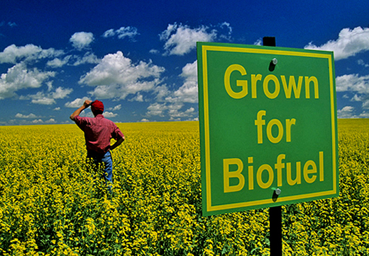
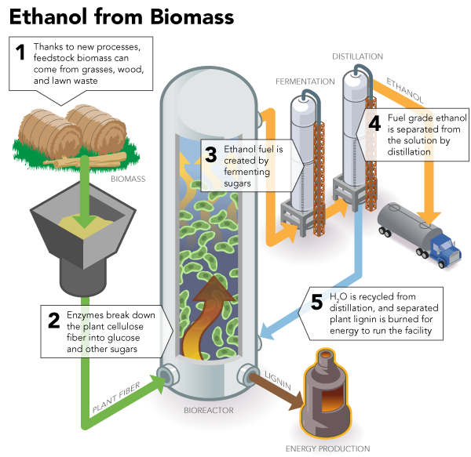
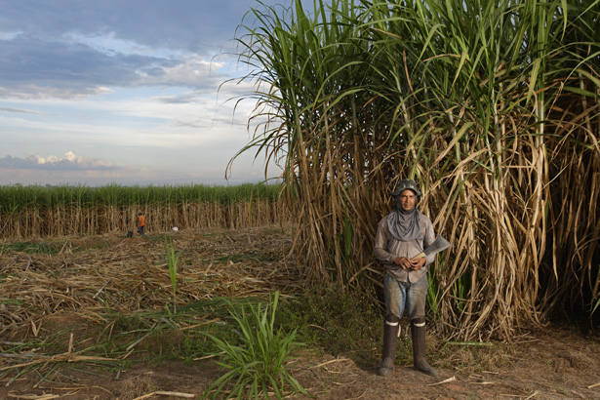
Biomass

Slide 30
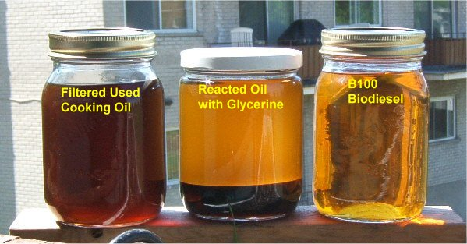
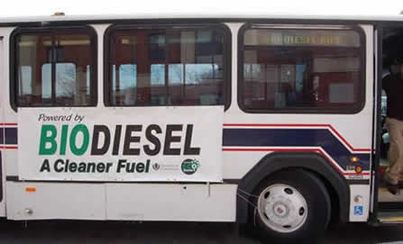
Biomass
Biodiesel is a biomass alternative for petroleum based diesel
Biodiesels are formed by extracting and processing oil from plants (usually soybeans or palm)
Current vehicles, especially larger transport trucks, can be easily modified to run on biodiesel including straight vegetable oil (SVO) that can be recycles from restaurants

Slide 31
Geothermal Energy
A renewable form of energy that does not come from the Sun
Driven by natural radioactive decay of elements in the Earth and convection within the Earth’s mantle that brings magma closer to the surface
United States, China and Iceland are the top users of geothermal energy
Iceland heats 87% of its homes and produces 25% of its electricity with geothermal energy
Requires the input of water that is turned to steam by the heat to generate electricity or cycle through a heat pump

Slide 32
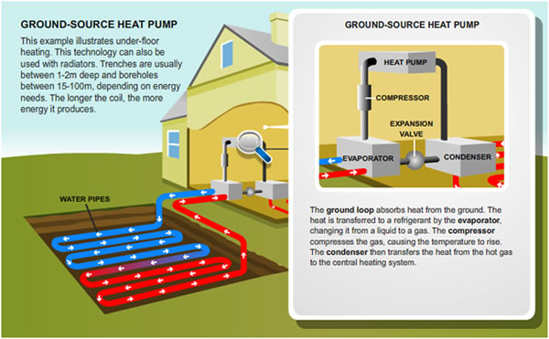
Geothermal Energy
Ground source heat pumps utilize heat stored deep underground all year to warm fluids and heat above ground structures
Not technically geothermal because the heat comes from solar radiation absorbed by the ground

Slide 33
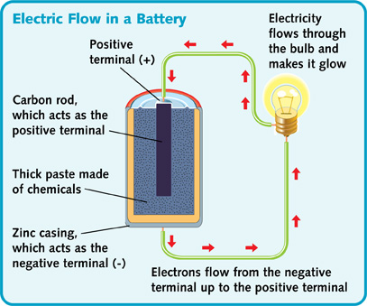
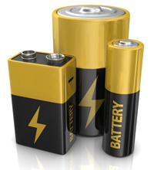
Hydrogen Fuel Cells
A fuel cell is an electrical-chemical device that converts fuel, like hydrogen, into an electrical current
Batteries operate in a similar way but require a reaction between two chemicals to create a charge and once those reactants are used up, no longer function (the battery dies)

Slide 34
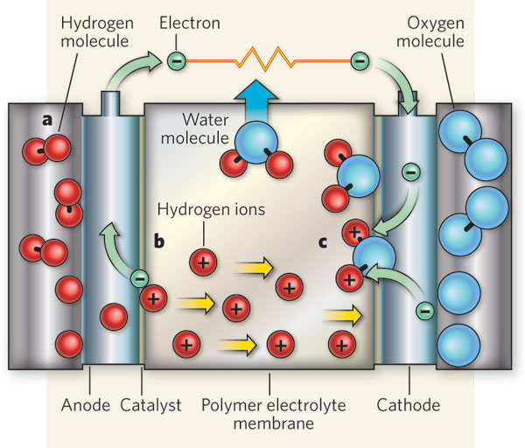
Hydrogen Fuel Cells
In a fuel cell reactants are added continuously so the cell can provide electricity as long as there is a fuel supply
Hydrogen fuel cell reaction:
2H₂ + O₂ → energy + 2H₂O
The basic process forces
atoms through a membrane
separating protons and electrons
which generates the electric current

Slide 35
Hydrogen Fuel Cells
Free hydrogen gas does not occur naturally on Earth so finding a viable supply of gas requires separating it from compounds like water or methane by heat or electricity
Current methods of producing hydrogen gas require burning natural gas which produces carbon dioxide
Cleaner methods of hydrogen gas production use electrolysis to “split” water into hydrogen and oxygen with an electric current

Slide 36
A future with renewables
Each alternative energy source has advantages and limitations
No single alternative energy source can replace the energy provided by fossil fuels so a renewable future must mean an integrated approach
Ways to improve energy efficiency with all energy sources include:
Utilizing natural geography and resources to maximize energy potential
Using local energy sources that don’t require transportation over long distances
Improve infrastructure for energy transmission

Slide 37
A future with renewables
Improvements to the current electrical grid are critical to maximizing efficiency of energy transfer from any source
The current system loses 5-10% of energy through power lines
Improvements are also necessary to protect the grid from attacks. Currently the United states grid is divided into three large sectors and if one part is knocked out it can affect the entire sector

Slide 38
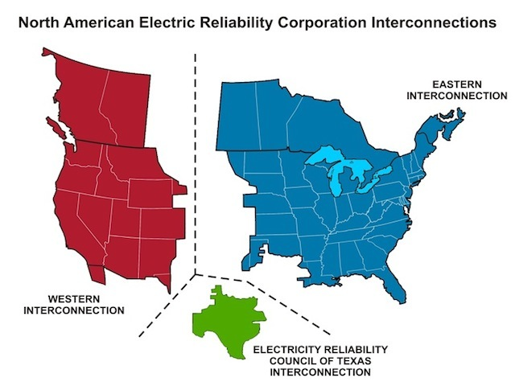
A future with Renewables

Slide 39
A future with renewables
Renewables mean a chance to provide local sources of energy that do not rely on the electrical grid for all electricity flow
A solution in development is the creation of a smart grid, a self-regulating distribution network that accepts any type of electricity and distributes it automatically to users.
The smart grid would use a computer to sense when electricity is needed and alert users when there is an excess

Slide 40
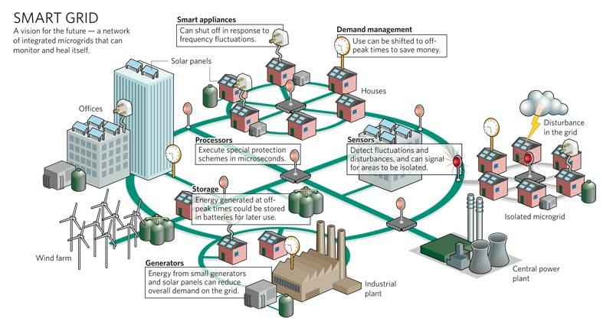
A future with renewables
In 2009 Obama announced a plan to invest $3.4 billion into smart grid technology which has gathered private industry support and funding

