Slide 1
APES Unit 2
The Living World: Biodiversity

Slide 2
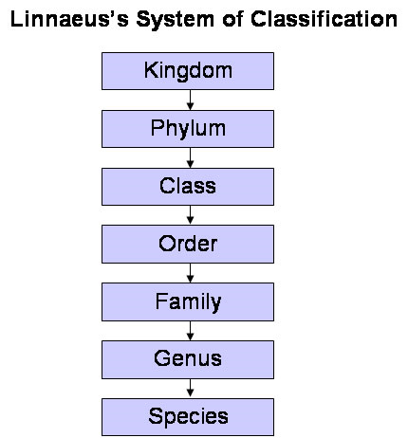
Biological Diversity
Refers to the variety of life forms (number of species) that inhabit a given area
The focus of biological diversity ranges from diversity of species worldwide, diversity within ecosystems, or diversity of genetic variations within a population

Slide 3
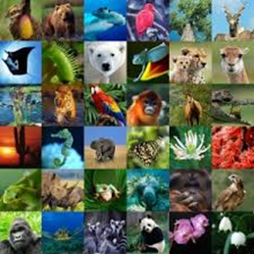
Biological Diversity
Diversity is constantly changing.
Only half of the species possible in ecosystems today may have been discovered at this point.
Extinction is happening at rates 100 times greater than natural rates of extinction.

Slide 4
Environmental Stressors
Physical Stress (natural disasters)
Wildfires
Pollution
Thermal stress
Radiation
Climatic (light, temperature)
Biological (predation, competition, parasitism, lack of mates)

Slide 5
Environmental Stress is increasing
By 2025, half of the world’s population will be living in water-stressed areas. | 17 of the 18 warmest years on record have occurred since 2001.
Populations of freshwater species have declined by 81% since 1970. | More than 8 million tons of plastics leak into the ocean each year . (That’s the same as one garbage truck every single minute.)

Slide 6
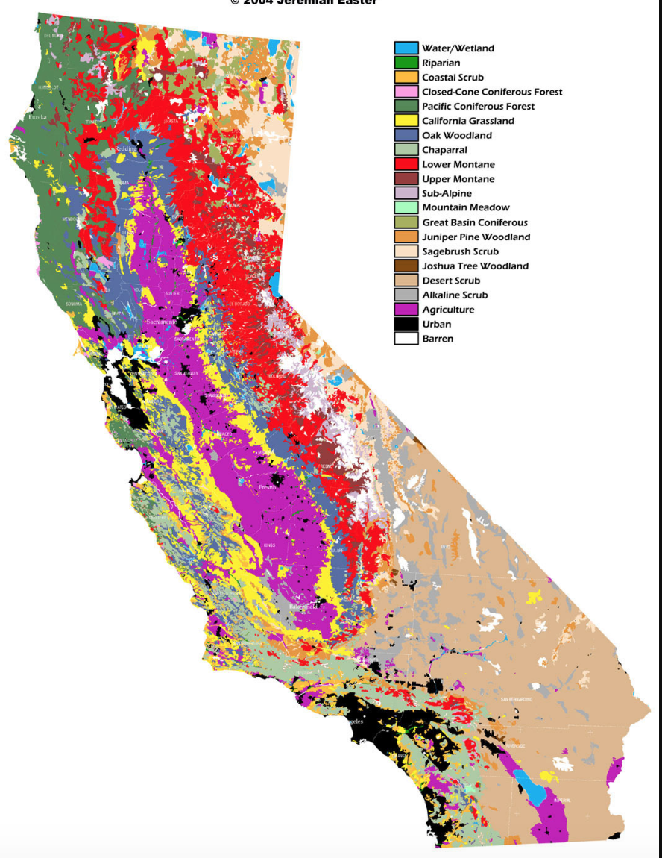
How is diversity measured?
Habitats/ecosystems are mapped.
Species are identified and catalogued according to evolutionary characteristics.
Genetic changes are analyzed using DNA technology.

Slide 7
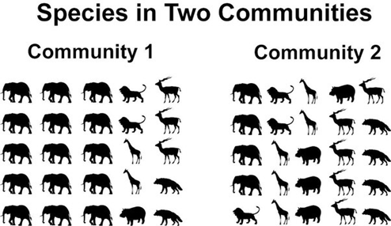
Habitat/Ecosystem Diversity
Abundance: total number of organisms in a community
Diversity: number of different species, niches, or genetic variations in a community
As diversity increases, abundance
of any one species generally
decreases.

Slide 8
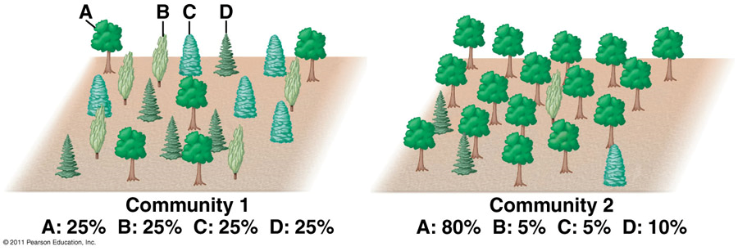
Habitat/Ecosystem Diversity
Species richness: total number of species
Species evenness: relative abundance of different species
Species dominance: abundance of one species relative to others

Slide 9
Species/Genetic Diversity
The diversity of species on Earth is created by individuals within a population adapting to their environment and finding success over their peers.
Adaptation: a change that makes an organism better suited for its environment

Slide 10
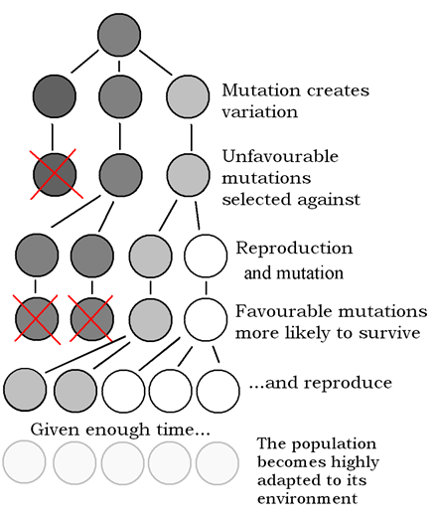
Evolution: change in species over time
Factors that drive evolution:
Inheritance of traits from one generation to the next (genetic variability)
Environmental variability
Difference in the number of offspring per individual

Slide 11
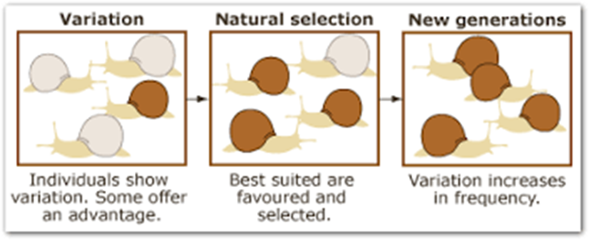
Natural Selection
Natural Selection: the process of better selected individuals passing on their traits to the next generation (survival of the fittest)
Environmental factors exert pressures on a population that can change the description of fitness for a species over time

Slide 12
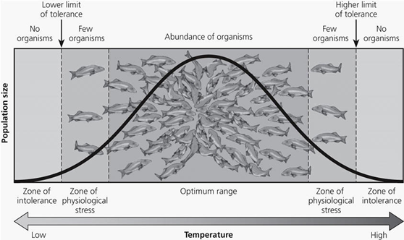
Selection pressures
Organisms naturally survive better in a certain range of conditions known as their tolerance limits
Liebig’s law states that the one
factor that has the biggest
influence on the success of the
organism is its critical factor

Slide 13
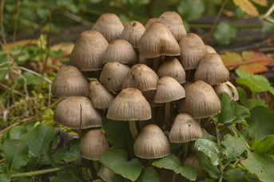
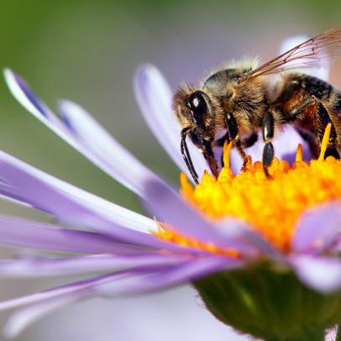
Selection Pressures
Ecological niche: the set of all environmental conditions under which a species can persist and carry out life functions
The extremely large number of species present on Earth is thought to be due to the high number of ecological niches available due to species interactions

Slide 14
Ecological Niche
Generalist species tolerate a wide range of environmental conditions and habitats as a part of their ecological niche
Specialist species only find success within a narrow range of conditions making them more vulnerable to changes in their environment (may also be endemic: native to only one specific area)

Slide 15
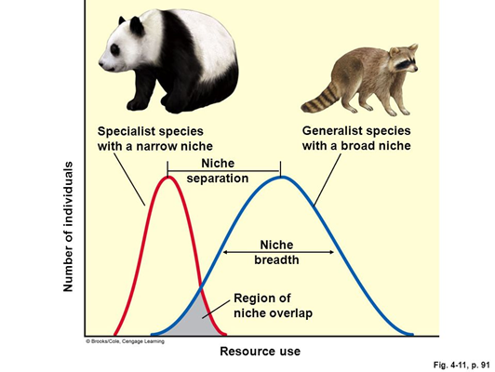
Ecological Niche
Specialists are more likely to become endangered due to disruptions in their habitat.
Successful invasive species are more likely to be generalists, easily adapting to a new habitat and resources.

Slide 16
Competition and Niches
Competition between species using similar resources can impact an organism's’ niche.
Two organisms cannot occupy the same niche according to the competitive exclusion principle.
A more diverse habitat can support a greater variety of niches.

Slide 17
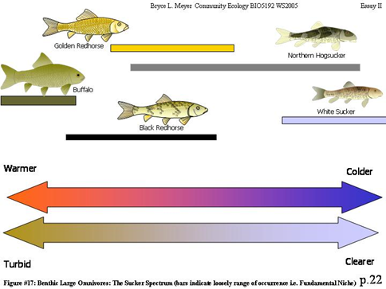
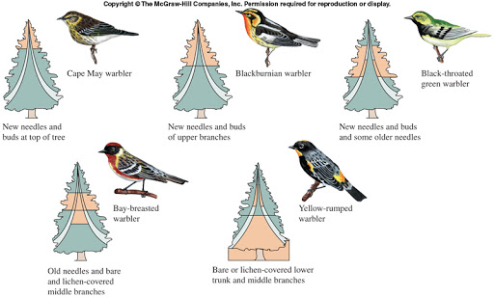
Competition and Niches

Slide 18
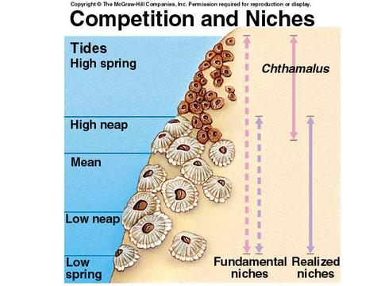
Competition and Niches
Fundamental niche: the conditions that a species can exist in without competition
Realized niche: the conditions that a species does exist in with normal competition

Slide 19
Population Viability
The more genetically diverse a population, the higher the chance of species survival
Genetic diversity increases the chance that if a population is impacted by a major disturbance some within the population will survive

Slide 20
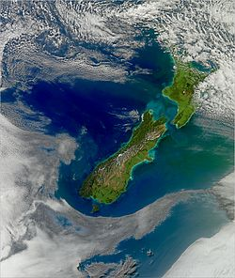
Population Viability
Small and isolated populations are more prone to extinction than large populations with better resources and individual movement
Small populations below a critical size may not be viable in just a few generations

Slide 21
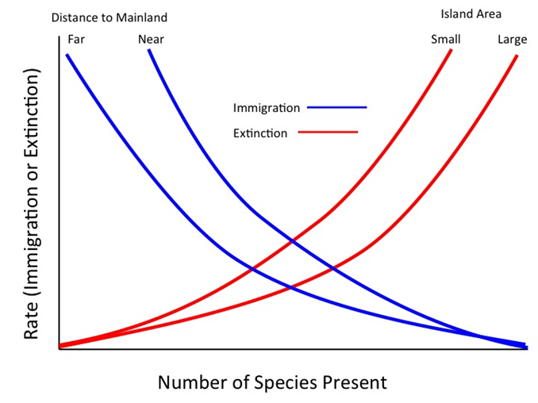
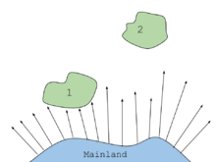
Island biogeography
:states that diversity of an ecosystem depends on rates of immigration and extinction
Immigration chances decrease with distance from a large landmass
Extinction rates increase with a smaller island size

Slide 22
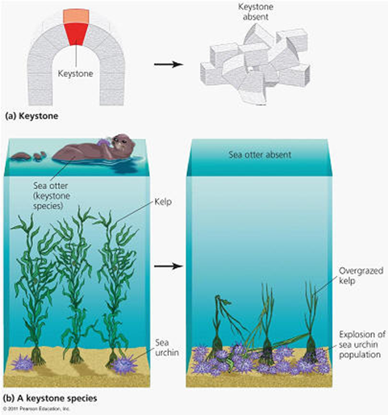
Keystone species
: a species that is critical to the survival of other species in the ecosystem
Keystone species support biodiversity in an ecosystem. Without the presence of a keystone species the ecosystem can collapse.

Slide 23
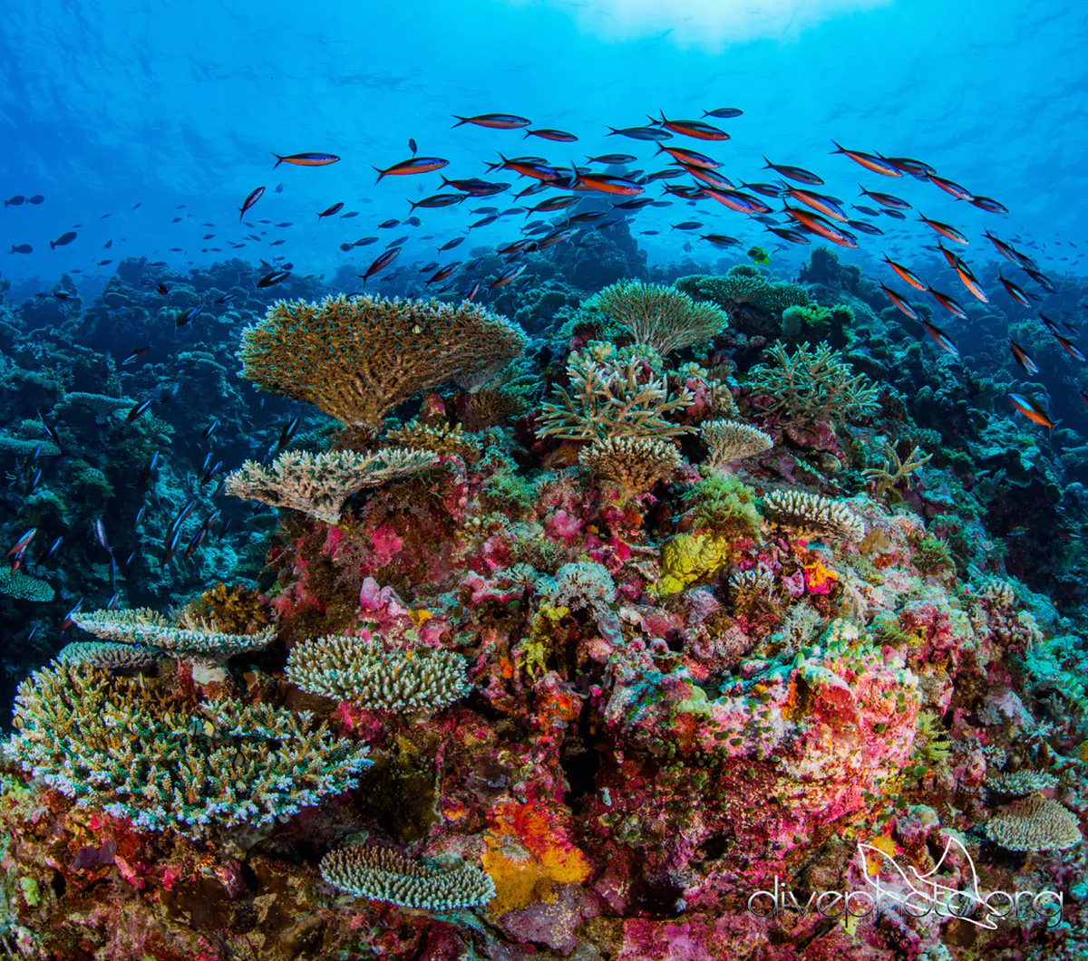
Foundation species
:Species that are critical to the structure of the ecosystem they inhabit
New research is defining species that have a hand in building an ecosystem that supports other species.

Slide 24
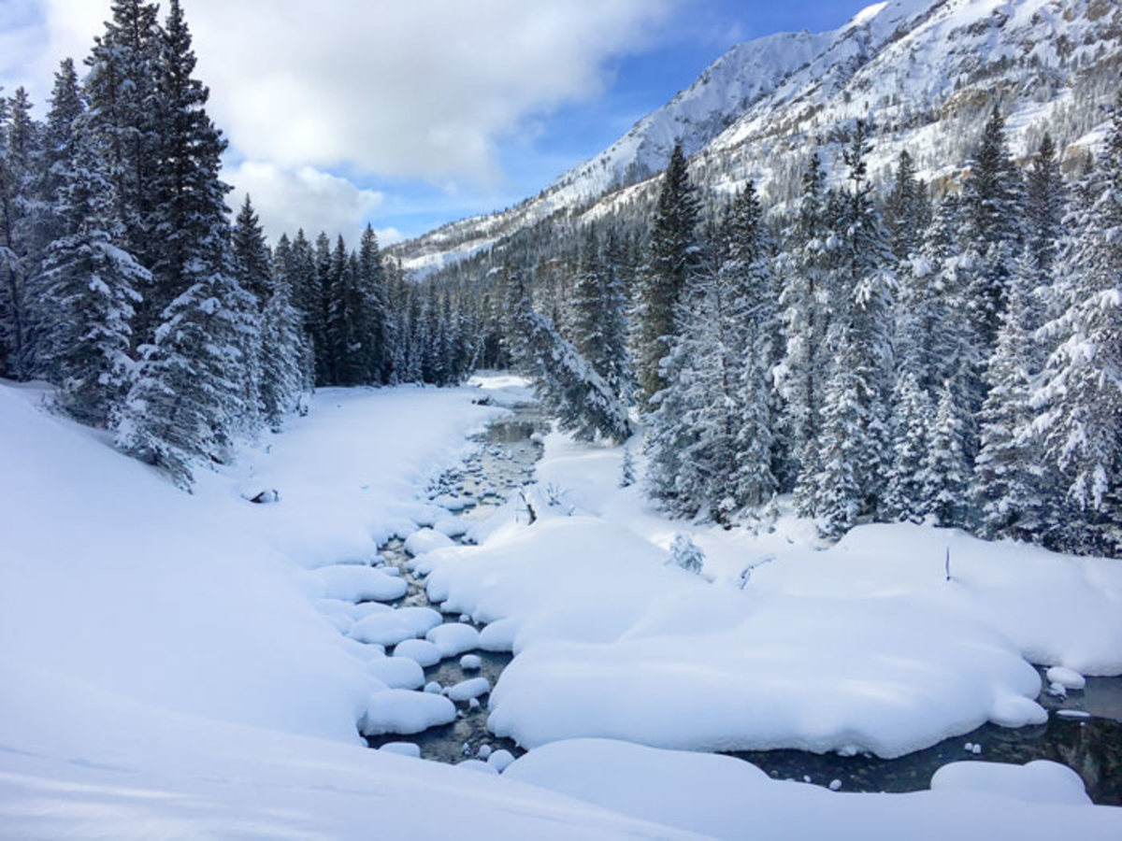
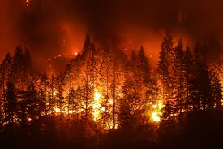
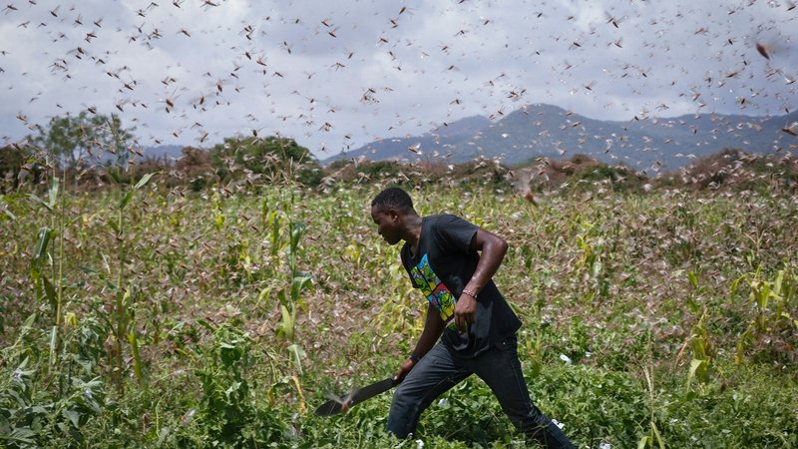
Natural Disturbances
Biodiversity is constantly threatened by both predictable and unpredictable events.

Slide 25
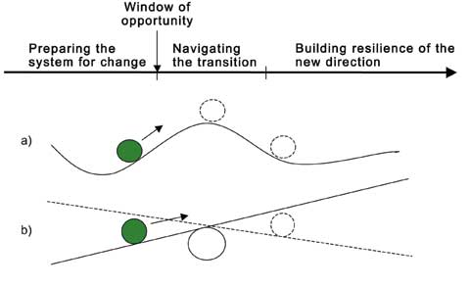
Ecological response to disturbance
Disturbances cause stress and force organisms to adapt or die.
An ecological tipping point is the
point at which the ecosystem
either builds resistance to changes
and adapts or begins to collapse.

Slide 26
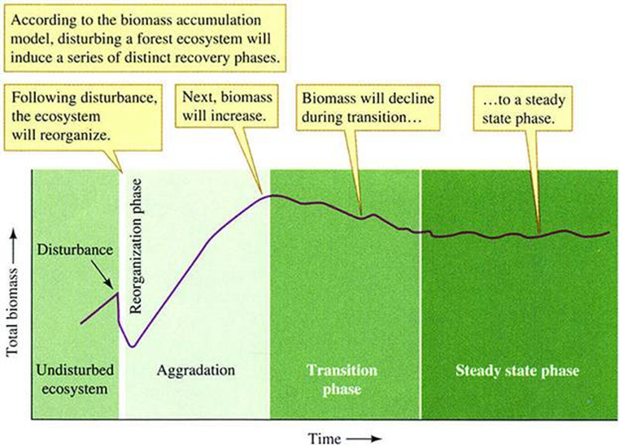
Ecological response to disturbance
Response to a disturbance is determined by characteristics of an ecosystem.

Slide 27
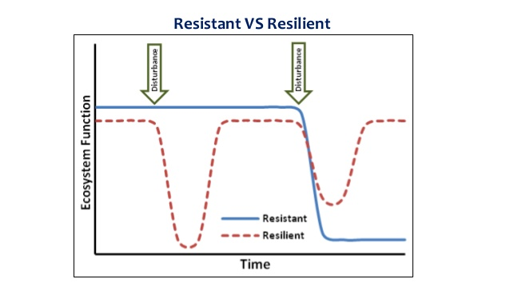
Ecological response to disturbance
Inertia/Resistance: the ability of a system to resist being disturbed
Resilience: the ability of a system to bounce back after disturbances

Slide 28
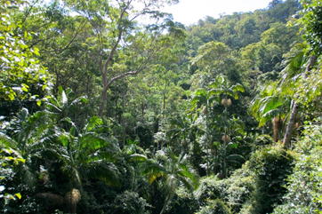
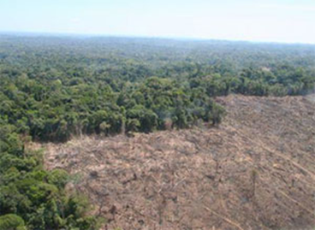
Ecological response to disturbance
Rainforests exhibit high inertia but low resilience.

Slide 29
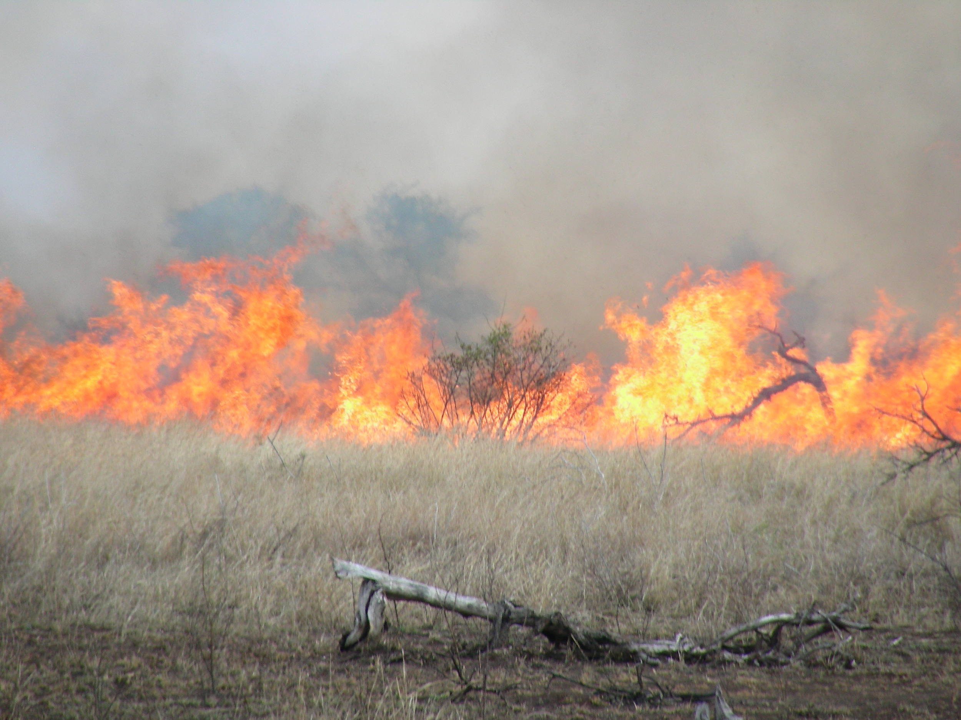
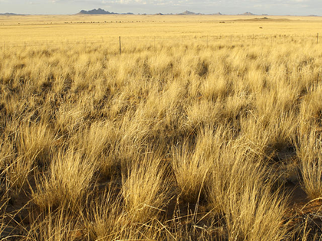
Ecological response to disturbance
Grasslands exhibit low inertia but high resilience.

Slide 30
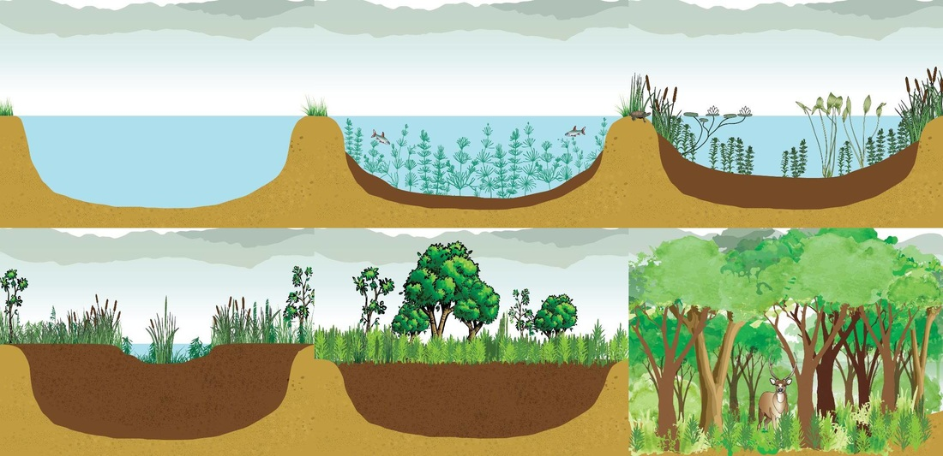
Succession
Natural, gradual changes in the types of species that live in an area or the replacement of one plant community by another through natural processes over time

Slide 31
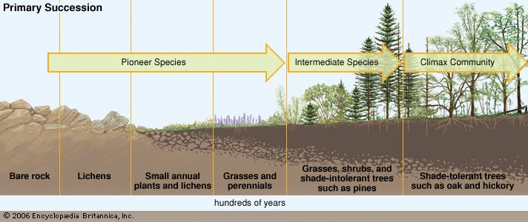
Types of succession

Slide 32
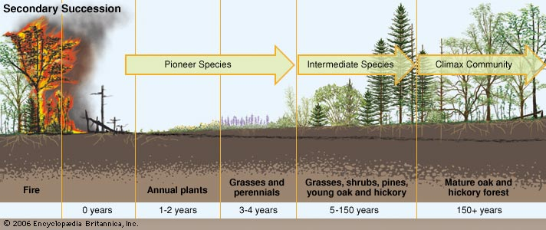
Types of succession

Slide 33
Human disturbances
Habitat destruction
Invasive species
Population growth
Pollution
Climate change
Overfishing
The acronym HIPPCO stands for the main threats to biodiversity in all ecosystems, mainly due to human influence.

Slide 34
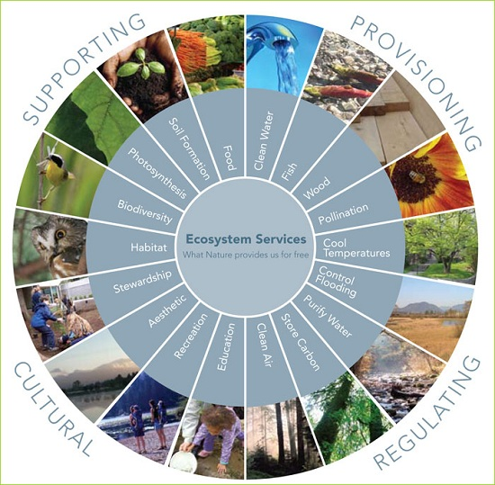
Ecosystem services
We should focus on improving ecosystems because of what they are able to provide for us.
Supporting ecosystem services support the economy and human society.

Slide 35
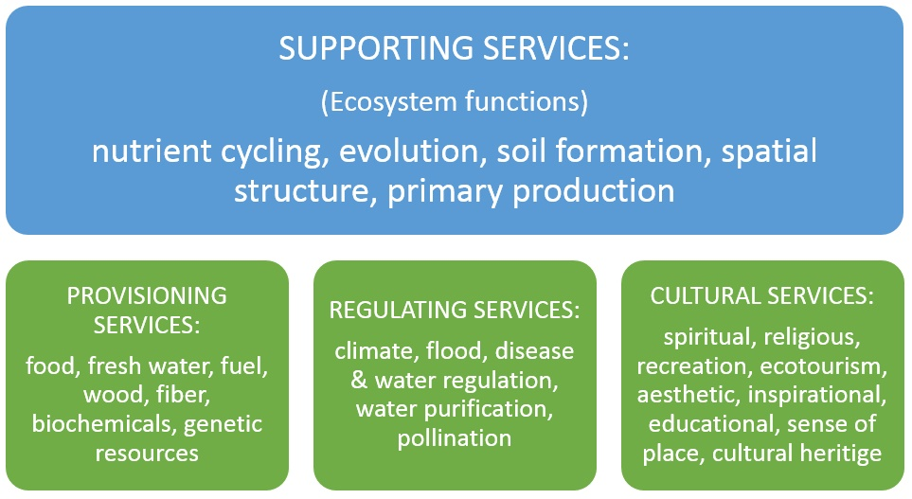

Slide 36
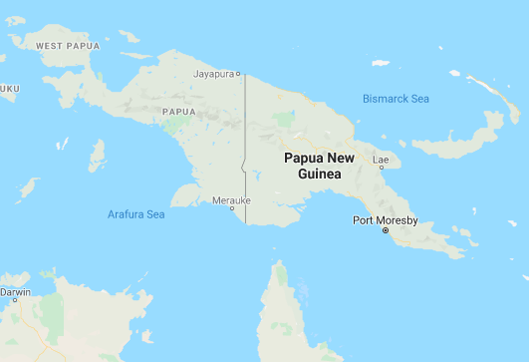
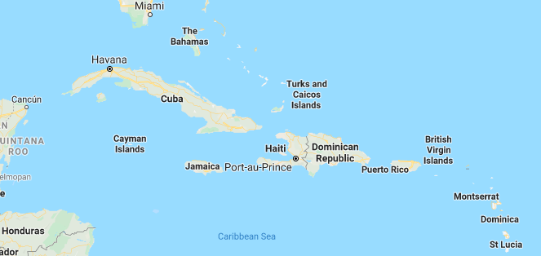
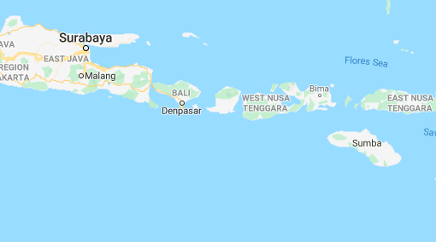
Island Biogeography

