Slide 1
APES Unit 4
Earth Systems

Slide 2
GEOSPHERE

Slide 3
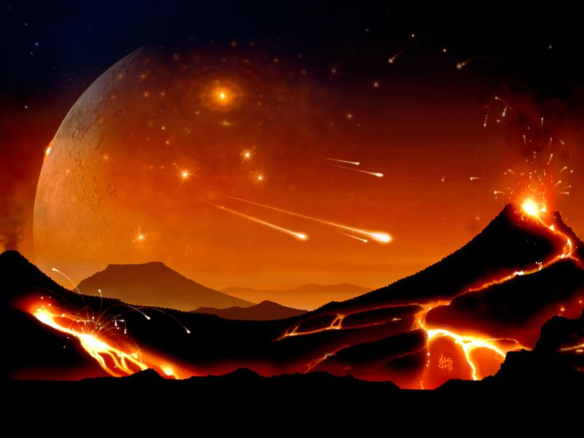
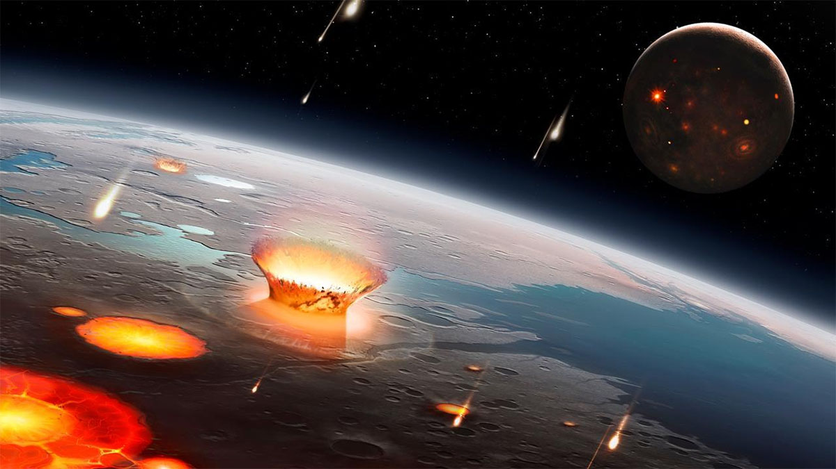
Geologic History of the Earth
Earth is 4.5 billion years old
Earth likely had a solid surface shortly after formation
Earth’s surface is constantly changing due to tectonic processes and weathering and erosion

Slide 4
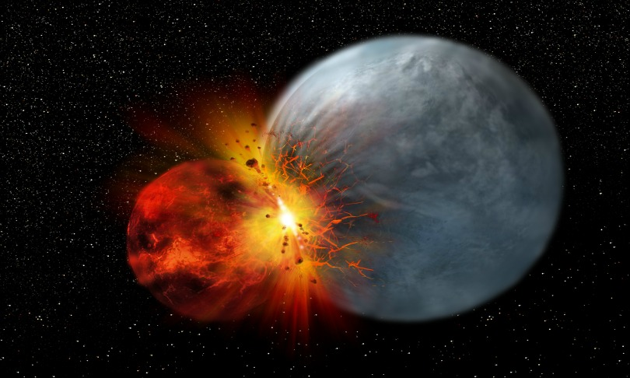
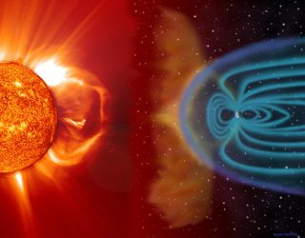
Theories about Earth’s key events
The moon formed from a collision with a rogue planet
Water accumulated due to the impact of thousands of ice comets
A molten outer core allowed for a strong magnetic field and stable atmosphere

Slide 5
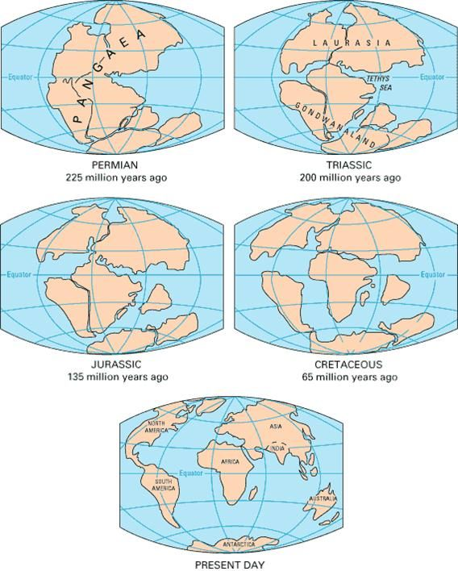
Earth Processes
Tectonics refer to large scale processes that change the Earth’s crust.
Evidence
Earthquake/volcano activity
Rock cycle
Movement of landmasses
Paleomagnetism
Geologic history

Slide 6
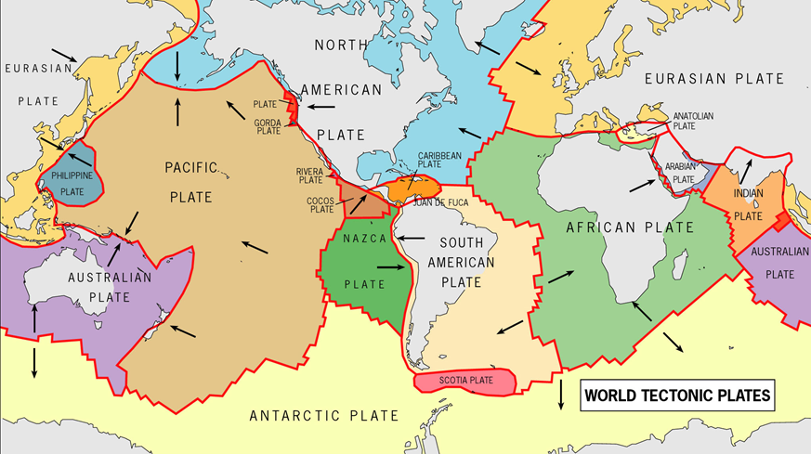

Slide 7
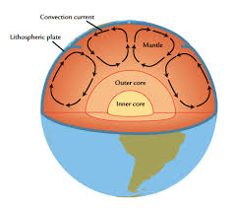
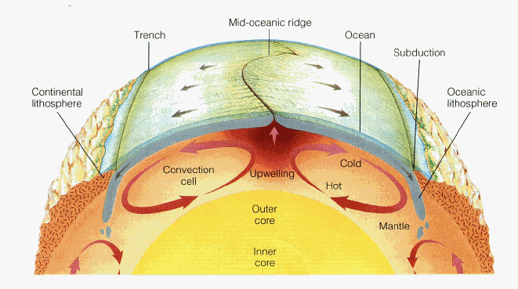
Earth Processes
Convection currents circulate material in the upper mantle due to temperature differences.
Hot material rises and cool material sinks.
How the currents interact with the crust determine the direction of plate movement.

Slide 8
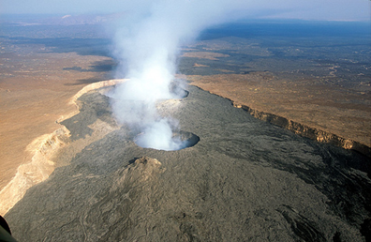
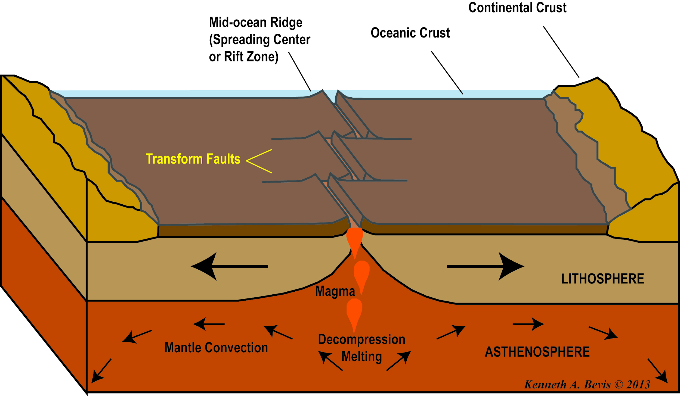
Divergent Boundaries
Places where tensional stress pulls plates apart.
Landforms: Mid-ocean ridges, rift valleys

Slide 9
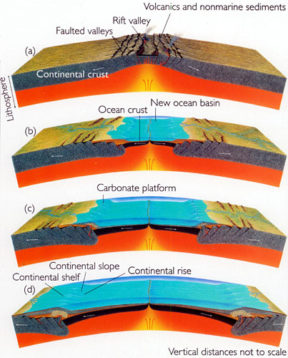
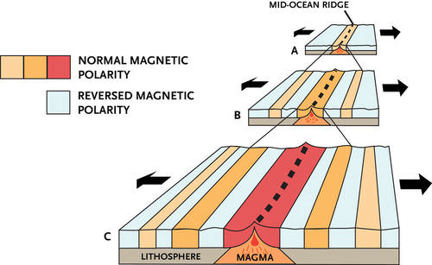
Divergent Boundaries
Seafloor spreading creates new ocean floor as plates move apart.
The youngest rocks are at the mid-ocean ridges.

Slide 10
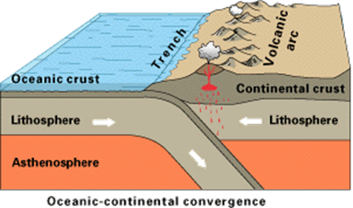
Convergent Boundaries
Places where compressional stress pushes plates together.
Landforms: Subduction zones, trenches, volcanic island arcs, mountain ranges
Oceanic crust that is more dense sits lower in the mantle and is more likely to subduct under less dense, continental crust.

Slide 11
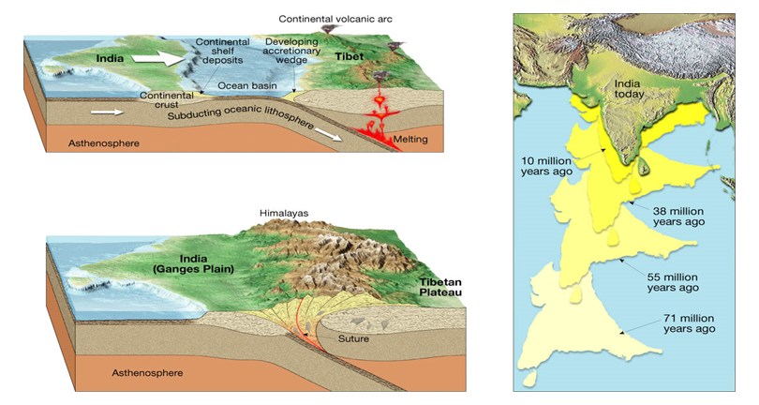
Convergent Boundaries

Slide 12
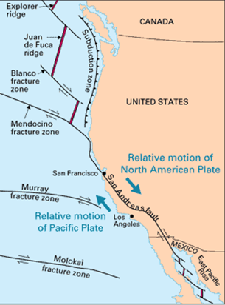
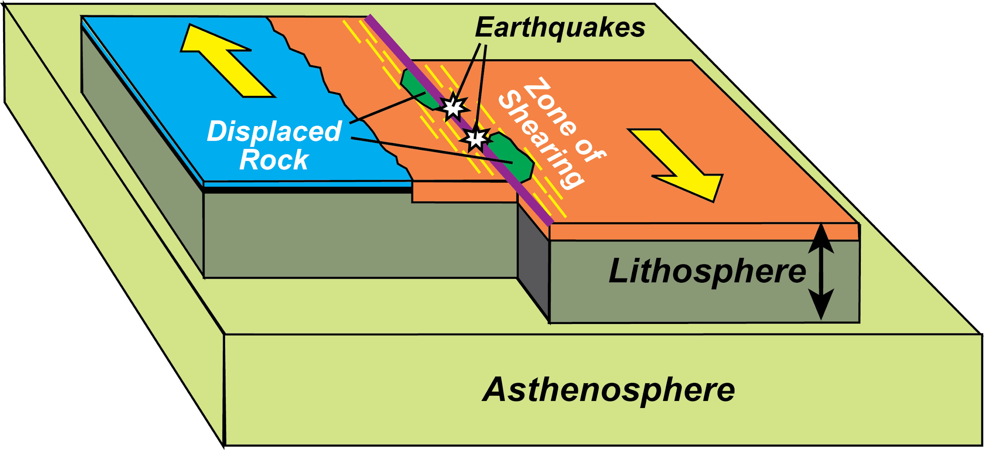
Transform Fault Boundaries
Places where shear stress twists rocks causing them to move past each other.
No landforms, high earthquake activity.

Slide 13
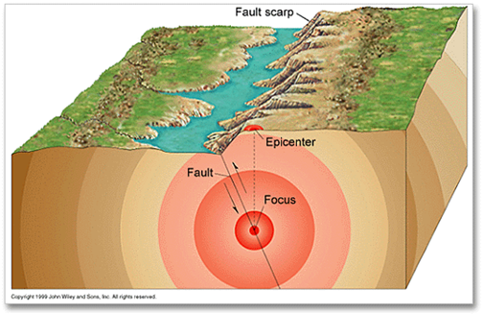
Earthquakes
STRESS STRAIN FAULTS
(Force on rocks) (Weakening of rocks) (Rocks break/fracture)
The major cause of earthquake
activity is stress acting on rocks
causing faults.

Slide 14
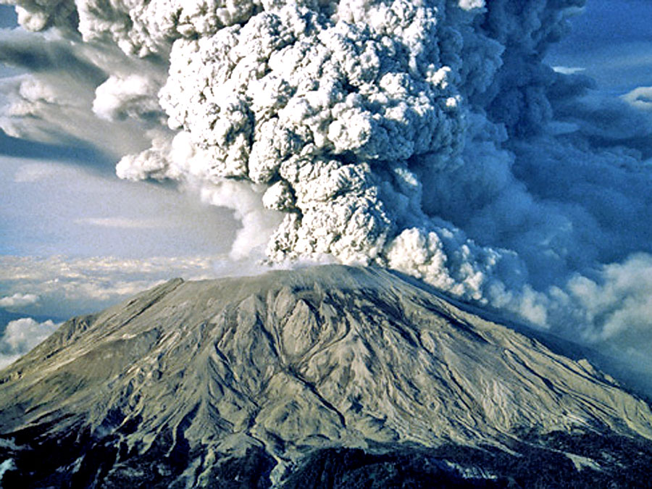
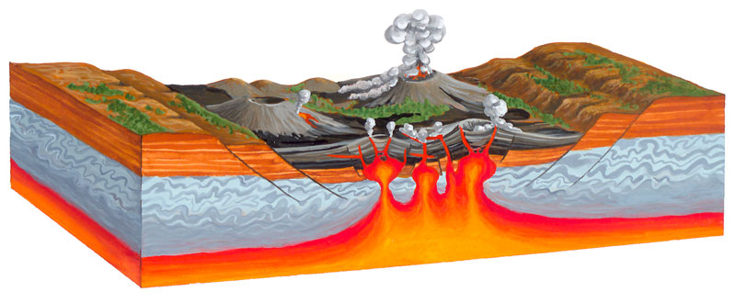
Volcanoes
Volcanism involves any movement of magma to the surface.
Volcanic rock is the initial source of material for the rock cycle because it forms igneous rock.

Slide 15
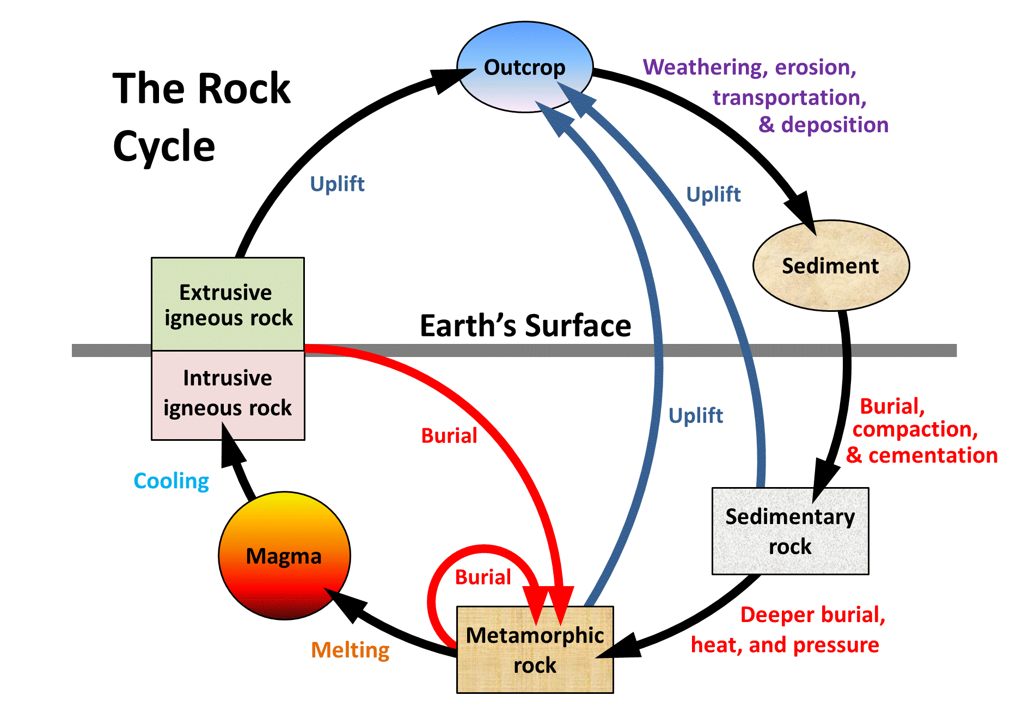
The Rock Cycle
: the continuous transformation of rocks from one form to another (igneous, metamorphic, sedimentary), driven by geologic forces

Slide 16
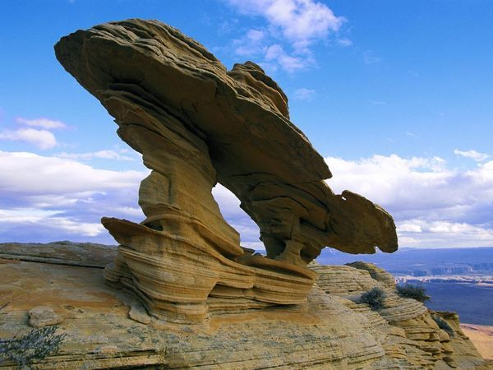
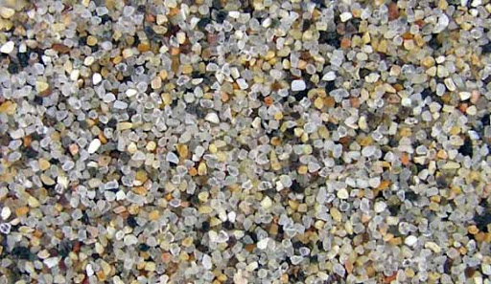
Weathering
: the process of breaking rocks into smaller pieces
Generates sediments through mechanical/physical processes or chemical reactions.

Slide 17
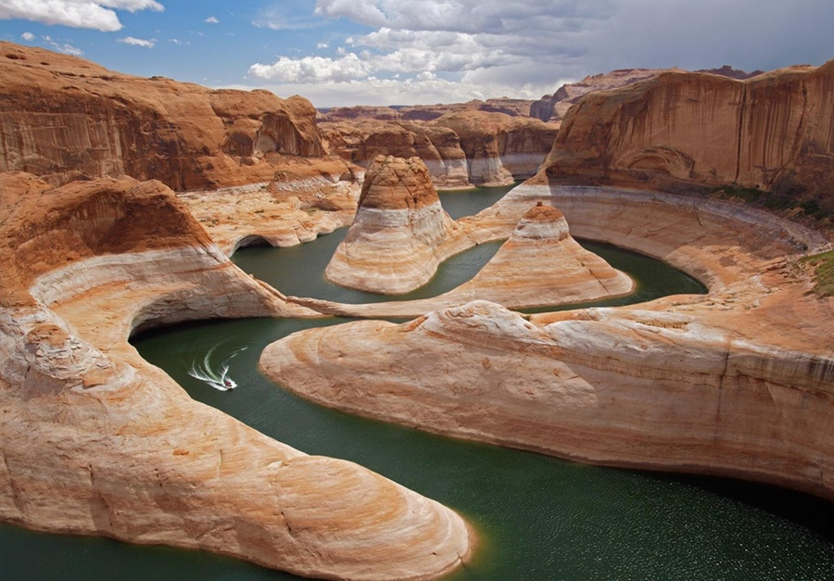
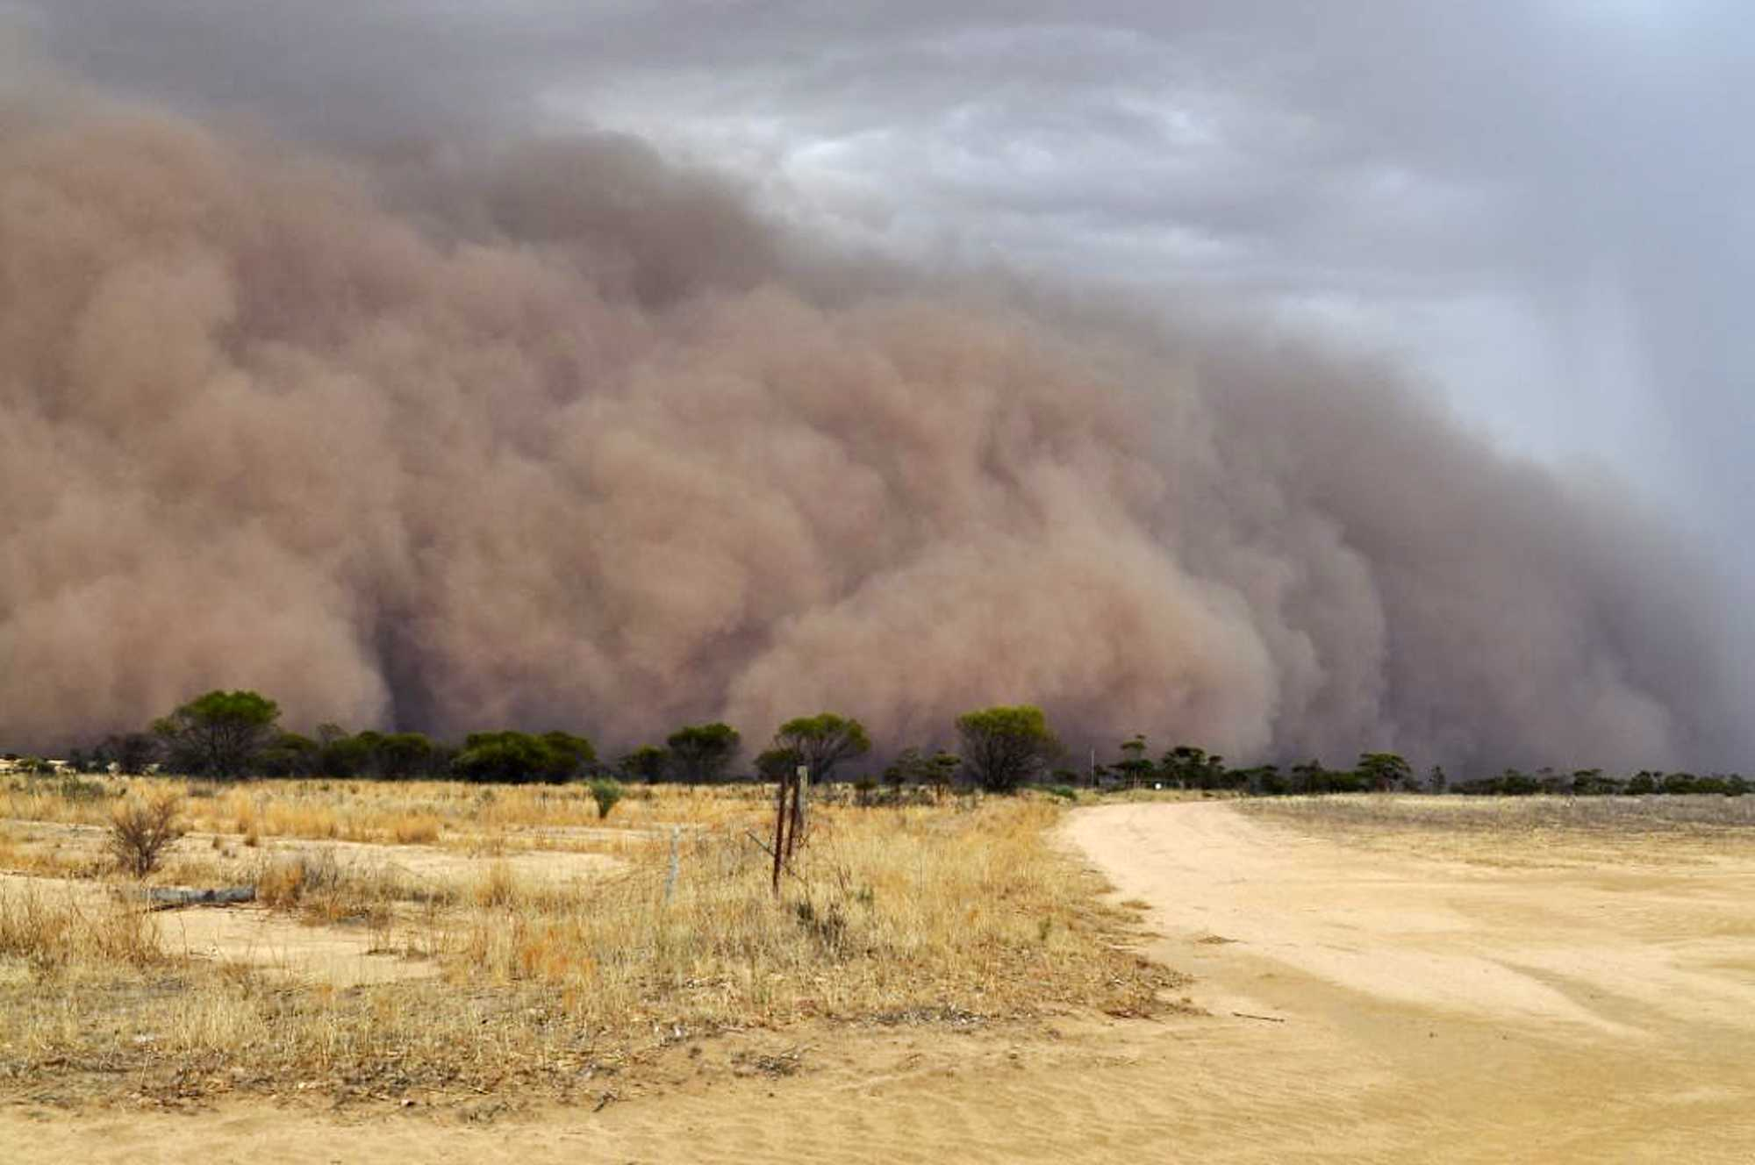
Erosion
: the transport of sediments from one location to another
Forces include wind, water, ice, living organisms.
Factors that affect amount of erosion include amount of force, size of sediment, and location.

Slide 18
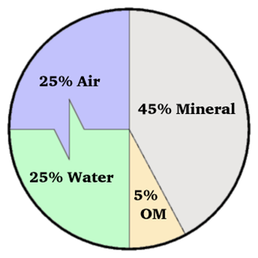
Deposition
: dropping of sediments in a new location
Deposition of sediments builds the foundation for soil
Soil is the portion of the Earth’s crust that supports plant growth
Composition of Soil
50% Water and air
45% Minerals
5% Organic matter (decomposing plants and animals also called humus)

Slide 19
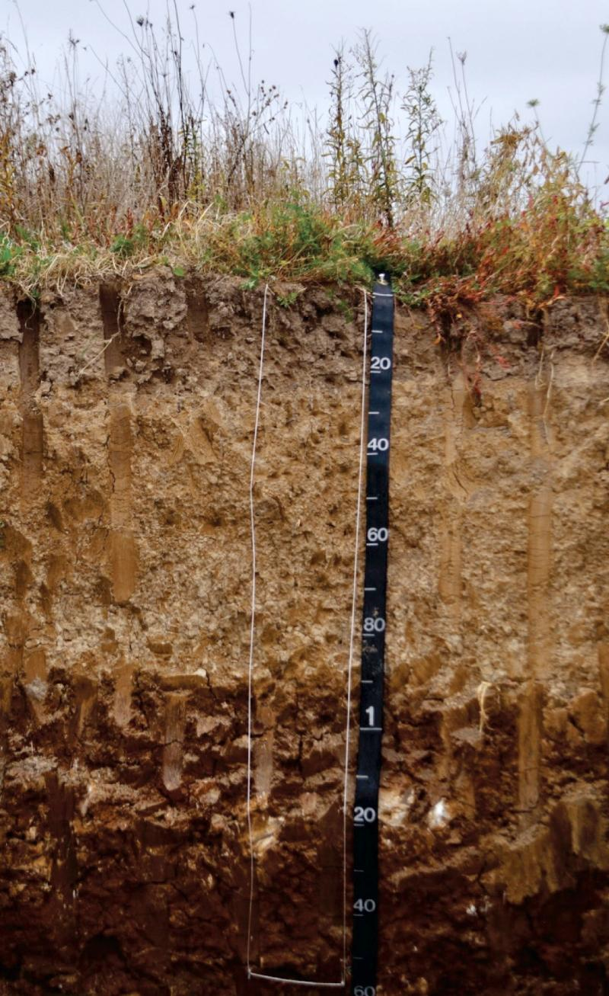
Soil development
From above: deposition of organic material from dead organisms and their waste
From below: weathering of rocks and minerals provide raw material

Slide 20
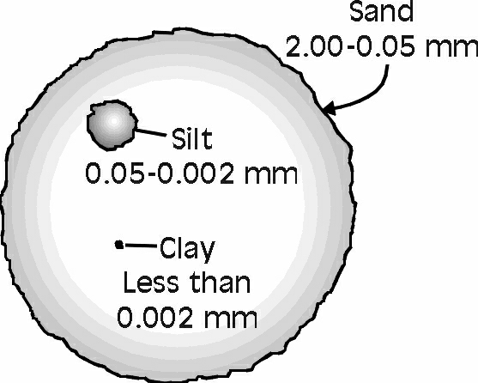
Soil Properties (Physical)
The amount of weathering can create different textures of soil based on sediment size.
Size categories: sand, silt, clay

Slide 21
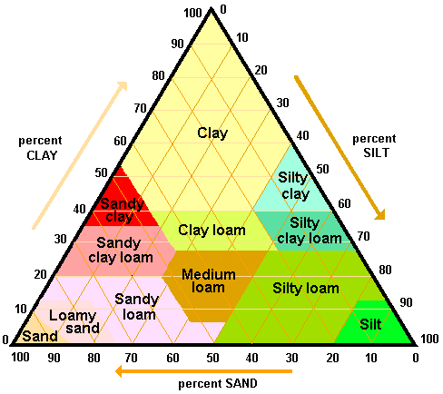
Soil Texture Triangle
To use the diagram:
Look at the percentages of clay, silt and sand in a soil sample and find where the 3 percentages meet.
Example:
30% Clay, 10% Silt, 60% Sand
= _____________

Slide 22
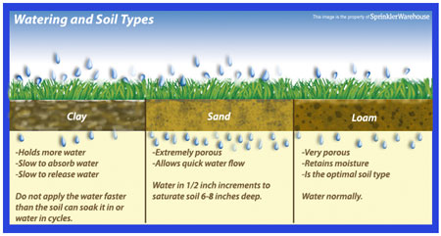
Soil Properties (Physical)
Soil texture directly relates to water drainage through soils.

Slide 23
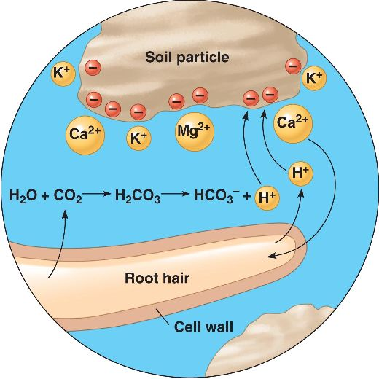
Soil Properties (Chemical)
Cation Exchange Capacity is a measure of negatively charged spaces in soil able to capture positively charged cations by electrostatic force
Common cations = Ca²⁺, Mg²⁺, Na²⁺, K⁺
High CEC = ability to retain nutrients,
buffer against acidification

Slide 24
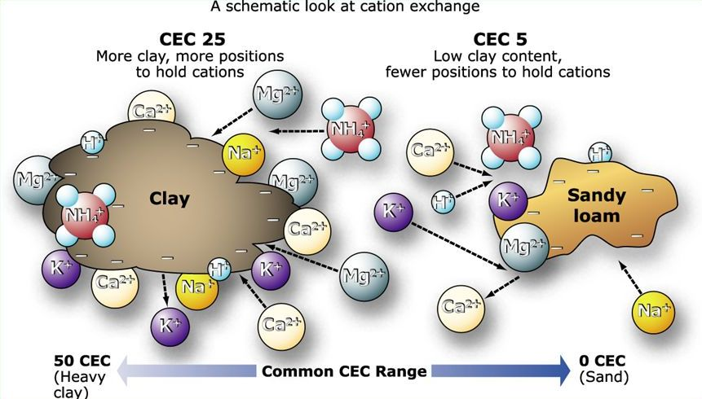
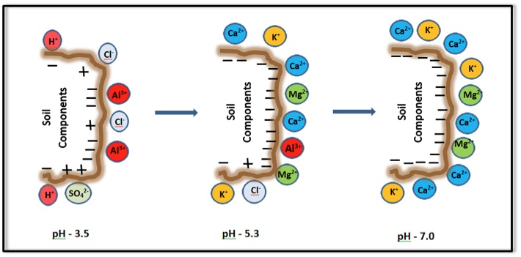
Soil Properties (Chemical)
High levels of clay and organic material increase CEC.
Sand has poor CEC.
Acidic soils retail more H⁺, Al⁺, Mn⁺ (acidic cations)

Slide 25
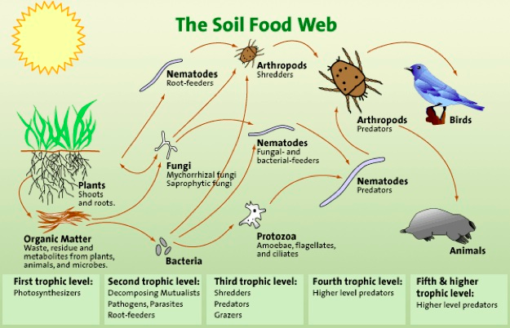
Soil Properties (Biological)

Slide 26
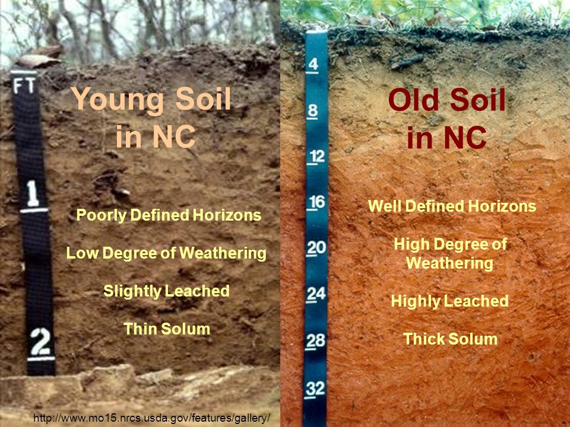
Soil Profiles/Horizons
As soil forms it separate into layers called horizons that are distinguished by color, texture, and composition.
Older soils generally develop thicker profiles and more well defined horizons.
A cross section of soil from the surface to bedrock is called a soil profile.

Slide 27
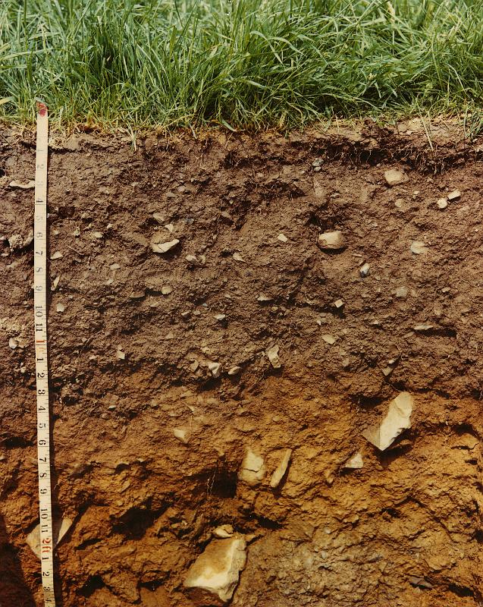
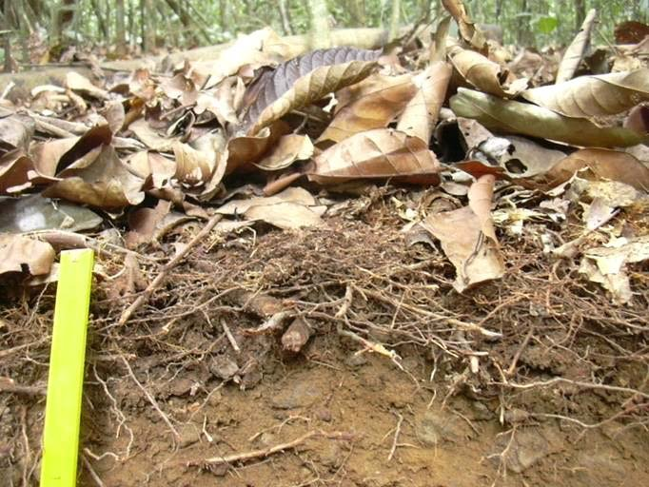
Soil Horizons
A Horizon (topsoil)
Surface soil/topsoil
Organic mixed with mineral material
Most biological activity
O Horizon (humus)
Decomposed organic material
Thicker in high productivity ecosystems

Slide 28
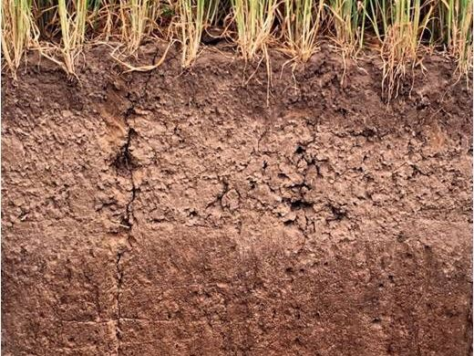
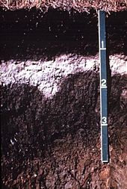
Soil Horizons
B Horizon (subsoil)
In some acidic soils
Metals and nutrients are leached, or eluviated, from above (iron, aluminum, organic acids)
E Horizon (Eluviated)
In some acidic soils
Metals and nutrients are leached, or eluviated, from above (iron, aluminum, organic acids)

Slide 29
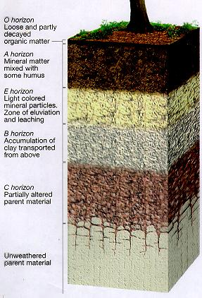
Soil Horizons
C Horizon
Least weathered
Similar to the parent material (bedrock)

Slide 31
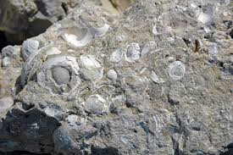
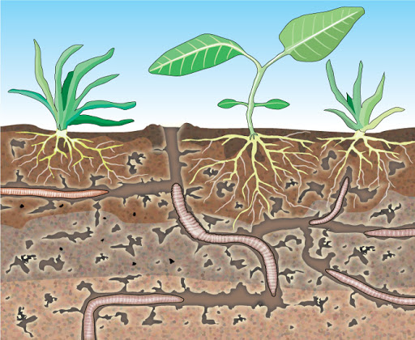
What makes a good soil?
Parent material (minerals)
Quartz = nutrient poor
Calcium carbonate= high pH, high nutrient content
Organisms
Plants absorb nutrients, secrete acid
Animals create tunnels for aeration
Decomposers recycle nutrients

Slide 32
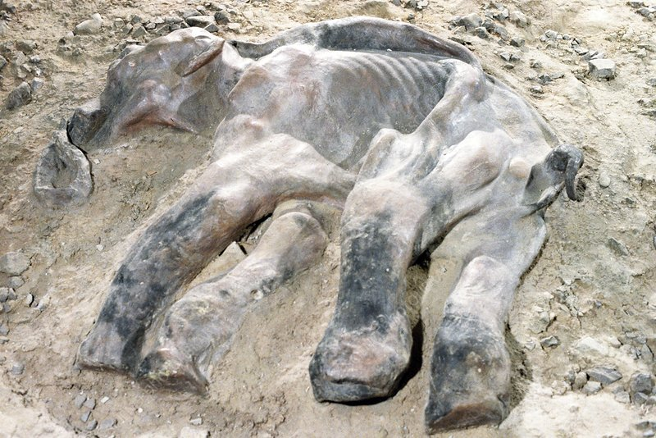
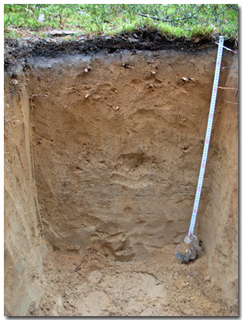
What makes a good soil?
Location/Climate
Too cold = organic material does not decompose
Tropical = rapid weathering, leaching, and absorption of nutrients leaving nutrient poor topsoil

Slide 33
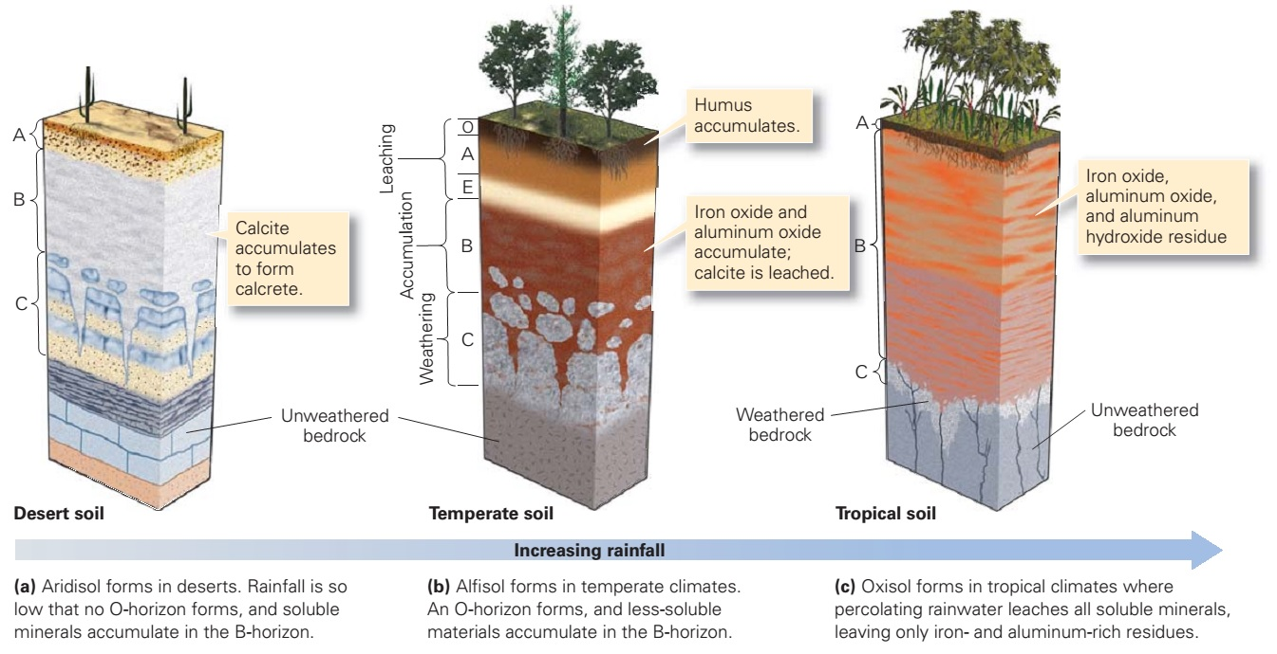

Slide 34
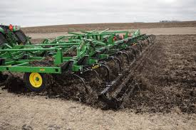
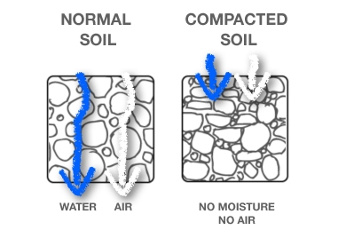
Human impact on soils
Agriculture
Disruption of topsoil
Increased erosion/loss of nutrients
Compaction of soils from equipment/livestock
Decrease of pH from pesticide use
Increased leaching from irrigation

Slide 35
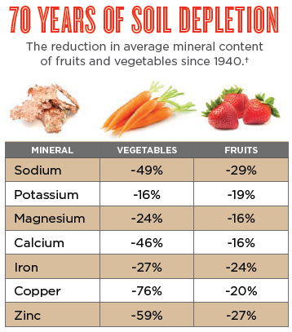
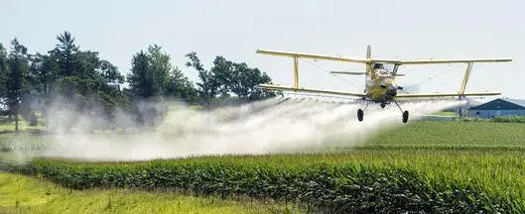
Human impact on soils

Slide 36
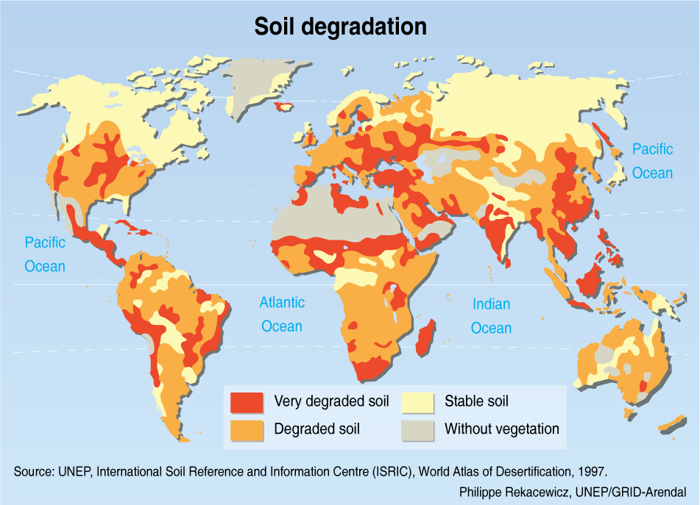

Slide 37
HYDROSPHERE

Slide 38
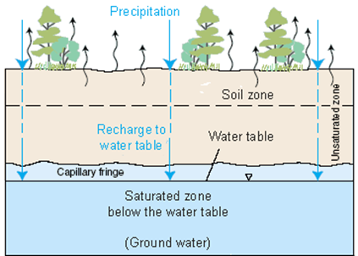
Water in soil
Infiltration from the water cycle contributes to water stored in rocks and soil.
Water stored underground becomes a part of groundwater.

Slide 39
Water in soil
Characteristics of soil/rock determine how much water infiltrates and how long it takes to filter.
Permeability: ability of water
to pass through a material.
Porosity: amount of space
between sediments.

Slide 40
Groundwater profiles
Zone of aeration: from the surface to the water table
Water table: highest point of water underground
Zone of saturation: area of water storage, water fills all sediment spaces

Slide 41
Groundwater
: any area where water is stored
underground
Also called aquifers.
Surrounded by impermeable layers of rock or soil called aquicludes
May or may not have direct access to the surface

Slide 42
Groundwater concerns
Humans can access groundwater through wells.
Most groundwater is used for irrigation of crops.
Groundwater must be recharged by precipitation/infiltration.

Slide 43
Watersheds
: an area of land that collects runoff and directs it into groundwater systems or surface features
Characterized by topography and surface material.

Slide 44
Watersheds
Precipitation that falls on a region is directed into watersheds based on ridges of elevation called divides.
Inside a watershed the amount water that infiltrates into groundwater vs. collecting in surface water is based on the amount of permeable surfaces.

Slide 46
Types of watersheds
Agricultural
barren fields, compact soil, less infiltration. Fewer streams
Application of fertilizers and pesticides

Slide 47
Types of watersheds
Urban
natural water flow pattern greatly altered
high runoff, vulnerable to flooding

Slide 48
ATMOSPHERE

Slide 49
What is the atmosphere?
: blanket of gases surrounding the Earth

Slide 50
What is the atmosphere?
We live at the bottom of an “ocean of air”
Atmospheric pressure is caused by the weight of air
As altitude increases, pressure decreases

Slide 51
Structure of the Atmosphere
Atmospheric layers are separated by differences in temperature trends.
Pauses are areas of stable air between temperature changes.

Slide 52
Conditions in the Atmosphere
Most atmospheric changes (weather) occur because of differences in temperature and/or pressure.

Slide 53
Conditions in the Atmosphere
Wind is generated by changes in temperature and pressure.
Wind blows from:
HIGH PRESSURE → LOW PRESSURE
Temperature differences create
pressure differences

Slide 54
Conditions in the Atmosphere

Slide 55
Conditions in the Atmosphere
Unequal solar radiation creates patterns of pressure and temperature differences. These difference result in global wind cells that distribute heat from the tropics to the poles.

Slide 56
Conditions in the Atmosphere
Global winds have circulation because of the Coriolis effect.
Coriolis effect describes the pattern of deflection taken by objects not firmly connected to the ground as they travel long distances around Earth.

Slide 57
Conditions in the Atmosphere
The Earth is wider at the equator than at the poles so it spins faster. Wind moving away from the equator takes on a curve as the speed of rotation changes.

Slide 58
Conditions in the Atmosphere
Weather is the set of the conditions in the atmosphere at a specific place and time.
(temperature, moisture, pressure, wind speed and direction)
Climate is the long term pattern of weather in a location.

Slide 59
Climate Factors
Climate is determined by:
Latitude : as latitude increases,
solar energy decreases
Elevation: as altitude increases, temperature decreases (troposphere)

Slide 60
Climate Factors
3. Surface material
4. Proximity to mountain ranges and ocean currents

Slide 61
Ocean Currents
Proximity to cool or warm ocean currents can drastically change the weather of the surrounding areas.

Slide 62
Ocean currents
Winds direct the movement of ocean surface currents.
Upwelling may occur where warm surface water is moved by winds and cold, nutrient rich water from below fills the gap.

Slide 63
El Niño-Southern Oscillation (ENSO)
ENSO refers to fluctuations in temperature between the ocean and atmosphere in the east-central Equatorial Pacific

Slide 64
El Niño (ENSO warm)
Unusually warm water in the equatorial Pacific
Caused by weakened or reversed trade winds
Suppressed upwelling reduces nutrients available to ecosystems

Slide 65
La Niña (ENSO cold)
Unusually cool water in the equatorial Pacific
Strong trade winds
Increased upwelling fuels ecosystems

