Slide 1
APES Unit 5
Land and Water Use:
Agricultural Practices and Solutions

Slide 2
How do we feed the world?
•Food production outpaces human population growth by increasing approximately 2.2% each year
•Average global consumption of food per person is 3,000 kcal each day, almost 1,000 kcal above recommended values
•Industrialized countries average 3,500 kcal per day

Slide 3
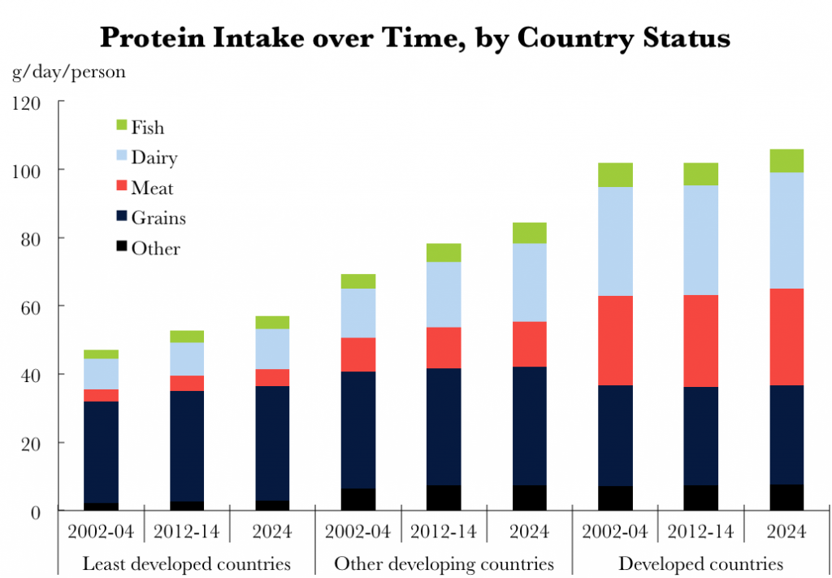
How do we feed the world?
•Globally, diets are increasing protein intake, going beyond the recommended 40-60g per day
Increasing protein consumption increases the demand for more agricultural land.

Slide 4
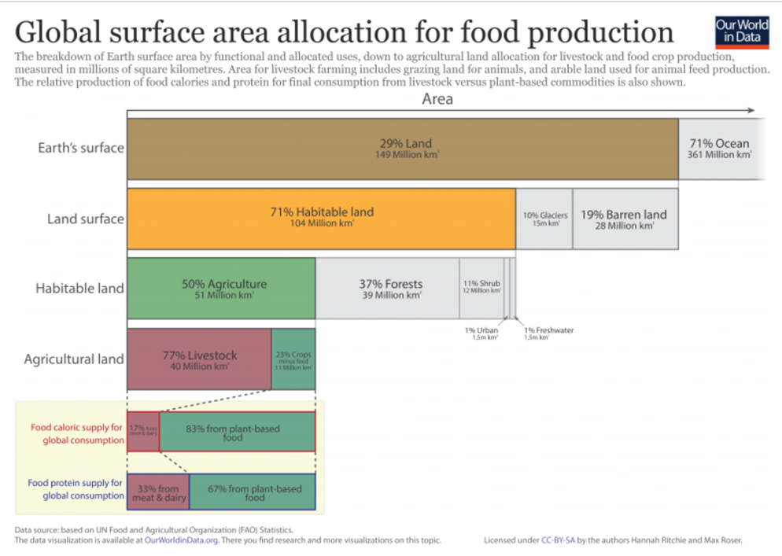

Slide 5
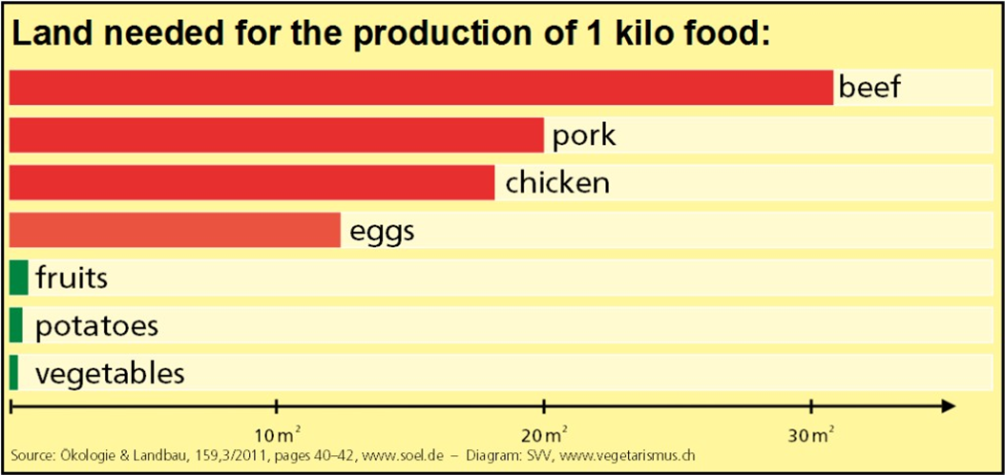
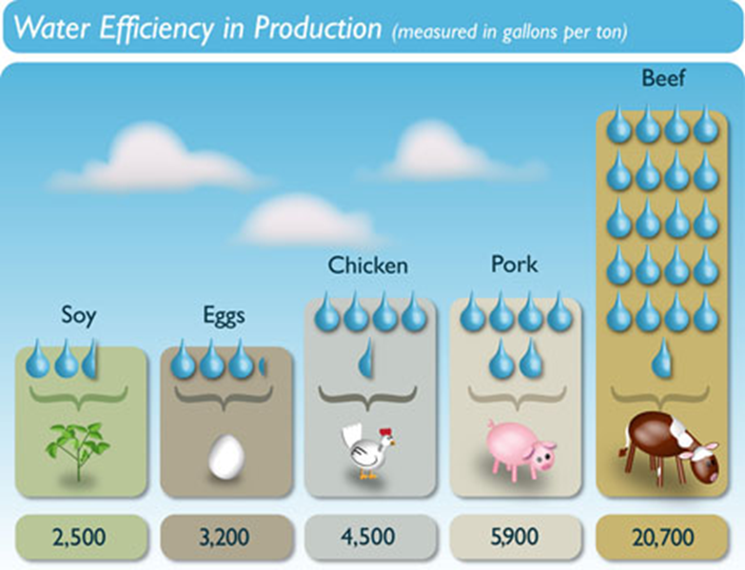
Meat Production
It takes 20X more land to produce the same amount of calories from meat as from plants.
It takes 10X more water to produce the same amount of calories from beef as from eggs and plants

Slide 6
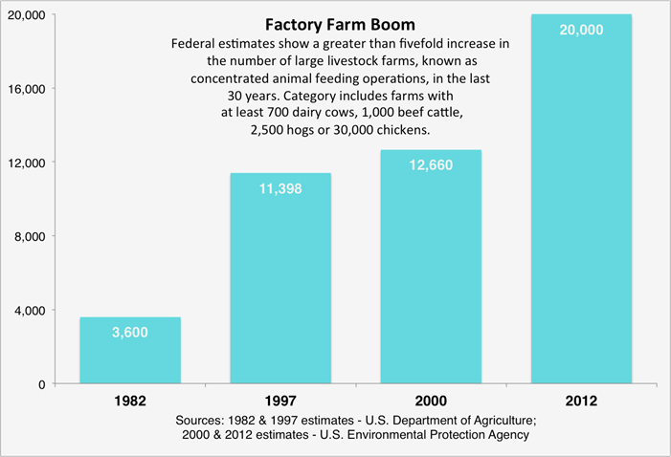
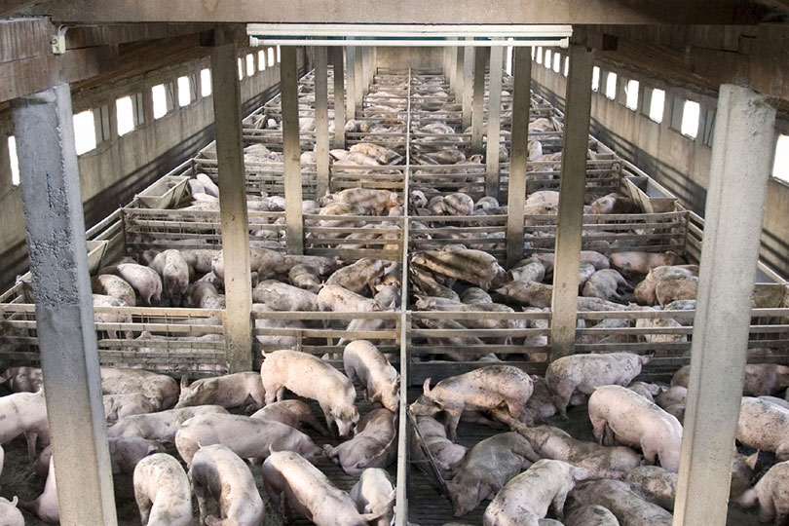
Meat Production
There has been an increasing trend toward factory farms focused on the quantity of the product and profit.
Factory farms for meat production are also called CAFO’s or Concentrated Animal Feeding Operations.

Slide 7
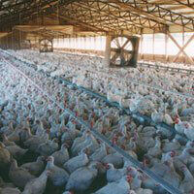
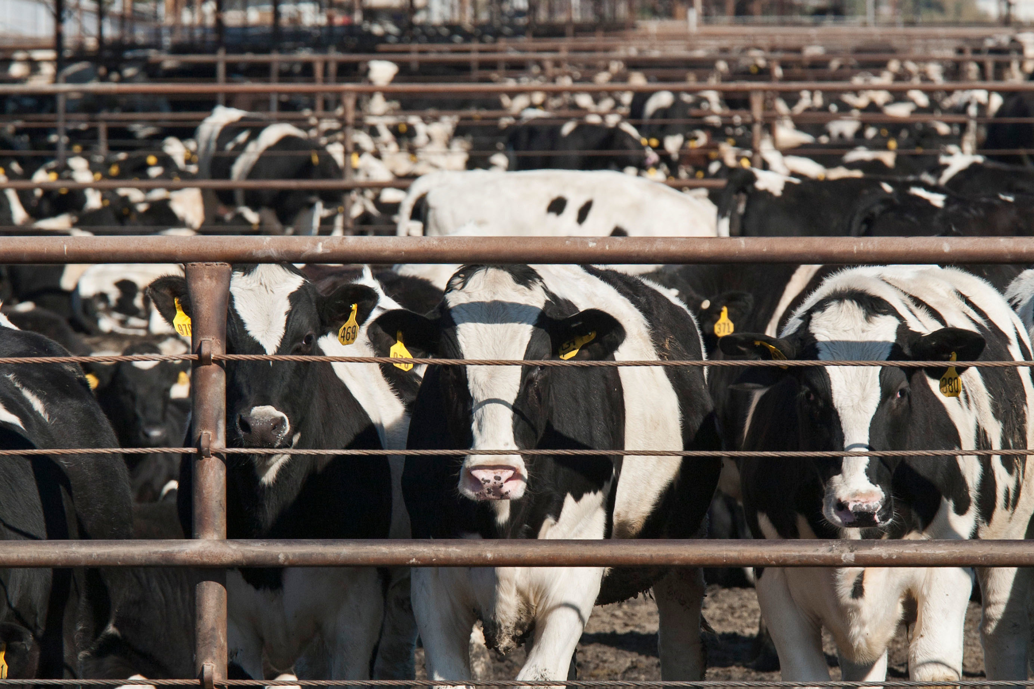
Meat Production
CAFO’s minimize the land costs involved in meat production.
Organisms are often confined to small spaces and live in close proximity to each other.
Antibiotics are widely used to combat diseases.

Slide 8
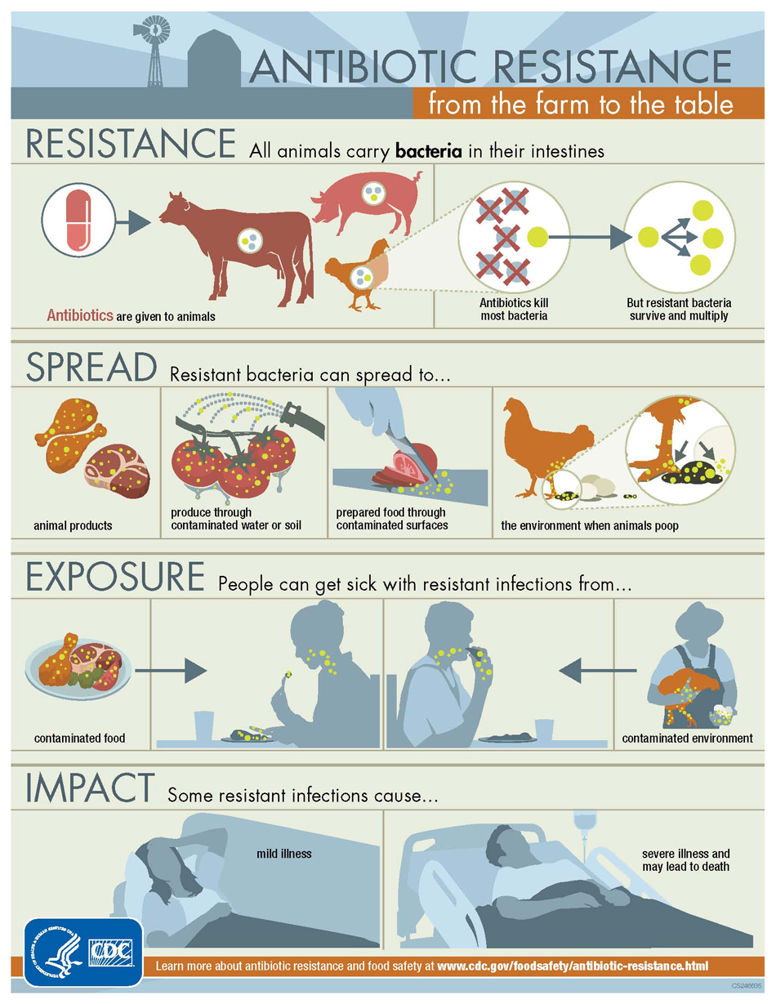
Environmental Concerns from CAFO’s
Antibiotic resistance: widespread use of general antibiotics generates genetic resistance in a population.
Disease: high density populations increase the chance of disease outbreaks that can be transferred to consumers (Mad Cow disease, E. coli)

Slide 9
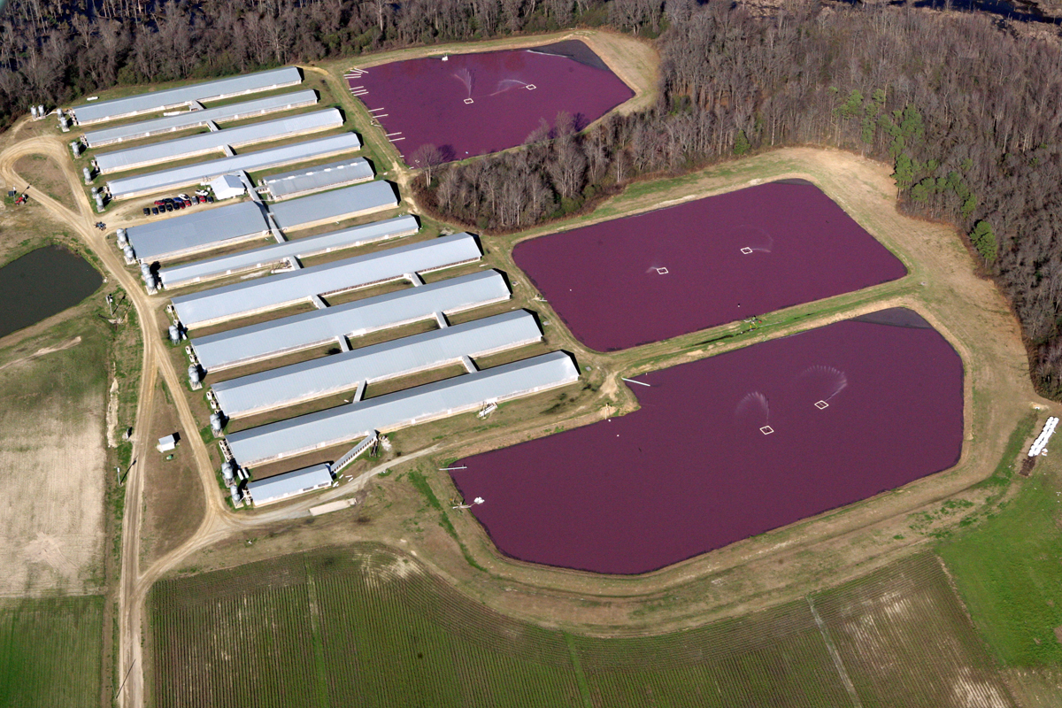
Environmental Concerns from CAFO’s
3. Waste disposal:
The average CAFO produces the amount of waste a town of 5000 humans would produce (on much less land).
Run off pollutes surrounding waterways and groundwater.

Slide 10
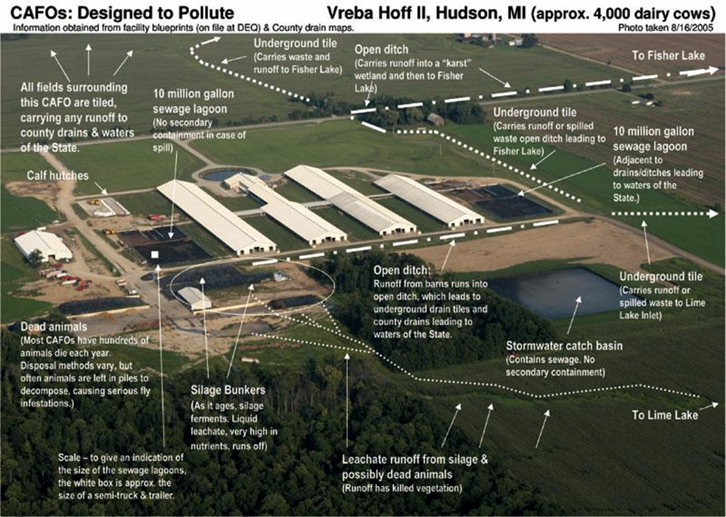

Slide 11
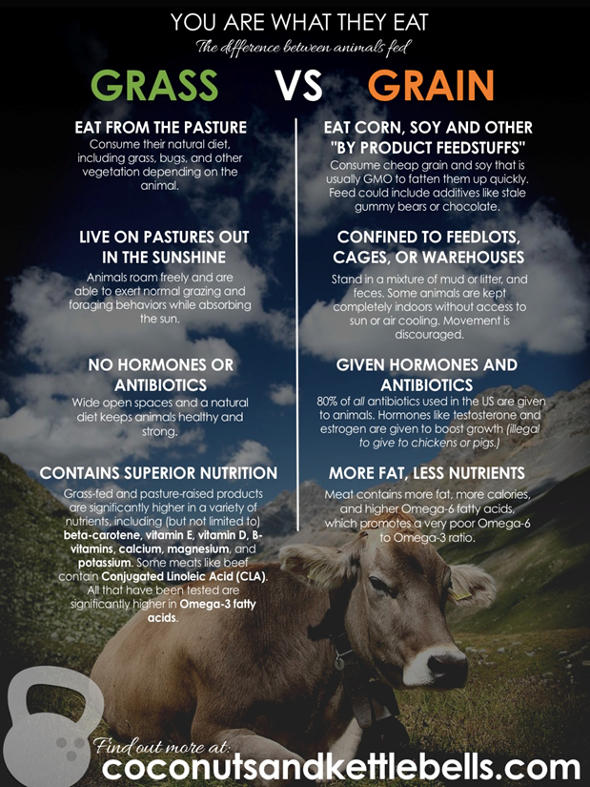
Environmental Concerns from CAFO’s
4. Ethical treatment of animals.
5. Nutritional content of food.

Slide 12
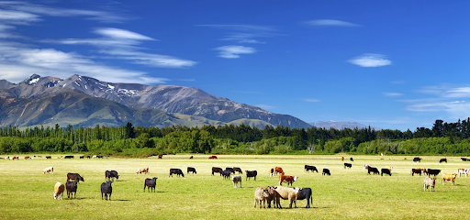
Meat Production on Rangelands
Rangelands: Dry, open grasslands used for the grazing of cattle
Free-range grazing
Most common use of land
in the United States

Slide 13
Rangelands
Benefits
Uses land that is too dry for other agricultural applications.
Less fossil fuels
More natural, nutritious meat produced.
Concerns
Stream bank erosion
Vulnerability to fires
Pollution of surface water
Overgrazing (soil compaction)

Slide 14
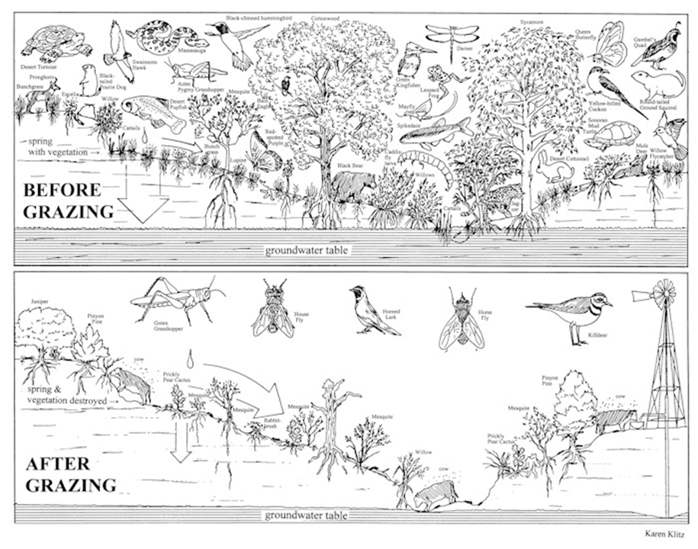

Slide 15
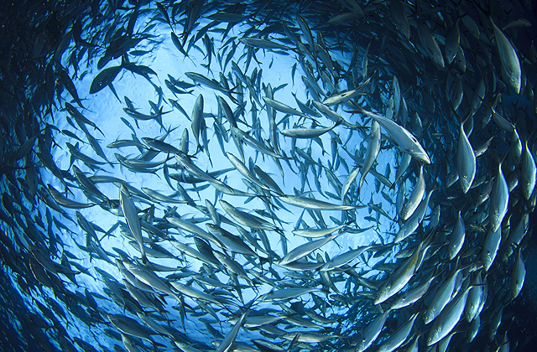
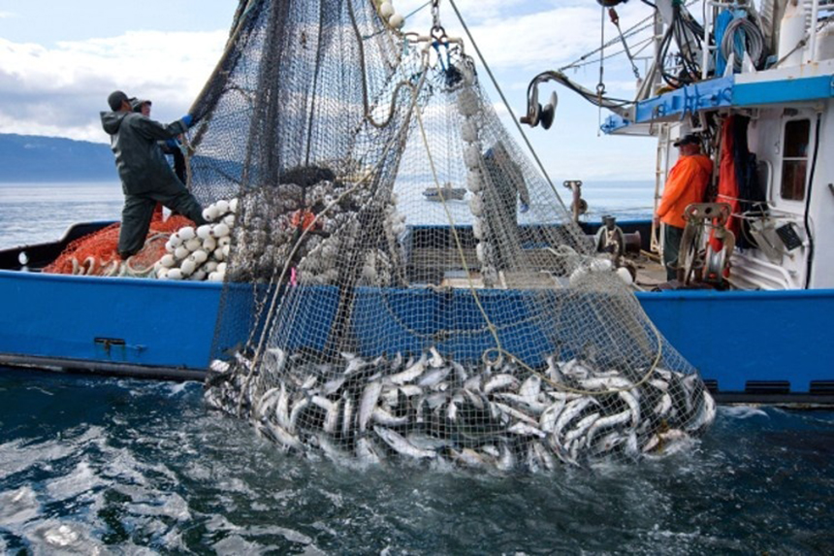
Fisheries
: fishing ground that can be harvested commercially
Fish protein makes up almost all dietary protein in Africa and Asia
Wild fish populations are decreasing

Slide 16
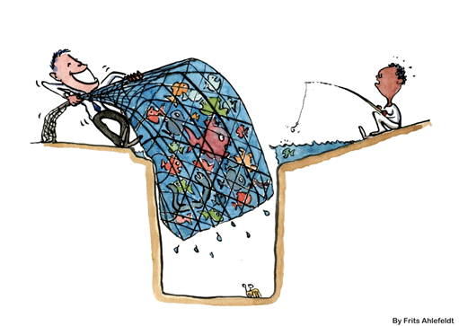
Fishery collapse
Decline of a fish population by 90% or more
25% of world fisheries have collapsed
There is no incentive to protect fish population because open water is not governed by a single nation. (ToC)

Slide 17
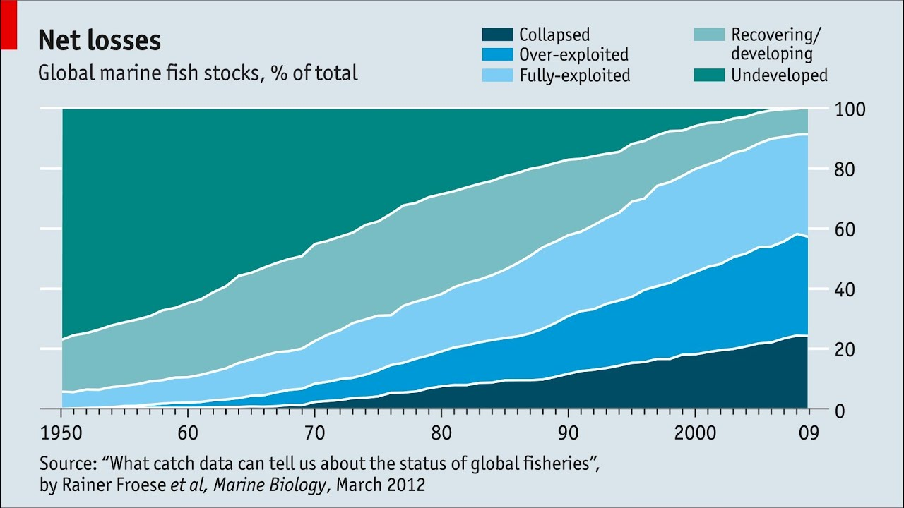
Fishery Collapse/Exploitation

Slide 18
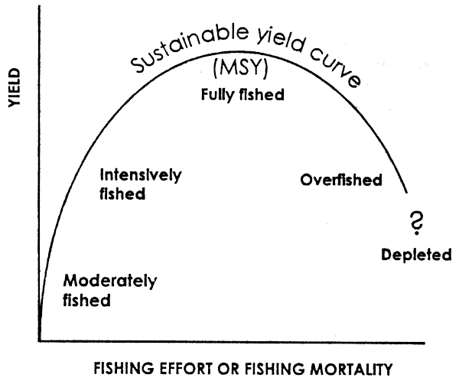
Maximum Sustainable Yield (MSY)
The maximum amount of a resource that can be harvested without compromising the future availability of that resource.
Must be used to prevent fishery collapse.

Slide 19
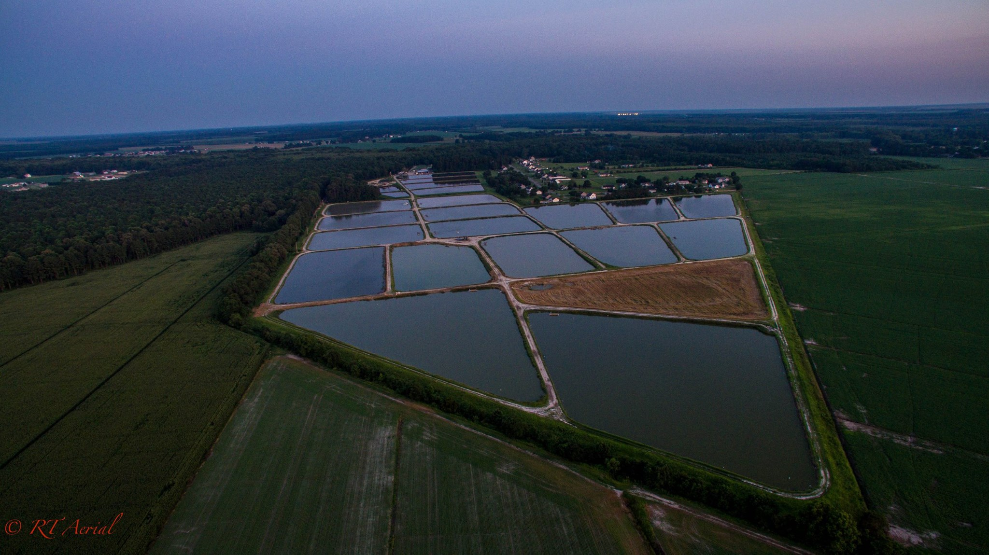
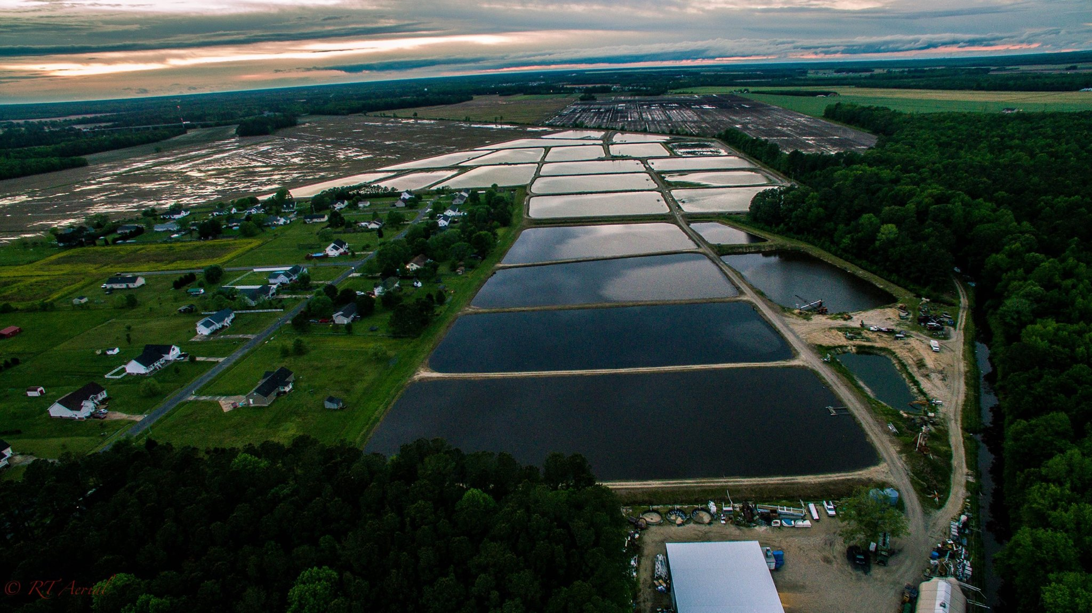
Aquaculture
:breeding, rearing, and harvesting of fish, shellfish, plants, algae, and other organisms in all types of water environments.

Slide 20
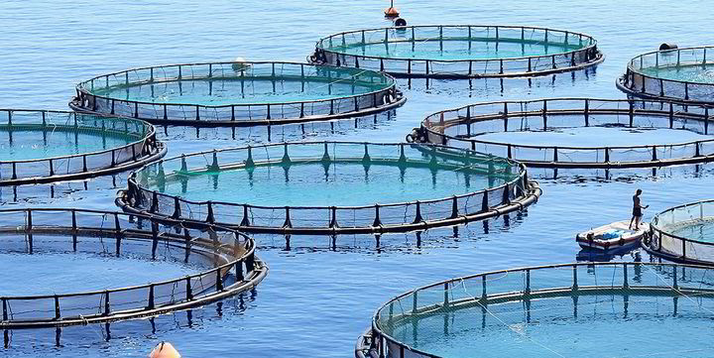
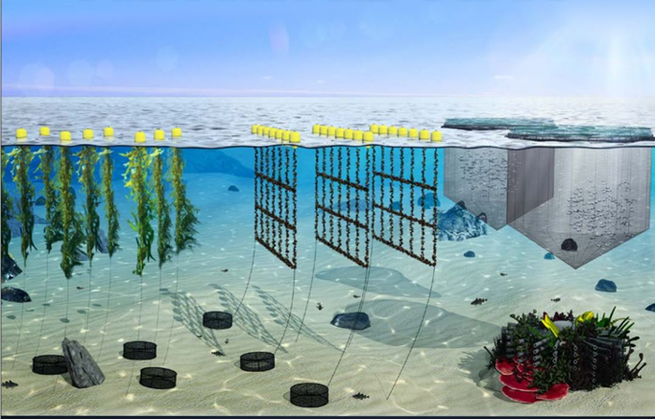
Aquaculture
Involves man-made tanks or enclosures
Controls the environment and diet of fish
Mariculture: marine organisms in open ocean enclosures or seawater tanks/ponds

Slide 21
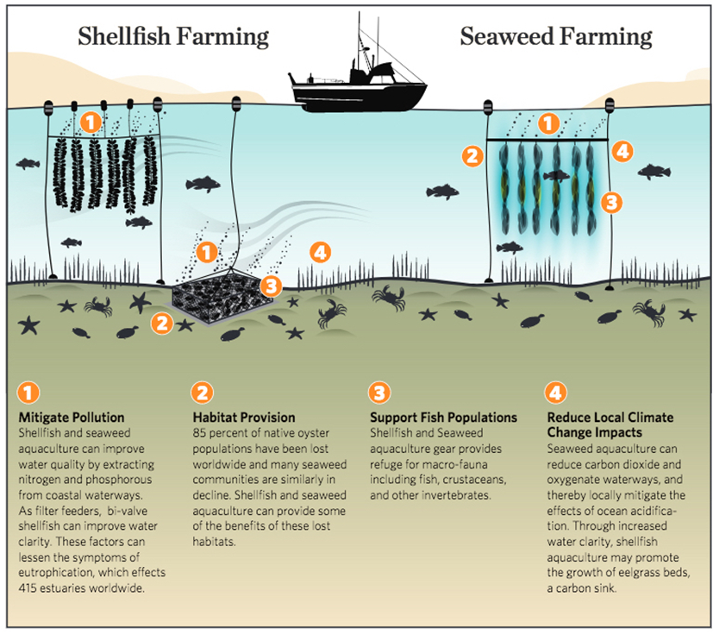
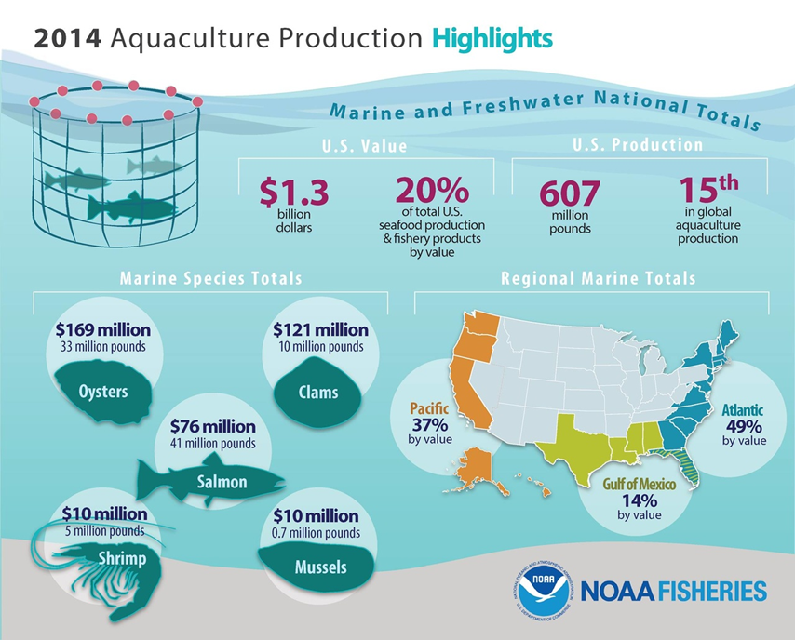

Slide 22
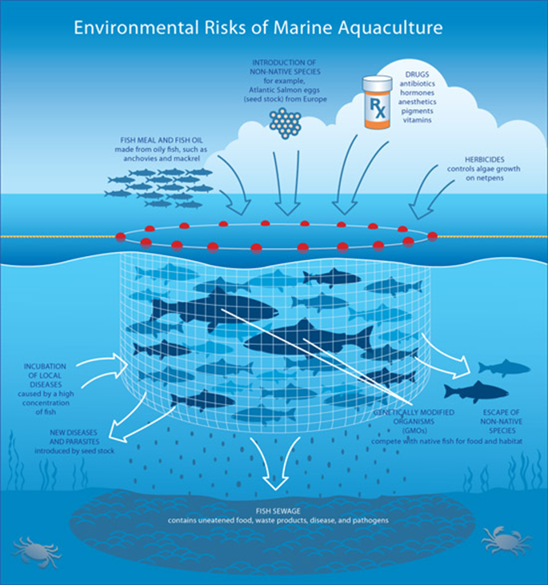
Aquaculture
Can improve populations of wild fish that have been decimated by overfishing
Can experience the same problems as terrestrial factory farms

Slide 23
How do we starve?
•Currently, over 800 million people worldwide lack access to adequate amounts of food
•24,000 people starve to death each day (8.8 million/year)
•The primary reason for undernutrition and malnutrition is poverty

Slide 24
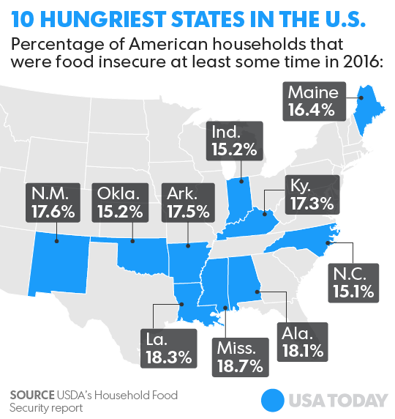
How do we starve?
Food security is adequate access to safe and nutritious food.
Food insecurity is an issue in the United States where local populations have access to limited or no fresh produce supplies and are relegated to junk food selections due to costs.

Slide 25
How do we starve?
•Highly processed foods rich in sugars and fats are becoming large parts of daily diets
•64% of adult Americans are overweight- up from 40% just 10 years ago
•Overeating also causes trickle down effects in terms of healthful living and healthcare. Without the proper nutrients this can also be malnourishment.

Slide 26
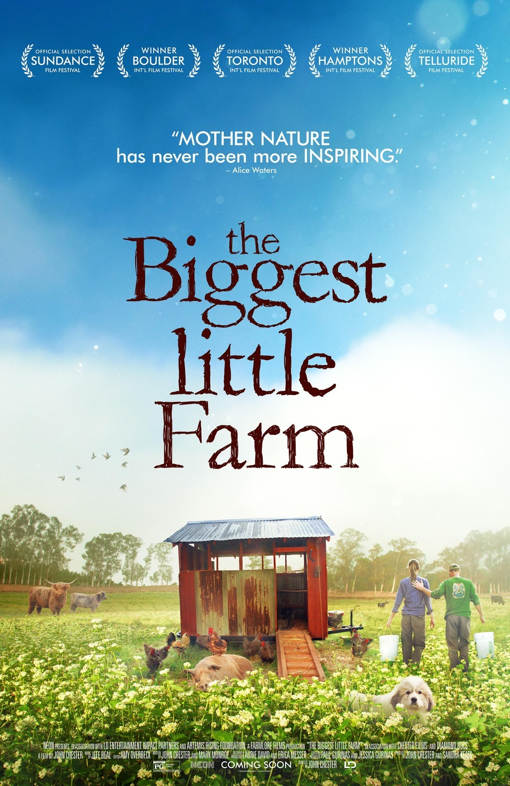
How do we feed the world?
Improve local production
Manage water resources
Use less chemicals
Increase diversity

Slide 27
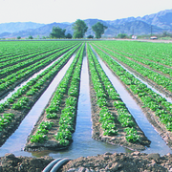
Management of water resources
Irrigation is the application of controlled amounts of water to plants.
Agricultural irrigation accounts
for 70% of all water use.
Irrigation is necessary to improve
crop yields especially on marginal lands.

Slide 28
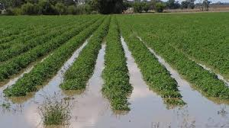
Management of water resources
When water resources are not managed wisely a number of issues are created:
Waterlogging: oversaturation of
soil with water creating a soil
environment with little to no oxygen

Slide 29
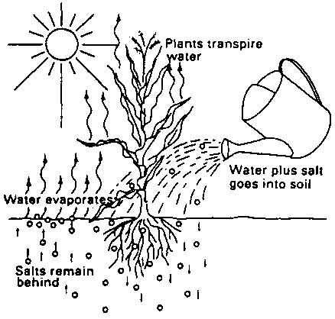
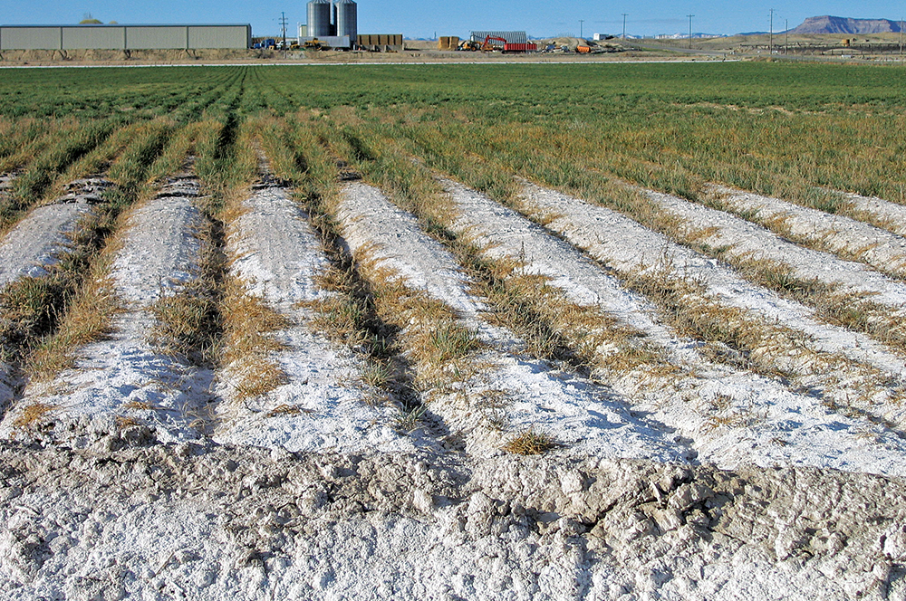
Management of water resources
Salinization: accumulation of water soluble salts in the soil that reduce the ability for plants to absorb water.
Occurs most often with
groundwater withdrawals

Slide 30
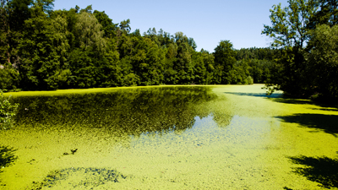
Management of water resources
Eutrophication: excessive nutrients in water that cause algal blooms and can lead to reduced oxygen levels
Can cause toxic blooms
Increase in plant/algae growth
Populations of plants/algae die
Decomposer populations increase
Dissolved oxygen levels drop

Slide 31
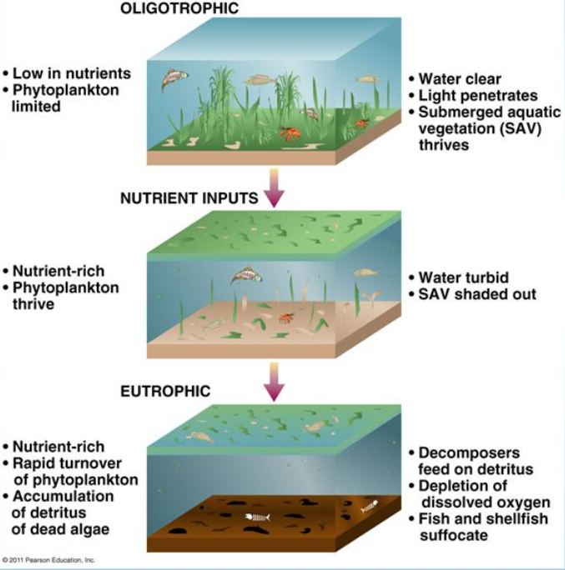

Slide 32
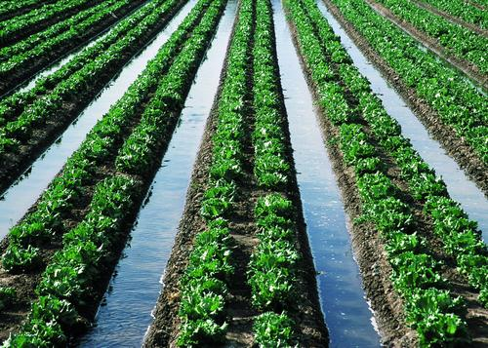
Management of water resources
Flood irrigation
Build trenches and fill with water or flood the fields
70% efficient (amount of water absorbed by plants/total water output)
Can cause waterlogging and salinization

Slide 33
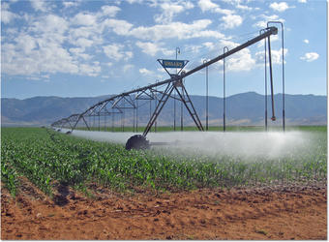
Management of water resources
Spray irrigation
Water is pumped through sprinklers
75-95% efficient
More expensive and uses more energy

Slide 34
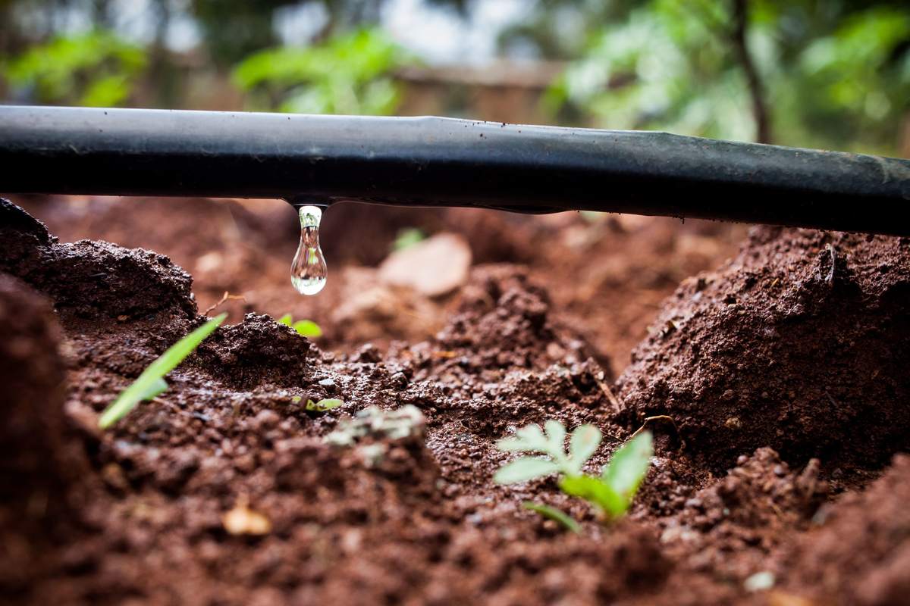
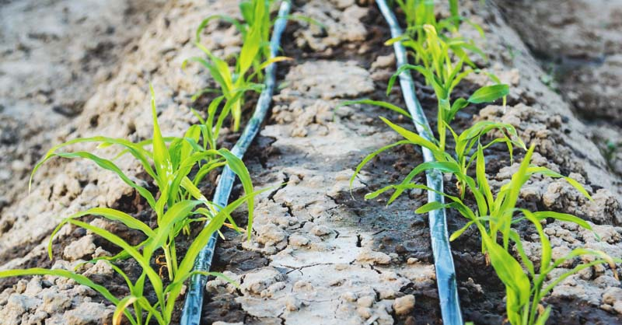
Management of water resources
Drip irrigation
Slow dripping hose on the surface or buried underground
>95% efficient
Most expensive
Prevents use of heavy equipment

Slide 35
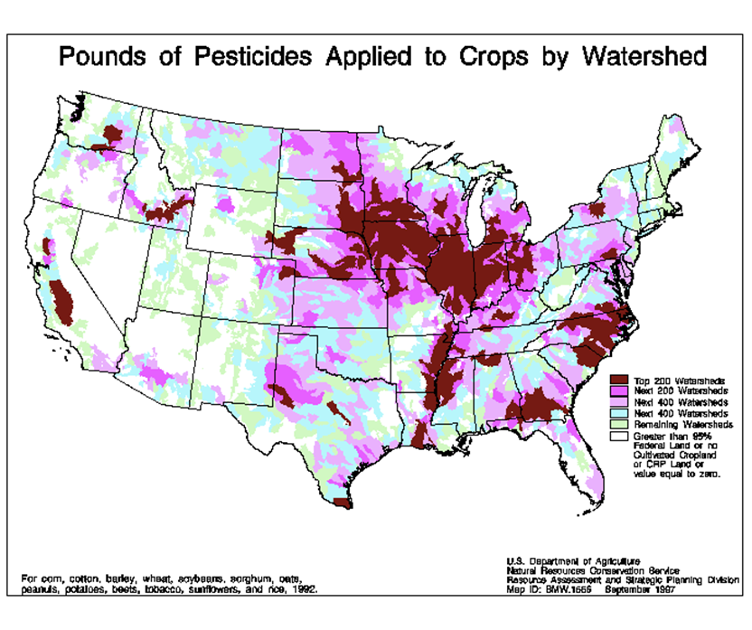
Management of pests
One of the threats to water access is pollution from chemical use.
The United States accounts for ⅓ of the global pesticide use.
Pesticides can be target specific or broad spectrum.

Slide 36
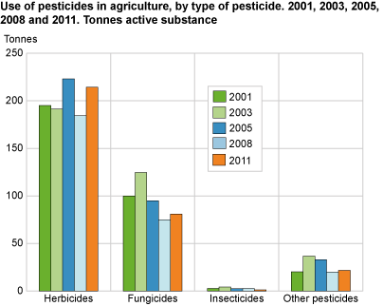
Management of pests
Types of Pesticides
Herbicides
Fungicides
Rodenticides
Insecticides

Slide 37
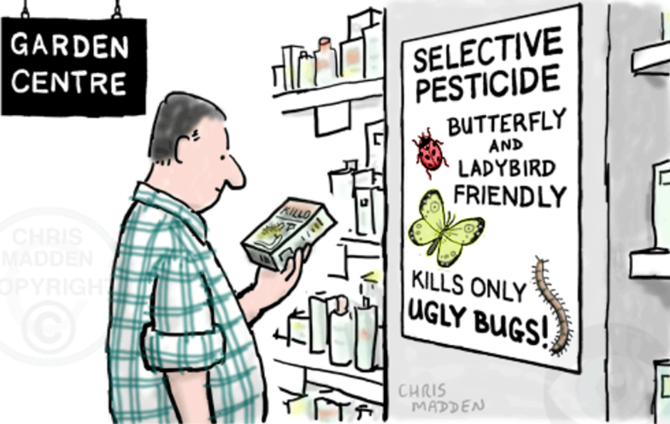
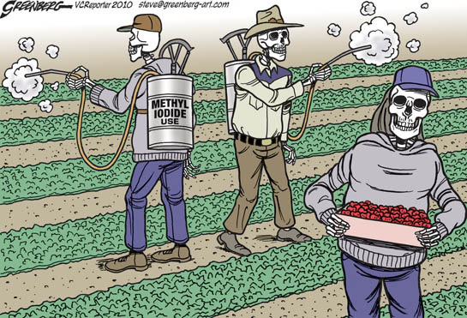
Management of pests
Consequences of pesticide use
Kills non-target pests
Bioaccumulation/Biomagnification
Pest resistance
Toxicity to humans

Slide 38
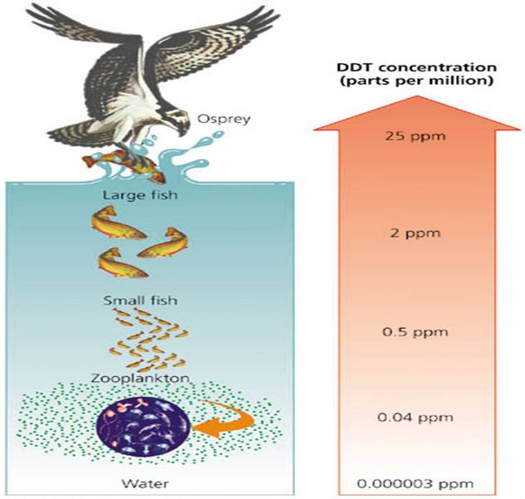
Consequences of pesticides
Excess pesticides often wash into surrounding bodies of water.
Small aquatic organisms absorb (bioaccumulate) pesticide chemicals.
Chemicals become concentrated (biomagnified) as they travel up food chains.

Slide 39
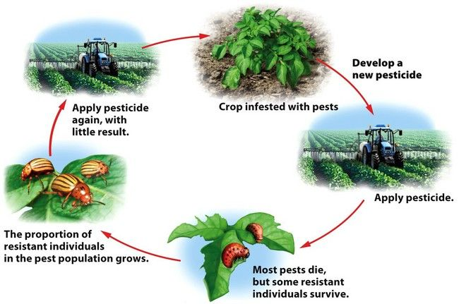
Consequences of pesticides
Application of pesticides does not affect a pest population equally.
Some of the population resistant to the pesticide survive and pass on the resistance, building the resistance in the population.
Stronger chemicals are used in a positive feedback loop called the pesticide treadmill.

Slide 40
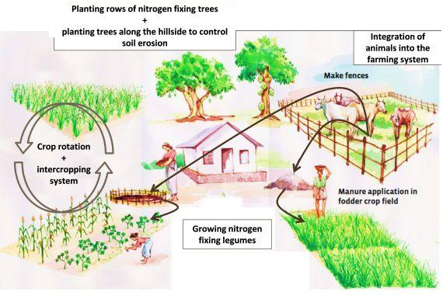
Sustainable Agriculture
Goal: feed the world without destroying the land or surrounding ecosystems
Priorities:
Nutrient rich soil
Biodiversity
Natural water cycle
Self-managing ecosystem
Everything works together. Everything has a purpose.

Slide 41
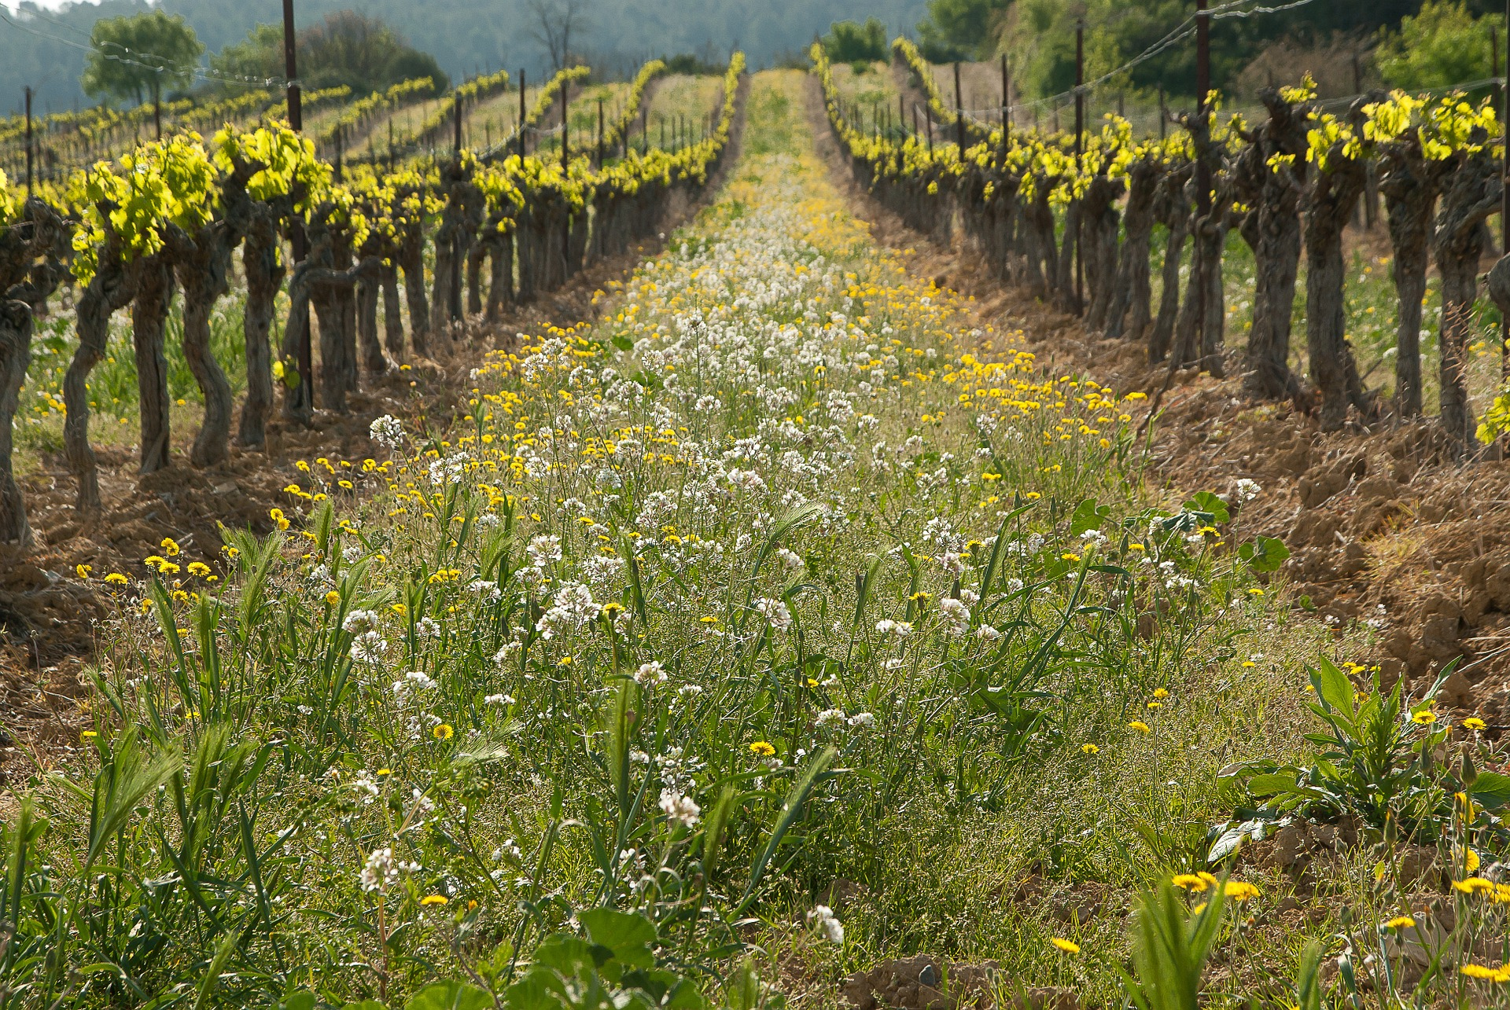
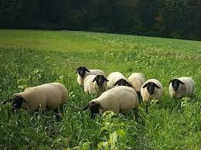
Sustainable Agriculture: Soil health
Cover crops are crops grown for the soil not for a yield.
Suppress weed growth
Reduce soil erosion
Decomposition adds organic material (green manure)
Animal manure can also add needed organic material and nitrogen to the soil.

Slide 42
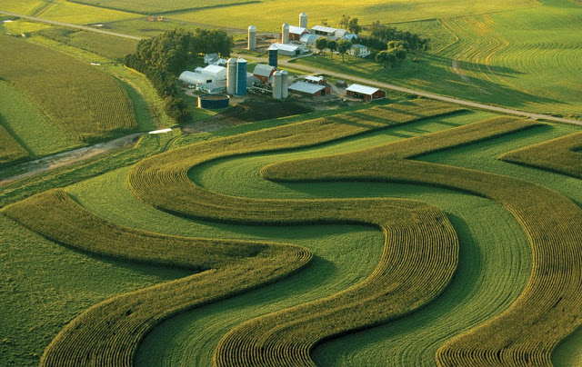
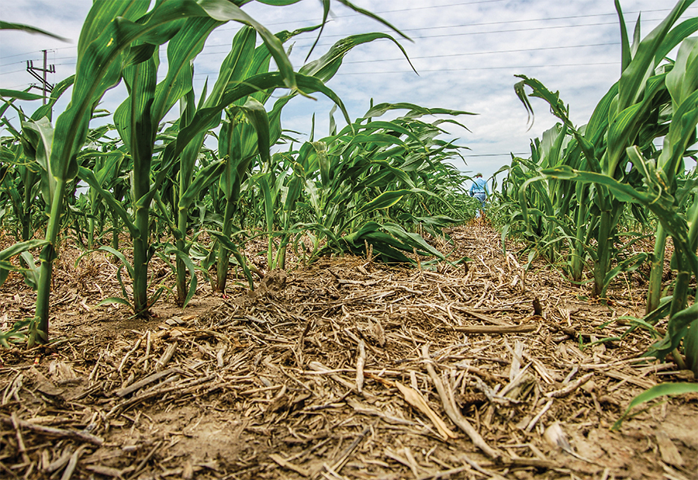
Sustainable agriculture: Soil health
Soil conservation techniques
Crop rotation
Contour plowing
Terracing
Wind breaks
No-till farming

Slide 43
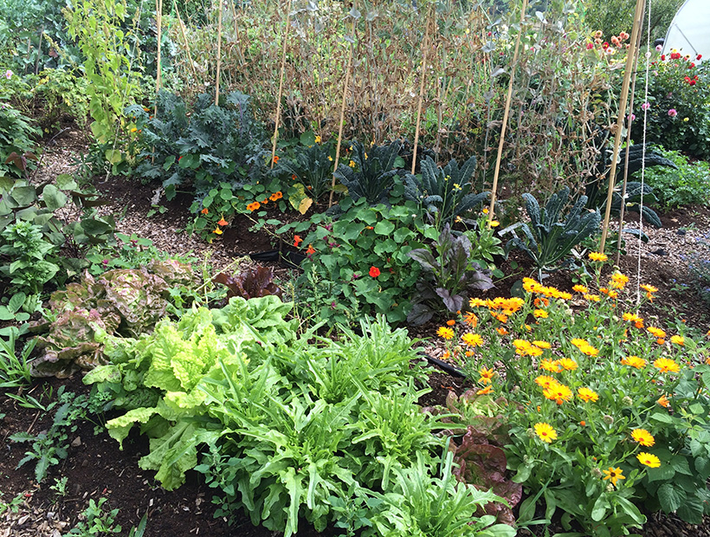
Sustainable Agriculture: Biodiversity
Polyculture practices of growing multiple crops together provides a diverse ecosystem to improve the health and yield of all crops.
Supports biodiversity
Improves nutrient cycling
Reduces pest populations

Slide 44
Sustainable agriculture: Pest control
Integrated Pest Management (IPM) uses multiple approaches to keep pest populations below the Economic Injury Level (lost profits).
Control methods
Biological controls (natural predators)
Physical controls (fencing)
Cultural controls (crop rotation)
Chemical controls (pesticides)
Regular monitoring and strategy adjustments

Slide 46
Sustainable Agriculture Options
Organic: sustainable agriculture that prohibits the use of chemical fertilizers or pesticides, genetically modified organisms, growth hormones, and antibiotics.
Free range: livestock grown in natural conditions (outside, grazing) with natural food sources.

